Slide 1
Summary: "Plasma cell and memory B cell differentiation from the germinal center"
Jared Frazier
2023-09-15
Bioinformatics 1 (UvA)
Computational Modelling

Slide 2
Structure
Background
Plasma Cell Differentiation
Memory B Cell Differentiation
Conclusion
Notes:
Background – function etc.
Plasma cell differentiation details
Conclusion – synthesizes what I describe about differentiation into a conceptual model
Differentiation: process changes

Slide 3
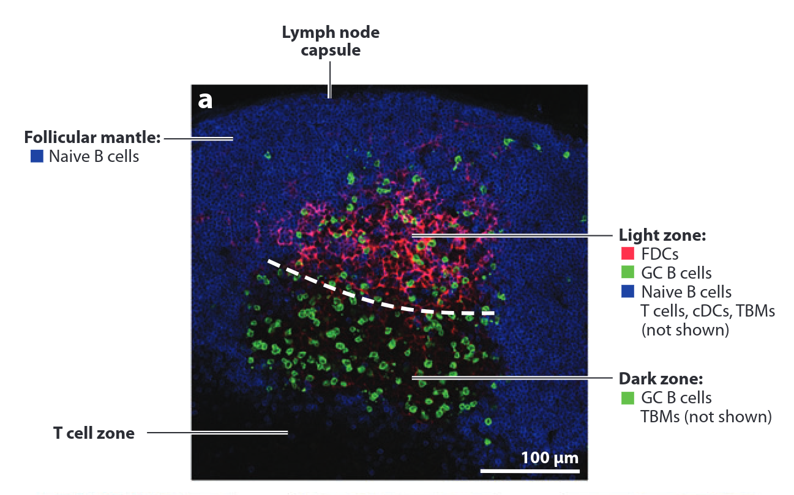
Background
What: Germinal Center (GC)
Located: Lymphoid tissues (lymph nodes, spleen, etc.).
Function: Produce antibodies as an immune system response to eliminate pathogens.
Importance: Vaccination design (among other things)
Notes:
Understanding how germinal centers produce a robust immune system response in the generation of PCs and MBCS is relevant to vaccination design. Therefore, understanding the underlying mechanism by which this occurs is relevant.

Slide 4
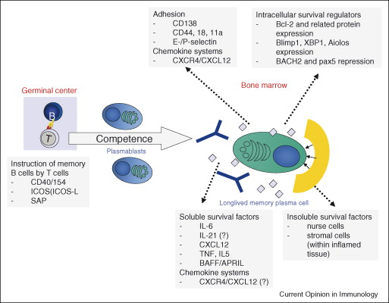
Plasma Cell (PC) Differentiation
Question: How does selection and transcriptional regulation lead to differentiation to PCs?
T Folicullar Helper (TFH) Cell:
Possesses signaling lymphocyte activation molecules (SLAM)--proteins important for PCs
Migration through dark zone of germinal center and wave of plasma blasts (precursor to PCs)
B Cell Receptor (BCR) Signaling:
Specialized membrane bound protein
Antigen-presenting cells (APCs) present to BCRs
BCR is possibly important for antigen engagement (important for PC diff.) by GC B cells
D. Tarlinton, A. Radbruch, F. Hiepe, and T. D ̈orner, “Plasma cell differentiation and survival,” Current Opinion in Immunology, vol. 20, pp. 162–169, 4 2008.

Slide 5
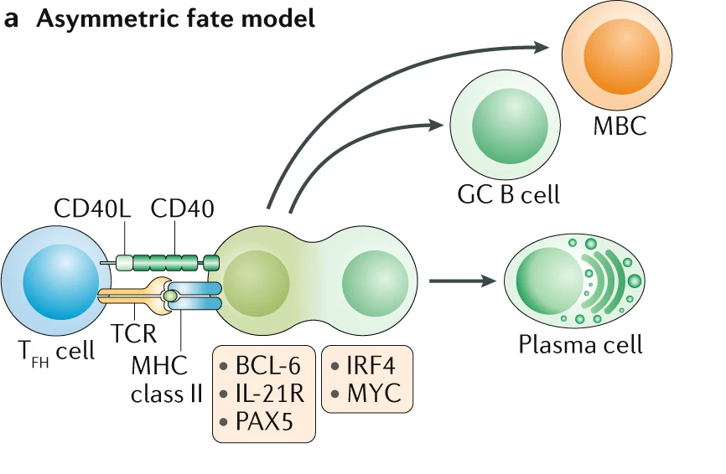
Memory B Cell (MBC) Differentiation
Question: How does selection and transcriptional regulation lead to differentiation to MBCs?
GC-Dependent/Independent:
MBCs can be derived from processes in/outside of the GC, making MBCs difficult to study
BCL6 deficient MBCs did not undergo somatic hypermutation (characteristic of GC)
Transcription Factors:
BCL2 (anti-cell death) correlates with differentiation to MBCs
BACH2 may facilitate differentiation to MBCs
GC B Cells lacking CXCR4 can't access dark zone and migrate to light zone (MBCs produced here)
B. J. Laidlaw and J. G. Cyster, “Transcriptional regulation of memory b cell differentiation,” Nature Reviews Immunology 2020 21:4, vol. 21, pp. 209–220, 10 2020.

Slide 6
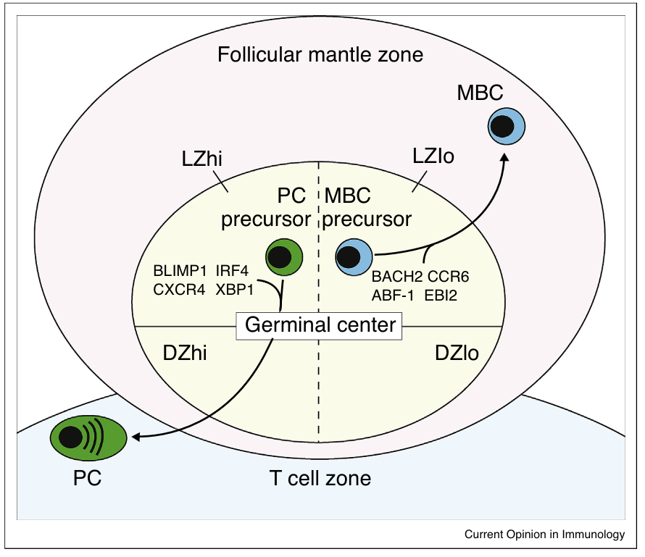
Conclusion
D. Suan, C. Sundling, and R. Brink, “Plasma cell and memory b cell differentiation from the germinal center,” Current Opinion in Immunology, vol. 45, pp. 97–102, 4 2017.

