Slide 1
Progress Meeting 2:
ODE Model of Germinal Center Exit Pathway
Jared Frazier
2023-09-22
Bioinformatics 1 (UvA)

Slide 2
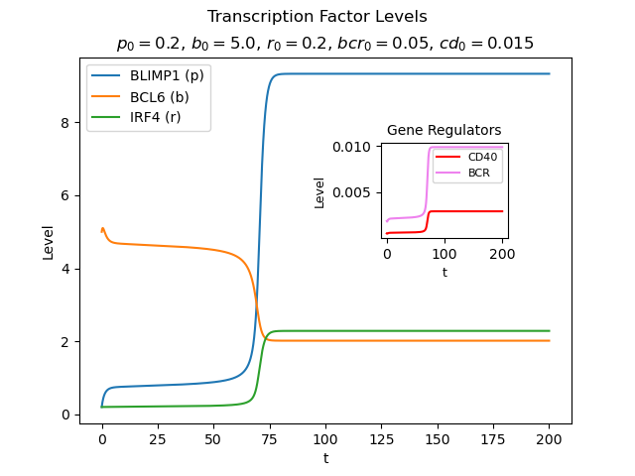
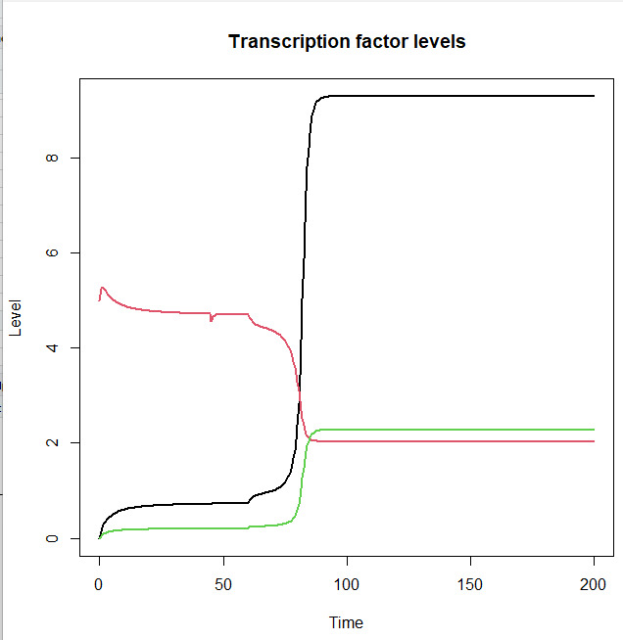
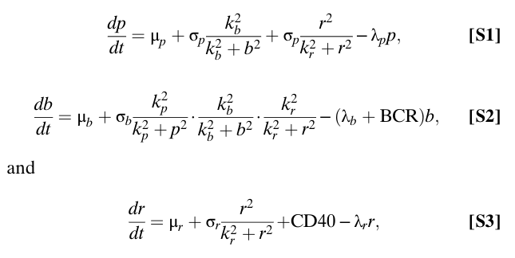
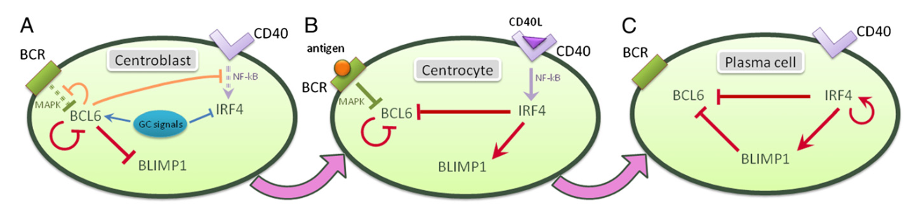
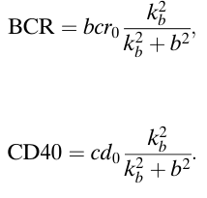
M. R. Martínez et al., Proceedings of the National Academy of Sciences, vol. 109, no. 7, pp. 2672–2677, 2012. doi:10.1073/pnas.1113019109

Slide 3
Interactive
Demo cd0 and bcr0

Slide 4
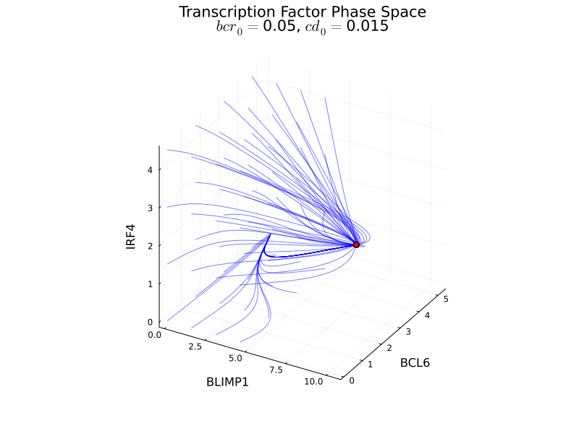
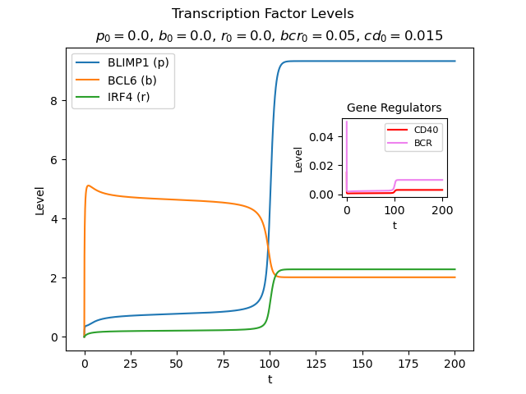

Slide 5
Interactive
Demo phase space

Slide 6
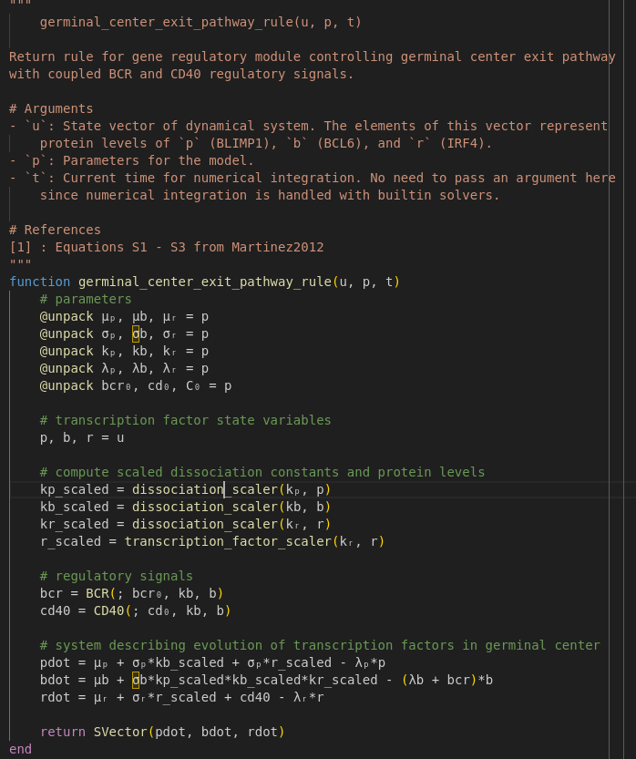
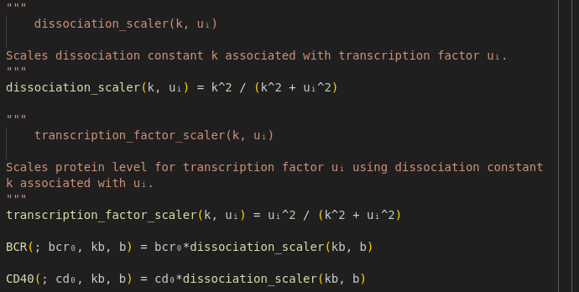
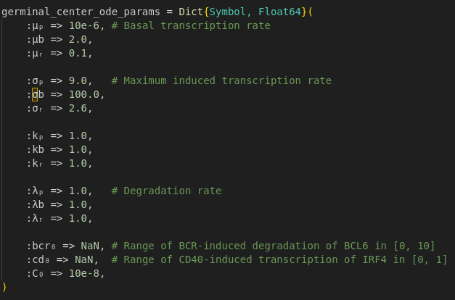

Slide 7
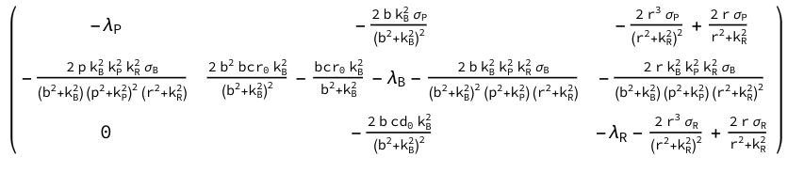
Jacobian(f)

Slide 8
Thank you

