Slide 1
Progress Meeting 3:
Bifurcation Analysis of Plasma Cell Differentiation
Jared Frazier
2023-10-06
Bioinformatics 1 (UvA)

Slide 2
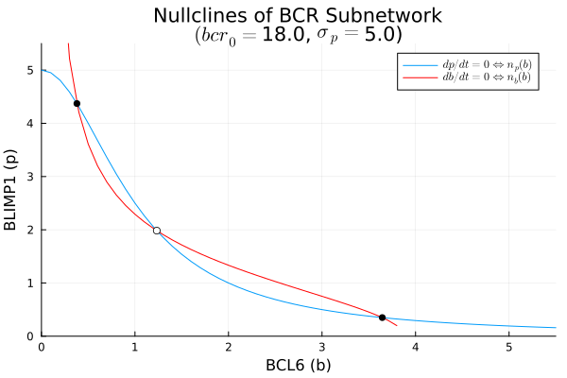
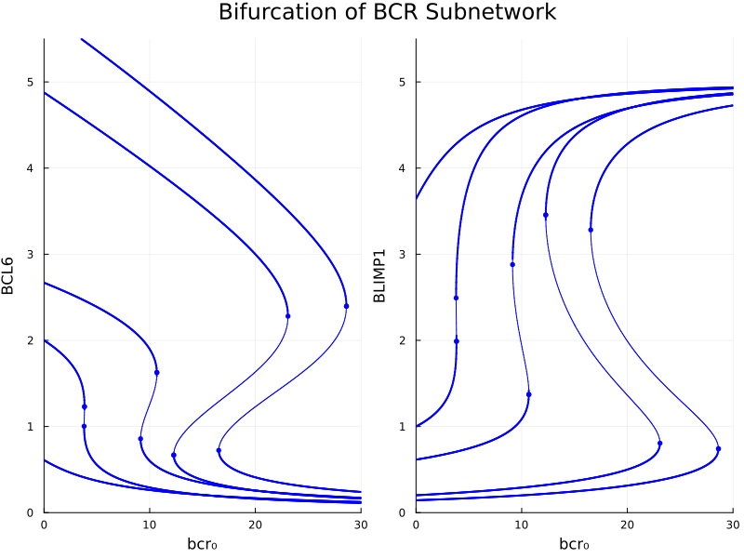


Slide 3
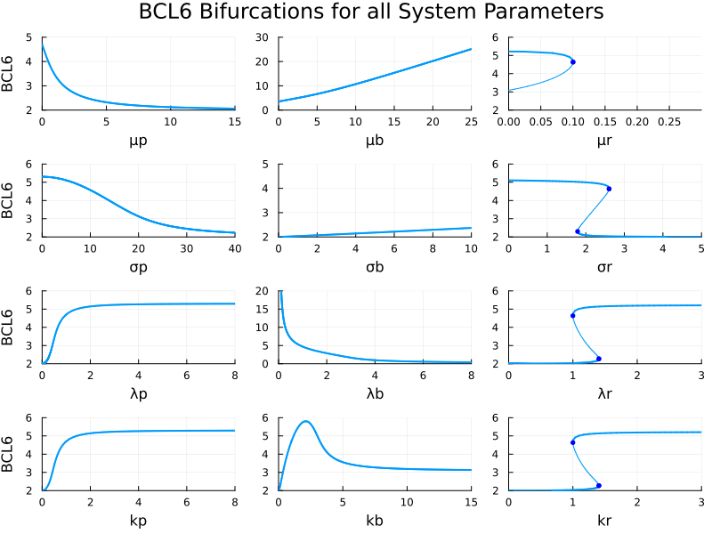

Slide 4

Cd40 signaling todo

Slide 5
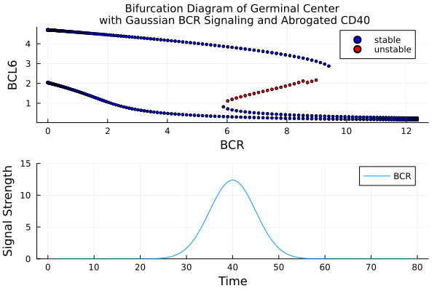
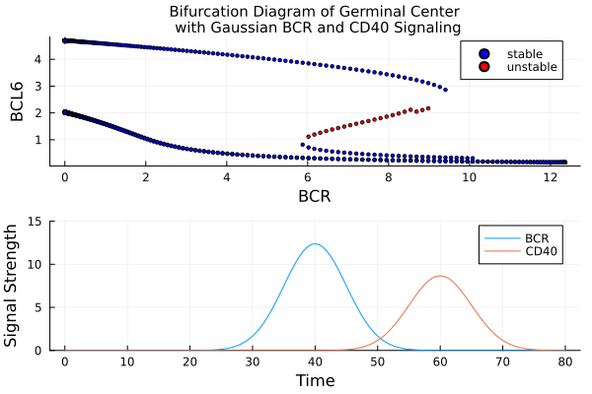
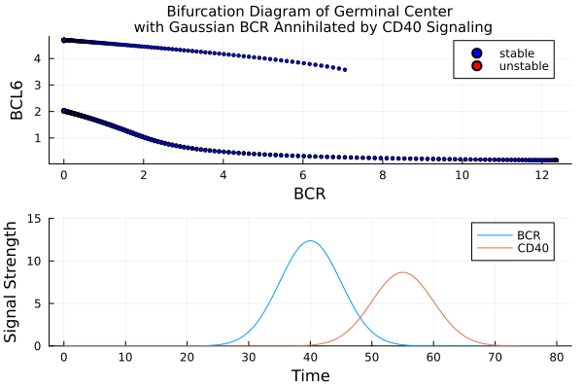
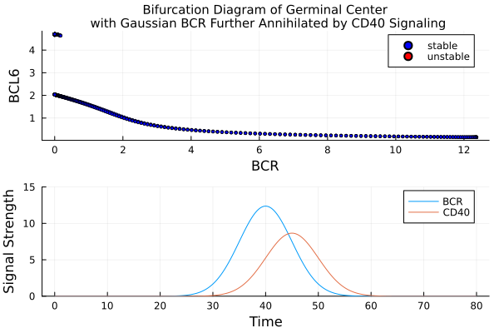

Slide 6
Thank you

