Slide 1
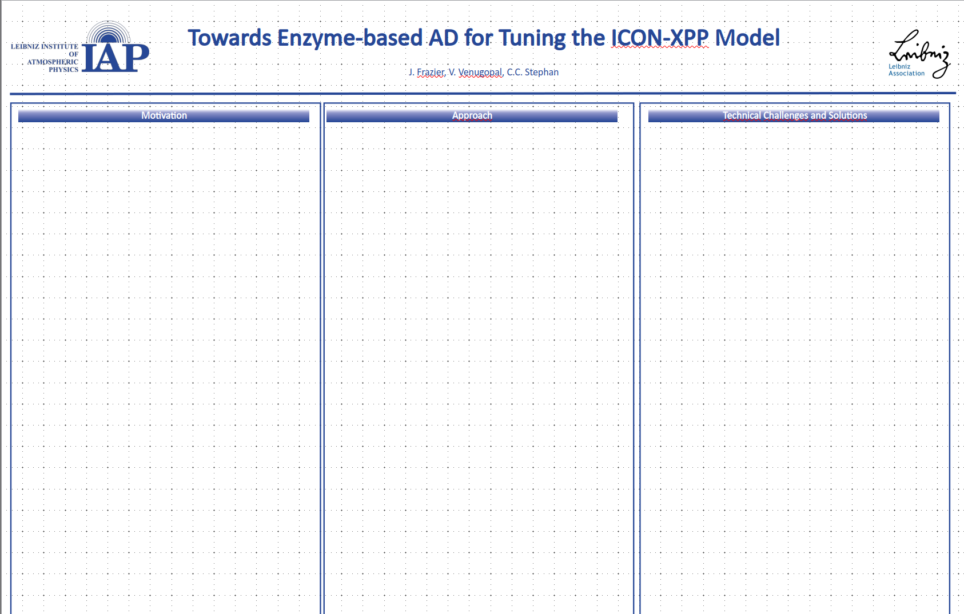
Structuring Poster
Motivation
  Scientific, some ICON background
Approach
  Parameterization/Parameter Identification
  Build this up component-wise
Technical Challenges
  Compiler details

Slide 2
Motivation

Slide 3
<Some science/background here>

Slide 4
Approach

Slide 5
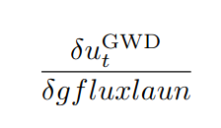
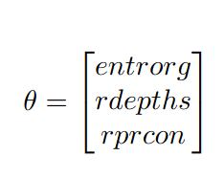
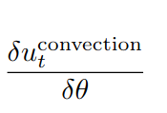


Identify
mo_gwdrag_wms
GWD Phys
gfluxlaun
entrorg
mo_cumastrn
Convection Phys
rdepths
1 Parametrization
1 Parameter
rprcon
Increasing Scope
-- we want
Something generic
And make changes
Across the whole
Calibration appraoch
X Parametrizations
X Parameters
? see: “Where Phys Contributes to Dynamics” Slide
Tendency
w.r.t Parametrization
? which parameter? Parameter must be input to timestepping routine… u is rediagnosed from vn??
Timestep
w.r.t
Parameter

Slide 6
Identify Suitable Parameterizations/Parameters

Slide 7
* we know we have tunable parameters list from nwp here:
https://docs.icon-model.org/documentation/atmosphere/miscellaneous/tuning_nwp.html#ref-atmosphere-tuning
* AD_UA-ICON document, C.C. Stephan mentions “It is not feasible to have fully differentiable code in two years. But we can still meet their requirements by starting with the already tuned and stable ICON-XPP and demonstrating better general circulation. This would only touch the atmosphere, mostly radiation and gravity waves. ”
Threfore, while GWD params are known (e.g., gfluxlaun), we would have to take a look at the radiation parameters of interest!
Figure: The figure for this should be a table with parameterizations, parametesr, and short descriptions of this

Slide 8
Single Parametrization and Single Parameter

Slide 9
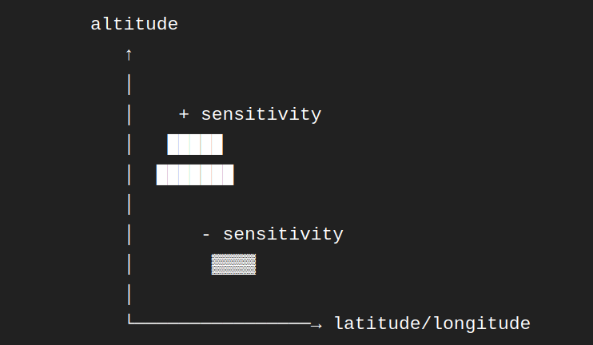
* single parametrization (e.g., gravity wave drag → gwdrag_wms) and a particular parameter such as gfluxlaun
- sensitivity plot

Slide 10
Single Parametrization and Multiple Parameters

Slide 11
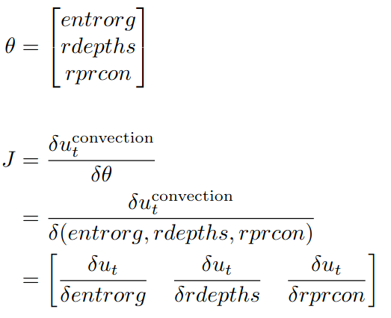
* convection physics with multiple parameters of interest

Slide 12
Subset of Parametrizations

Slide 13
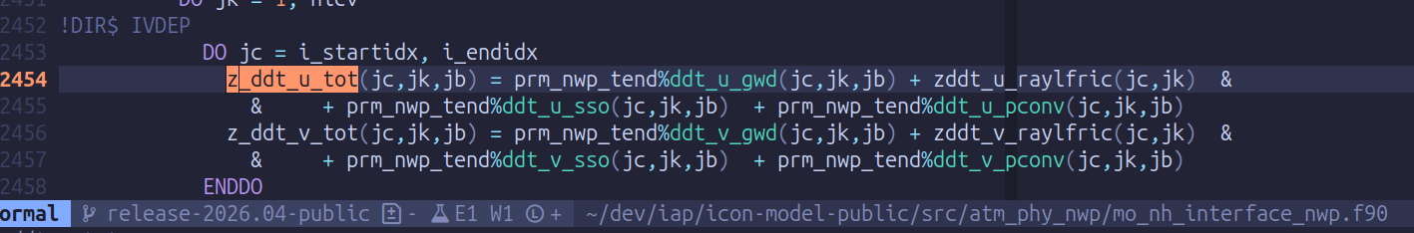
* subset of physics parametrizations affecting horizontal wind tendency: gwd, raylfric, sso, pconv

Slide 14
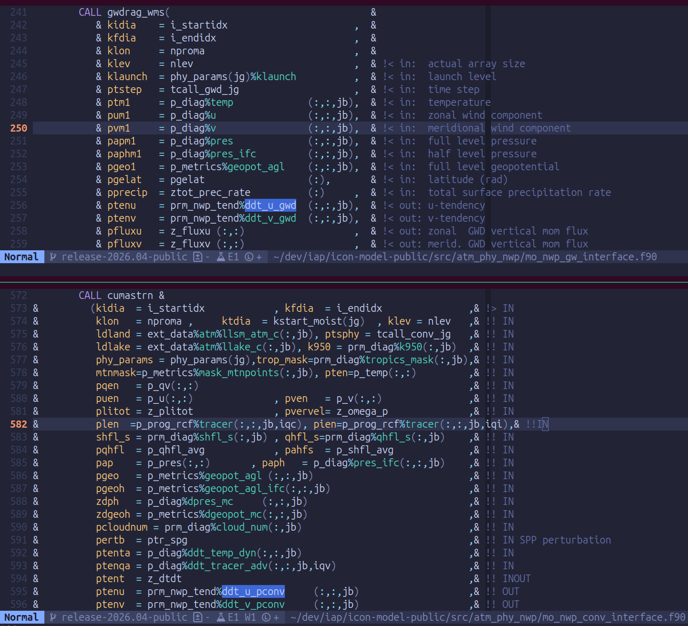
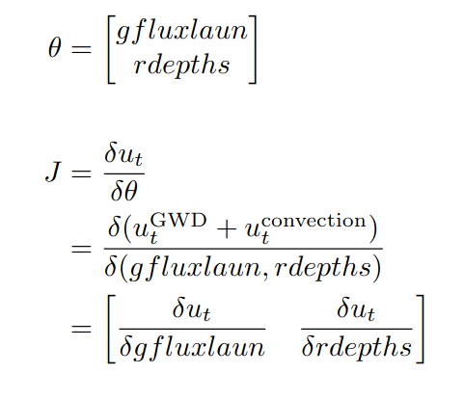
* pick some parameters for e.g., gravity wave drag and convection such as gfluxlaun and rdepths
* this case happens to not be very interesting because rdepths is not a variable in GWD!

Slide 15
Where Do These Physics Contribute to Dynamics

Slide 16
* where in the code do the gwd and convection ddt_u_* contribute to the horizontal wind tendency

Slide 17
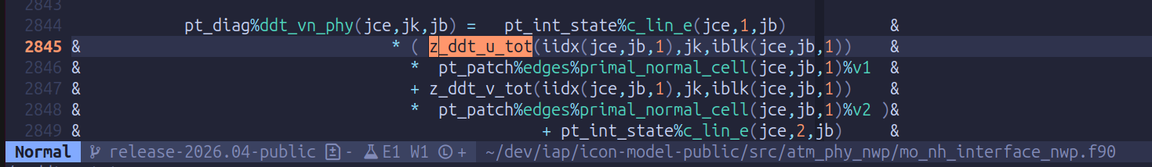
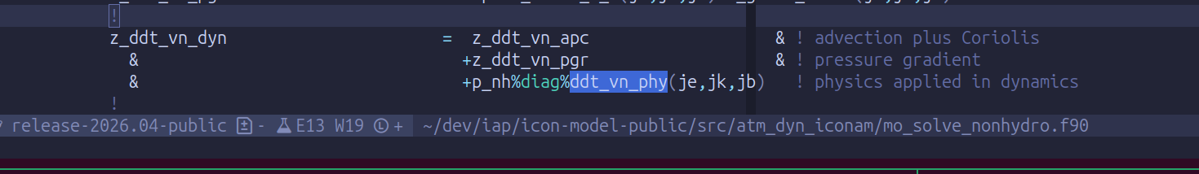
* where in the code (∂u/∂t) contributes to the total dynamics tendency

Slide 18
Technical Challenges:
IFX vs Flang

Slide 19
ICON-XPP
IFX 2023.0.0 or
IFX 2023.2.x
Flang
- IFX 2025.3
- ICON supported
- Enzyme not supported
- IFX 2023.0 and 2023.2
- ICON not supported
- Enzyme supported
- not guaranteed support
- Flang v21
- ICON not (yet) supported
- Enzyme supported
- continued support
LLVM IR
LLVM IR
Enzyme
Differentiated LLVM IR
GNU Autotools
AD ICON-XPP

