Slide 1
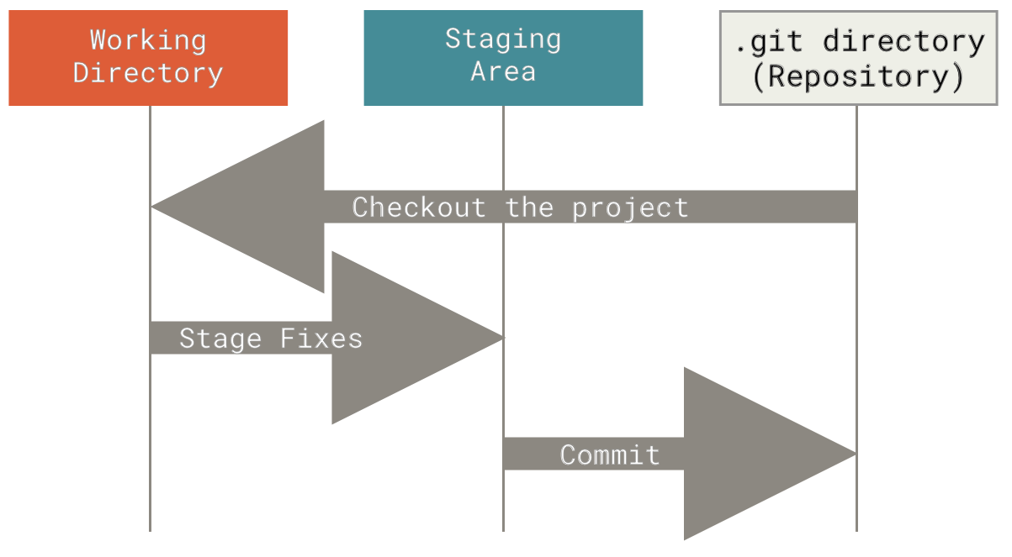


Local
Remote
Remote Repository
Push
Pull

Slide 2
Another slide

