Slide 1


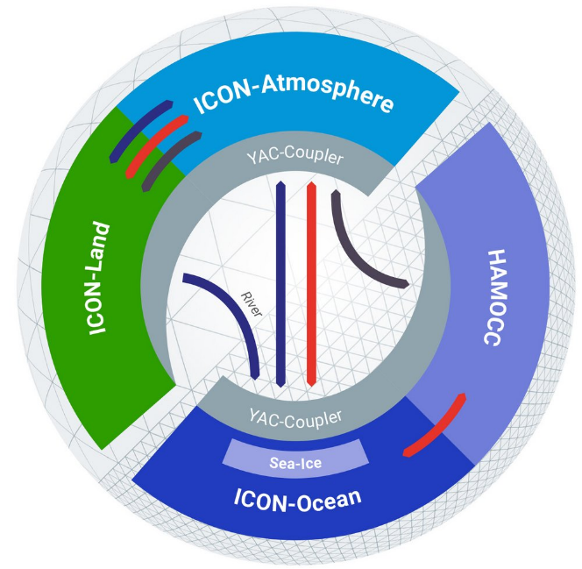





Towards Enzyme-based AD for Tuning the ICON-XPP Model
J. Frazier, V. Venugopal, C.C. Stephan
Overview
Challenges and Outlook
Can automatic differentiation help us calibrate the atmosphere from the surface to space?
ICON-XPP is a state-of-the-art Earth system model for which a subset known as UA-ICON extends the model atmosphere from 75 to 150 km. This creates new physical constraints from the upper atmosphere, whose response to climate forcing can differ dramatically from that of the lower atmosphere. We will use Enzyme-based automatic differentiation to quantify parameter sensitivities and enable efficient, systematic calibration of the coupled model. This provides a foundation not only for improved physical parameterizations, but ultimately for differentiable hybrid ML–physics modelling and online optimization.
ICON-XPP
Figure 2: IFX is a supported ICON compiler and provides an LLVM-based backend, but its generated IR is not designed as a stable public interface.Flang provides an open LLVM-based Fortran compilation path but does not yet compile the complete ICON software stack. Establishing a robust ICON to LLVM to Enzyme workflow is therefore a major initial challenge. Note, however, there is ongoing work at the German Climate Computing Center (DKRZ) for supporting Flang-based compilation. ICON can be compiled with IFX 2025.3; however, it is not trivial for Enzyme to support optimization of Intel compiler emitted LLVM IR as it is currently an open question since instead the Flang MLIR—known as FIR—may become the sole AD transformation target of Enzyme.
IFX 2023.x
Flang
LLVM IR
LLVM IR
Approach
Enzyme
AD LLVM IR
GNU Autotools
AD ICON-XPP
More Challenges
ICON combines large legacy Fortran code with MPI, OpenMP/OpenACC, external libraries and complex build infrastructure.
Enzyme has demonstrated differentiation of parallel constructs, but scaling these capabilities to ICON's Fortran implementation requires validation.
Outlook
From ICON to other ESMs: Establish a general workflow for compiler-based AD of large-scale Fortran models.
Transferability: Potential pathway to models such as MITgcm, WRF, and CESM.
Scientific calibration: Extend from local parameter sensitivities to systematic model calibration.
ML–physics coupling: Enable future online optimization of machine-learning parameterizations within the ESM.
Long-term vision: Differentiable Earth-system modelling from the surface to the upper atmosphere.
Figure 1: Enzyme operates on the LLVM intermediate representation generated from ICON's Fortran code, providing forward- and reverse-mode derivatives without requiring separately maintained tangent-linear or adjoint source code. We initially target self-contained physics parameterizations and scalar tuning parameters, allowing us to quantify local parameter sensitivities before extending toward larger coupled model components.
Candidate Schemes and Parameters
Scheme | Parameter | Meaning | Nominal value ± range
GWD | gfluxlaun | Non-orographic gravity-wave launch momentum flux | (2.50 ± 0.75) × 10⁻³ Pa
SSO | gkwake | Low-level wake drag constant | 1.5 ± 0.5
SSO | gkdrag | Gravity-wave drag constant | 0.075 ± 0.04
Convection | entrorg | Convective entrainment parameter | (1.95 ± 0.20) × 10⁻³
Convection | rdepths | Maximum shallow-convection depth | (2.0 ± 0.5) × 10⁴ Pa
Table 1: We begin with a single scalar parameter in a single physics scheme (e.g., GWD/gfluxlaun) and quantify its impact on the resulting tendency fields. We then extend to multiple parameters within a scheme and eventually to combinations of parameterizations, enabling analysis of parameter interactions and contributions to model tendencies.
References
1. Müller, W. A. et al.: The ICON-based Earth System Model for climate predictions and projections (ICON XPP v1.0), Geosci. Model Dev., 18, 9385–9415, 2025.
2. Jungclaus JH, et al. The icon Earth System Model Version 1.0. Journal of Advances in Modeling Earth Systems. 14(4), 2022.
3. Moses WS, et al. DJ4Earth: Differentiable, and performance‐portable Earth System Modeling via program transformations. Journal of Advances in Modeling Earth Systems. 18(5), 2026.
4. Moses WS, et al. Scalable automatic differentiation of multiple parallel paradigms through compiler augmentation. In: Proceedings of the International Conference on High Performance Computing, Networking, Storage and Analysis (SC '22). IEEE, 1-18, 2022.

