Slide 1
 |  |  | Design | Tuning | 5-Fold CV
 |  | MLR | X | X | ✓
Curiosity Weather Data | Data Preprocessing | RF | X | ✓ | ✓
 |  | ANN | ✓ | ✓ | ✓

Slide 2
 | base_lstm_unstacked_joint | base_lstm_unstacked_iterative | base_lstm_stacked_joint | base_lstm_stacked_iterative
mean_absolute_error_mean | 0.050359179 | 0.052404764 | 0.05739149 | 0.057179248
mean_absolute_error_std | 0.00622037 | 0.007031879 | 0.015796622 | 0.018023149
mean_squared_error_mean | 0.004264288 | 0.004611943 | 0.005699062 | 0.005854167
mean_squared_error_std | 0.001087007 | 0.001162395 | 0.003290932 | 0.003855468
root_mean_squared_error_mean | 0.064835856 | 0.067438126 | 0.072897277 | 0.073100261
root_mean_squared_error_std | 0.00778455 | 0.008002595 | 0.019622653 | 0.022594657

Slide 3
base_gru_unstacked_joint | base_gru_unstacked_iterative | base_gru_stacked_joint | base_gru_stacked_iterative
0.06363276 | 0.048590834 | 0.073484815 | 0.072424059
0.010843512 | 0.003693088 | 0.007736847 | 0.010297757
0.006615655 | 0.00393623 | 0.008243845 | 0.008419806
0.002074674 | 0.00045603 | 0.001625356 | 0.002499606
0.080460773 | 0.062635038 | 0.090365083 | 0.090848055
0.011904581 | 0.00361684 | 0.008831576 | 0.012901034

Slide 4
1-Month Prior Weather Data
Multilayer* GRU/LSTM RNN
(A)
t+1
t+2
t…
t+7
MarsRNN
MarsARNet*
(Multilayer GRU/LSTM RNN)*
(B)
Fully Connected Layer
7-day Mean Ambient Air Temp. Predictions

Slide 5
1-Month Prior Weather Data
Convolutional Layer
Max Pooling Layer
Multilayer*
CNN Block
Batch Normalization Layer
Fully Connected Layer
Dropout Layer
7-day Mean Ambient Air Temp. Predictions

Slide 6



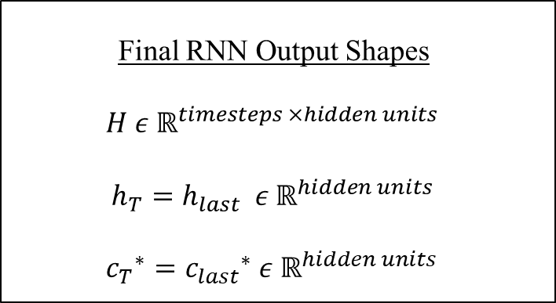






$$h_{t}$$
$$h_{t+1}$$
$$h_{t+2}$$
Final RNN Output Shapes
$$H ε ℝ^{timesteps ×hidden units }$$
$$h_{T}=h_{last} ε ℝ^{hidden units }$$
${c_{T}}^{∗}={c_{last}}^{∗}$ $ε ℝ^{hidden units }$
Internal Memory Mechanisms & Hidden Units
…
…
$${c_{t+2}}^{∗}$$
$${c_{t}}^{∗}$$
$${c_{t+1}}^{∗}$$
$$x_{t}$$
$$x_{t+1}$$
$$x_{t+2}$$
Notes:
Recurrent neural network

Slide 7
Input
0 | 1 | 2 | 3 | 4
0 | 1 | 2
1 | 2 | 3
2 | 3 | 4
3 | 4 | ?

Slide 8
(B)
0 | 1 | 2 | 3 | 4
0 | 1 | 2
2 | 3 | 4
4 | ? | ?

Slide 9
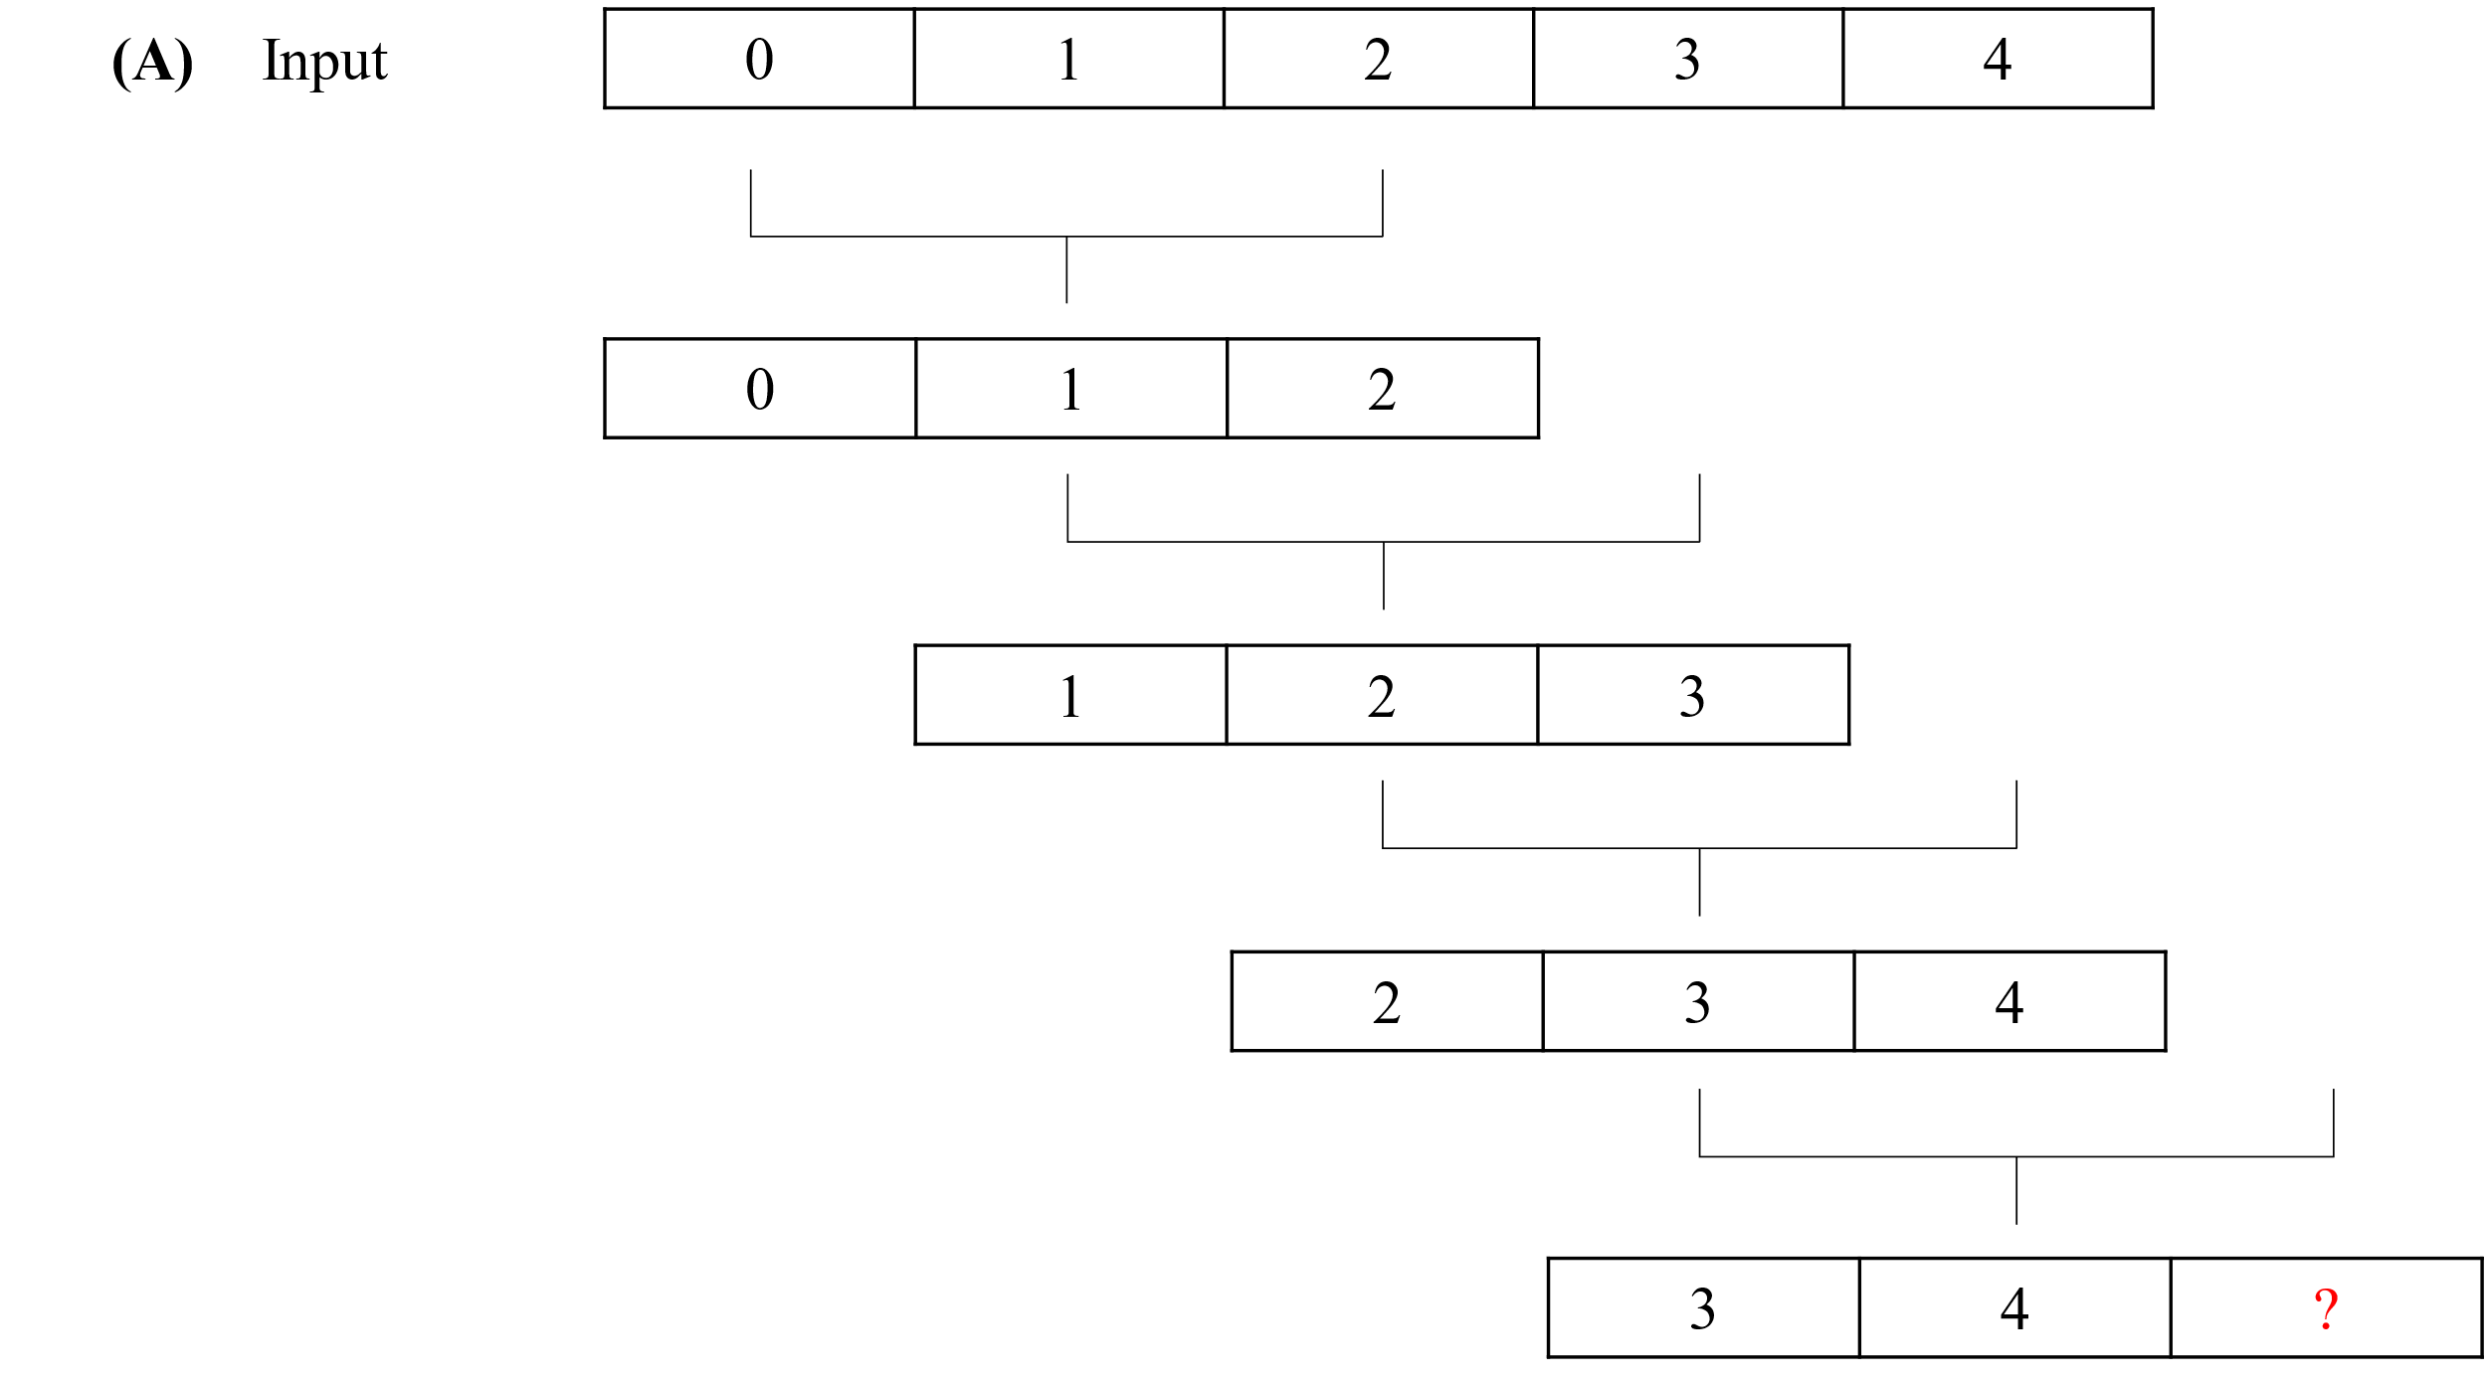
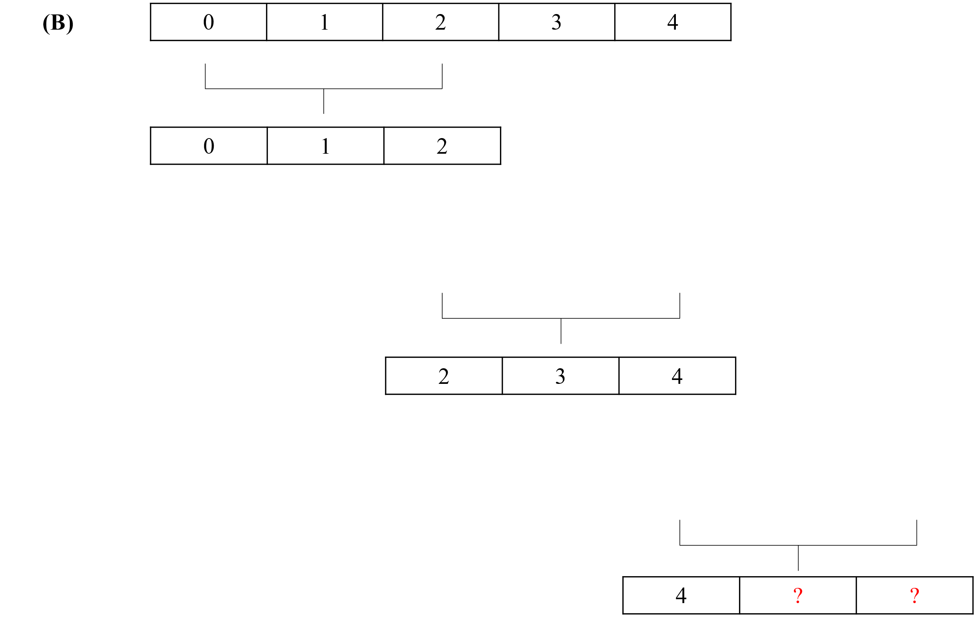

Slide 10
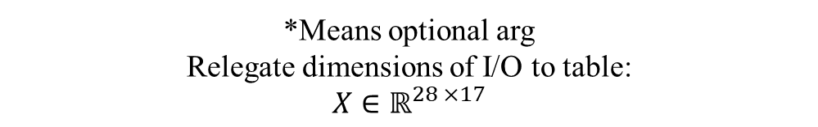
*Means optional arg
Relegate dimensions of I/O to table:
$$X∈ℝ^{28 ×17}$$

