Slide 1
Maven
Apache Maven is a popular build tool, that takes your project’s Java source code, compiles it, tests it and converts it into an executable Java program: either a.jar or a.war file. mvn clean install is the command to do just that.
Downoad the binary: https://maven.apache.org/
Get dependencies here: https://mvnrepository.com/

Slide 2
Environment Setup
Java
JAVA_HOME java directory
JRE_HOME java directory
add java directory \bin to path %JAVA_HOME%\bin
Maven
MAVEN_HOME maven directory
M2_HOME maven directory
add maven directory \bin to path %MAVEN_HOME%\bin
ANT
ANT_HOME ant directory
add ant directory \bin to path %ANT_HOME%\bin
GRADLE
GRADLE_HOME gradle directory
add gradle directory \bin to path %GRADLE_HOME%\bin

Slide 3
Maven in 5 Minutes
http://maven.apache.org/guides/getting-started/maven-in-five-minutes.html
PS: mvn archetype:generate “-DgroupId=com.mycompany.app” “-DartifactId=my-app” “-DarchetypeArtifactId=maven-archetype-quickstart” “-DarchetypeVersion=1.4” ”-DinteractiveMode=false”
Cmd: mvn archetype:generate -DgroupId=com.mycompany.app -DartifactId=my-app -DarchetypeArtifactId=maven-archetype-quickstart -DarchetypeVersion=1.4 -DinteractiveMode=false
mvn package
java -cp target/my-app-1.0-SNAPSHOT.jar com.mycompany.app.App

Slide 4
Parameters
archetype:generate
groupId=com.mycompany.app
artifactId=my-app
archetypeArtifactId=maven-archetype-quickstart
archetypeVersion=1.4
interactiveMode=false

Slide 5
Archetype
Archetype is a Maven project templating toolkit. An archetype is defined as an original pattern or model from which all other things of the same kind are made. The names fits as we are trying to provide a system that provides a consistent means of generating Maven projects. Archetype will help authors create Maven project templates for users, and provides users with the means to generate parameterized versions of those project templates.

Slide 6
Scrape Table
id | datestamp | symbol | lastprice | pricechange | changepercentage | markettime | volume | avgvol | marketcap
1 | 01/22/21 | AMD | 91.53 | +2.78 | +3.13% | 4:00PM EST | 52.9M | 46.486M | 110.209B
2 | 01/22/21 | CVS | 74.08 | -0.67 | -0.90% | 4:00PM EST | 4.998M | 8.608M | 96.964B
3 | 01/22/21 | GOOG | 1,891.25 | +4.35 | +0.23% | 4:00PM EST | 2.064M | 1.661M | 1.277T
4 | 01/22/21 | HAS | 97.00 | +2.26 | +2.39% | 4:00PM EST | 706,539 | 992,220 | 13.291B
5 | 01/22/21 | IBM | 131.65 | +1.57 | +1.21% | 4:00PM EST | 10.924M | 5.434M | 117.308B
6 | 01/22/21 | INTC | 62.46 | +3.79 | +6.46% | 4:00PM EST | 84.739M | 41.608M | 255.961B
7 | 01/22/21 | MSFT | 224.97 | +0.63 | +0.28% | 4:00PM EST | 30.75M | 28.661M | 1.701T
8 | 01/22/21 | NVDA | 554.70 | +20.07 | +3.75% | 4:00PM EST | 8.458M | 7.888M | 343.359B
9 | 01/22/21 | SNE | 102.55 | -0.34 | -0.33% | 4:00PM EST | 647,607 | 1.077M | 126.607B
10 | 01/22/21 | SQNXF | 57.11 | -0.64 | -1.11% | 2:52PM EST | 260 | 156 | 6.882B
11 | 01/22/21 | TSLA | 844.99 | -5.46 | -0.64% | 4:00PM EST | 20.463M | 43.989M | 800.967B

Slide 7
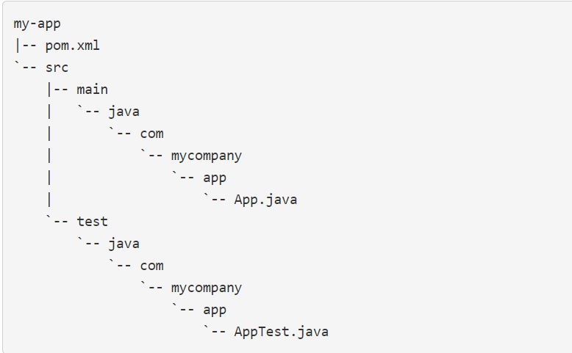
Project Structure

