Slide 1
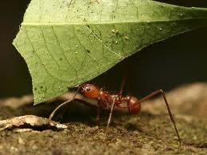
ANTS’ SIMULATION
NAME: JONATHAN FIDELIS PAUL
ROLL NO.: 517
DEPARTMENT:COMPUTER SCIENCE
ST. XAVIER’S COLLEGE KOLKATA
30, MOTHER TERESA SARANI
KOLKATA- 700 016

Slide 2
ABOUT:
A simulation , which mimics ant behavior . Ants are numerous in species and each species has developed its own abilities .
They are quite often seen working in groups.
They search for food. When they find it ,they return to their nests and give a positive feedback (by depositing pheromones) . This strengthens the trail it followed. Other ants are convinced to follow the same.
Life’s always been ‘ the survival of the fittest’ ; similarly in this simulation ,two ant colonies compete for food .

Slide 3
KEY-POINTS:
Various situations have been considered in this simulation:
1> Ants initially search for food.
2> On finding food they return to their nests and spawn more ants.
3> On their way, they communicate with other nearby naïve ants sharing their knowledge of food found.
4> The ants move in an optimum path when carrying food.
5> They avoid barriers and remember the path they followed.
6> On encountering ants of another species they fight to survive, either alone or in a group. The healthier ant groups survive in a fight.
7> As they fight they improve in health . Health also improves when they deposit food into their nests.
8> Since food particles can appear anywhere, and since the ants move randomly till they find food; the environment’s outcomes are very unpredictable and it gives the simulation a natural touch

Slide 4
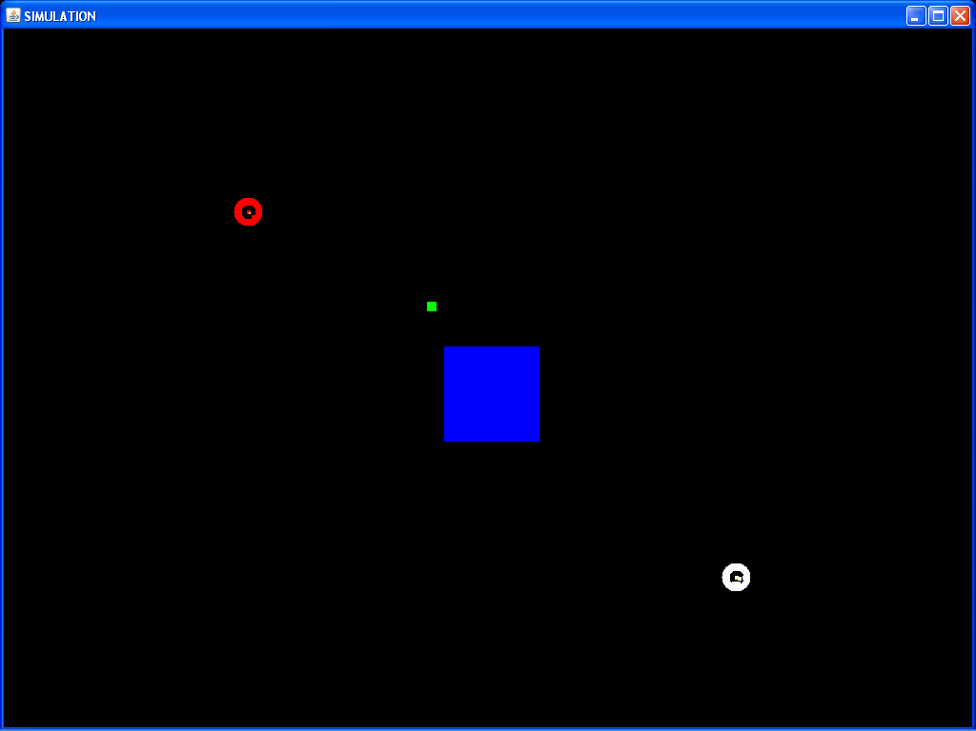
The Simulation begins with the ants emerging from their nests.

Slide 5
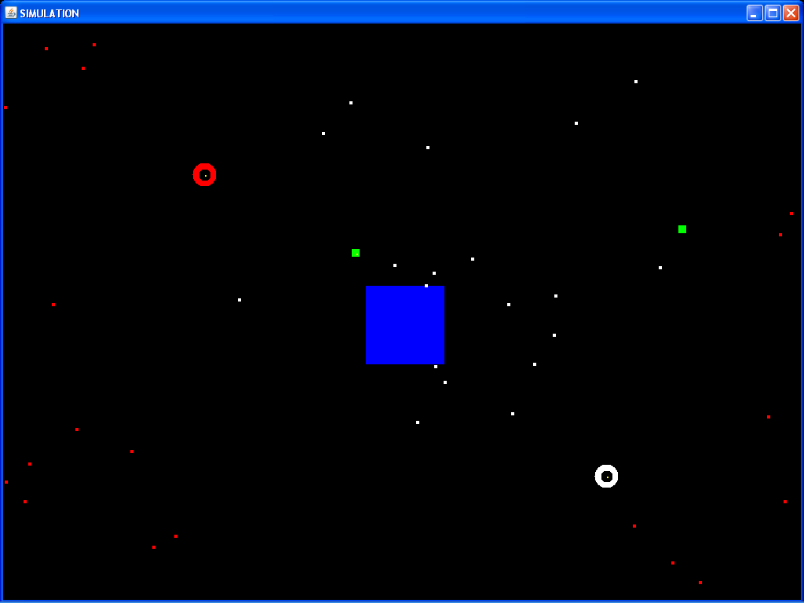
Then they undergo a random search to search for food.

Slide 6
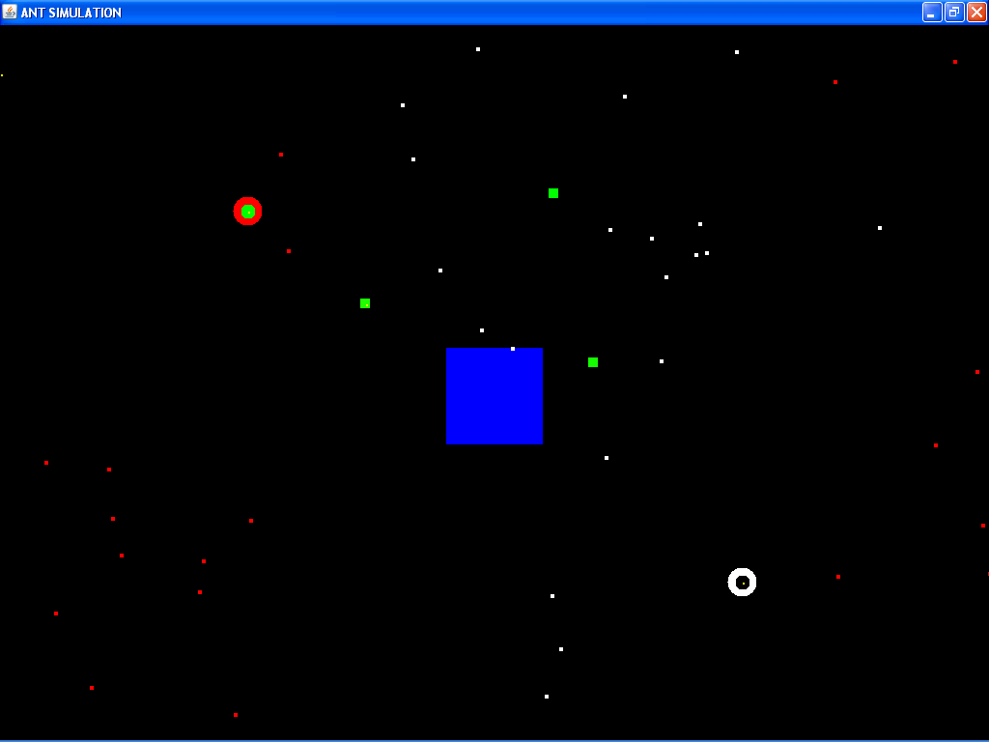
When found, they return to their nests with the food. Their nests too, then become , a source of food.

Slide 7
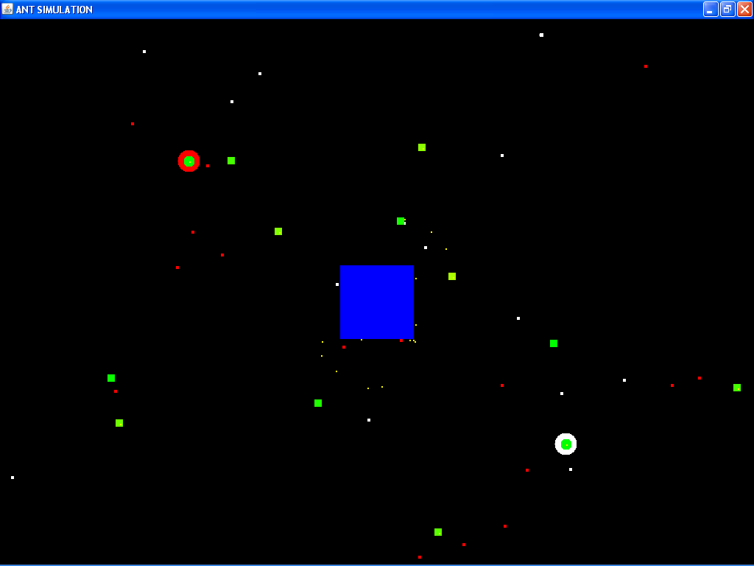
They make a trail of the path followed when they encounter an obstruction. Thus they learn from their experience.

Slide 8
REFERENCES:
Internet : http://docs.oracle.com/javase/7/docs

