Slide 1
Elm Programming Language
Nathan Feaver at SEP, May 19th 2026
github.com/jfeaver/elm-quick-introduction

Slide 2
Overview
What is Elm?
Why Elm?
Language Introduction
The Elm Architecture (a framework)
Demo (time permitting)
Questions
github.com/jfeaver/elm-quick-introduction

Slide 3
What is Elm?
What is Elm?
Why Elm?
Language Introduction
The Elm Architecture (a framework)
Demo (time permitting)
Questions
github.com/jfeaver/elm-quick-introduction

Slide 4
What is Elm?
For browser-based applications
Compiles to JavaScript
github.com/jfeaver/elm-quick-introduction

Slide 5
Why Elm?
Functional
Want to learn pure functional programming?
Elm is a friendly way to go
github.com/jfeaver/elm-quick-introduction

Slide 6
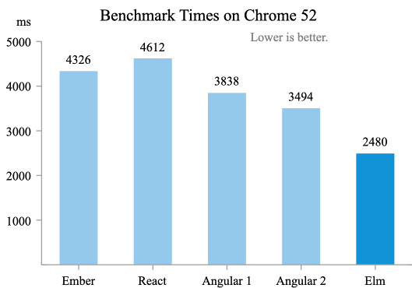
Why Elm?
Functional
Fast
https://elm-lang.org/news/blazing-fast-html-round-two
github.com/jfeaver/elm-quick-introduction

Slide 7
Why Elm?
Functional
Fast
Safe
"if it compiles, it works"
Strongly typed and strictly checked
https://incrementalelm.com/if-it-compiles-it-works
https://elm-lang.org/news/compilers-as-assistants
github.com/jfeaver/elm-quick-introduction

Slide 8
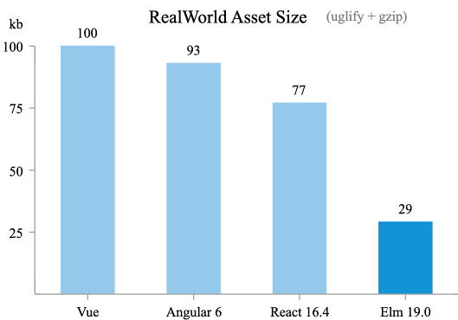
Why Elm?
Functional
Fast
Safe
Small
https://elm-lang.org/news/small-assets-without-the-headache
github.com/jfeaver/elm-quick-introduction

Slide 9
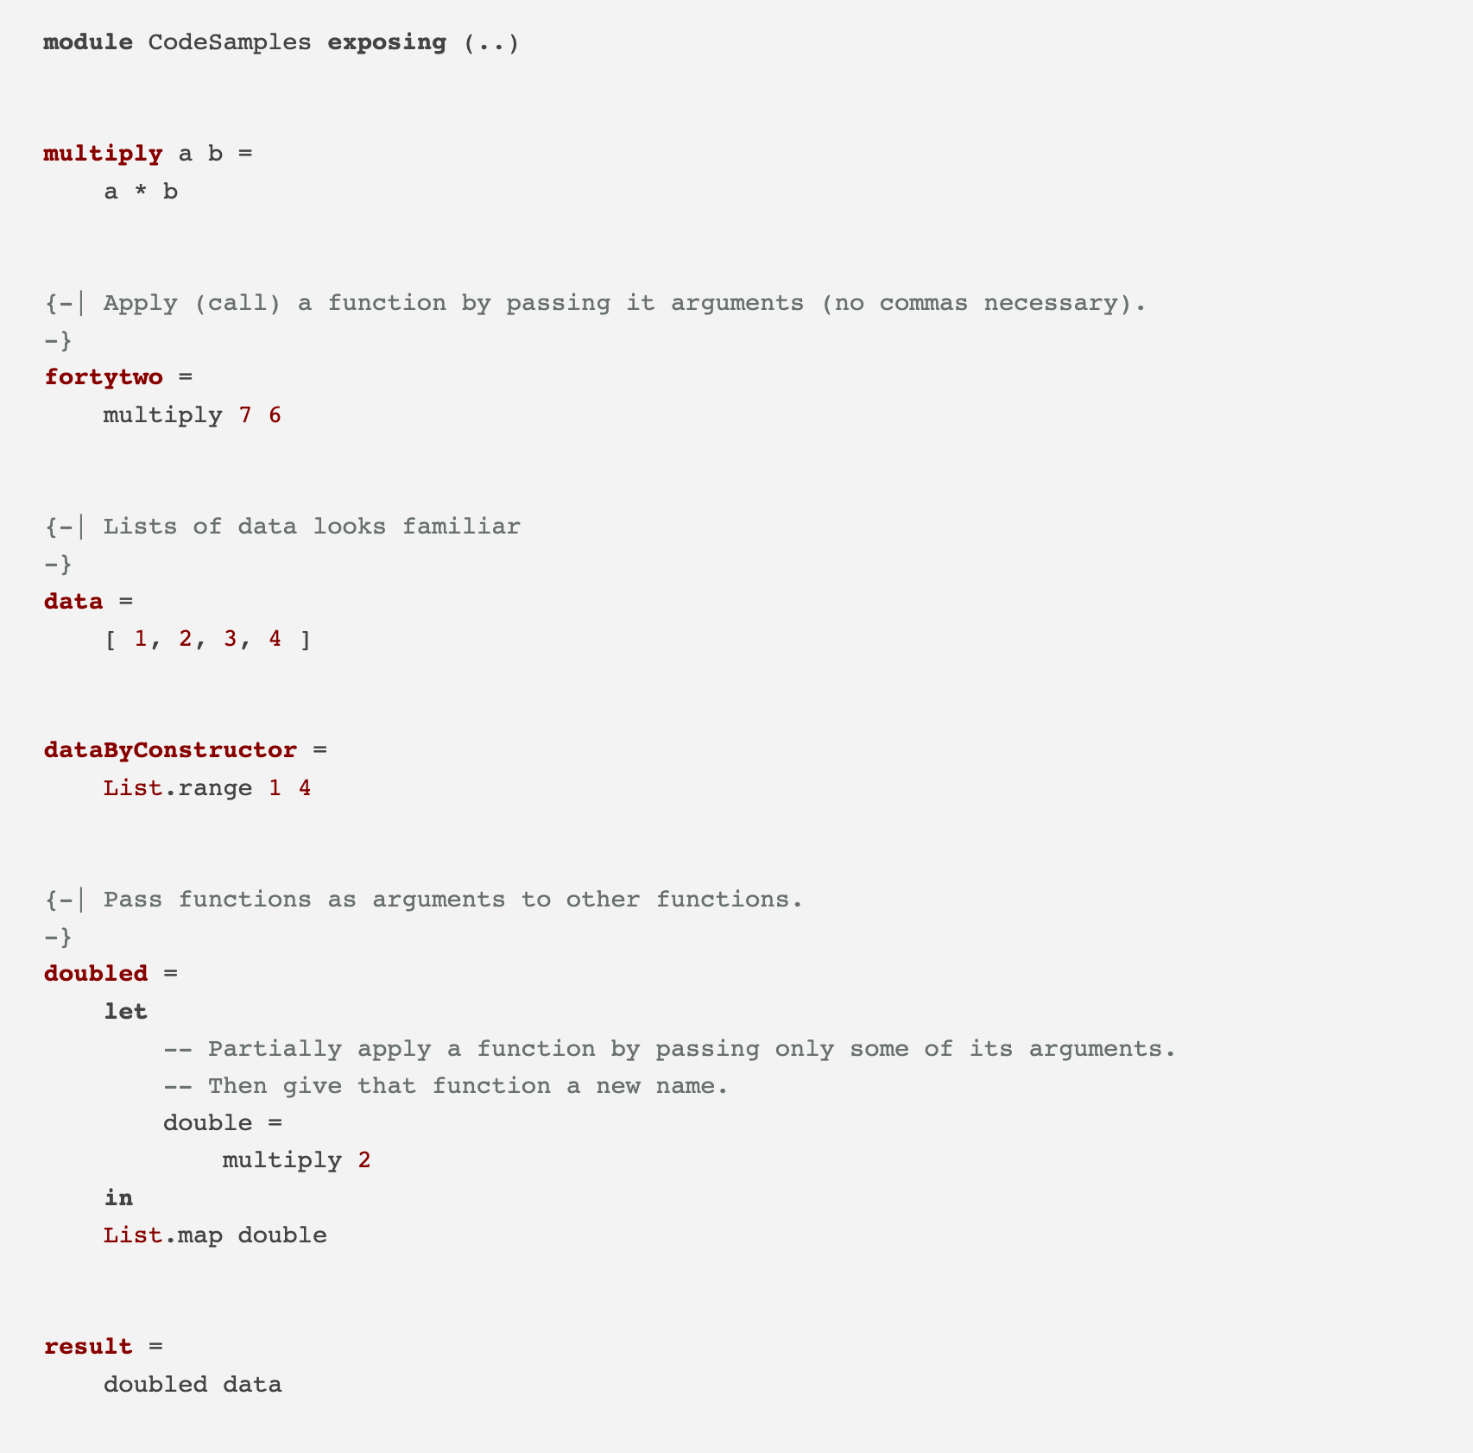
Language Introduction
github.com/jfeaver/elm-quick-introduction

Slide 10
Language Introduction
github.com/jfeaver/elm-quick-introduction

Slide 11
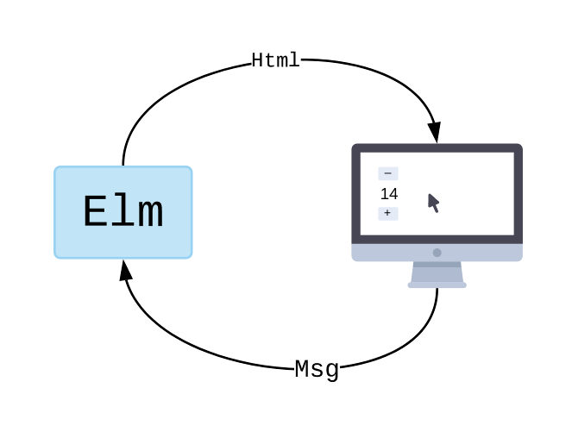
The Elm Architecture
Model
View
Update
github.com/jfeaver/elm-quick-introduction

Slide 12
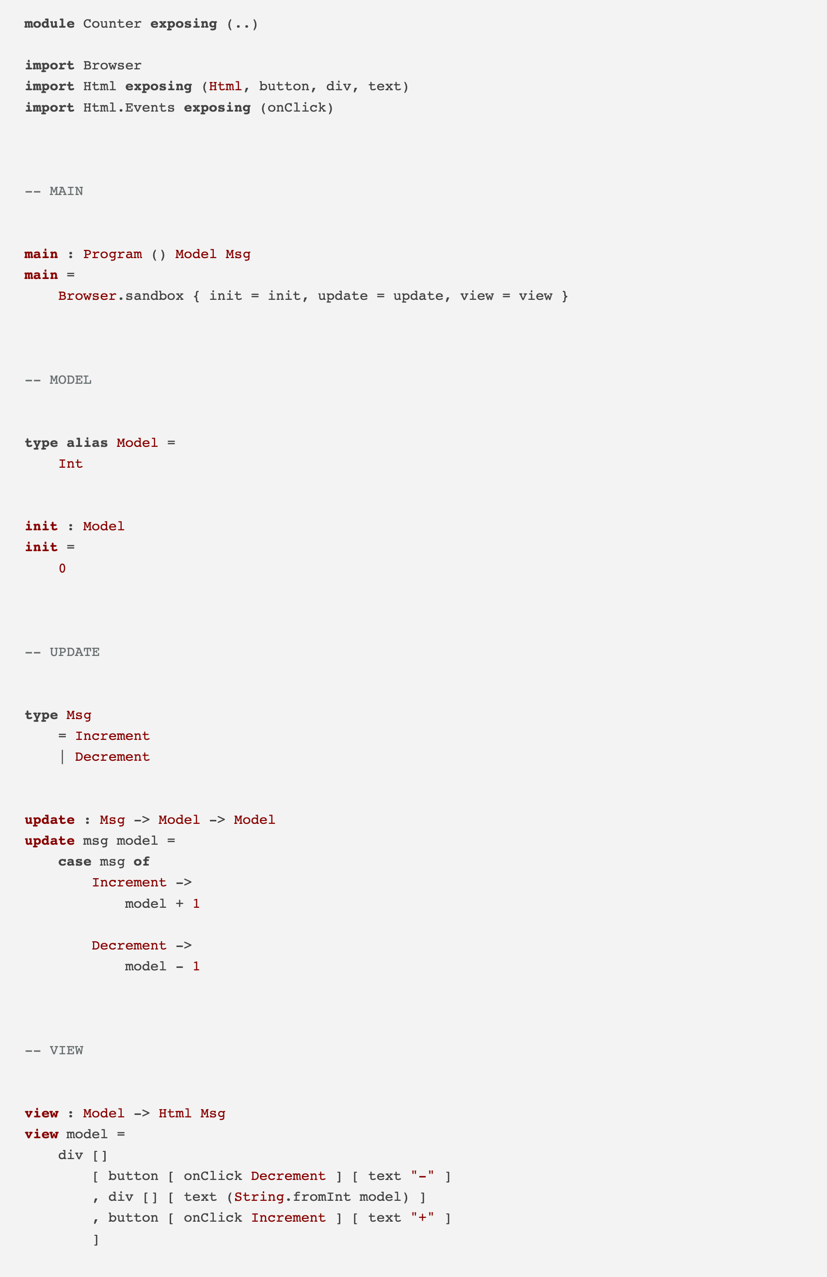
The Elm Architecture
boilerplate
github.com/jfeaver/elm-quick-introduction

Slide 13
The Elm Architecture
boilerplate
github.com/jfeaver/elm-quick-introduction

Slide 14
The Elm Architecture
boilerplate
github.com/jfeaver/elm-quick-introduction

Slide 15
The Elm Architecture
github.com/jfeaver/elm-quick-introduction

Slide 16
Going Further
The Elm Guide (guide.elm-lang.org)
Installation (guide.elm-lang.org)
Language Documentation (package.elm-lang.org)
Elm Packages (package.elm-lang.org)
github.com/jfeaver/elm-quick-introduction

Slide 17
Demo
Freecell (jfeaver.itch.io)
Source Code (github.com/jfeaver/elm-freecell)
github.com/jfeaver/elm-quick-introduction

Slide 18
Questions
github.com/jfeaver/elm-quick-introduction

