Slide 1
Real-time robot arm control using motor imaginary movements decoded from EEG signals
Research Practice
Juri Fedjaev
2017-05-21

Slide 2
Overview
Introduction
Experimental- Design
Results
Discussion and Conclusion

Slide 3
Overview
Introduction
Experimental- Design
Results
Discussion and Conclusion

Slide 4
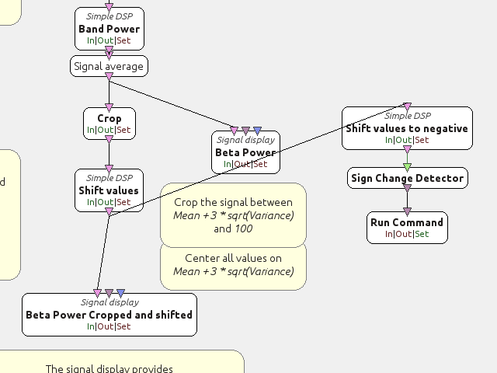
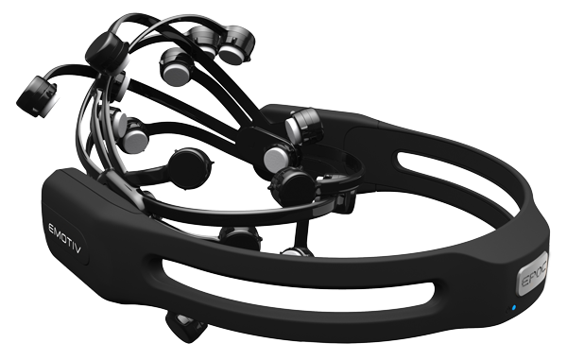
Experimental Design
First approach – OpenVibe & Emotiv EPOC+
Emotiv EPOC+ headset
OpenVibe Workflow

Slide 5
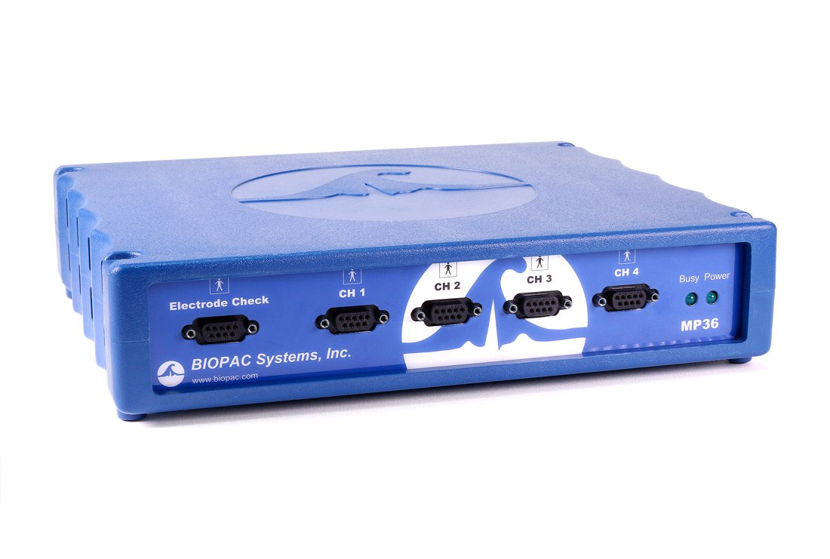
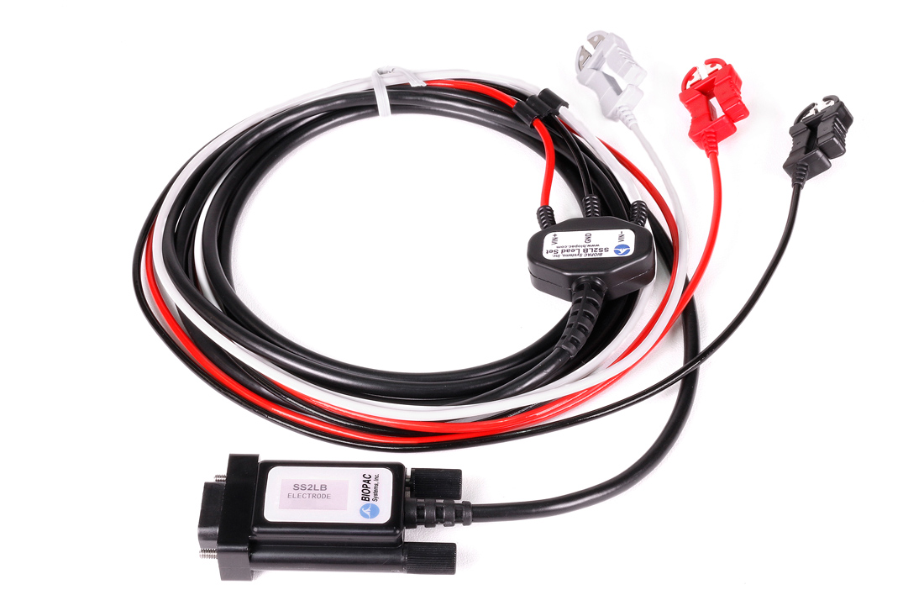
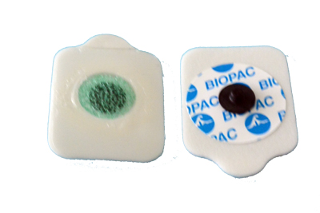
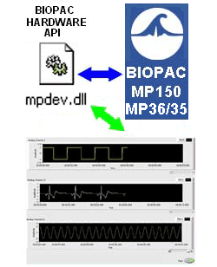

Experimental Design
Second approach
Biopac MP36 Signal Acquisition Device
Biopac Hardware API

Slide 6
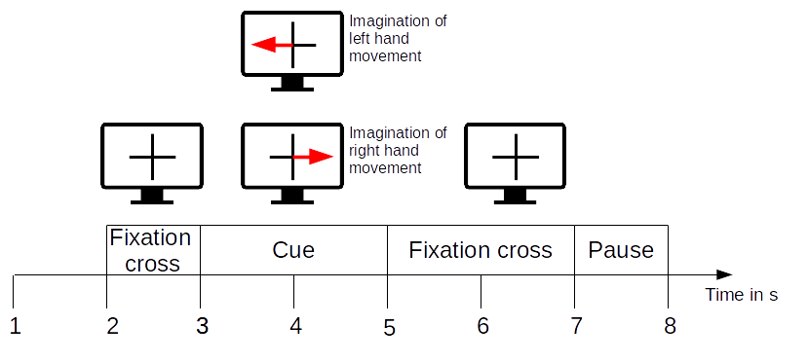
Experimental Design
Experimental Design

Slide 7
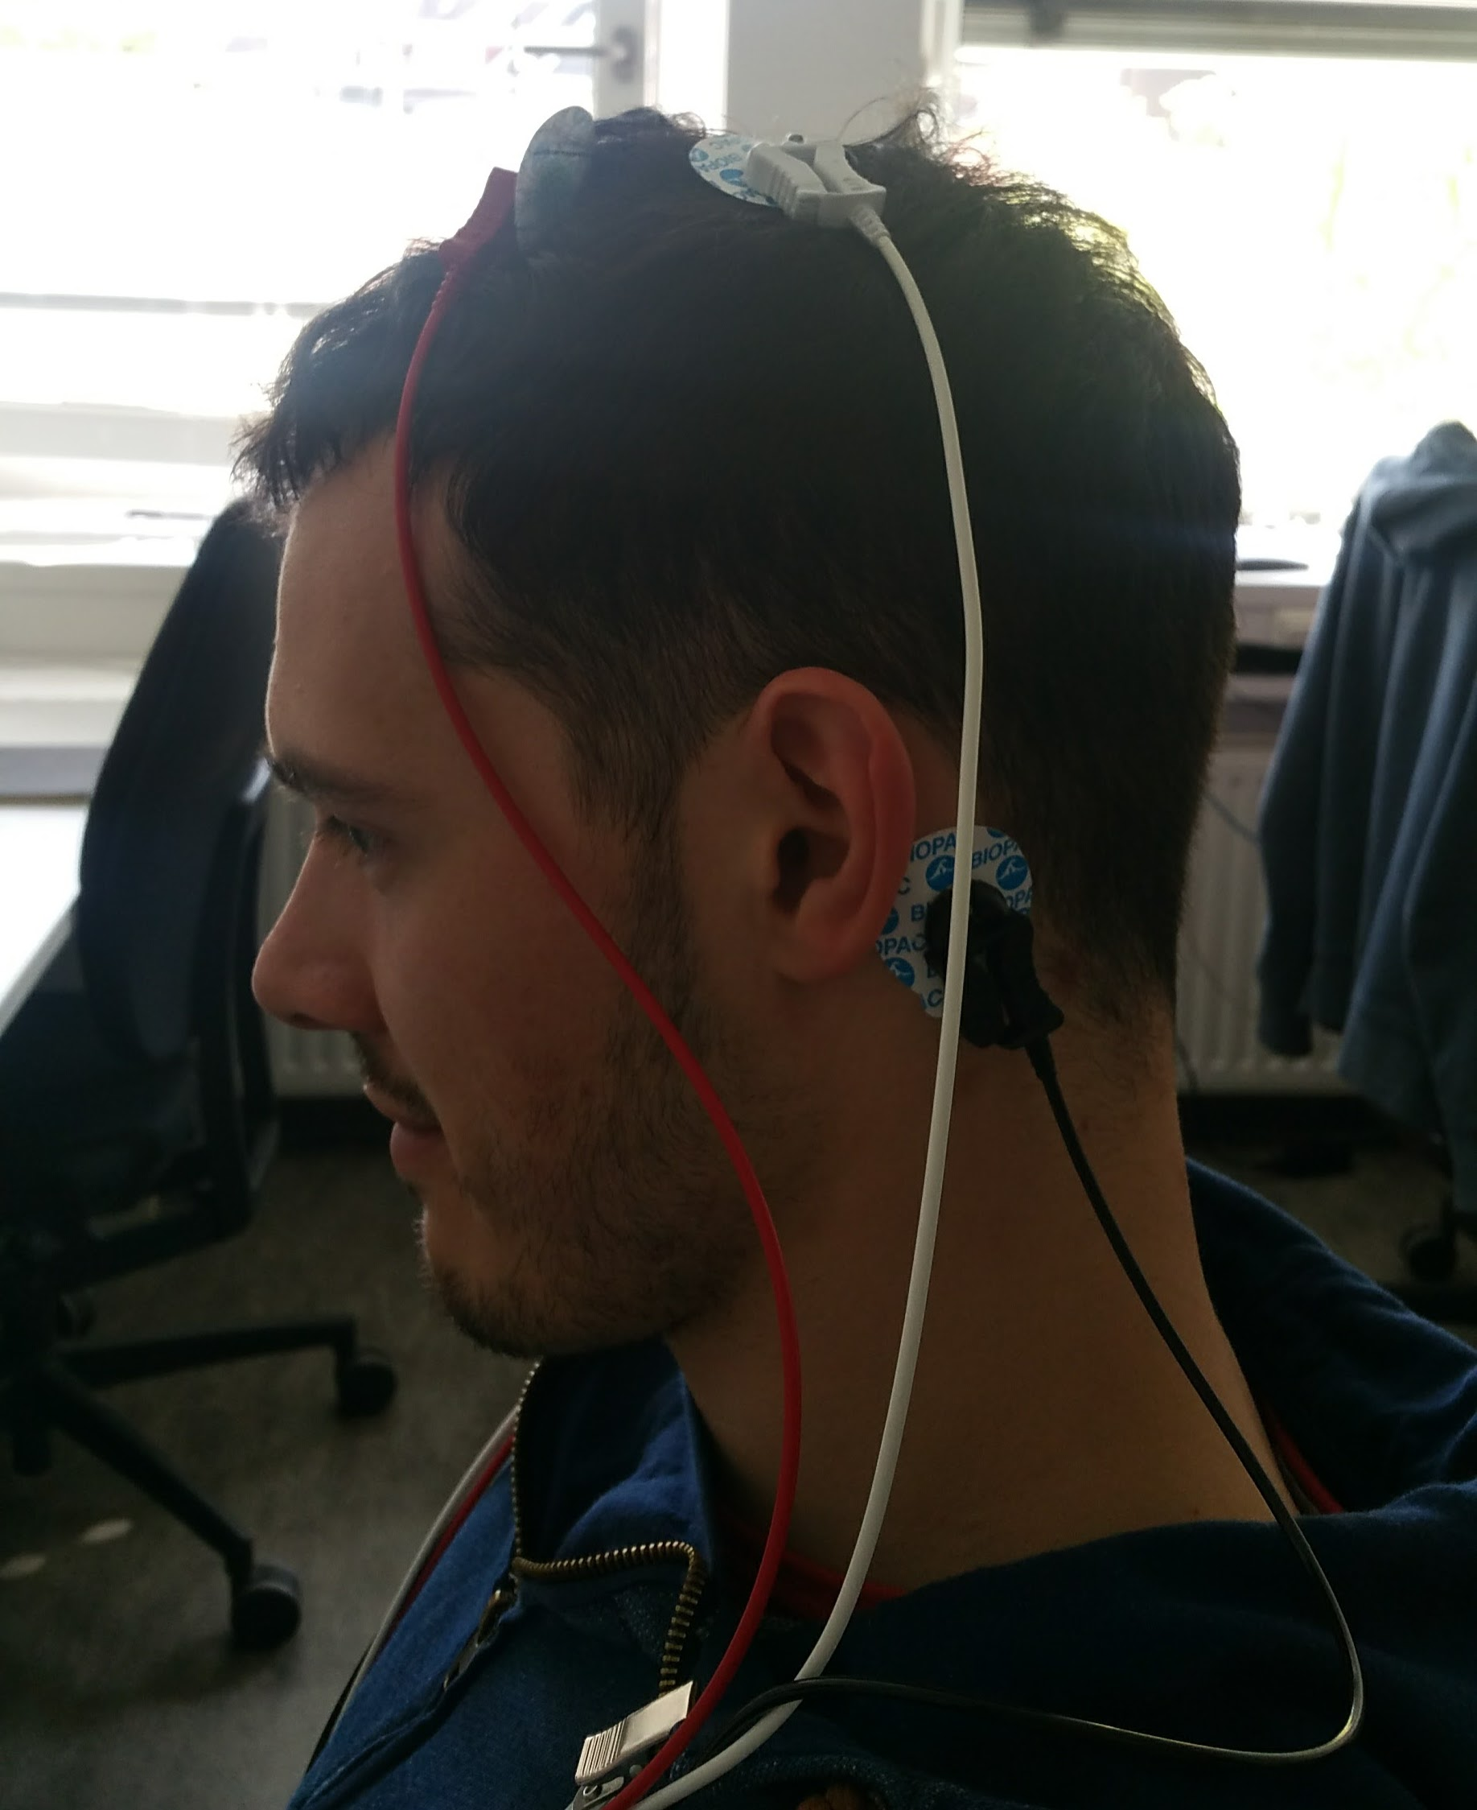
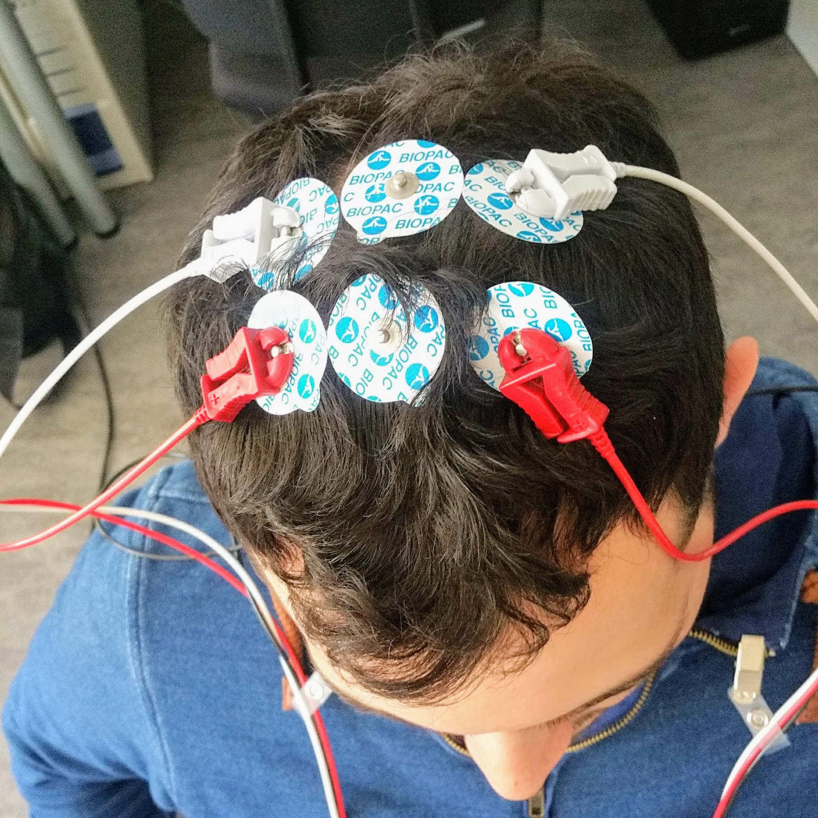
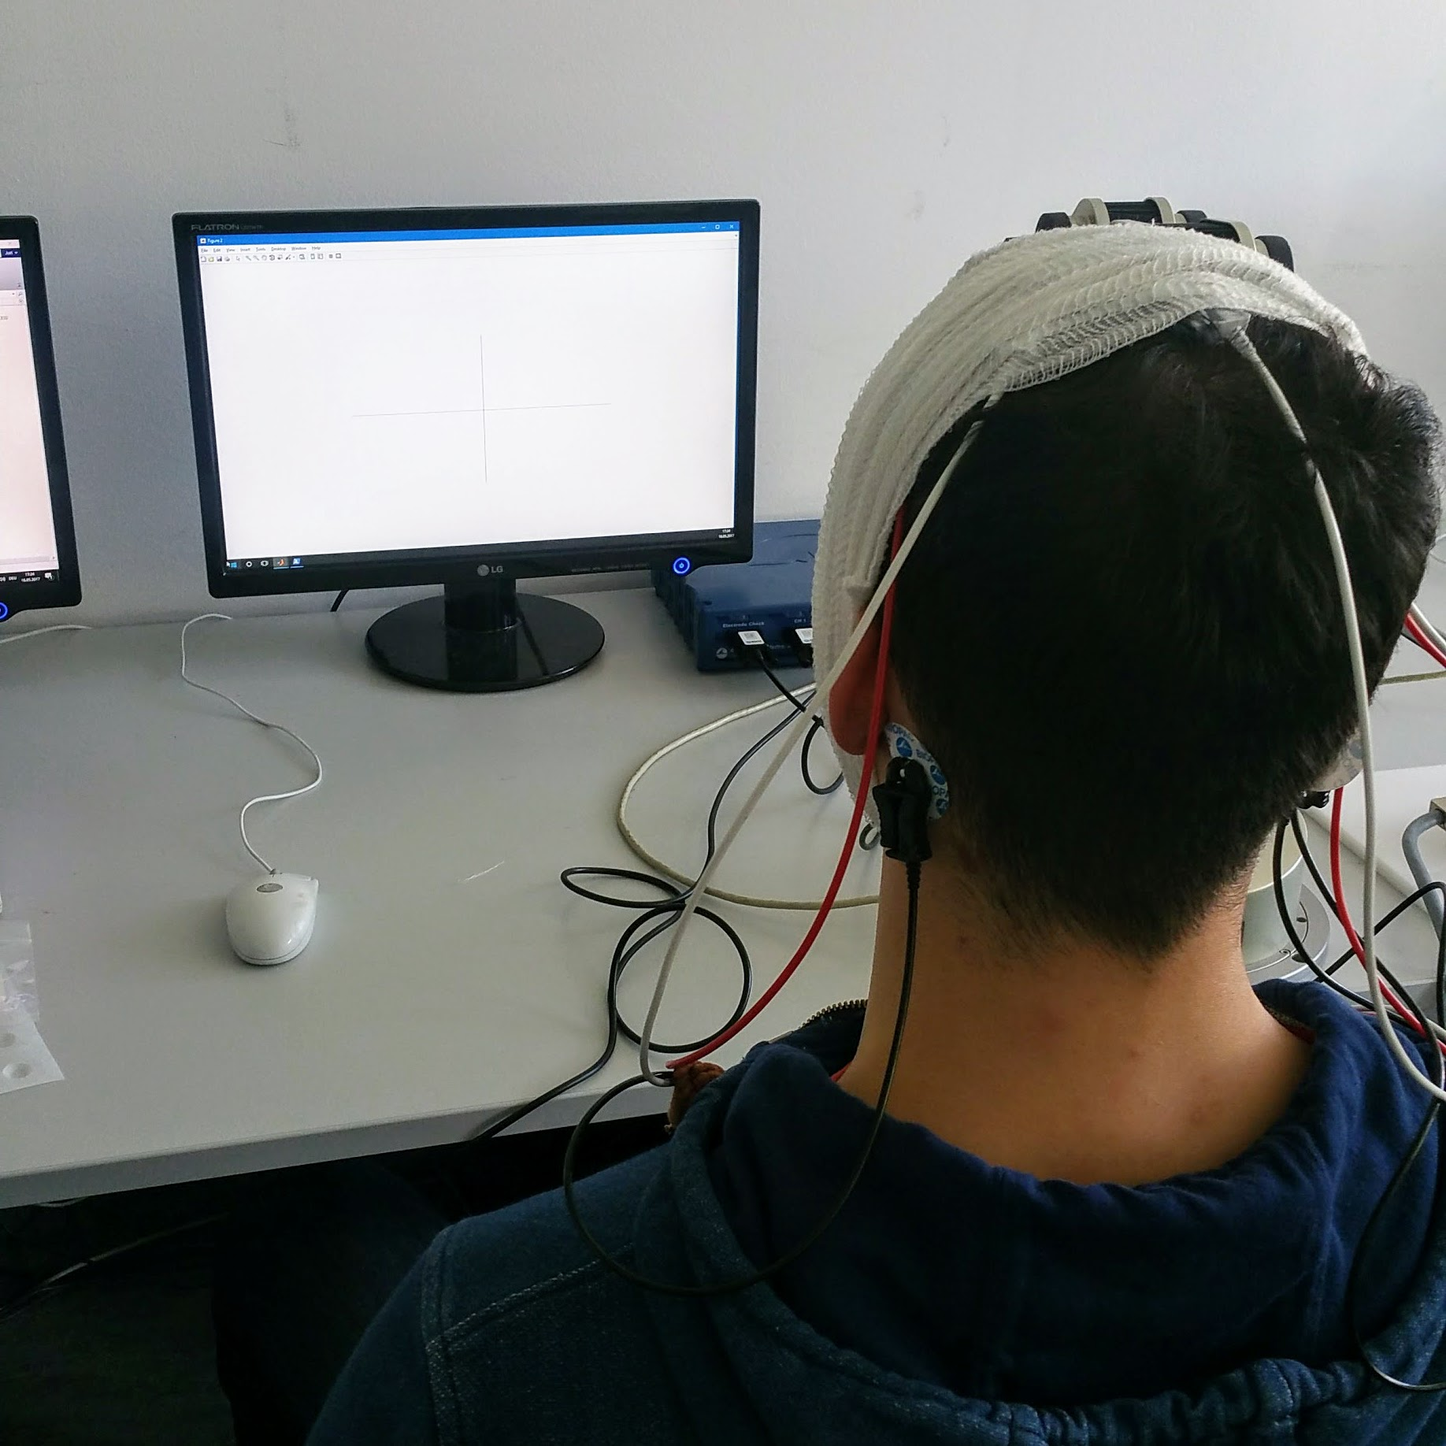
Experimental Design
Data Acquisition

Slide 8
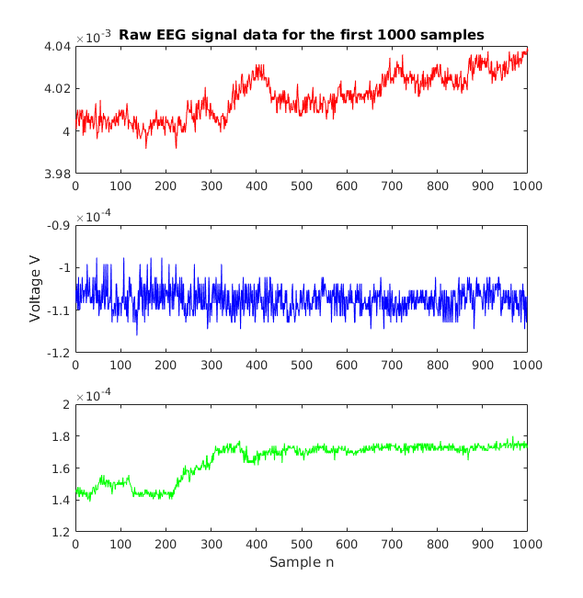
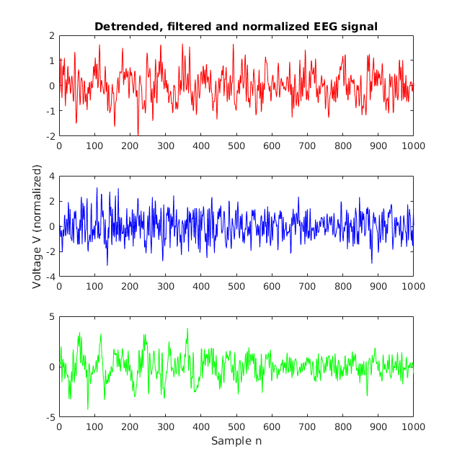
Experimental Design
Signal processing

Slide 9
Experimental Design
Feature extraction
2000 ms epochs; 500 ms pre-stimulus baseline
Band power (BP) features
  72 frequency bands using overlapping narrow bands in range between 8 and 30 Hz
Total of 216 BP features
Principal component analysis (PCA) with 12 coefficients → 12-D feature vector per trial

Slide 10
Experimental Design
Classification
SVM model fitcsvm() from Matlab toolbox „Statistics and Machine Learning“
Radial basis function (RBF) kernel
10-fold cross-validation with crossval()
Misclassification rate with kfoldLoss()

Slide 11
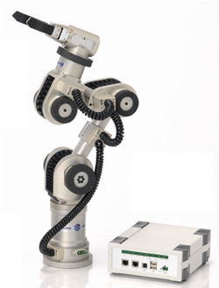
Experimental Design
Robot Arm Control
Python script for communication with SOAP server
  py.KatanaSoap.KatanaSoap()
  katana.calibrate()
  katana.moveMotAndWait(axis, val)
  katana.closeGripper(), katan.openGripper()
  ...

Slide 12
Experimental Design
Results
Here the results table
Recording ID | Number of trials | Accuracy (%)
AS01-11 | 40 | 64
AS02-11 | 40 | 67
JF02-10 | 40 | x
JF03-10 | 40 | x
JF04-10 | 40 | 74
JF02-15 | 50 | 66
JF02-16 | 50 | 60
JF01-15 | 50 | 58
JF01-16 | 50 | 60
AS01-16 | 50 | 46
AS02-12 | 50 | 77

Slide 13
Conclusion
Here a video of Alex

Slide 14
Conclusion

Slide 15
Thank you for your attention!

Slide 16
Sources
[1] N. Birbaumer, \Brain{computer-interface research: coming of age," 2006.
[2] A. Sivakami and S. S. Devi, \Analysis of eeg for motor imagery based classification of hand activities,"
[3] J. Meng, S. Zhang, A. Bekyo, J. Olsoe, B. Baxter, and B. He, \Noninvasive
electroencephalogram based control of a robotic arm for reach and grasp tasks,"
Scientific Reports, vol. 6, 2016.
[4] X. Yong and C. Menon, \Eeg classification of different imaginary movements
within the same limb," PloS one, vol. 10, no. 4, p. e0121896, 2015.
[5] J. Decety, \The neurophysiological basis of motor imagery," Behavioural brain
research, vol. 77, no. 1, pp. 45{52, 1996.
[6] M. Lotze, P. Montoya, M. Erb, E. H¨ulsmann, H. Flor, U. Klose, N. Birbaumer,
and W. Grodd, \Activation of cortical and cerebellar motor areas during executed and imagined hand movements: an fmri study," Journal of cognitive
neuroscience, vol. 11, no. 5, pp. 491{501, 1999.
[7] R. W. Homan, J. Herman, and P. Purdy, \Cerebral location of international
10{20 system electrode placement," Electroencephalography and clinical neurophysiology, vol. 66, no. 4, pp. 376{382, 1987.
[8] C. A. Kothe and S. Makeig, \Bcilab: a platform for brain{computer interface
development," Journal of neural engineering, vol. 10, no. 5, p. 056014, 2013.
[9] Y. Renard, F. Lotte, G. Gibert, M. Congedo, E. Maby, V. Delannoy,
O. Bertrand, and A. LA ~ c cuyer, \Openvibe: An open-source software platform
to design, test, and use brain-computer interfaces in real and virtual environments.," Presence, vol. 19, no. 1, pp. 35{53, 2010.
[10] G. Schalk and J. Mellinger, A practical guide to brain{computer interfacing
with BCI2000: General-purpose software for brain-computer interface research,
data acquisition, stimulus presentation, and brain monitoring. Springer Science
& Business Media, 2010.
[11] I. Biopac Systems, \Biopac product site," 2017.
[12] S. Ge, R. Wang, and D. Yu, \Classification of four-class motor imagery employing single-channel electroencephalography," PloS one, vol. 9, no. 6, p. e98019,
2014.
[13] R. Leeb, F. Lee, C. Keinrath, R. Scherer, H. Bischof, and G. Pfurtscheller,
\Brain{computer communication: motivation, aim, and impact of exploring a
virtual apartment," IEEE Transactions on Neural Systems and Rehabilitation
Engineering, vol. 15, no. 4, pp. 473{482, 2007.
[14] Z. Tayeb, E. Ercelik, and J. Conradt, \Decoding of motor imagery movements
from eeg signals using spinnaker neuromorphic hardware," arXiv, 2017.

