Slide 1
Spark On Demand Deploying on Rhea
Dale Stansberry
John Harney
Advanced Data and Workflows Group
NCCS/OLCF

Slide 2
Spark Configuration
Spark 1.6 + Hadoop 2.6 binary dist
Will soon be available as module on Rhea
Spark configured using “Standalone” mode
Spark jobs run using PBS scripts generated with OLCF spark command-line utility (spark_setup)
PBS script contains Spark dynamic deployment plus custom application setup/commands

Slide 3
Manual Spark Install
Download pre-built Spark 1.6.X + Hadoop 2.6.X from http://spark.apache.org
Extract archive to accessible path on Atlas (scratch or project directory)
Export SPARK_HOME and add SPARK_HOME/bin to path
Clone spark_on_demand project from: git@code.ornl.gov:d3s/spark_on_demand.git
Copy spark_setup.py to SPARK_HOME/bin
Copy spark_deploy.py to SPARK_HOME/sbin

Slide 4
How Spark on Demand Works (Setup)
spark_setup.py script generates PBS script and provisions deployment directory
Deployment directory includes template directory containing configuration files that may be edited
Includes Rhea-appropriate values (cores, memory, etc.)
Must edit generated PBS script to add application commands and optional module dependencies
PBS environment is exported to allocated nodes
Spark application(s) are launched using $SPARK_SUBMIT command
Python, Scala, and Java are supported

Slide 5
How Spark on Demand Works (cont.)
When job is run, PBS script uses mpirun to launch a deployment script on allocated nodes
Deployment script harvests node information and creates spark configuration files in deployment directory (from templates)
Deployment script then starts Spark daemon processes
Spark application(s) are launched
Application output goes to stdout
Spark driver logs to stderr by default
Spark daemons are killed when PBS script ends

Slide 6
Options for spark_setup
-? : show usage
-s : PBS script name
-a : account to charge
-n : number of nodes (must be >= 2)
-w : wall time (PBS format)
-d : deployment directory (full path)
--driver-mem : 64GB default
--exec-mem : 4GB default

Slide 7
Guidelines / Comments
Number of nodes must be >= 2
Deployment directory should be in scratch area
Be careful re-using PBS scripts!
Number of nodes in two places
Deployment directory initialized by setup script
Languages:
Scala is Spark “native” language
Python is not as well supported by some Spark libraries (MLlib)
Using Java may require translation to/from Spark/Scala objects

Slide 8
Spark On Demand Deploying on Rhea
Demo

Slide 9
Initial Experiences and Benchmarks
Why Spark-on-demand on Rhea?
Elimination of data movement step
Utilization of OLCF resources
Do not need dedicated cluster or HDFS (instances are created and destroyed)
Client code/Driver programs “easier” to write
Embeddable (e.g. BEAM and ICE)
Includes out-of-the-box capabilities
Spark-streaming
GraphX
MLLib

Slide 10
Initial Experiences and Benchmarks
When should we use Spark-on-Rhea?
When not to use Spark-on-Rhea?
Working with smaller datasets
Applications that require spark to be listening for requests
MPI applications
Does it exhibit expected performance benefits?
What are the optimal conditions for using it?
Number of nodes, size of datasets, number of threads, etc
Examples:
Wordcount
Singular Value Decomposition (from MLLib)

Slide 11
Applications – WordCount and Singular Value Decomposition (SVD)
Preliminary Findings (experiment setup)
Parameters
Number of nodes – 2,4,8,16,32, (64)
WordCount: Document sizes (1,2,4,8,100 GB)
SVD: Matrix sizes
Small – 5000x500 (~46MB), 5000x1000 (~92MB), 5000x2500 (~231MB)
Medium (e.g. 256x256 images) – 1000x65536 (~1,2 GB), 10000x65536 (~12 GB)
Large (e.g higher res 10000x10000 images) – 10000x100000000 (~185 GB)
Assumptions
Input are text files of random values
Data preparation time not considered
Uses out-of-box Spark task manager (YARN? Mesos?)
I/O performance not considered in measurements

Slide 12
Application – Wordcount

Slide 13
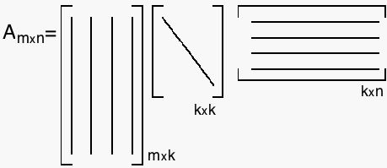
Application – Singular Value Decomposition (SVD)
SVD:
U,V – orthogonal matricies containing singular vectors
S – diagonal containing singular values
Exists for all A
Numerous calculation methods
Many uses:
Dimensionality Reduction/Compression
PCA (Image/Face Recognition)
Recommender systems (locating important features)

Slide 14
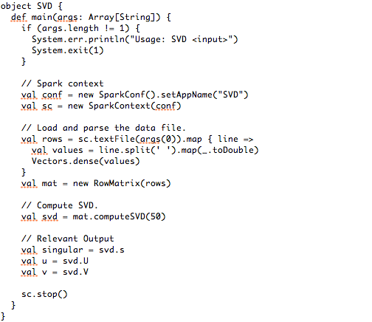
Application – Singular Value Decomposition (SVD)
SVD Driver Program (Scala)
Declare Context
Load Data into RDD From File
Compute SVD (MLLib API)
Output

Slide 15
Application – Singular Value Decomposition (SVD)

Slide 16
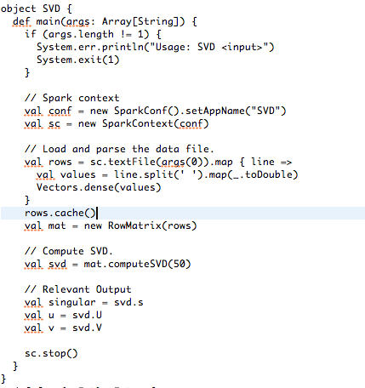
Application – Singular Value Decomposition (SVD)
SVD Driver Program (Scala) - caching

Slide 17
Application – Singular Value Decomposition (SVD)

Slide 18
Application – Singular Value Decomposition (SVD)

Slide 19
Discussion/Observations
Results
Improved computational performance for wordcount and SVD as node count increases (in some cases)
Caching makes a huge difference (what happens when required cache is greater than available memory?)
Structure of the data can be important (Large matrix 10000x100000000) caused timeout error
Investigate other tunable parameters including
number of threads
number of open sockets
serialization methods
number of threads
mounting options

Slide 20
Discussion/Observations
Other observations of using spark-on-demand on Rhea
Edit the pbs script at your own risk!
Cannot take advantage of the spark shell (REPL)
More support for driver programs in scala (Streaming, MLLib)
Future investigation:
I/O (Darshan)
TPC-DS and BigData Benchmarks (Kay Ousterhout - https://github.com/kayousterhout/trace-analysis)
Comparison with traditional spark setup (CADES with HDFS) is needed

