Slide 1
Introduction to Apache Spark
Slides from: Patrick Wendell - Databricks

Slide 2
What is Spark?
Fast and Expressive Cluster Computing Engine Compatible with Apache Hadoop
Up to 10× faster on disk, 100× in memory
2-5× less code
Efficient
Usable
General execution graphs
In-memory storage
Rich APIs in Java, Scala, Python
Interactive shell

Slide 3
Spark Programming Model

Slide 4
Key Concept: RDD’s
Write programs in terms of operations on distributed datasets
Resilient Distributed Datasets
Collections of objects spread across a cluster, stored in RAM or on Disk
Built through parallel transformations
Automatically rebuilt on failure
Operations
Transformations (e.g. map, filter, groupBy)
Actions (e.g. count, collect, save)

Slide 5

Example: Log Mining
Load error messages from a log into memory, then interactively search for various patterns
Base RDD
Transformed RDD
Cache 1
lines = spark.textFile(“hdfs://...”)
errors = lines.filter(lambda s: s.startswith(“ERROR”))
messages = errors.map(lambda s: s.split(“\t”)[2])
messages.cache()
results
Worker
tasks
Block 1
Driver
Action
messages.filter(lambda s: “mysql” in s).count()
Cache 2
messages.filter(lambda s: “php” in s).count()
Worker
Cache 3
. . .
Full-text search of Wikipedia
60GB on 20 EC2 machine
0.5 sec vs. 20s for on-disk
Worker
Block 2
Block 3

Slide 6
Impact of Caching on Performance

Slide 7
Fault Recovery
RDDs track lineage information that can be used to efficiently recompute lost data
msgs = textFile.filter(lambda s: s.startsWith(“ERROR”))
.map(lambda s: s.split(“\t”)[2])
HDFS File
Filtered RDD
Mapped RDD
filter (func = startsWith(…))
map (func = split(...))

Slide 8
Programming with RDD’s
Notes:
cs451

Slide 9
SparkContext
Main entry point to Spark functionality
Available in shell as variable sc
In standalone programs, you’d make your own

Slide 10
Creating RDDs
# Turn a Python collection into an RDD
sc.parallelize([1, 2, 3])
# Load text file from local FS, HDFS, or S3
sc.textFile(“file.txt”)
sc.textFile(“directory/*.txt”)
sc.textFile(“hdfs://namenode:9000/path/file”)

Slide 11
Basic Transformations
nums = sc.parallelize([1, 2, 3])
# Pass each element through a function
squares = nums.map(lambda x: x*x) // {1, 4, 9}
# Keep elements passing a predicate
even = squares.filter(lambda x: x % 2 == 0) // {4}
# Map each element to zero or more others
nums.flatMap(lambda x: => range(x))
# => {0, 0, 1, 0, 1, 2}
Range object (sequence of numbers 0, 1, …, x-1)
Notes:
cs431

Slide 12
Basic Actions
nums = sc.parallelize([1, 2, 3])
# Retrieve RDD contents as a local collection
nums.collect() # => [1, 2, 3]
# Return first K elements
nums.take(2) # => [1, 2]
# Count number of elements
nums.count() # => 3
# Merge elements with an associative function
nums.reduce(lambda x, y: x + y) # => 6
# Write elements to a text file
nums.saveAsTextFile(“hdfs://file.txt”)

Slide 13
Working with Key-Value Pairs
Spark’s “distributed reduce” transformations operate on RDDs of key-value pairs
Python: pair = (a, b) pair[0] # => a pair[1] # => b
Scala: val pair = (a, b) pair._1 // => a pair._2 // => b
Java: Tuple2 pair = new Tuple2(a, b); pair._1 // => a pair._2 // => b

Slide 14
Some Key-Value Operations
pets = sc.parallelize( [(“cat”, 1), (“dog”, 1), (“cat”, 2)])
pets.reduceByKey(lambda x, y: x + y) # => {(cat, 3), (dog, 1)}
pets.groupByKey() # => {(cat, [1, 2]), (dog, [1])}
pets.sortByKey() # => {(cat, 1), (cat, 2), (dog, 1)}

Slide 15
Word Count (Python)
lines = sc.textFile(“hamlet.txt”)
counts = lines.flatMap(lambda line: line.split(“ ”)) .map(lambda word => (word, 1)) .reduceByKey(lambda x, y: x + y) .saveAsTextFile(“results”)
“to” “be” “or”
(to, 1) (be, 1) (or, 1)
(be, 2) (not, 1)
“to be or”
“not” “to” “be”
(not, 1) (to, 1) (be, 1)
(or, 1)
(to, 2)
“not to be”

Slide 16
Word Count (Scala)
val textFile = sc.textFile(“hamlet.txt”)
textFile
.flatMap(line => tokenize(line))
.map(word => (word, 1))
.reduceByKey((x, y) => x + y)
.saveAsTextFile(“results”)

Slide 17
Word Count (Java)
val textFile = sc.textFile(“hamlet.txt”)
textFile
.map(object mapper {
def map(key: Long, value: Text) =
tokenize(value).foreach(word => write(word, 1))
})
.reduce(object reducer {
def reduce(key: Text, values: Iterable[Int]) = {
var sum = 0
for (value <- values) sum += value
write(key, sum)
})
.saveAsTextFile(“results)

Slide 18
Other Key-Value Operations
visits = sc.parallelize([ (“index.html”, “1.2.3.4”), (“about.html”, “3.4.5.6”), (“index.html”, “1.3.3.1”) ])
pageNames = sc.parallelize([ (“index.html”, “Home”), (“about.html”, “About”) ])
visits.join(pageNames) # (“index.html”, (“1.2.3.4”, “Home”)) # (“index.html”, (“1.3.3.1”, “Home”)) # (“about.html”, (“3.4.5.6”, “About”))
visits.cogroup(pageNames) # (“index.html”, ([“1.2.3.4”, “1.3.3.1”], [“Home”])) # (“about.html”, ([“3.4.5.6”], [“About”]))

Slide 19
Setting the Level of Parallelism
All the pair RDD operations take an optional second parameter for number of tasks
words.reduceByKey(lambda x, y: x + y, 5)
words.groupByKey(5)
visits.join(pageViews, 5)

Slide 20
Under The Hood: DAG Scheduler
General task graphs
Automatically pipelines functions
Data locality aware
Partitioning aware to avoid shuffles
B:
A:
F:
Stage 1
groupBy
C:
D:
E:
join
Stage 2
map
filter
Stage 3
= RDD
= cached partition
Notes:
directed acyclic graph

Slide 21
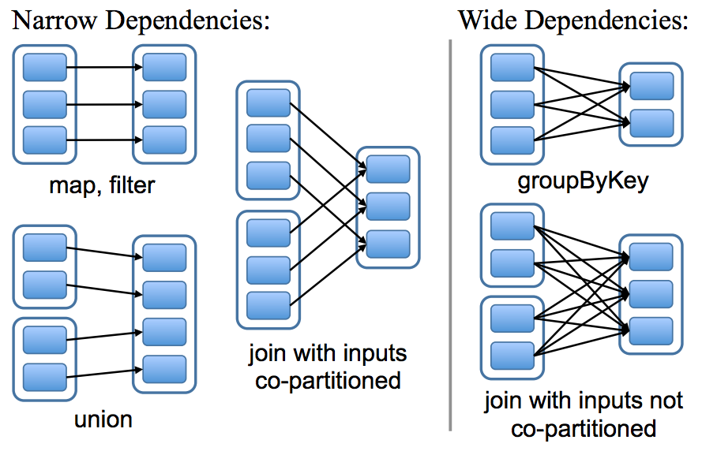
Physical Operators

Slide 22
More RDD Operators
map
filter
groupBy
sort
union
join
leftOuterJoin
rightOuterJoin
reduce
count
fold
reduceByKey
groupByKey
cogroup
cross
zip
sample
take
first
partitionBy
mapWith
pipe
save ...

Slide 23
Performance

Slide 24
PageRank Performance

Slide 25
Other Iterative Algorithms
Time per Iteration (s)

