Slide 1
Spark details

Slide 2
installation
Work with single node (manual approach)
Need to install
maven, jdk, scala, python, hadoop
scala installation with the latest version:
*Also check https://gist.github.com/osipov/c2a34884a647c29765ed for installing SBT, which is the code building tool for scala.
Download spark-for-hadoop binary and unzip to a directory
sudo apt-get remove scala-library scala
sudo wget www.scala-lang.org/files/archive/scala-2.12.3.deb
sudo dpkg -i scala-2.12.3.deb
sudo apt-get update
sudo apt-get install scala

Slide 3
Easier approach
Pull a docker image (certainly install docker first)
If you want to try scala
docker run -it apache/spark /opt/spark/bin/spark-shell
If you prefer python
docker run -it apache/spark-py /opt/spark/bin/pyspark

Slide 4
Use multiple workers (locally, not docker)
Go to the spark directory, say /usr/local/spark. Change configuration ./conf/spark-env.sh
export SPARK_WORKER_MEMORY=100m
export SPARK_WORKER_INSTANCES=2
export SPARK_WORKER_DIR=some_directory_you_like
Note that 100MB memory for worker is sufficient for simple experiments. The more the better for a real system

Slide 5
Local non-docker setup
Start the single-node cluster
./sbin/start-master.sh
./sbin/start-slaves.sh
./bin/pyspark for python, ./bin/spark-shell for scala

Slide 6
Testing the Wordcount program
Scala: (spark-shell)
val f = sc.textFile("README.md")
val wc = f.flatMap(l => l.split(" ")).map(word => (word, 1)).reduceByKey(_ + _)
wc.saveAsTextFile("wc_out.txt")
Python: (pyspark)
from operator import add
f = sc.textFile("README.md")
wc = f.flatMap(lambda x: x.split(' ')).map(lambda x: (x, 1)).reduceByKey(add)
wc.saveAsTextFile("wc_out.txt")

Slide 7
Spark Essentials
SparkSession
The “master” parameter
RDD operations
The concept of “persistence”
Shared variables

Slide 8
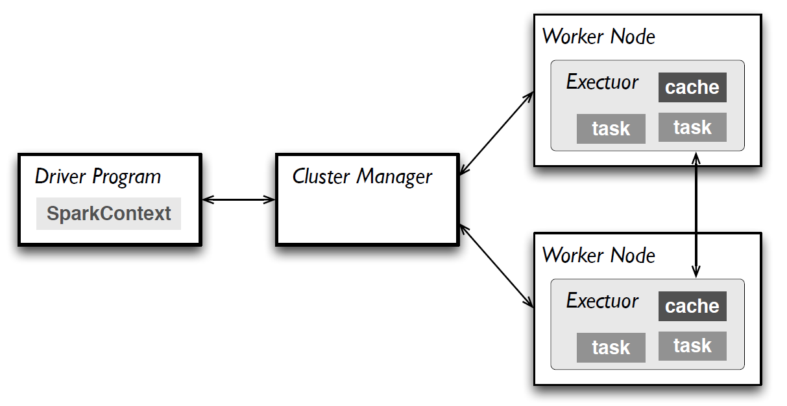
SparkSession
A SparkSession object manages all interactions with the Spark cluster and all parameters
SparkSession

Slide 9
SparkSession
Sample code (the python version)
Note that before Spark 2.0, multiple “context” classes are used such as “SparkContex”, and “SQLContext”. Now use the unified “SparkSession”
The global SparkContext object “sc” is still there in spark-shell and pyspark
After 2.0, a global SparkSession is created as “spark”. Use spark.sparkContext for creating RDD
from pyspark.sql import SparkSession
sparkSession = SparkSession.builder \
.master("local") \
.appName("my-spark-app") \
.config("spark.some.config.option", "config-value") \
.getOrCreate()

Slide 10
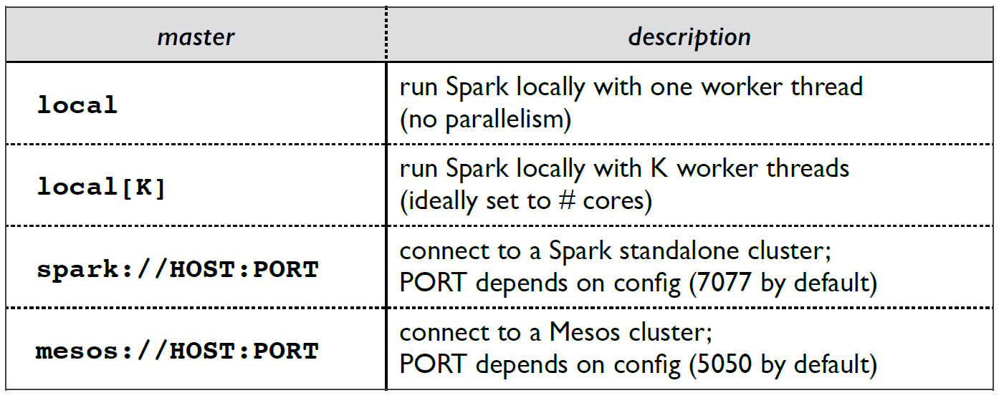
master – the master info
Master can be specified in program or command line
Types of masters
from pyspark.sql import SparkSession
sparkSession = SparkSession.builder \
.master("local") \
.appName("my-spark-app") \
.config("spark.some.config.option", "config-value") \
.getOrCreate()
yarn | connect to a Hadoop yarn cluster
| yarn needs to be configured in advance

Slide 11
Command line “--master” (skip)
Yarn
$ ./bin/spark-submit --class path.to.your.Class --master yarn --deploy-mode cluster [options] <app jar> [app options]
Standalone
Change to --master spark://MASTER_NODE_IP:PORT
Mesos
Change to –master mesos://MASTER_NODE_IP:PORT

Slide 12
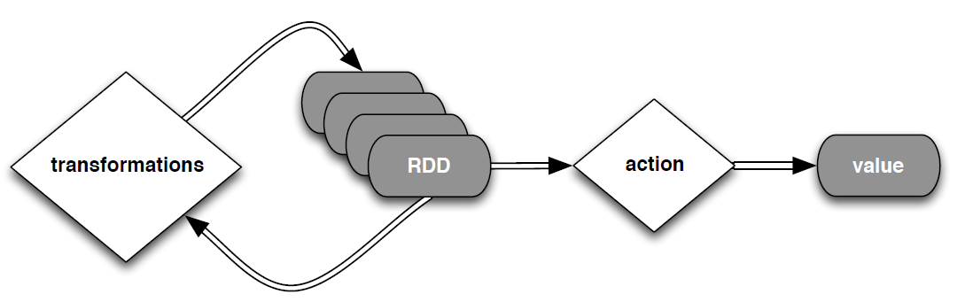
RDD operations
Create RDDs
Transformations
Actions

Slide 13
Creating RDD
Load files using sc (global variable) or the sparkContext variable in SparkSession
sc.textFile(…) or
sparkSession.sparkContext.textFile(…)
Convert a scala collection to RDD
#create sparkSession first and use it, or use sc
>>>data = [1,2,3,4,5]
>>>distributedData = sparkSession.sparkContext.parallelize(data)
>>>print distributedData
ParallelCollectionRDD[0] at parallelize at PythonRDD.scala:475

Slide 14
Transformations
Create a new dataset from an existing one
Transformations are “lazy”
They are not evaluated until an action or persistence operation is seen
Easier for optimization
Also for keeping the lineage of operations for failure recovery

Slide 15
Two types of RDD
Normal RDD
Pair RDD: key-value pairs
A lot of operations are designed for key-value pairs
Those *ByKey
Inherit the ideas of MapReduce, and key-based relational operations (e.g., join, groupby)

Slide 16
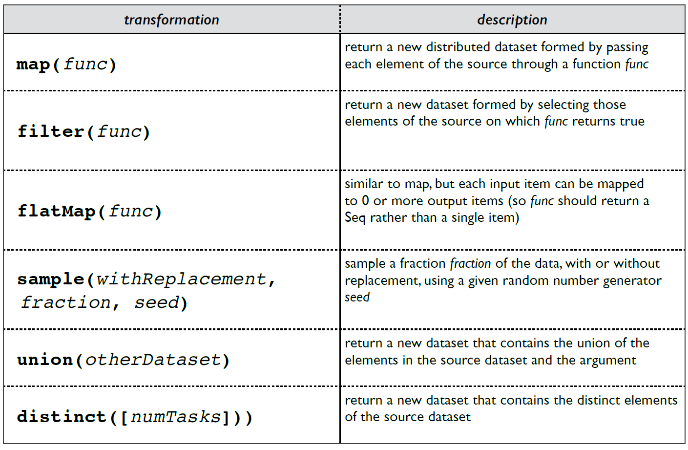
Transformations

Slide 17
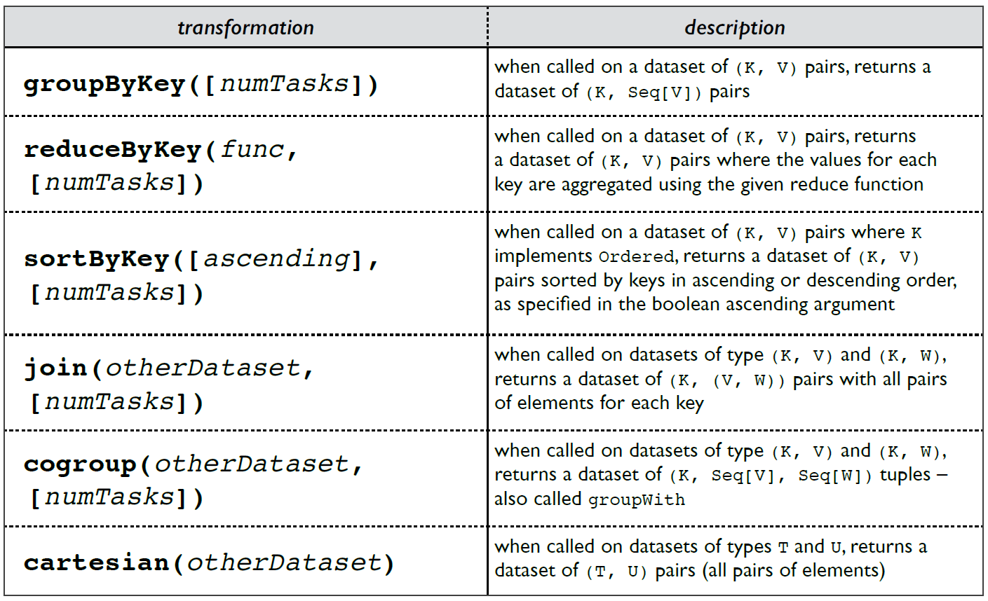
Transformations

Slide 18
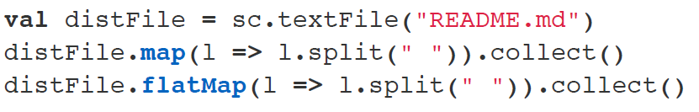
Compare map and flatMap
Pyspark
>>> distFile = sc.textFile (“README.md”)
>>> distFile.map(lambda l: l.split(“ “)).collect()
>>> distFile.flatMap(lambda l: l.split(“ “)).collect()
Scala:

Slide 19
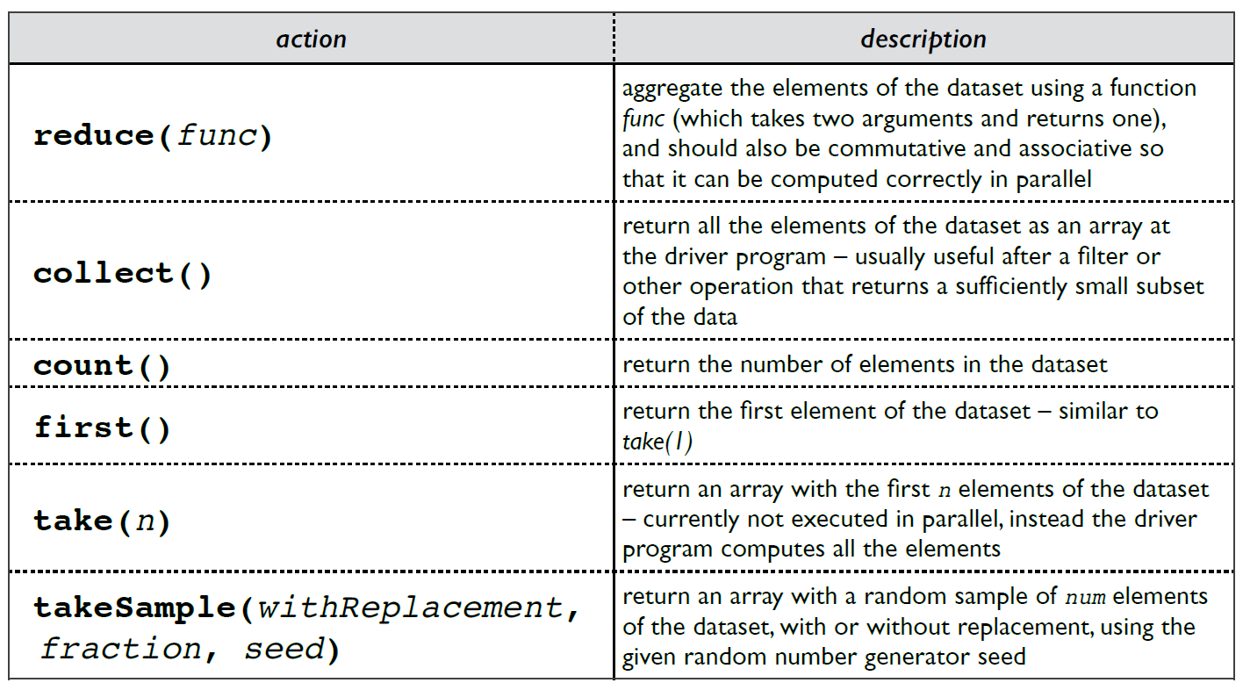
Actions

Slide 20
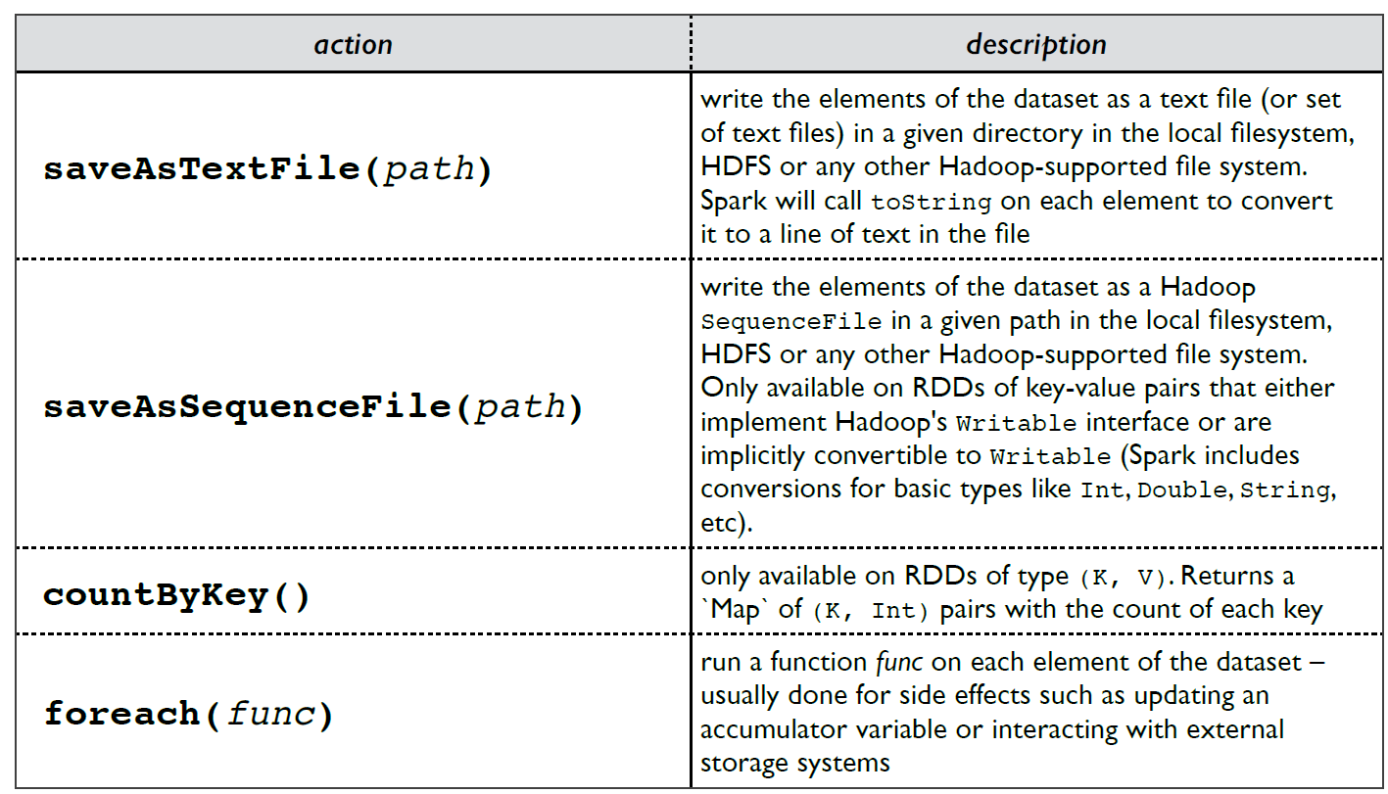
Actions

Slide 21
Partitioning
Workers represent the physical resources
How data are actually partitioned and distributed to workers?
Implicit for normal RDD – based on blocks (64MB by default)
Explicit partitioning
Works for pair RDD only
.partitionBy method
example: normalrdd.partitionBy(new HashPartition(5))
Works more efficiently for key-based operations: maximize the benefits of locality

Slide 22
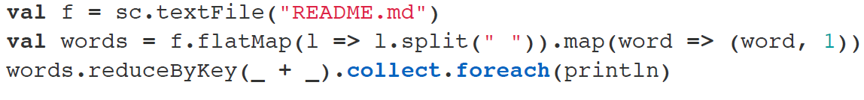
Action Example
Turn RDD to a local collection, then any collection-oriented
functions can be applied, such as .foreach(println)
Pyspark
>>> from operator import add
>>> f = sc.textFile (“README.md”)
>>> words = f.flatMap(lambda l: l.split(“ “)).map(lambda w: (w, 1))
>>> results = words.reduceByKey( add).collect()

Slide 23
Persistance
RDD.persist() or RDD.cache()
Compute the previous transformations, create a “checkpoint”, the result is distributed to the nodes in the cluster
Can be re-used by different processing
persist() can choose the storage type (memory, or memory+disk, etc)
cache() uses memory only

Slide 24
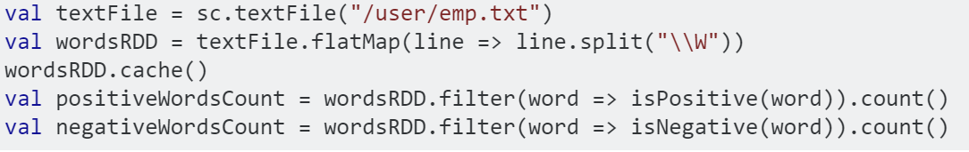
example
Create your own Pyspark version

Slide 25
Shared Variables: Broadcast Variables
Normally, all values are copied, distributed to nodes by the driver. No updates will be propagated back. No concept of “global variables” so far.
Broadcast variables let programmer keep a read-only variable cached on each machine rather than shipping a copy of it with tasks.
Spark also attempts to distribute broadcast variables using efficient broadcast algorithms to reduce communication cost

Slide 26
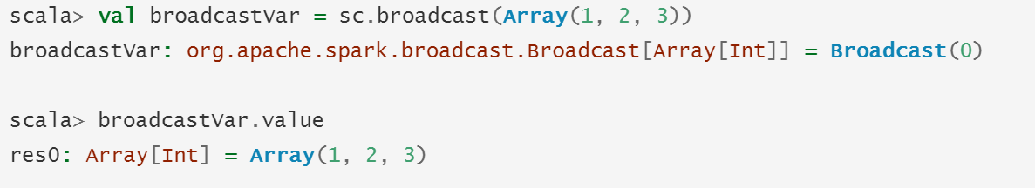
example

Slide 27
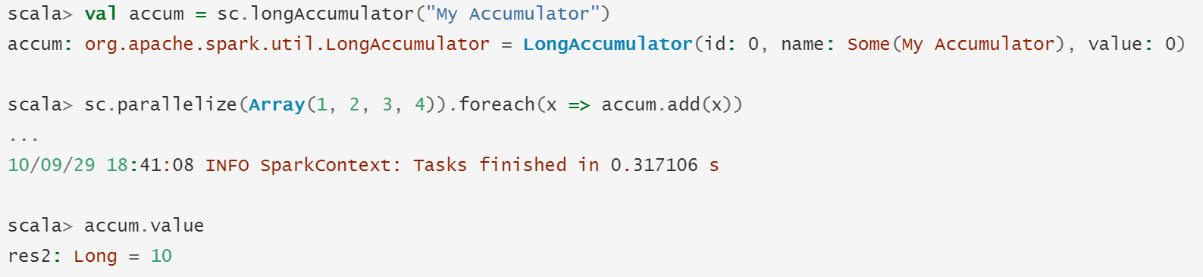
Shared variables: Accumulators
A global counter or sum
Only the driver program can read the result

Slide 28
Complete Example Analysis
For simplicity, we will use python implementations
Examples
KMeans
PageRank
Relational data manipulation
Source code directory: under the spark directory
./examples/src/main/python

Slide 29
Submitting applications
From command line
spark-submit [options] <app jar | python file> [app arguments]
The most important option is “--master”, which has been discussed earlier

Slide 30
Input data
1,1.5,2
1.1,2.1,1.5
…
…

Slide 31
Kmeans
Importing packages
from __future__ import print_function
import sys
import numpy as np
from pyspark.sql import SparkSession

Slide 32
Auxiliary functions
def parseVector(line):
return np.array([float(x) for x in line.split(' ')])
def closestPoint(p, centers):
bestIndex = 0
closest = float("+inf")
for i in range(len(centers)):
tempDist = np.sum((p - centers[i]) ** 2)
if tempDist < closest:
closest = tempDist
bestIndex = i
return bestIndex

Slide 33
Main function
# initialization
if len(sys.argv) != 4:
print("Usage: kmeans <file> <k> <convergeDist>", file=sys.stderr)
exit(-1)
spark = SparkSession\
.builder\
.appName("PythonKMeans")\
.getOrCreate()
K = int(sys.argv[2])
convergeDist = float(sys.argv[3])

Slide 34
#load data
lines = spark.read.text(sys.argv[1]).rdd.map(lambda r: r[0])
data = lines.map(parseVector).cache() # prepare for the loop
# get initial centroids
kPoints = data.takeSample(False, K, 1)
tempDist = 1.0
Getting DataFrame

Slide 35
while tempDist > convergeDist:
closest = data.map(lambda point: (closestPoint(point, kPoints), (point, 1)))
# input: (clusterIndex, (point, 1)); the reduced part is a list of (point, 1)
# output: (clusterIndex, (sum of points, count of points))
pointStats = closest
.reduceByKey(lambda p1, p2: (p1[0] + p2[0], p1[1] + p2[1]))
newPoints = pointStats.map(lambda st: (st[0], st[1][0] / st[1][1])).collect()
tempDist = sum(np.sum((kPoints[iK] - p) ** 2) for (iK, p) in newPoints))
for (iK, p) in newPoints:
kPoints[iK] = p
print("Final centers: " + str(kPoints))
spark.stop()

Slide 36
PageRank
Importing packages
from __future__ import print_function
import re
import sys
from operator import add
from pyspark.sql import SparkSession

Slide 37
Input data
(url1, url2) # url1 ->url2

Slide 38
def computeContribs(urls, rank):
"""Calculates URL contributions to the rank of other URLs."""
num_urls = len(urls)
for url in urls:
yield (url, rank / num_urls)
def parseNeighbors(urls):
"""Parses “URL neighborURL” string into urls pair."""
parts = urls.split(‘,’)
return parts[0], parts[1]
Auxiliary functions

Slide 39
if len(sys.argv) != 3:
print("Usage: pagerank <file> <iterations>", file=sys.stderr)
exit(-1)
spark = SparkSession\
.builder\
.appName("PythonPageRank")\
.getOrCreate()

Slide 40
# Loads in input file. It should be in format of: “URL neighbor URL”
lines = spark.read.text(sys.argv[1]).rdd.map(lambda r: r[0])
# or lines = sc.textFile(sys.argv[1])
# Loads all URLs from input file and initialize their neighbors.
links = lines.map(lambda urls: parseNeighbors(urls)).distinct().groupByKey().cache()
# result: a list of (url (url1, url2,…))
# initialize url ranks to one.
ranks = links.map(lambda url_neighbors: (url_neighbors[0], 1.0))

Slide 41
# main loop
# Calculates and updates URL ranks continuously using PageRank algorithm.
for iteration in range(int(sys.argv[2])):
# Calculates URL contributions to the rank of other URLs.
# links.join gives (link, (neighbors, rank))
contribs = links.join(ranks)
.flatMap(lambda (link, (neighbors, rank)): computeContribs(neighbors, rank))
# Re-calculates URL ranks based on neighbor contributions.
ranks = contribs.reduceByKey(add).mapValues(lambda rank: rank * 0.85 + 0.15)
for (link, rank) in ranks.collect():
print("%s has rank: %s." % (link, rank))
spark.stop()
Apply transformation on the value of each (key, value)

Slide 42
“Spark SQL” for Relational Data
Use the new structure “DataFrame”: a special RDD for relational data with an attached schema
The major benefit: can use SQL SELECT statements to query the data

Slide 43
Packages and initialization
from pyspark.sql import SparkSession
from pyspark.sql.types import Row, StructField, StructType, StringType, IntegerType
spark = SparkSession\
.builder\
.appName("PythonSQL")\
.config("spark.some.config.option", "some-value")\
.getOrCreate()

Slide 44
Creating DataFrame from Rows
# A list of Rows. Infer schema from the first row,
# create a DataFrame and print the schema
rows = [Row(name="John", age=19), \
Row(name="Smith", age=23), Row(name="Sarah", age=18)]
some_df = spark.createDataFrame(rows)
some_df.printSchema()

Slide 45
Create DataFrame from tuples and schema
# A list of tuples
tuples = [("John", 19), ("Smith", 23), ("Sarah", 18)]
# Schema with two fields - person_name and person_age
schema = StructType([StructField("person_name", StringType(), False),
StructField("person_age", IntegerType(), False)])
# Create a DataFrame by applying the schema to the RDD and print the schema
another_df = spark.createDataFrame(tuples, schema)
another_df.printSchema()

Slide 46
Create a DataFrame by loading a JSON file
people = spark.read.json(json_file_path)
or people = spark.read.load(json_file_path, format="json")
people.printSchema()

Slide 47
Manipulate data with SQL SELECT
# Creates a temporary view using the DataFrame.
people.createOrReplaceTempView("people")
# get a table named “people” so that SQL statements can use
# SQL statements can be run by using the sql methods provided by `spark`
teenagers = spark.sql(\
"SELECT name FROM people WHERE age >= 13 AND age <= 19")
for each in teenagers.collect():
print(each[0])

Slide 48
Dataset (new in v1.6)
Manipulate objects: converting objects to relational data
examples
val ds = Seq(1, 2, 3).toDS()
ds.show
+-----+
|value|
+-----+
| 1|
| 2|
| 3|
+-----+
case class Person(name:String, age: Long)
val ds = Seq(Person(“Andy”, 20)).toDS()
ds.show
+-----+ ----+
|name|age|
+-----+
| Andy|20|
+-----+ ----+
Work with JSON:
val path = "/tmp/people.json"
val people = spark.read.json(path).as[Person] // Creates a DataSet

Slide 49
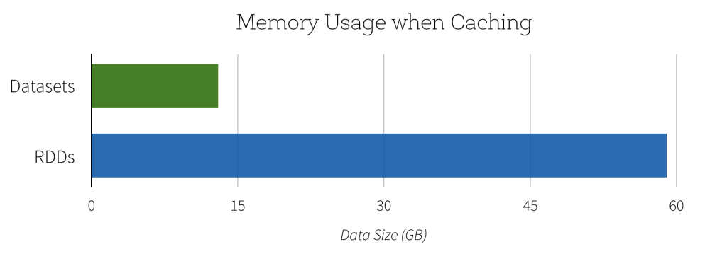
Features
Most RDD transformations and actions are applicable in Datasets
all the power of a full relational execution engine, in the form of functions
E.g., all the aggregate functions used in SQL
You can write SQL in the functional processing form
Reduction in memory use

Slide 50
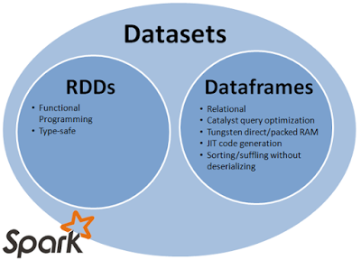
RDD, DataFrame, and Dataset
Evolution
RDD (spark 1.0) -> DataFrame (1.3) -> Dataset (1.6)

Slide 51
RDD
Its building block of spark. Dataframe or Dataset, internally final computation is done on RDDs.
RDD is lazily evaluated immutable parallel collection of objects.
The best part about RDD is its simplicity.
The disadvantage is performance limitations. Being in-memory jvm objects, RDDs involve overhead of Garbage Collection and Java(or little better Kryo) Serialisation which are expensive when data grows.

Slide 52
DataFrame
DataFrame is an abstraction that gives a schema view of data. (a table)
Execution in Dataframe is also lazy triggered .
Offers huge performance improvement over RDDs because of two powerful features
Binary data, in more compact form (known schema), no garbage collection
query plan optimization
Drawback: debugging run-time errors, no static type check

Slide 53
Dataset
extension to Dataframe; best of both RDD and Dataframe.
comes with OOPs style and developer friendly compilation time safety like RDD as well as performance boosting features of Dataframe
Compilation-time type check
an additional feature Encoders .
Encoders act as interface between JVM objects and off-heap custom memory binary format data.
Encoders generate byte code to interact with off-heap data and provide on-demand access to individual attributes without having to de-serialize an entire object.

