Slide 1
Spark SQL
Relational Data Processing in Spark
Junting Lou
lou8@illinios.edu

Slide 2
Earlier Attempts
MapReduce
Powerful, low-level, procedural programming interface.
Onerous and require manual optimization
Pig, Hive, Dremel, Shark
Take advantage of declarative queries to provide richer automatic optimizations.
Relational approach is insufficient for big data applications
ETL to/from semi-/unstructured data sources (e.g. JSON) requires custom code
Advanced analytics(ML and graph processing) are challenging to express in relational system.
Notes:
In practice, most data pipelines would ideally be expressed with a combination of both relational queries and complex procedural algorithms. Relational and procedural—have remained largely disjoint.

Slide 3
Spark SQL(2014)
A new module in Apache Spark that integrates relational processing with Spark’s functional programming API.
Offers much tighter integration between relational and procedural in processing, through a declarative DataFrame API.
Includes a highly extensible optimizer, Catalyst, that makes it easy to add data sources, optimization rules, and data types.

Slide 4
Apache Spark(2010)
General cluster computing system.
One of the most widely-used systems with a “language-integrated” API.
One of the most active open source project for big data processing.
Manipulates(e.g. map, filter, reduce) distributed collections called Resilient Distributed Datasets (RDD).
RDDs are evaluated lazily.
Notes:
Resilient Distributed Datasets (RDD) is a fundamental data structure of Spark. It is an immutable distributed collection of objects. Each dataset in RDD is divided into logical partitions, which may be computed on different nodes of the cluster.

Slide 5
Scala RDD Example: Counts lines starting with “ERROR” in an HDFS file
lines = spark.textFile("hdfs://...")
errors = lines.filter(s => s.contains("ERROR"))
println(errors.count())
Each RDD(lines, errors) represents a “logical plan” to compute a dataset, but Spark waits until certain output operations, count, to launch a computation.
Spark will pipeline reading lines, applying filter and computer counts.
No intermediate materialization needed.
Useful but limited.
Notes:
because the engine does not understand the structure of the data in RDDs

Slide 6
Shark
First effort to build a relational interface on Spark.
Modified the Apache Hive system with traditional RDBMS optimizations,
Shows good performance and opportunities for integration with Spark programs.
Challenges
Only query external data stored in the Hive catalog, and was thus not useful for relational queries on data inside a Spark program(e.g. RDD errors).
Inconvenient and error-prone to work with.
Hive optimizer was tailored for MapReduce and difficult to extend.
Notes:
Hive: data warehouse built on top of Apache Hadoop, providing data summarization, query, and analysis with SQL-like interface to query data stored in various databases and file systems that integrate with Hadoop.

Slide 7
Goals for Spark SQL
Support relational processing both within Spark programs and external data sources using a programmer-friendly API.
Provide high performance using established DBMS techniques.
Easily support new data sources, including semi-structured data and external databases amenable to query federation.
Enable extension with advanced analytics algorithms such as graph processing and machine learning.

Slide 8
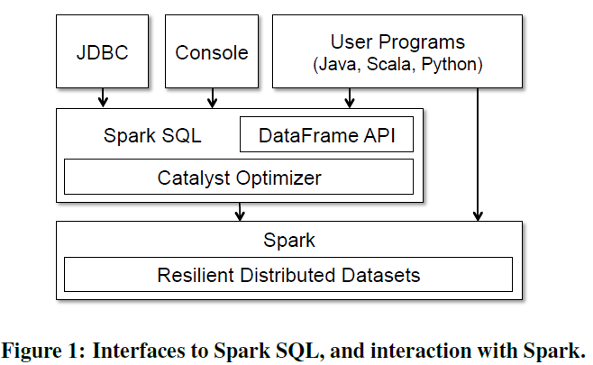
Programming Interface

Slide 9
DataFrame API:
ctx = new HiveContext()
users = ctx.table("users")
young = users.where(users("age") < 21)
println(young.count())
Equivalent to a table in relational database
Can be manipulated in similar ways to the “native” RDD.
Notes:
A DataFrame is equivalent to a table in a relational database,
and can also be
manipulated in similar ways to the “native” distributed collections in Spark (RDDs).

Slide 10
Data Model
Uses a nested data model based on Hive for tables and DataFrames
Supports all major SQL data types
Supports user-defined types
Able to model data from a variety sources and formats(e.g. Hive, RDB, JSON, and native objects in Java/Dcala/Python)

Slide 11
DataFrame Operations
Employees users.where(users("age") < 21)
.join(dept , employees("deptId") === dept("id")) .registerTempTable("young")
.where(employees("gender") === "female") ctx.sql("SELECT count(*), avg(age)
.groupBy(dept("id"), dept("name")) FROM young")
.agg(count("name"))
All of these operators build up an abstract syntax tree (AST) of the expression, which is then passed to Catalyst for optimization.
The DataFrames registered in the catalog can still be unmaterialized views, so that optimizations can happen across SQL and the original DataFrame expressions.
Integration in a full programming language( DataFrames can be passed Inter-language but still benefit from optimization across the whole plan).
Notes:
support all common relational operators, including projection (select), filter (where), join, and aggregations (groupBy).

Slide 12
Querying Native Datasets
Allows users to construct DataFrames directly against RDDs of objects native to the programming language.
Automatically infer the schema and types of the objects.
Accesses the native objects in-place, extracting only the fields used in each query (avoid expensive conversions).
case class User(name: String , age: Int)
// Create an RDD of User objects
usersRDD = spark.parallelize(List(User("Alice", 22), User("Bob", 19)))
// View the RDD as a DataFrame
usersDF = usersRDD.toDF
Notes:
traditional object-relational mapping often incur expensive conversion that translates an entire object into a different format

Slide 13
In-Memory Caching Columnar cache can reduce memory footprint by an order of magnitude User-Defined Functions supports inline definition of UDFs (avoid complicated packaging and registration process)

Slide 14
Catalyst Optimizer
Based on functional programming constructs in Scala.
Easy to add new optimization techniques and features,
Especially to tackle various problems when dealing with “big data”(e.g. semi- structured data and advanced analytics)
Enable external developers to extend the optimizer.
Data source specific rules that can push filtering or aggregation into external storage systems
Support for new data type
Supports rule-based and cost-based optimization
First production-quality query optimizer built on such a language (Scala).

Slide 15
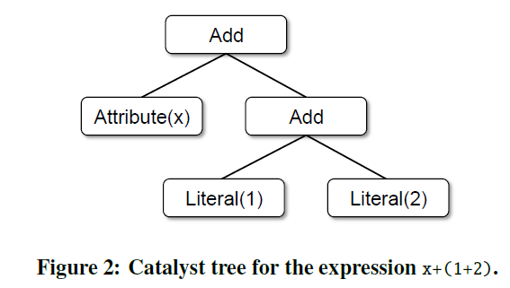
Trees Scala Code :Add(Attribute(x), Add(Literal(1), Literal(2)))
Notes:
Each node has a node type and zero or more children

Slide 16
Rules
Trees can be manipulated using rules, which are functions from a tree to another tree.
Use a set of pattern matching functions that find and replace subtrees with a specific structure.
tree.transform{
case Add(Literal(c1), Literal(c2)) => Literal(c1+c2)
}
tree.transform {
case Add(Literal(c1), Literal(c2)) => Literal(c1+c2)
case Add(left , Literal(0)) => left
case Add(Literal(0), right) => right
}
Catalyst groups rules into batches, and executes each batch until it reaches a fixed point.

Slide 17
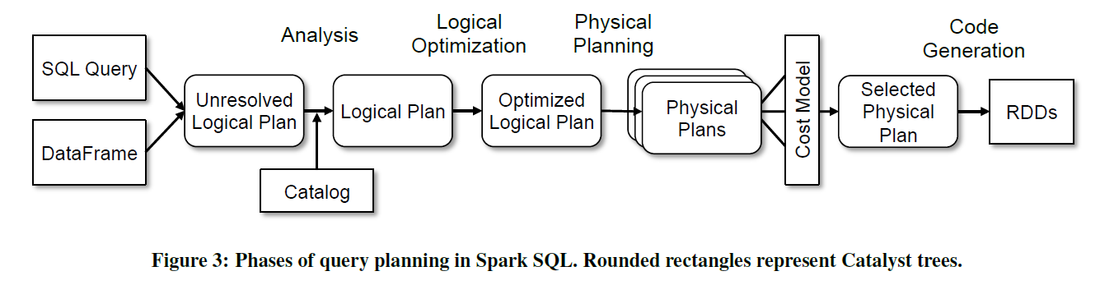
Using Catalyst
Notes:
(1) analyzing a logical plan to resolve references
(2) logical plan optimization
(3) physical planning
(4) code generation to compile parts of the query to Java bytecode.
In the physical planning phase, Catalyst may generate multiple plans and compare them based on cost. All other phases are purely rule-based.

Slide 18
Analysis SELECT col FROM sales
Takes input from SQL parser or DataFrame object
Unresolved : have not matched it to input table or do not know type
Catalog object tracks the tables in all data sources
Around 1000 lines of rules
Notes:
Named attribute col
Unique ID allows optimization of expressions, such as col = col

Slide 19
Logical Optimization
Applies standard rule-based optimizations to the logical plan
Constant folding
Predicate pushdown
Projection pruning
Null propagation
Boolean expression simplification
…
Extremely easy to add rules for specific situation
Around 800 lines of rules
Notes:
Filtering and Projection ahead of join

Slide 20
Physical Planning
Take a Logical Plan and generates one or more physical plans.
Cost-based
selects a plan using a cost model.(currently only used to select join algorithm)
Rule-based:
Pipelining projections or filter into one Spark map operation
Push operations from the logical plan into data sources that support predicate or projection pushdown.
Around 500 lines of rules.

Slide 21
Code Generation
Generates Java bytecode to run on each machine.
Relies on quasiquotes of Scala to wrap codes into trees
Transform a tree representing an expression in SQL to an AST for Scala to evaluate that expression.
Compile(optimized by Scala again) and run the generated code.
Around 700 lines of rules
def compile(node: Node): AST = node match {
case Literal(value) => q"$value"
case Attribute(name) => q"row.get($name)"
case Add(left , right) => q"${compile(left)} + ${compile(right)}"
}
Notes:
parsed by the Scala compiler at compile time and represent ASTs for the code within

Slide 22
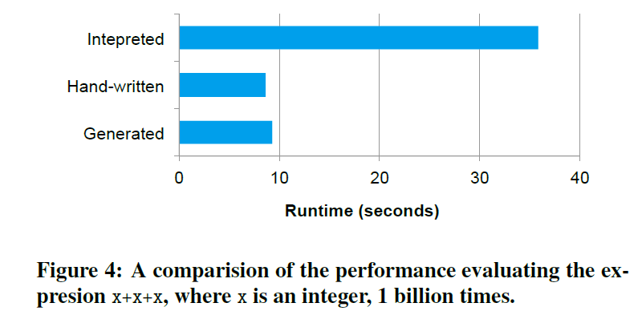
Performance by using quasiquotes

Slide 23
Extension Points
Catalyst’s design around composable rules makes it easy to extend.
Data Source
CSV, Avro, Parquet, etc.
User-Defined Types (UDTs)
Mapping user-defined types to structures composed of Catalyst’s built-in types.

Slide 24
Advanced Analytics Features Specifically designed to handle “big data”
A schema inference algorithm for JSON and other semi-structured data.
A new high-level API for Spark’s machine learning library.
Supports query federation, allowing a single program to efficiently query disparate sources.
Notes:
features all build on the Catalyst framework

Slide 25
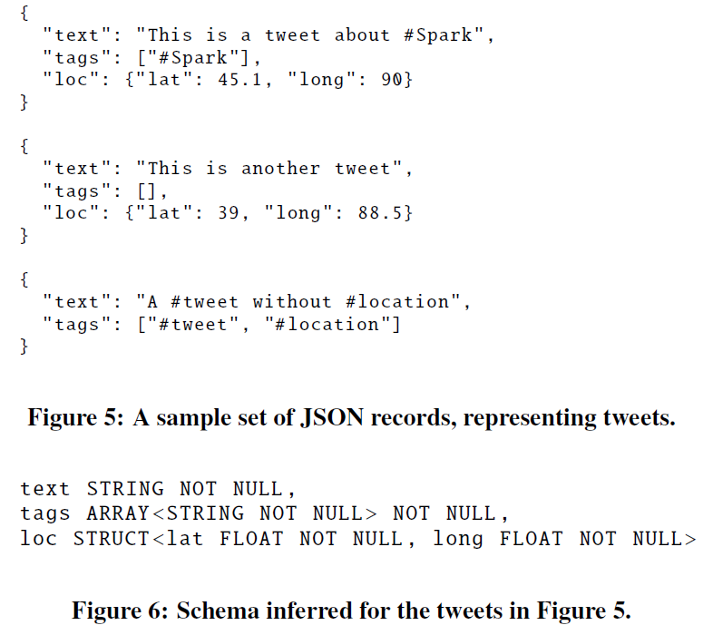
Notes:
One pass Schema Inference Algorithm
“most specific supertype"

Slide 26
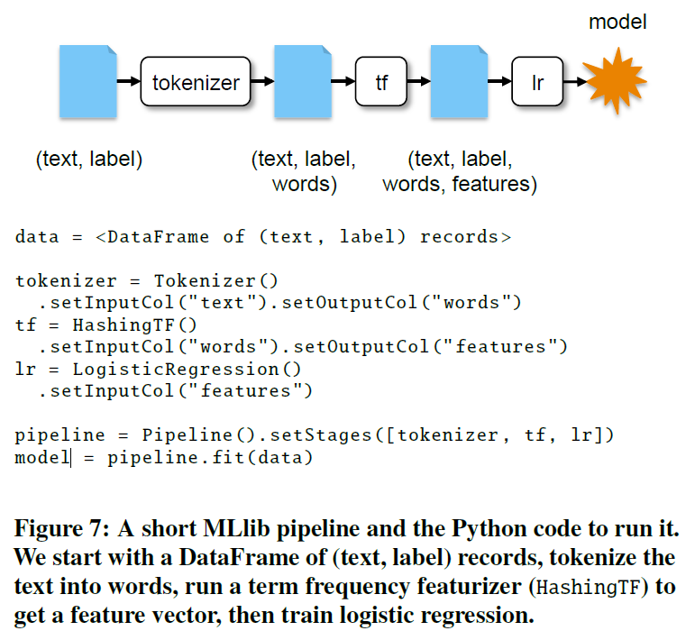
Integration with Spark’s Machine Learning Library
Notes:
DataFrame ApI make exchange data between pipeline stages much easier
Support different language

Slide 27
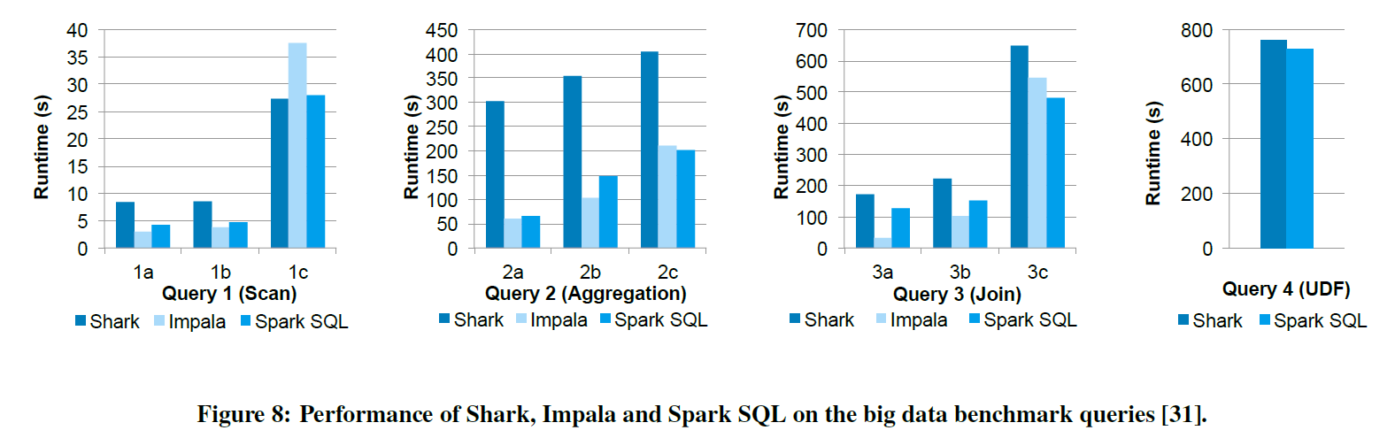
SQL Performance
Notes:
Most selective to least selective.
Impala choose a smarter join plan

Slide 28
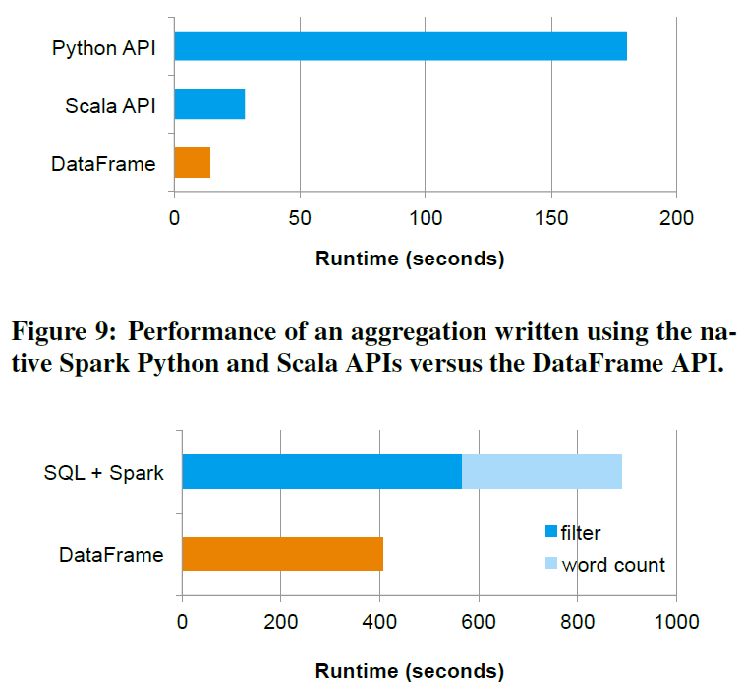
Notes:
logical plan is constructed in Python, and all physical execution is compiled down into native Spark code as JVM bytecode
the code in the DataFrame version avoids expensive allocation of key-value pairs that occurs in hand-written Scala code.
avoids the cost of saving the whole result of the SQL query to an HDFS

Slide 29
Conclusion
Extends Spark with a declarative DataFrame API to allow relational processing, offering benefits such as automatic optimization, and letting users write complex pipelines that mix relational and complex analytics.
Supports a wide range of features tailored to large-scale data analysis, including semi-structured data, query federation, and data types for machine learning.

