Slide 1
Bank Marketing Case Study
Based on an example from UC Irvine’s Machine Learning Repository
Megan Petralia

Slide 2
Description
Goal:
To predict if the client will subscribe a term deposit by using the direct marketing campaign data of a Portuguese banking institution provided to create a model that will help the banking institution determine what clients will be receptive to such marketing campaigns.

Slide 3
Dataset
“The data is related with direct marketing campaigns of a Portuguese banking institution. The marketing campaigns were based on phone calls. Often, more than one contact to the same client was required, in order to access if the product (bank term deposit) would be ('yes') or not ('no') subscribed.”
This dataset can be accessed on UC Irvine’s Machine Learning Repository

Slide 4
Datasets:
bank-additional-full.csv
41,188 records, 20 inputs/columns
Data from May 2008 to November 2010
bank-additional.csv
4,119 records, 20 inputs/columns
A random 10% subset of bank-additional-full.csv
Notes:
When creating a model , the bank-additional dataset will act as a training dataset and the bank-additional-full dataset with be the test dataset

Slide 5
Input variables: # bank client data: 1 - age (numeric) 2 - job : type of job (categorical: 'admin.','blue-collar','entrepreneur','housemaid','management','retired','self-employed','services','student','technician','unemployed','unknown') 3 - marital : marital status (categorical: 'divorced','married','single','unknown'; note: 'divorced' means divorced or widowed) 4 - education (categorical: 'basic.4y','basic.6y','basic.9y','high.school','illiterate','professional.course','university.degree','unknown') 5 - default: has credit in default? (categorical: 'no','yes','unknown') 6 - housing: has housing loan? (categorical: 'no','yes','unknown') 7 - loan: has personal loan? (categorical: 'no','yes','unknown') # related with the last contact of the current campaign: 8 - contact: contact communication type (categorical: 'cellular','telephone') 9 - month: last contact month of year (categorical: 'jan', 'feb', 'mar', ..., 'nov', 'dec') 10 - day_of_week: last contact day of the week (categorical: 'mon','tue','wed','thu','fri') 11 - duration: last contact duration, in seconds (numeric). Important note: this attribute highly affects the output target (e.g., if duration=0 then y='no'). Yet, the duration is not known before a call is performed. Also, after the end of the call y is obviously known. Thus, this input should only be included for benchmark purposes and should be discarded if the intention is to have a realistic predictive model. # other attributes: 12 - campaign: number of contacts performed during this campaign and for this client (numeric, includes last contact) 13 - pdays: number of days that passed by after the client was last contacted from a previous campaign (numeric; 999 means client was not previously contacted) 14 - previous: number of contacts performed before this campaign and for this client (numeric) 15 - poutcome: outcome of the previous marketing campaign (categorical: 'failure','nonexistent','success') # social and economic context attributes 16 - emp.var.rate: employment variation rate - quarterly indicator (numeric) 17 - cons.price.idx: consumer price index - monthly indicator (numeric) 18 - cons.conf.idx: consumer confidence index - monthly indicator (numeric) 19 - euribor3m: euribor 3 month rate - daily indicator (numeric) 20 - nr.employed: number of employees - quarterly indicator (numeric) Output variable (desired target): 21 - y - has the client subscribed a term deposit? (binary: 'yes','no')

Slide 6
Creating the model: Binomial GLM
Since the desired output is binomial, having two options (yes or no), the binomial general linear model (glm) is used.
Significance of each variable detailed on next slide

Slide 7
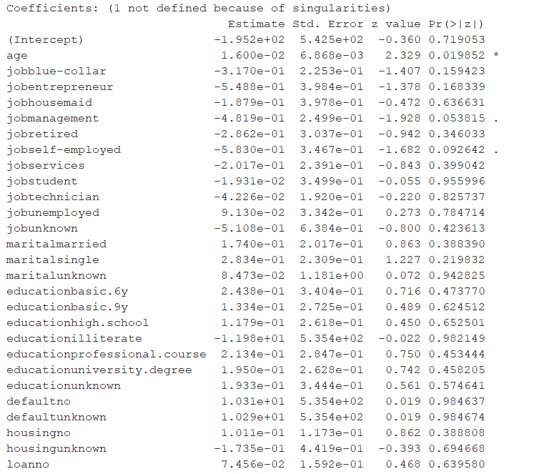
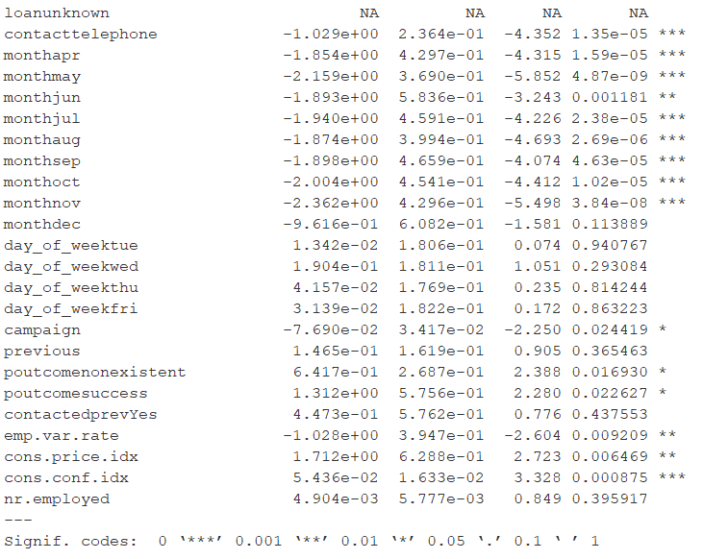
Notes:
-Tue-Friday are more significant days of the week than Monday.
Contact telephone is significant
Job in management or self-employed are somewhat significant
Top 5 significant variables are month, contact, consumer confidence index, consumer price index
-Note on warning: Some of the variables are not defined because of singularity means that the variables are not linearly independent. If you remove the variable giving NA, you will obtain the same result for the rest of the variables. This is because the information given by those variables is already contained in the other variables and thus redundant.

Slide 8
Top Significant Variables
cons.conf.idx: consumer confidence index - monthly indicator (numeric)
month: last contact month of year (categorical: 'jan', 'feb', 'mar', ..., 'nov', 'dec’)
contact: contact communication type (categorical: 'cellular','telephone’)
cons.price.idx: consumer price index - monthly indicator (numeric)
emp.var.rate: employment variation rate - quarterly indicator (numeric)
Notes:
Top 5 significant variables are month, contact, consumer confidence index, consumer price index

Slide 9

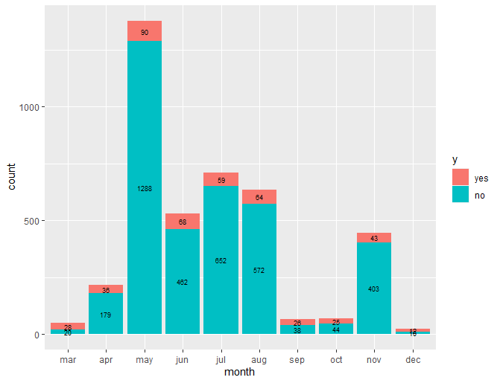
Month
Significant Variables
Observations:
Summer months have more volume.
November has a higher volume than it’s surrounding months
The proportion of No’s to Yes’s is high in the months with larger volume.

Slide 10

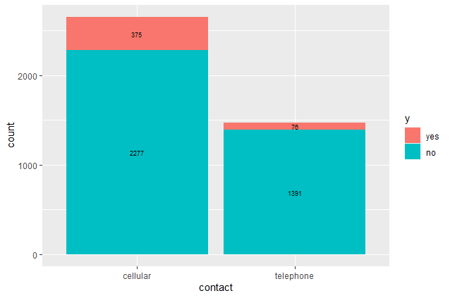
Contact
Significant Variables
Observations:
The proportion of yes to no is better for cellular than for telephone. Approximately 16% yes for cellular and 5% yes for telephone
Those who are contacted on a cellular number may be more likely to subscribe

Slide 11

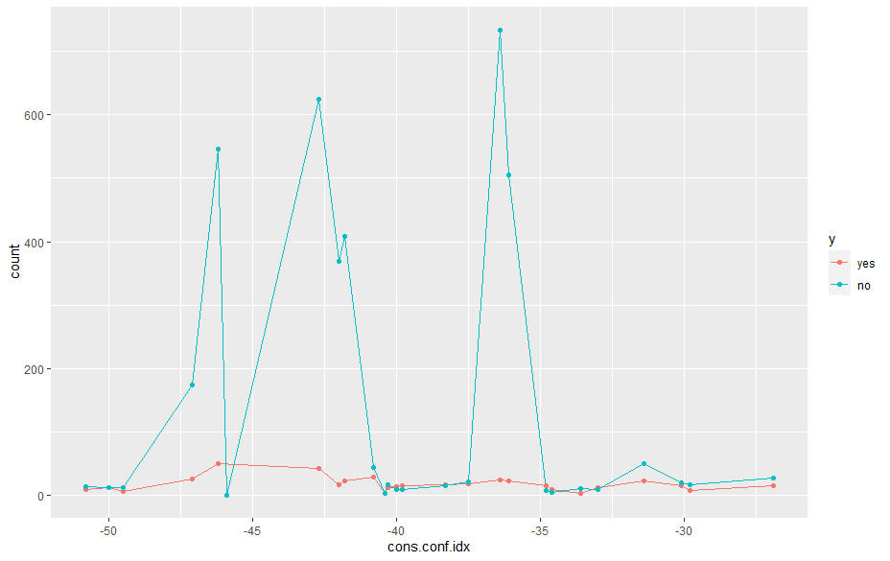
Consumer Confidence Index
Significant Variables
Observations:
Looking at the distribution of ‘yes’, there are more yes’s when the consumer confidence index is lower
Client may be more likely to subscribe when consumer confidence index is lower
Notes:
Lots of variability in volume

Slide 12

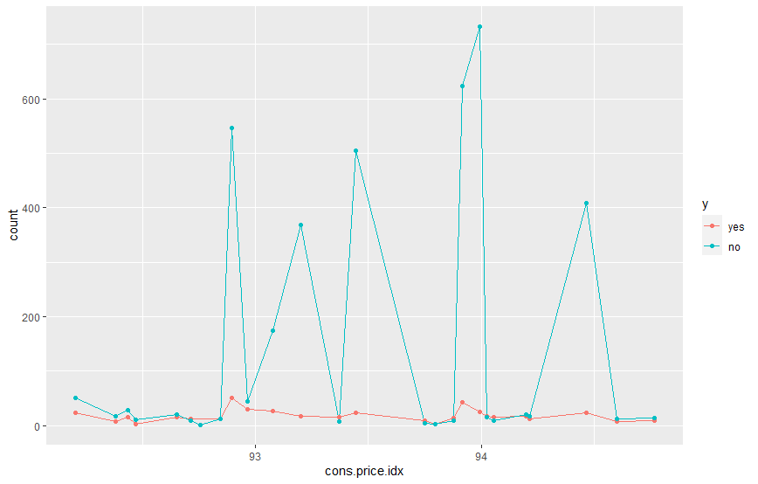
Consumer Price Index
Significant Variables
Observations:
Just below 93 and 94 has spikes in ‘Yes’ . When the consumer price index is around 93/94 , the client may be more likely to subscribe
Lots of variability in volume
Notes:
Lots of variability in volume

Slide 13

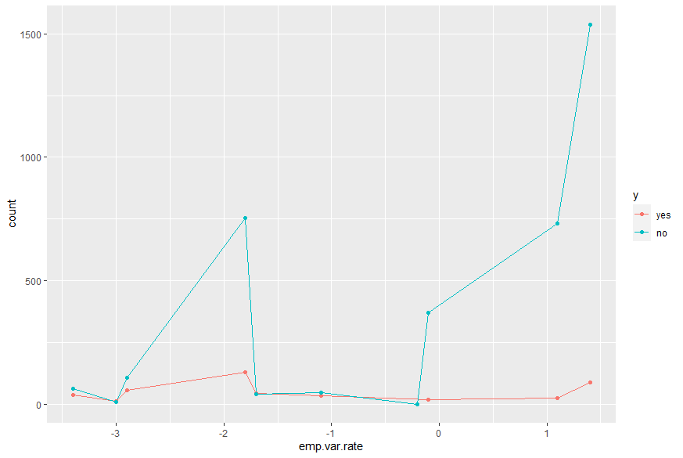
Employment Variation Rate
Significant Variables
Observations:
Overall, when the employment variability rate is lower, there are more subscriptions

Slide 14
Creating the optimal model: Binomial GLM
Below is the model created to predict whether a client will subscribe to a term deposit.
Only the significant variables are used.
This model is trained on the bank-additional dataset
When tested on the bank-additional_full dataset, the predictions are ~87% accurate

Slide 15

In Conclusion…
Using month, contact method, consumer confidence index, consumer price index, and employment variability rate, we can produce a model that predicts whether a client will subscribe to a bank term deposit with ~87% accuracy
87%

