Slide 1
ALPHABET AND NUMBERS

Slide 2

THE ENGLISH ALPHABET

Slide 3

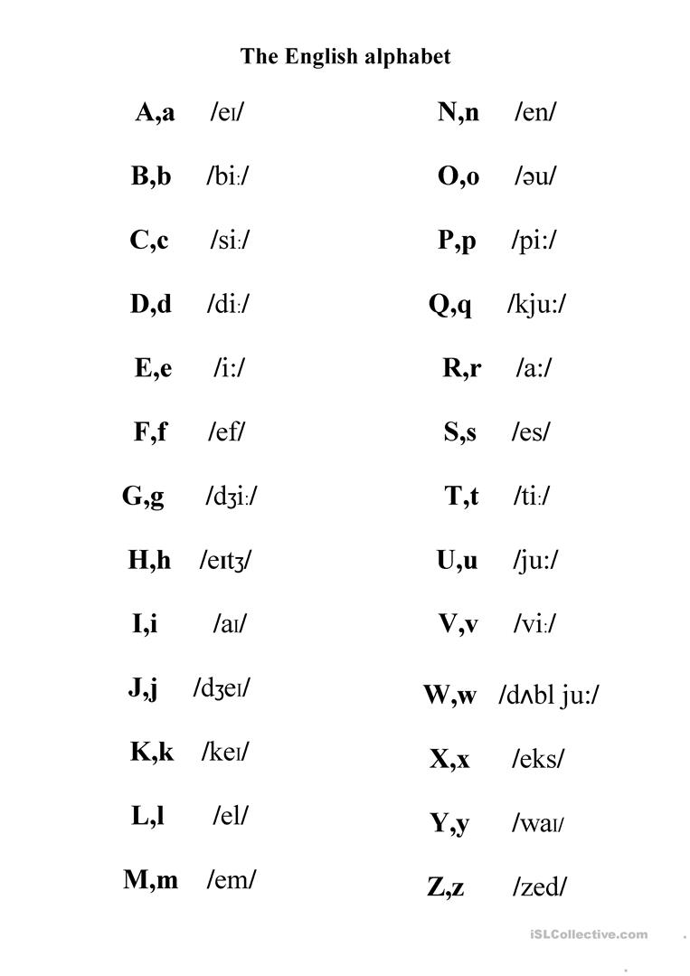

Slide 4
Spelling
https://wordwall.net/resource/12237152/spelling

Slide 5
How many sounds/phonemes are there in English?
https://www.youtube.com/watch?v=wBuA589kfMg
https://www.dyslexia-reading-well.com/44-phonemes-in-english.html
http://cambridgeenglishonline.com/interactive_phonemic_chart/

Slide 6
NUMBERS

Slide 7
1 – one
2 – two
3 – three
4 – four
5 – five
6 – six
7 – seven
8 – eight
9 – nine
10 – ten
11 – eleven
12 – twelve
13 – thirteen
14 – fourteen
15 – fifteen
16 – sixteen
17 – seventeen
18 – eighteen
19 – nineteen
20 – twenty
21 – twenty-one
22 – twenty-two
23 – twenty-three
24 – twenty-four
25 – twenty-five
26 – twenty-six
27 – twenty-seven
28 – twenty-eight
29 – twenty-nine
30 – thirty
40 – forty
50 – fifty
60 – sixty
70 – seventy
80 – eighty
90 – ninety
100 – one hundred
1000 – one thousand
1000000 – one million

Slide 8
LET’S PLAY!
1-20
21-40
41-60
61-80
81-100
B | I | N | G | O
https://wheelofnames.com/es/
Paste numbers from excel

Slide 9
EXTRA MATERIAL
https://www.youtube.com/watch?v=BLhBas7CiYQ
https://www.youtube.com/watch?v=EgzHCuzVKb8&t=354s
https://es.liveworksheets.com/worksheets/en/English_as_a_Second_Language_(ESL)/The_alphabet/The_Alphabet_yh250391ut
https://www.educaplay.com/learning-resources/3463508-listening_to_phone_numbers.html

Slide 10


