Slide 1
Telco Customer Churn
ISA340 MACHINE LEARNING FINAL
Janaye Ferrante
3 May 2024

Slide 2
AGENDA
Introduction
Exploratory Data Analysis
Model Learning
Model Fitting
Model Evaluation
Key Takeaways
Next Steps

Slide 3
Introduction

Slide 4
CUSTOMER CHURN+ OBJECTIVE
Customer churn is when users stop using your service or product within the last month.
Important for resource allocation, targeting a specific market and business planning
The objective is to study customer data and see the features contributing the most to churn.

Slide 5
DATASET DESCRIPTION
7043 customer entries (21 features)
Dropped customerID (20 features)
Target variable: churn
No nulls
Some features include:
Personal info: gender, partner, etc.
Account info: tenure, payment + charges, etc.
Add on Services
Source: IBM; also found on Kaggle

Slide 6
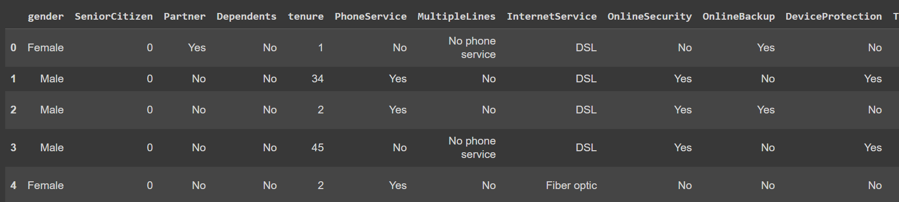

Slide 7
Exploratory Data Analysis

Slide 8
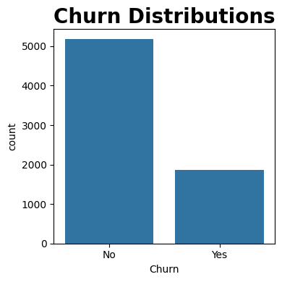
CHURN (TARGET VARIABLE)
Data has an uneven distribution with more people not churning than churning.
Churn Count
Using .value_counts()
No: 5174
Yes: 1869

Slide 9
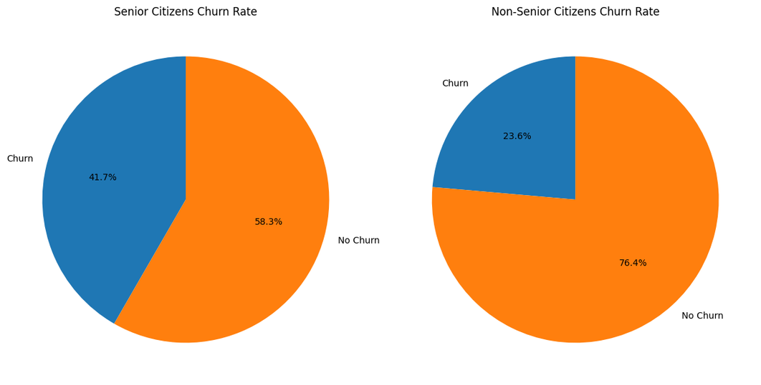
SENIOR CITIZENS (Q1)
Are Senior Citizens more likely to churn than Non Senior Citizens?
Non-senior citizens churn > senior citizens
A higher proportion of senior citizens churn > non-senior citizens

Slide 10
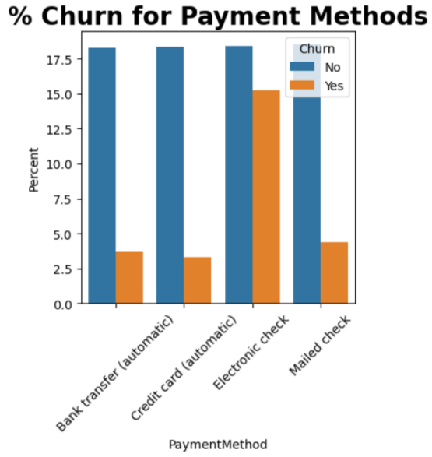
PAYMENT METHODS (Q2)
Do people paying electrically have a higher chance of churning than those who pay by paper?
People who have electric checks churn more.

Slide 11
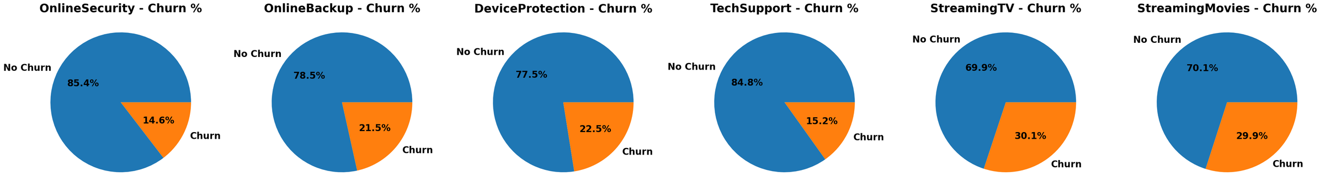
ADD ON SERVICES (Q3)
How do add on services affect churn rate?
Online Security + Tech Support Churn the least
Streaming TV and Movie Services churn the most

Slide 12
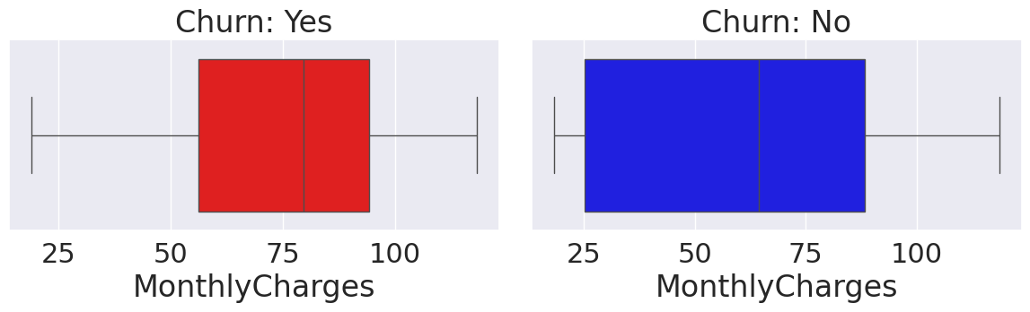
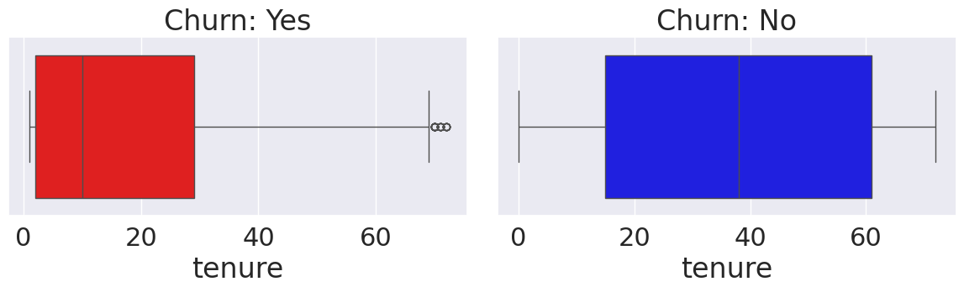
MONTHLY CHARGES + TENURE (Q4)
Customers are most likely to churn when the price increases to over 50.
Customers are more likely to churn within the earlier years of tenure, with the probability decreasing as years increase.

Slide 13
Model Fitting + Evaluation

Slide 14
INITITAL STEPS
Converting Yes or No to 1 or 0
Separate numeric and categorical variables
Our numeric variables are: SeniorCitizen, Partner, Dependents, tenure, PhoneService, PaperlessBilling, MonthlyCharges, Churn
Two data frames
“X” has numeric values besides churn
“y” has churn value
Testing and Splitting Data
Test size = 0.2
Random state = 0

Slide 15
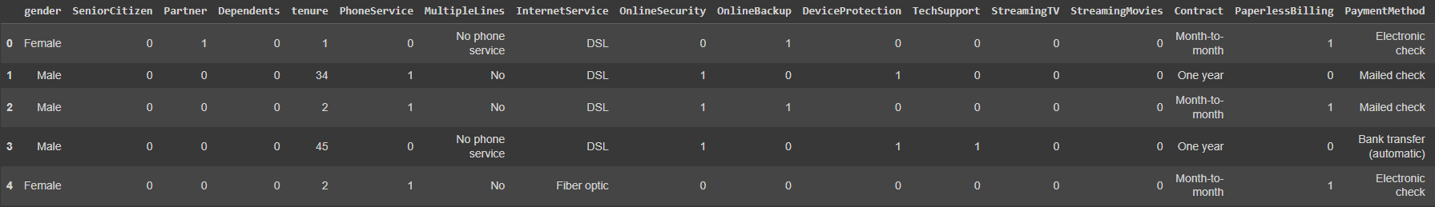

Slide 16
MODELS USED
Logistic Regression
Decision Tree
Random Forest

Slide 17
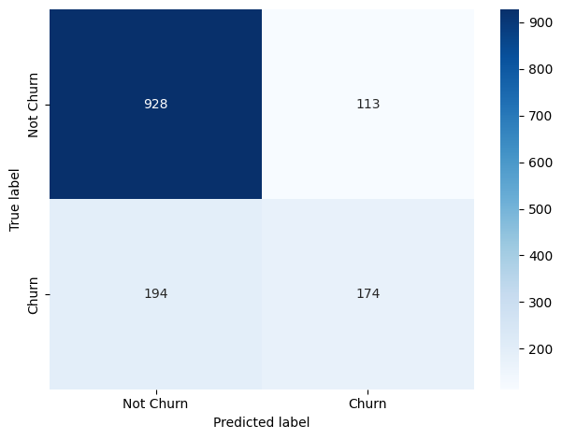
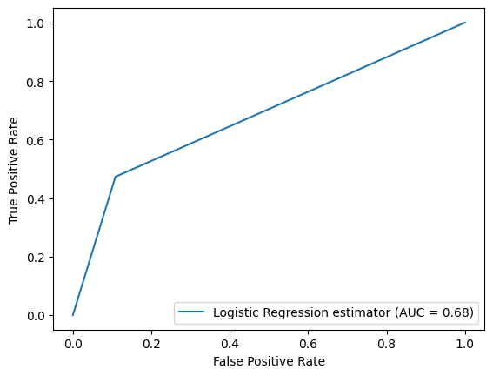
LOGISTIC REGRESSION
ACCURACY: 78.2%
Highest AUC indicating
better model performance

Slide 18
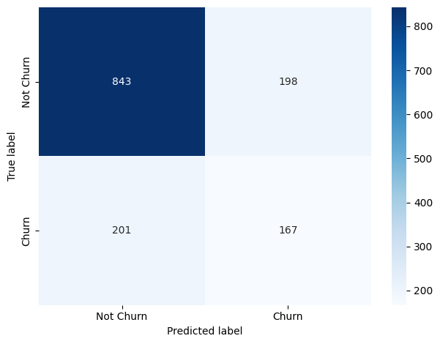
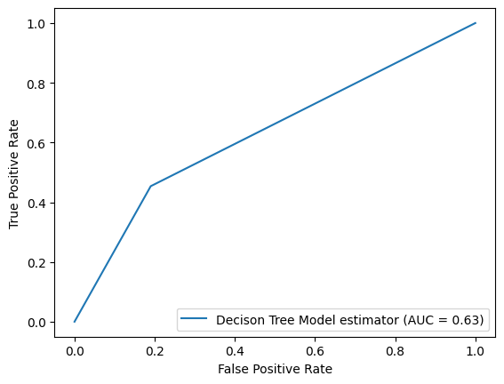
DECISION TREE
ACCURACY: 71.9%

Slide 19
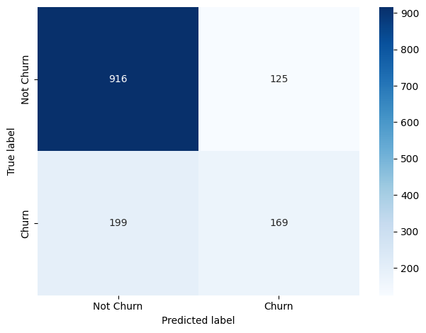
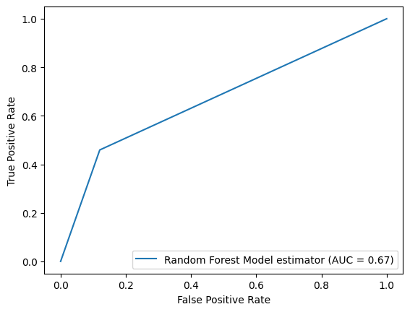
RANDOM FOREST
ACCURACY: 77.0%

Slide 20
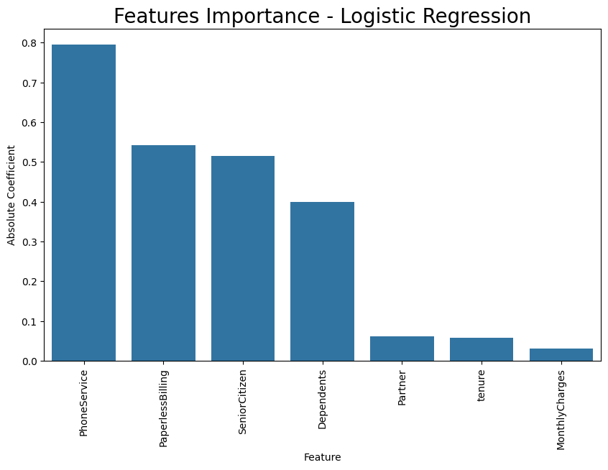
FEATURE IMPORTANCE
Using our best model based on accuracy, logistic regression, we can say the most important features are
Phone Service
Paperless Billing
Senior Citizen
Dependants
Partner
Tenure
Monthly Charges

Slide 21
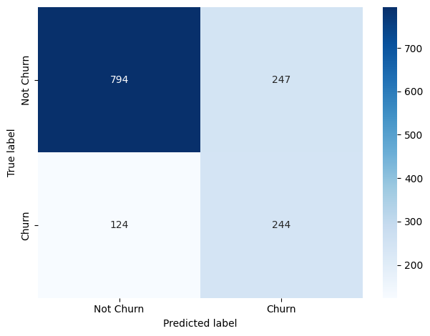
SMOTE ANALYSIS- LOGISTIC REGRESSION
Accuracy: 74.0%
This means accuracy decreased and there was more false positives and true negatives then we thought with normal logistic regression

Slide 22
Key Takeaways
+ NEXT STEPS

Slide 23
KEY TAKEAWAYS + NEXT STEPS
Logistic Regression was the model with the highest accuracy
Data is oversampled/ has uneven distribution between churn and no churn
Use some other oversampling techniques
Support Vector Machines + Neural Networks
Try to not convert all columns to numeric values
Do more EDA with dependents + Partners
Look into different stats

