Slide 1
Spotify Data Analysis
Janaye Ferrante
Fall 2023

Slide 2
Table of Contents
Objective
Data Extraction
Data Cleaning
Challenges & Opportunities
Solutions
Data Analysis
Lessons Learned
Sources

Slide 3

Objective
To analyze the trend of music on Spotify from the last few decades (1970s to 2020s) using Databricks and its PySpark packages.
We want to answer the following:
What are the most popular songs per decade and ever?
How has music changed since 1970s
Are explicit songs danceable?
What is the correlation between acoustics and popularity?
How has duration changed?

Slide 4
Data Extraction (Spotify Developer Web API)
Search by “year” to get track_id
The track_id gets audio features such as acoustics, danceability, duration_ms, energy, id, instrumentals, key, liveness, loudness, mode, speechiness, tempo, time_signature, and valence,
Search
Audio Features
Notes:
Spotify Developer has a Web API reference with a bunch of different categories. Specifically, we focused on a two categories: search, and tracks audio features. We extracted this data.

Slide 5
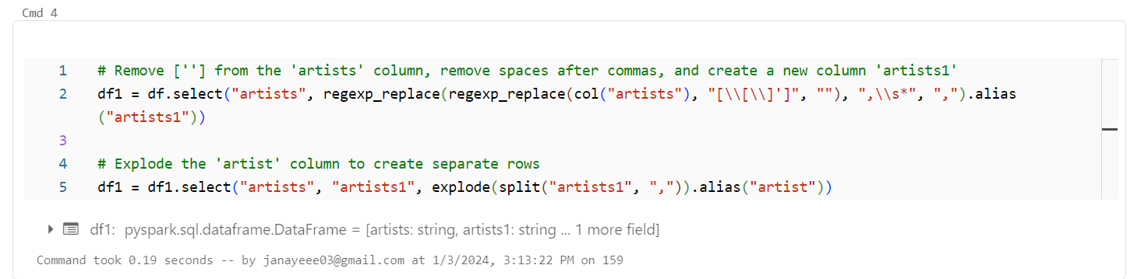
Data Cleaning
Joining the data frames using “track_id”
Deleting duplicate columns
Split and explode “artist” column
Total data set is 670,850 rows & 18 columns
Example of data cleaning: split and explode columns

Slide 6
Challenges/ Opportunities
To search for a term (i.e. year), we need a client_id and client_secret to get the API_token that grants us access to Spotify’s data collection.
API token expires every hour and would fail out for being over the hour mark. For this, we used a response.status_code.
There was a limit error (429 error) arising, so we would either look for other ways to extract data or use another data source.

Slide 7

Solutions
Due to the 429 error and limitations, we were able to find an existing dataset with over 500,000 records and we expanded our research upon that.
This is where with our data cleaning we get over 600,000 records. The dataset used comes from Kaggle. This means we analyze five decades and how music changed since the 1970s.
Which brings us to…

Slide 8
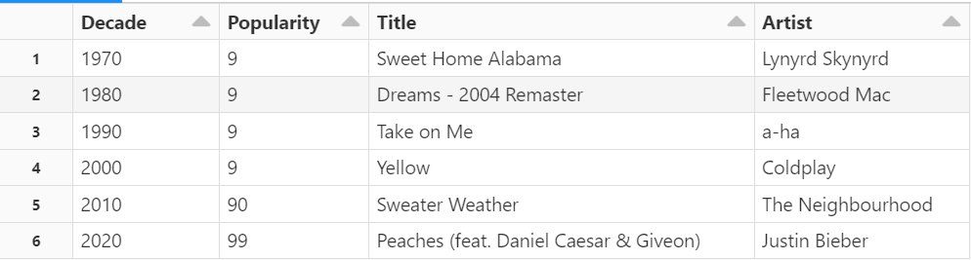
Some Data Analysis
Most popular song per decade (1970s to 2020)

Slide 9
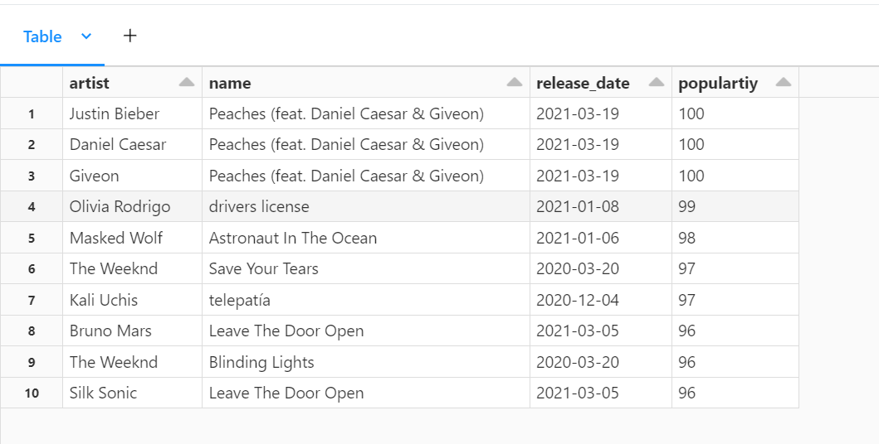
Continued
Most popular songs ever
We see Peaches as the top song with the three contributing artists.
We also see that songs that came out recently are some of the most popular making us wonder if listening to music is more popular now than before.

Slide 10
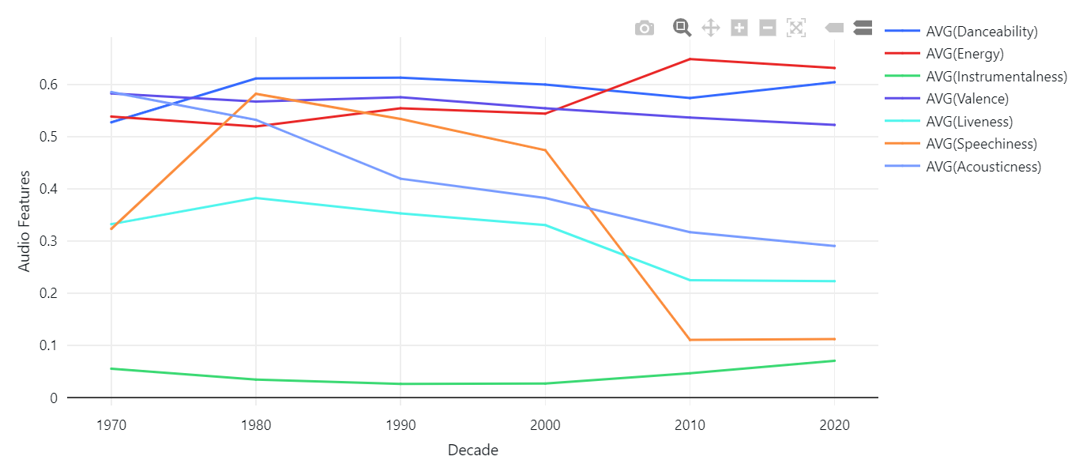
Continued
How has music changed over the decades?
Using the average values for audio categories.
Some Noticeable Characteristics:
______________
Speech and acoustics decreased
Energy increased

Slide 11
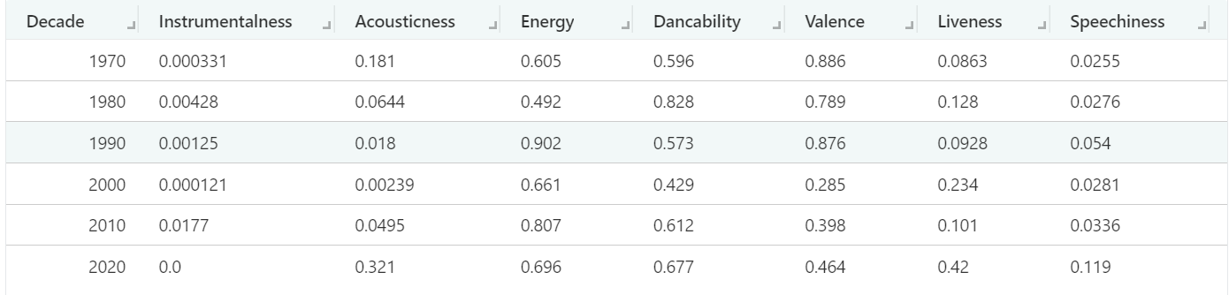
Continued
How has music changed over the decades based on popularity?
Popularity is ranked on a 1 – 100 scale, these are the average scores based on high popularity.
We see an increase in almost everything except valence. Danceability and energy have remained relatively the same since the 1970s.

Slide 12
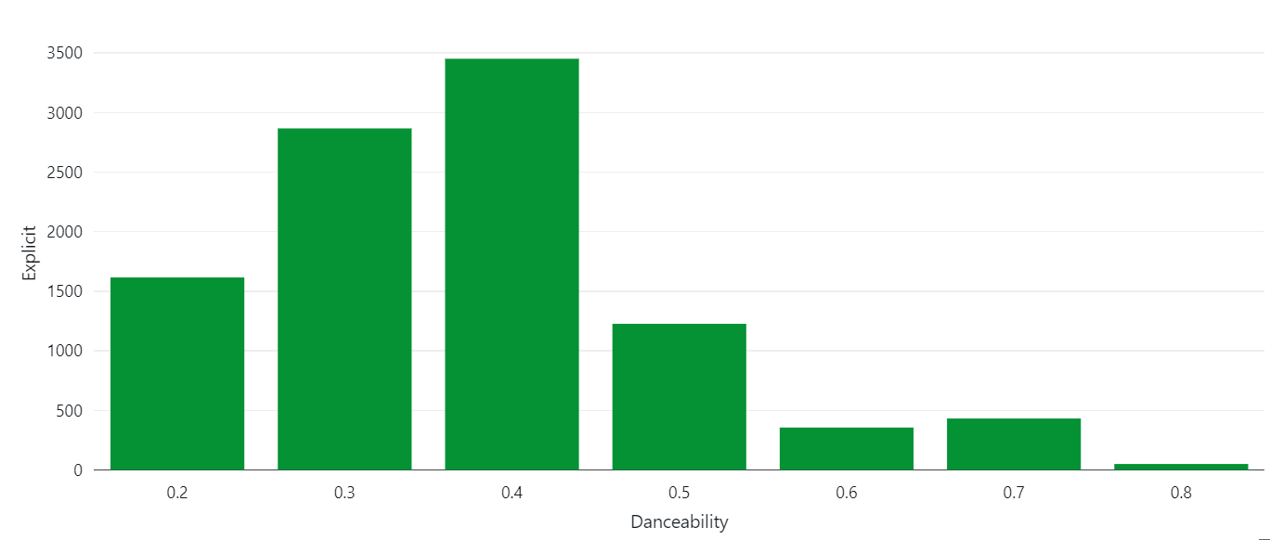
Continued
Are explicit songs danceable?
We see a ton of explicit songs under 0.4 meaning more explicit songs throughout the decade are not often danced to.
The # of explicit songs per danceability record

Slide 13
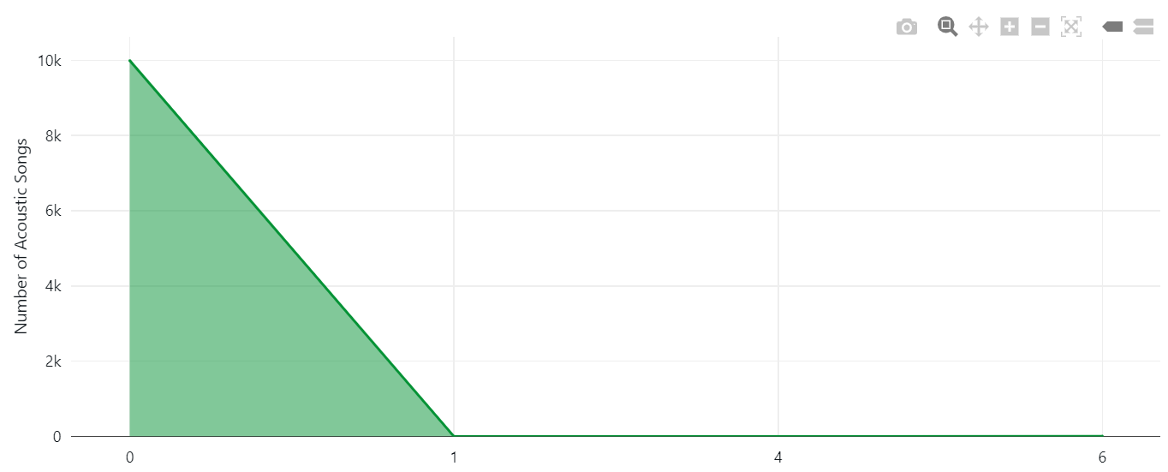
Continued
What is the correlation between acoustics and popularity?
Acoustic songs tend to not be as popular.

Slide 14
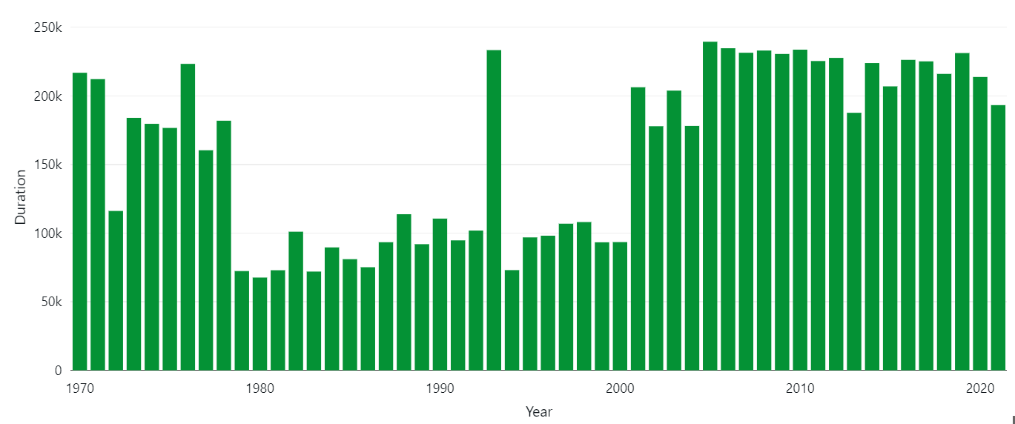
Continued
How has the duration (in milliseconds) of songs changed?

Slide 15
Lessons Learned
Although there were some challenges using the Spotify API, I extracted data to use on a new platform, Databricks.
I used the PySpark book to help me learn and use the fundamentals when creating a pipeline to extract and analyze code.
I learned how to create a compute on Databricks and create visualizations based on different PySpark SQL codes.

Slide 16
Thank You!
Any questions?

Slide 17
Sources
Final Spotify Data Analysis
Kaggle Spotify Tracks
Spotify API Code to Extract Data
Spotify for Developers - Web API

Slide 18
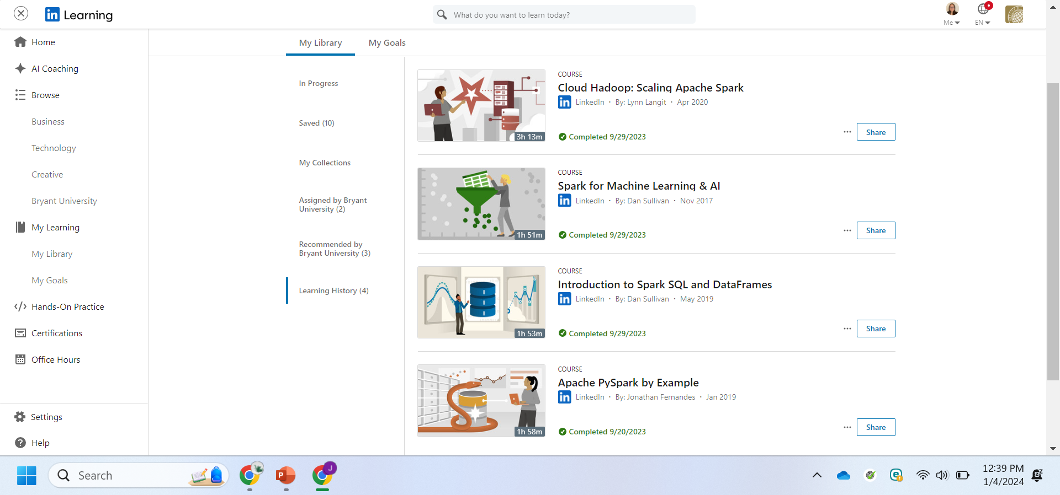
LinkedIn Completions

