Slide 1
Student Retention Analysis
ISA441 Group F
May 10, 2024
Notes:
Marcus

Slide 2
Agenda
Business Problem
Two Tier Platform
Project Charter
Gantt Chart
Use Case & Forms
System Sequence Diagram
Er-Diagram
Use Case Dialog
Menu Hierarchy
Storyboard
Demonstration
Notes:
Marcus

Slide 3
Business Problem
University student retention is a valuable tool to measure student success, rankings, and reputation. Collecting data on whether they are content with their college experience and why they withdraw from the university is important to improve student retention.
Notes:
Janaye

Slide 4
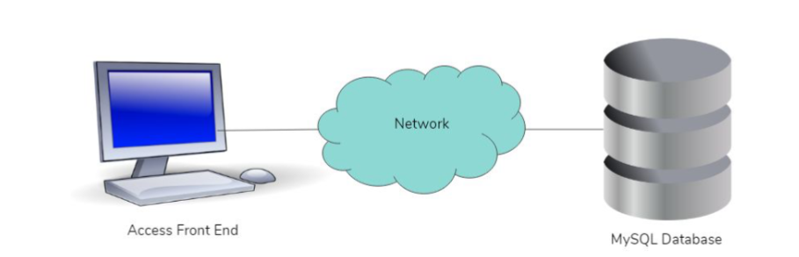
Two – Tier Platform
Notes:
Janaye

Slide 5
Project Charter
General Project Information
Project Name: |  |  | Student Retention Analysis
Sponsors: |  |  | Patrick Casey, Abhijit Chaudhury
Impact of Project: |  |  | Analyzing the factors that impact student retention, and seeing what tables store what data
Project Team
 | Name | Department | Telephone | Email
Client: | Patrick Casey | AV Department |  | pcasey@bryant.edu
Team Members: Project Manager | Janaye Ferrante | ISA 441-A |  | jferrante1@bryant.edu
 | Marcus Moody | ISA 441-A |  | mmoody@bryant.edu
 | Luke Lamontagne | ISA441-A |  | llamontagne1@bryant.edu
 | Zachary Cullison | ISA 441-A |  | zcullison@bryant.edu
Notes:
Janaye

Slide 6
Project Charter
Stakeholders & Goals Admissions, OIES, Counseling, ResLife: would be interested in seeing students at risk, identifying them, and providing resources to combat dropouts. Professor Chaudhury: involved in project success and is bringing our project to administration or other departments that can put the project in place AV department: maintain the software/ data systems and use these systems for further actions
Objectives Create an efficient system that will track student retention rates and the iteration of the analysis system Include requirements provided by our client Maintain retention rates, information on students, and identify students at risk
Deliverables Use Case Diagram Entity-Relationship Diagram Work Breakdown Structure & Gantt Chart System Sequence Diagrams Story Board SQL Code
Scope Store, record, and retrieve data related to the student’s academic, student activities, and other involvements Determine the stages and requirements of development for approval Create a presentation that will address the current procedure of development for feedback
Notes:
Janaye

Slide 7
Project Charter
Project Milestones Project Start: January 26, 2024 Phase I End: April 21, 2024 Phase II End: May 3, 2024 Project End: May 10, 2024
Major Known Risks Risks Classification of Inventory Classification of procedures Time management of members Timeline punctually of process |  | Risk Rating (High, Med, Low) Lo Lo Lo Med
Constraints Limited time Limited group numbers Schedule management between group members
External Dependencies We all agreed to this interaction and will make an effort to manage our schedules. The success will relate to the number of meetings and external work each individual will input into this project.
Sign Off
 | Name | Signature | Date (MM/DD/YYYY)
Department Sponsor
Project Manger

Slide 8
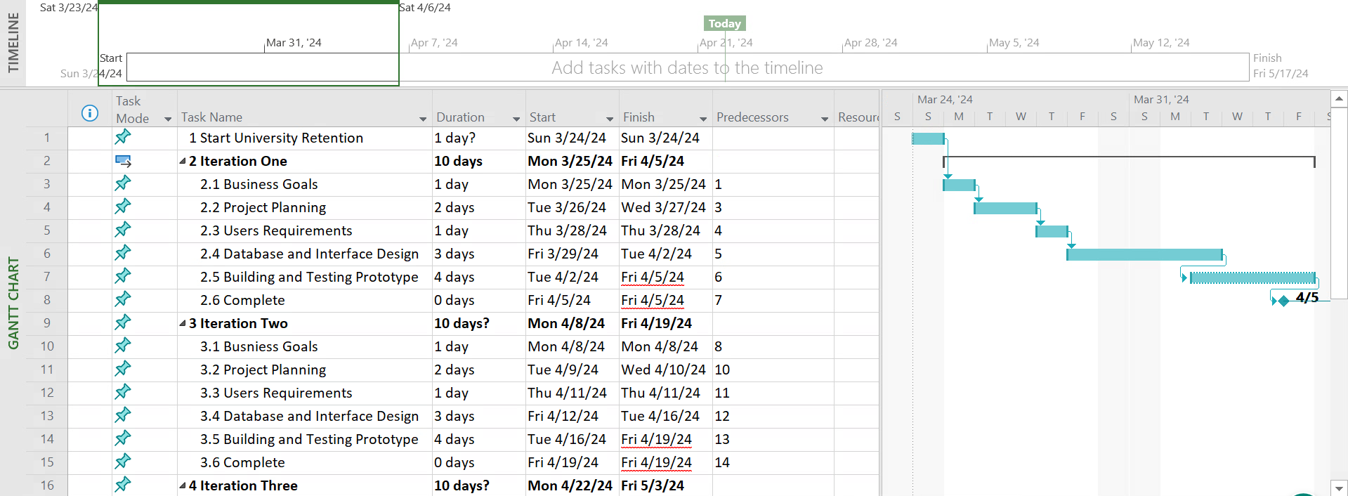
Gantt Chart
Notes:
Luke

Slide 9
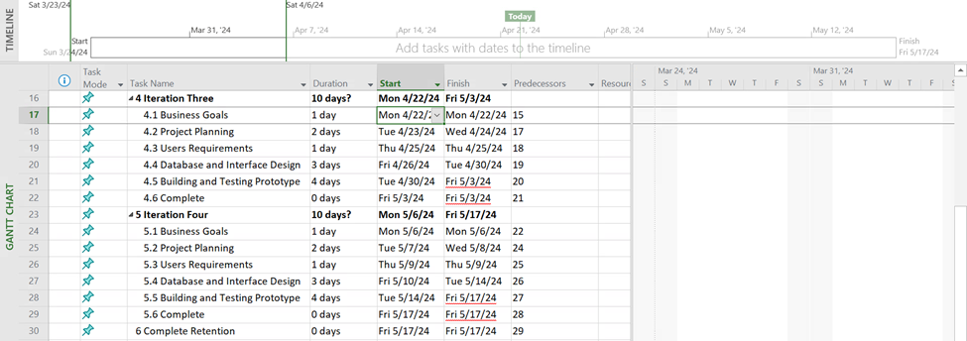
Gantt Chart
Notes:
Luke

Slide 10
Use Cases
** Showing the 2/5 most impactful and useful cases.
Notes:
Luke

Slide 11
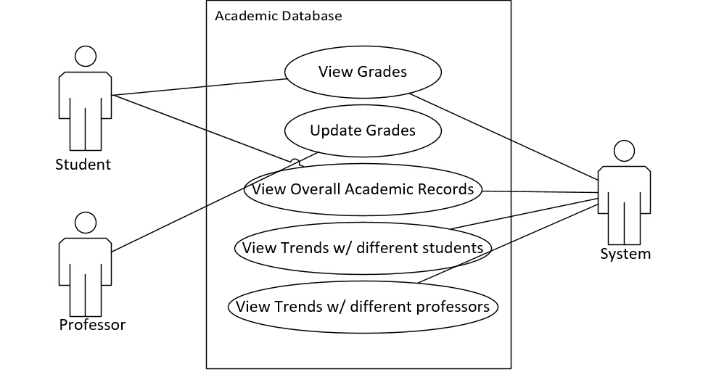
#1 Academic Database
Notes:
Luke

Slide 12
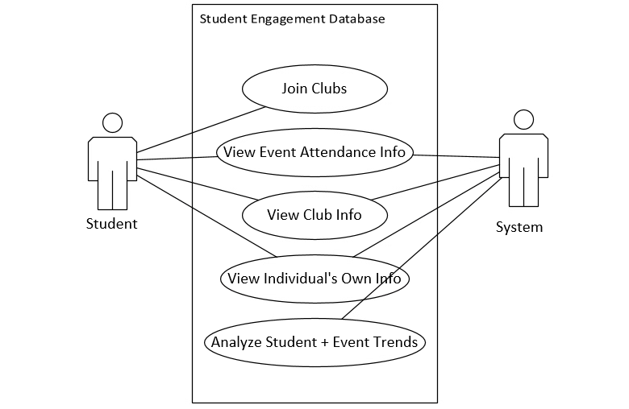
#2 Student Engagement Database
Notes:
Marcus

Slide 13
Use Forms
Notes:
Marcus

Slide 14
Use Form #1
Use case name: | Academic Database
Actors: | Student, Professor, and System
Scenario: | Academic Database for Students + Professors
Brief Description: | To identify students at risk and to gather reports that allow them to see individuals who may be struggling.
Triggers: | Attendance
Related Use cases | Other Databases (clubs, sports, etc.)
Preconditions: | studentID
Postconditions: | Student is entered into system to be watched
Special Requirements: | studentID, courseID
Flow of Activities
Actor Action |  | System Response
Views Grades |  | View overall academic records
 |  | View Trends
Notes:
Marcus

Slide 15
Use Form #2
Use case name: | Student Engagement Database
Actors: | Student and System
Scenario: | Student Engagement for Club Attendance
Brief Description: | To draw conclusions from student attendance of club events, use assumptions to decide on what changes must be made to improve student retention
Triggers: | No club attendance
Related Use cases | Other Databases (academics, sports, etc.)
Preconditions: | studentID
Postconditions: | Student Trends are analyzed
Special Requirements: | studentID, clubID
Flow of Activities
Actor Action |  | System Response
Student attends club |  | View attendance info
 |  | Views club info Analyze student and event trends
Notes:
Marcus

Slide 16
System Sequence Diagrams
Notes:
Marcus

Slide 17
System Sequence Diagrams
Academic Database
Student Engagement Database
Student/Professor System |------ View Academic Records ------->| |--- View Overall Academic Records->| |-----View Grades------------------------>| |-----View Trends w/ Professors------->| |<------Trends Data-----------------------| |-----Update Grades--------------------->| |<------Update Confirmation-------------|
Student Administrator |--- Joining Clubs ---------------------->| |--- Viewing Event Attendance ------>| |--- Viewing Club Info ---------------->| |--- Viewing Individual's Info-------->| |--- Analyzing Trends ----------------->| |<--- Trend Analysis Report -----------|
Notes:
Janaye

Slide 18
ER Diagram
Notes:
Luke

Slide 19
SQL Tables
Students (central table)
SurveyResults
Student_in_Course
Courses
Departments
Schools
Student_Use_Service
Services
Student_in_Engagement
Engagements
Events
Student_Attends_Event
Notes:
Luke

Slide 20
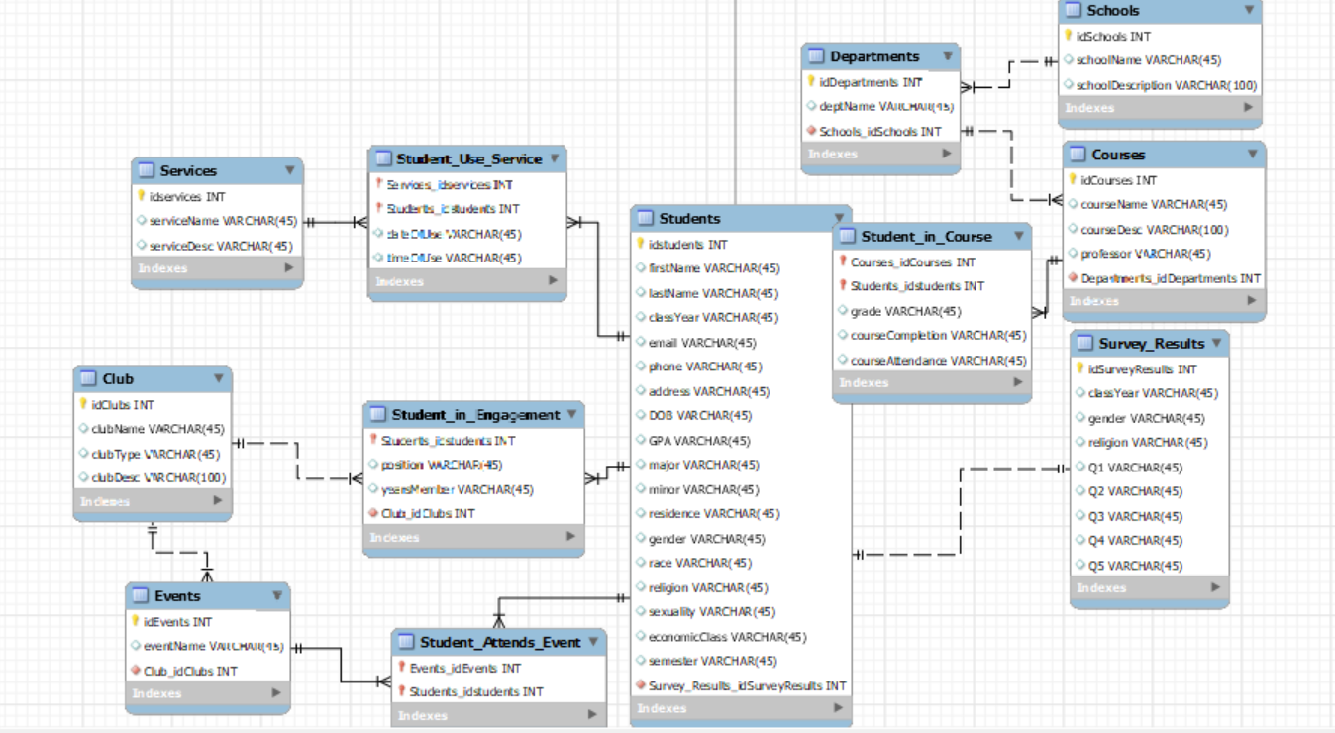
ER Diagram
Notes:
Luke

Slide 21
Use Case Dialog
Notes:
Janaye

Slide 22
Academic Records Example
Professor: "I'd like to view my student’s academic records, please. Here is the name XXXXXX, XXXXXXXX."
System: "Sure, let me retrieve that for you."
System: "Here are the academic records."
Professor: "Great, thank you. Can you also show me the grades?"
System: "Certainly, let me fetch those for you."
System: "Here are the grades."
Professor: "Excellent. I'm also interested in viewing trends regarding my teaching."
System: "Alright, let me gather that information."
System: "Here is the data on your professor trends.”
Professor: "Thank you. Lastly, I need to update some grades."
System: "Understood. Please provide the updates, and I'll confirm them for you."
System: "Your grade updates have been confirmed."
Notes:
Janaye

Slide 23
Student Engagement Example
Student: "I want to check my event attendance, please."
System: "Of course. Could you provide me with the specific events you'd like to review attendance for?"
Student: "I attended the debate competition and the movie night."
System: "Let me pull up the attendance records for those events for you."
Student: "I'd like to see information about the chess club, please."
System: "Certainly. Are you looking for general information or something specific?"
Student: "I want to know about upcoming events and meeting times."
System: "I'll provide you with all the relevant details regarding upcoming events and meeting schedules for the chess club."
Notes:
Janaye

Slide 24
Menu Hierarchy

Slide 25
Menu Hierarchy
Login
View Student Record
Student
Professor
View Clubs
Dashboard/ Home
View Student Record
Input Student Name
Change Student Grade
View Student Grade
Input Student Name
View Club Involvement
View Grades
View Clubs
View Clubs Joined
View Events Attended
View Student Info
Update Information
Dashboard/ Home
Notes:
Zach

Slide 26
Storyboards
Notes:
Zach

Slide 27
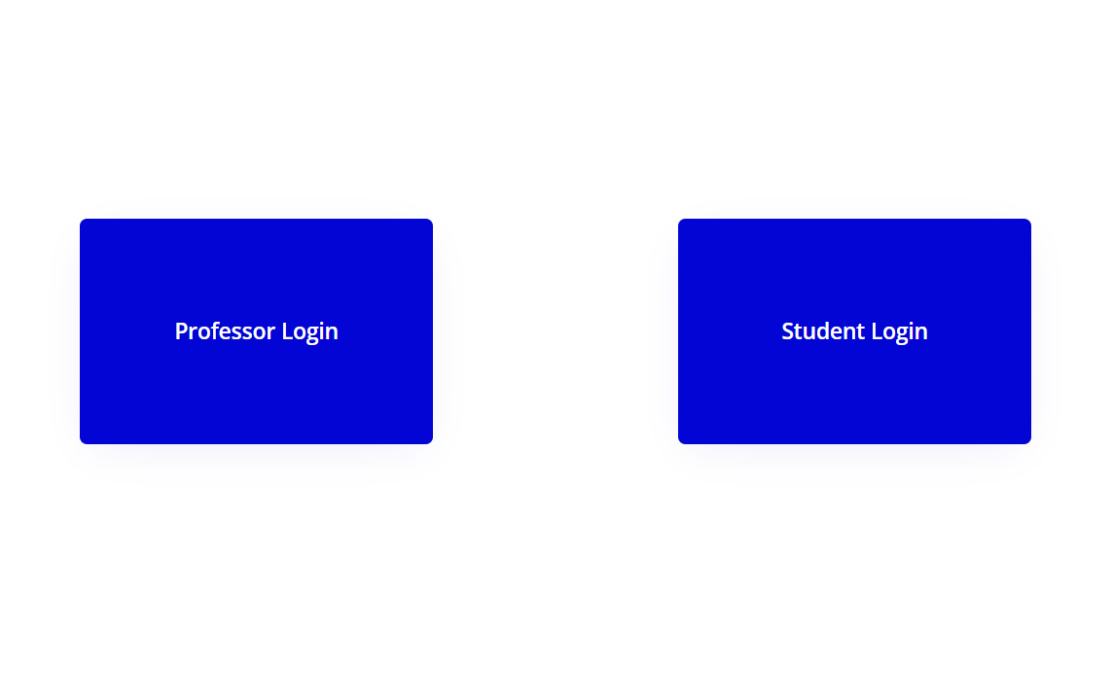
Story Board
More will be shown in a demonstration.
Notes:
Zach

Slide 28
Demonstrations
User Interface on Bubble.io
Link
MySQL Code (Er Diagram + Code)
OBDC Connection to Access
Connection to Jupyter Notebook
Notes:
Janaye

Slide 29
Thank you!!

