Slide 1
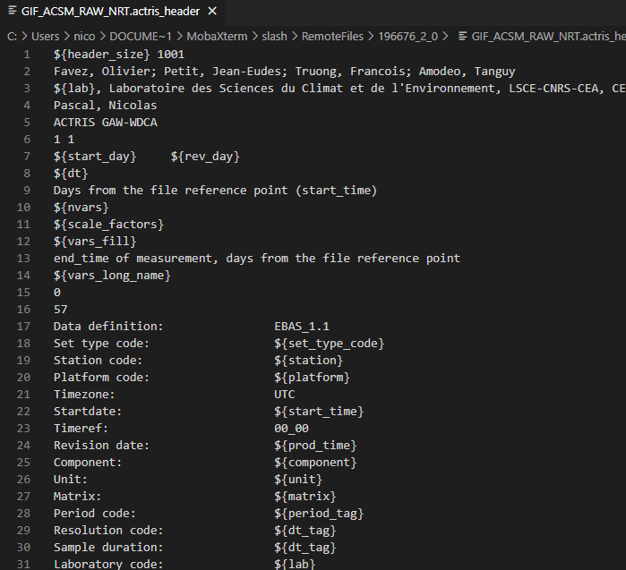
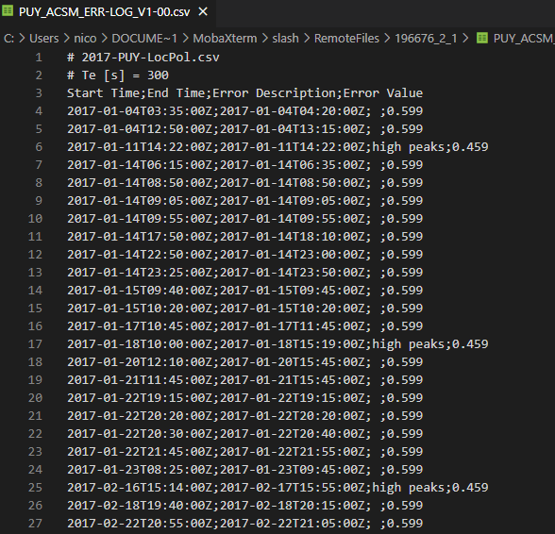
ACTRIS ACSM regular yearly submissions
Dataset template
Station specific
dataset
template
event-log
Quad ACSM
Quad ACSM
ACMCC
procedure
(IGOR)
Yearly raw
NRT-like
format
lev0
actris-acsm-converter
(python)
lev1
Next year...
lev2
ToF ACSM
Event log
usual
yearly .csv
format
usual
export procedure
(IGOR)
implements a zero-code approach, but needs station configuration files,
once ToF-ACSM automatic NRT QA will be implemented, a unique workflow will be used, matching the NRT one,
support of usual ToF exported csv not supported yet. Will be available early March 2022.

