Slide 1
Grade Me App
COP3035
Gokila Dorai
Final Semester Group Project
By: Andrea Richter-Sanchez
Daphne Rousey
Trenton Ultsh
Jonathan Garcia

Slide 2
Original Proposal
Create an interactive dashboard for students
Dashboard will contain charts and graphs that display grades per assignment.
Convert text file containing data to an interactive dashboard

Slide 3
Reading in data from a file

Slide 4
Reading data from file
We wanted to create a format for the file that contains the data so that our code could be used universally.
The grade percentages will correspond to the weight of each type of assignment. This will also tell us how many rows of grades will be at the bottom of the text file.
<course number and section>
<semester>
<student id>
<student name>
<grade percentage titles>
<grade percentages>
<name of all students in class>
<columns of grades per student>

Slide 5
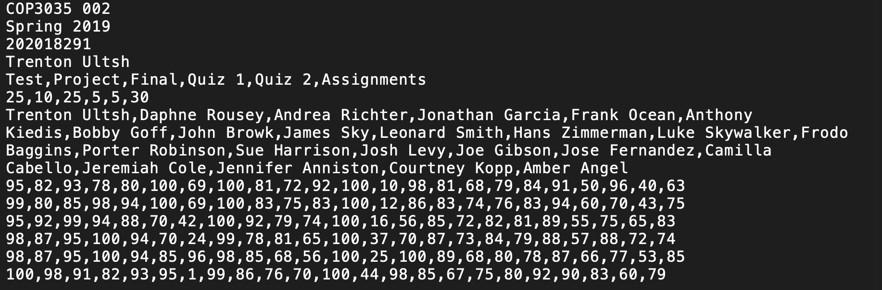
Example Text File

Slide 6
Code to read in file
#INPUT
filename1 = input("Enter a file to read data from: ")
with open(filename1) as txtfile: #opens file
csv_file = csv.reader(txtfile)
#Moving data into a matrix
for row in csv_file:
matrix.append(row) #adding rows to matrix
This stores the data in the CSV file into a two dimensional matrix

Slide 7
Making Stored Data Useful
From the 2D matrix that holds the information in the text file, we needed to make data access and usage more convenient. We did this by assigning variable names to each piece of data. Here, we store the course and section, the semester, the student ID and student name.
#moving data from matrix to variables
course_code = matrix[0][0] #first row, first column
semester = matrix[1][0]
ID = matrix[2][0]
student_name = matrix[3][0]

Slide 8
Making Stored Data Useful
We want to store names of the weights of the grades into an array so that it is easier to set up pages with names of the weights.
weightnames = [] #a list for the percentage that each grade is
for names in matrix[4]: #any number of weights is allowed
if names=='':
break
weightnames.append(names)

Slide 9
Making Stored Data Useful
We also want to store the weights of the grades into an array so that it is easier to multiply grades by in order to calculate final grades.
#store percentages into weights
weights = [] #a list for the percentage that each grade is
for percentage in matrix[5]: #any number of weights is allowed
if percentage=='':
break
weights.append(percentage)

Slide 10
Making Stored Data Useful
This assumes that the student name given at the beginning of the file is name of the student who is calculating grades. This code finds where the student is in the list of students.
#find the index for the “logged in” student
j = 0
for student in matrix[6]:
if(student_name == student):
break
else:
j = j + 1

Slide 11
Making Stored Data Useful
#obtain grades for “logged in” student
student_grades = [] #ONLY GRADES for the “logged in” student
for i in range(7,len(weights)+7):
student_grades.append(int(matrix[i][j]))

Slide 12
Imports and Functions

Slide 13
Imports
import csv #Inputs data
import matplotlib #makes graphs
#make graphs work with dashboard
matplotlib.use("TkAgg")
#import matplotlib.pyplot as plt
from matplotlib.backends.backend_tkagg import FigureCanvasTkAgg#, NavigationToolbar2TkAgg
from matplotlib.figure import Figure
import tkinter as tk #makes dashboard/buttons/interactivity
from tkinter import ttk
These are the imports we used in order to start off the code

Slide 14
Function: Get_all_final_grades
J
O
def get_all_final_grades(matrix):
final_grades = []
for j in range(len(matrix[5])):
column = []
for i in range(6, len(weights) + 6):
column.append(matrix[i][j])
final_grades.append(calculate_final_grade(column,matrix[4]))
return final_grades #returns a list with all final grades

Slide 15
Programming Graphs and Plots using Matplotlib

Slide 16
Pie Chart
def pie_chart(): #Function that creates a pie chart
global letter_count
test = ['A', 'B', 'C', 'D', 'F']
labels = list(test)
colors = ['gold', 'yellowgreen', 'pink', 'lightskyblue', 'red']
f = Figure(figsize=(5,5), dpi=100)
graph = f.add_subplot(111)
graph.pie(letter_count, labels=labels, colors=colors, autopct='%1.1f%%', shadow=True, startangle=140)
graph.axis('equal')
#graph.show()
return f
We decided to use the formatting that we had been taught in class

Slide 17
Box and whisker plot
def whisker_plot():
#fig = plt.figure(1, figsize=(9, 6))
global grades
f = Figure(figsize=(5,5), dpi=100)
graph = f.add_subplot(111)
graph.boxplot(grades)
return f
These plots are one of the best visual representations for illustrating where the student is compared to his/her peers
FSU’s canvas uses these charts in the grade section for each grade uploaded.

Slide 18
Histogram
Global calls the variable outside of the function (makes the code look all through the program for that specific variable).
def histogram():
global grades
number_bins = 10
f = Figure(figsize=(5,5), dpi=100)
graph = f.add_subplot(111)
graph.hist(grades,number_bins,facecolor='yellow',alpha=0.5)
return f

Slide 19
Creating a Dashboard

Slide 20

Trial and Error
Dash, Plotly, Anaconda

Slide 21
class GradeMeApp(tk.Tk): #Controller class, right out of tutorial
def __init__(self,*args,**kwargs):
tk.Tk.__init__(self,*args,**kwargs) #initializes the application
#tk.Tk.iconbitmap(self,default="clienticon.ico")
tk.Tk.wm_title(self, "Grade Me client") #names the window
container = tk.Frame(self)
container.pack(side="top", fill="both", expand=True)
container.grid_rowconfigure(0, weight=1)
container.grid_columnconfigure(0, weight=1)
self.frames={}
for page in (HomePage, pie_page, whisker_page, histogram_page):
frame = page(container, self)
self.frames[page] = frame
frame.grid(row=0, column=0, sticky="nsew")
self.show_frame(HomePage)
def show_frame(self, cont):
frame = self.frames[cont]
frame.tkraise()
Tkinter Success
We created and edited the dashboard by making a window and adding the buttons for the dashboard . This will take us to the different graphs for the class grades.

Slide 22
Pages and Buttons
class HomePage(tk.Frame):
def __init__(self, parent, controller):
global student_name
global weightnames
#Creating kinda like the window
tk.Frame.__init__(self,parent)
label = tk.Label(self, text=student_name+"'s Home Page")
label.pack(pady=10,padx=10)
button = ttk.Button(self, text="See Overall Grade", command=lambda: controller.show_frame(Page1))
button.pack()
button2 = ttk.Button(self, text="See "+weightnames[0], command=lambda: controller.show_frame(Page2))
button2.pack()
button3 = ttk.Button(self, text="See "+weightnames[1], command=lambda: controller.show_frame(Page3))
button3.pack()
button4 = ttk.Button(self, text="See "+weightnames[2], command=lambda: controller.show_frame(Page4))
button4.pack()
button5 = ttk.Button(self, text="See "+weightnames[3], command=lambda: controller.show_frame(Page5))
button5.pack()
button6 = ttk.Button(self, text="See "+weightnames[4], command=lambda: controller.show_frame(Page6))
button6.pack()
button7 = ttk.Button(self, text="See "+weightnames[5], command=lambda: controller.show_frame(Page7))
button7.pack()

Slide 23
Arranging Graphs in the Dashboard

Slide 24
Final Product

Slide 25
Future Improvements

Slide 26
One of our constraints is changing the amount of percentages we have.
We would like to be able to use this program to calculate where the students stands in the class. No matter the number of types of assignments we have.
Currently, we are only able to calculate the grade if, there are six types of assignments/categories.
This advancement would make the application more accessible for different classes.

Slide 27
An extension that could be made, would be making another calculator within our program that helps a student calculate what grade they need on a particular assignments in order to receive the letter grade they are aiming for.
Many students throughout college have had to calculate the minimum grade needed on a final or project needed to pass the class or to get an A.
The extension would help students where the students could stand in the class, if they got the grade the application calculated.

Slide 28
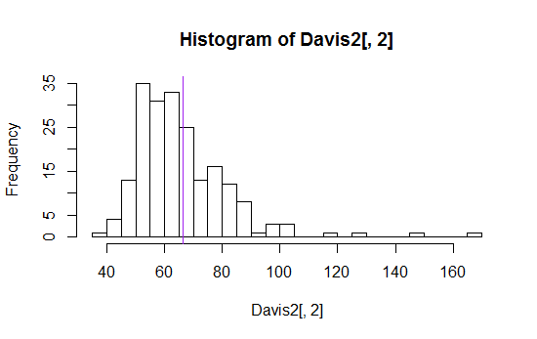
Making the program more aesthetically appealing is another future goal.
Students would enjoy using the application more.
Adding a line on the graph that visually shows where the student is in the data set.
Refer to bottom right figure

