Slide 1
Unit Conversion with Natural Language Processing
A user friendly solution

Slide 2
Table of Contents
Product overview
Need for the product
Advantages over other solutions
Guidance and errors
Future-facing design
End Results
Pull out your phone and try it along with us
jfglantz.github.io/Project3400

Slide 3
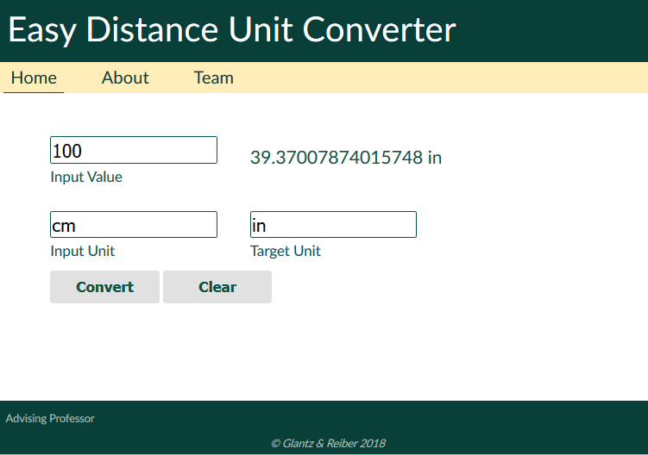
Appearance

Slide 4
The Product - A Natural Language Unit Converter
Unit Conversion – Distance units
Takes input written out or as abbreviations
Prompts you to complete the unit as you type
Responds to improper input with helpful error message

Slide 5
Input your way
Great for expert users and fast typists
Carat selects first box automatically
Boxes can be navigated by TAB
Hit enter to get result
Designed so no newbie can get lost
Error messages give helpful feedback
Dropdown units menu is an option for the confused

Slide 6
Details to note
Minimalist design
Loads quickly on all devices and connections
Keeps attention on task
Link to Prof Zhong for SEO boost
Consistent and unique fonts
Color scheme is homage to WSU

Slide 7
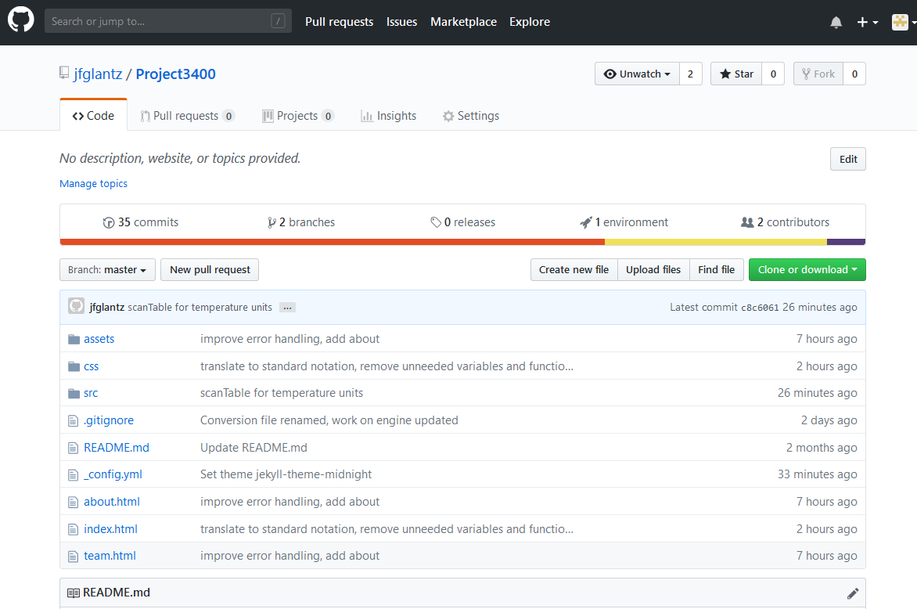
All code publicly available
github.com/jfglantz/Project3400

Slide 8
Modular design for scalability
Functions are written to handle multiple types of input
No quick-fixes or jerry-rigging under the hood
Can be expanded in future to include other types of units

Slide 9
Available right now
jfglantz.github.io/project3400

