Slide 1
A Convergence Study, Sort Of.
Joshua Holbrook
University of Alaska Fairbanks
Dec. 10th 2010

Slide 2
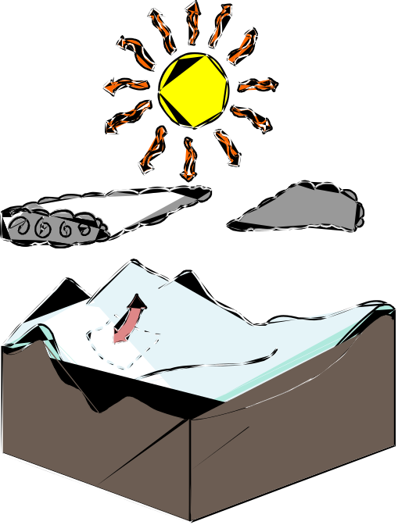
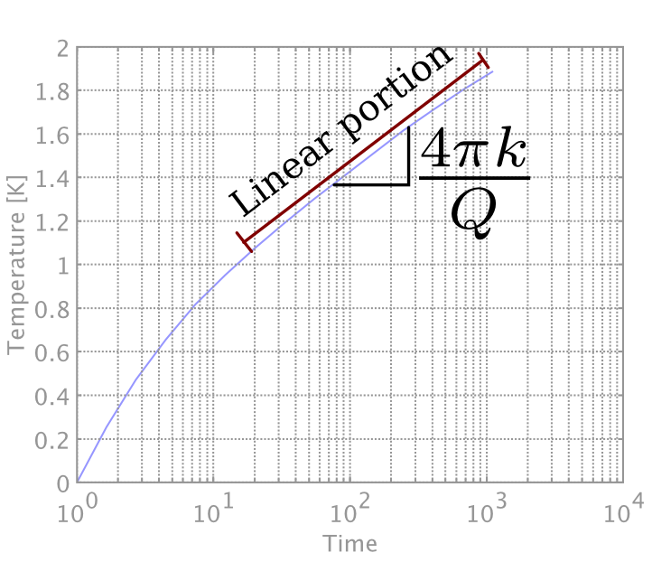
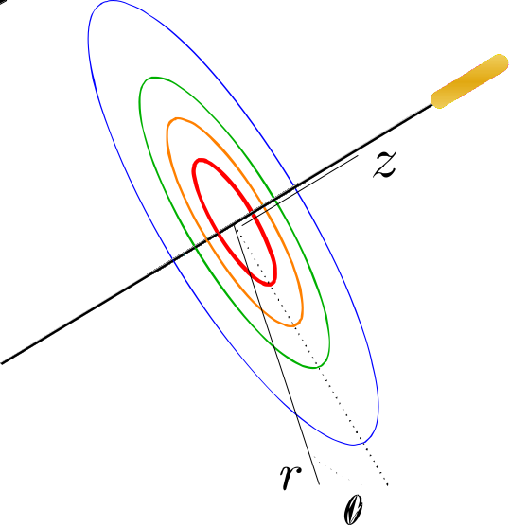
Background:

Slide 3
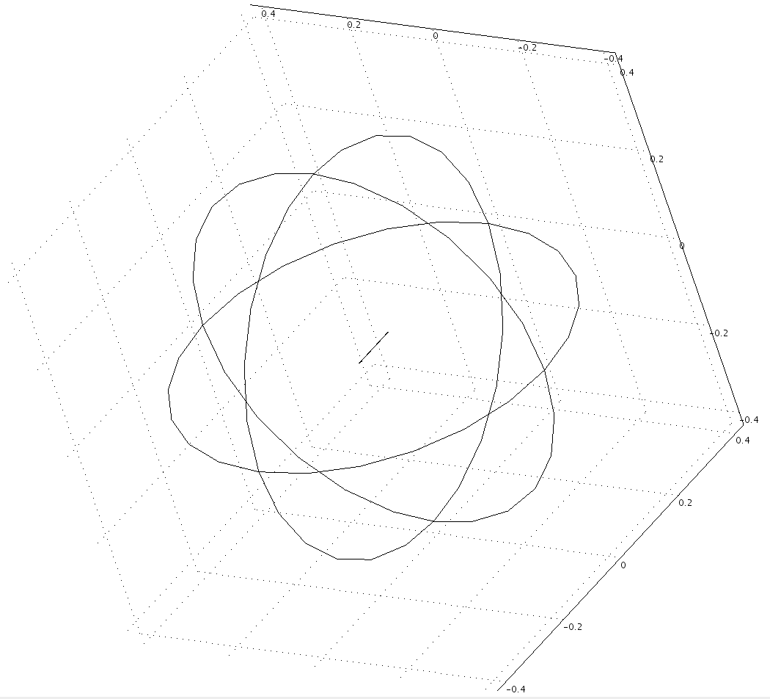
Model:

Slide 4
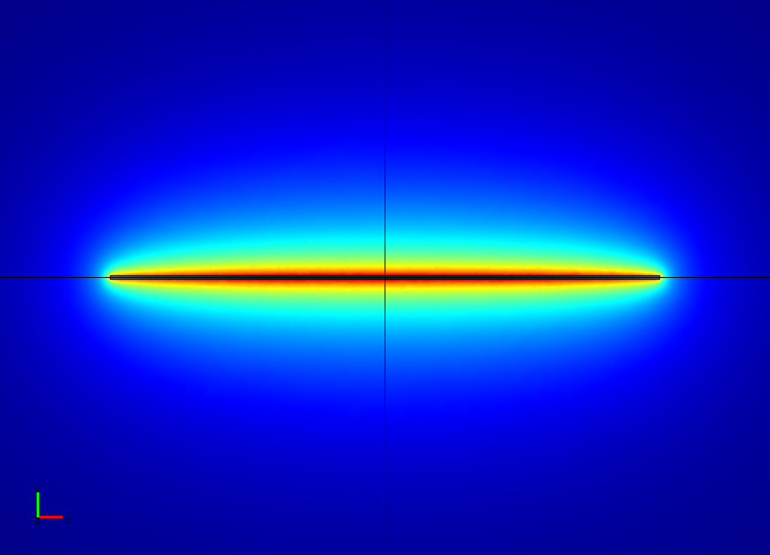
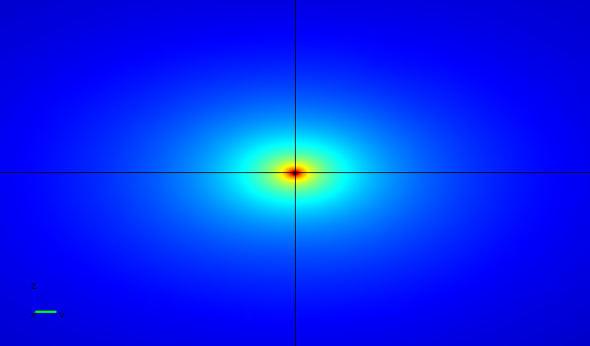
Research Results: I Have Some!

Slide 5
Problem: Convergence Study
Had originally only modified default coarseness to enable meshing of needle
Plan: Refine mesh twice, inspect results, check for sameness/convergence

Slide 6
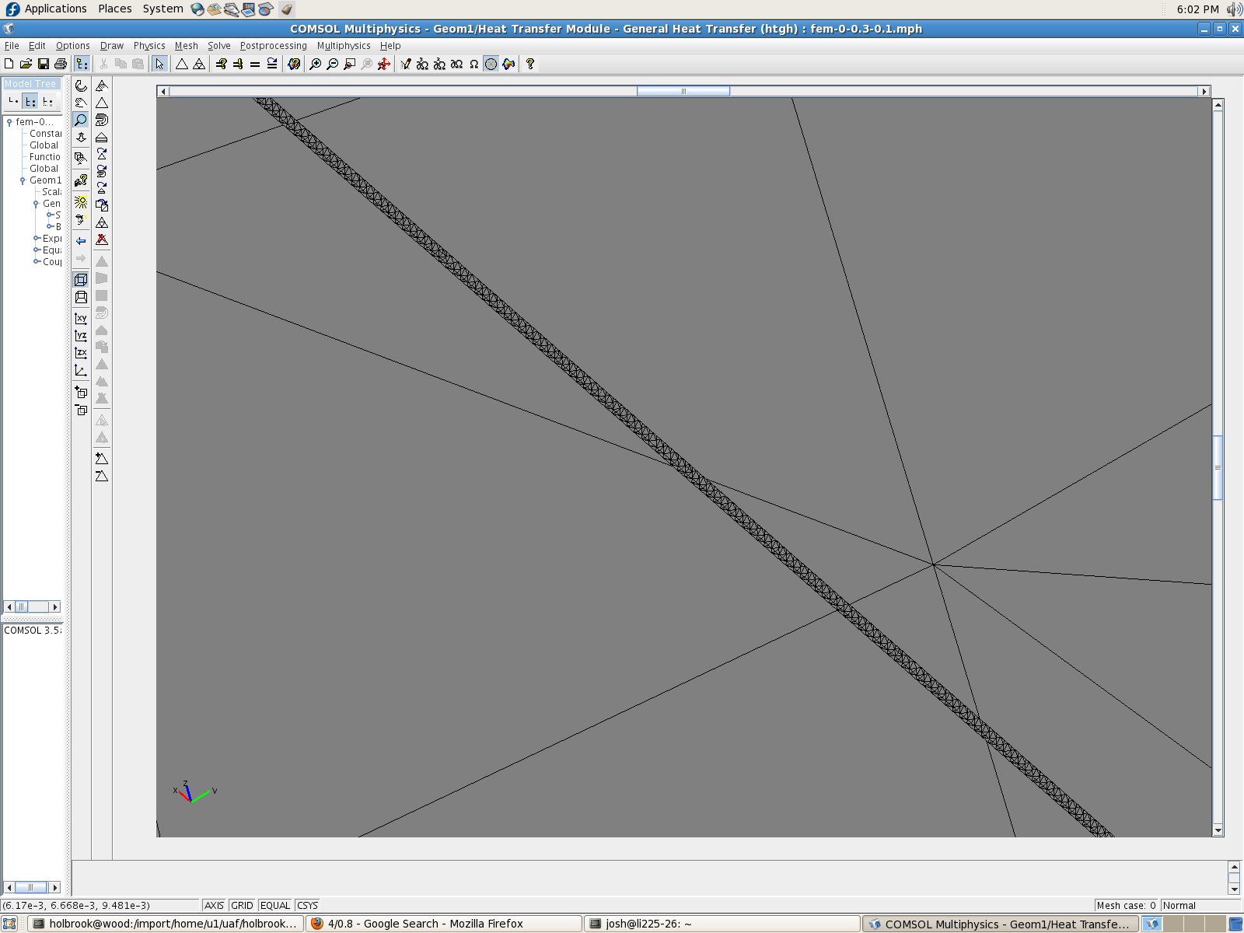

Slide 7
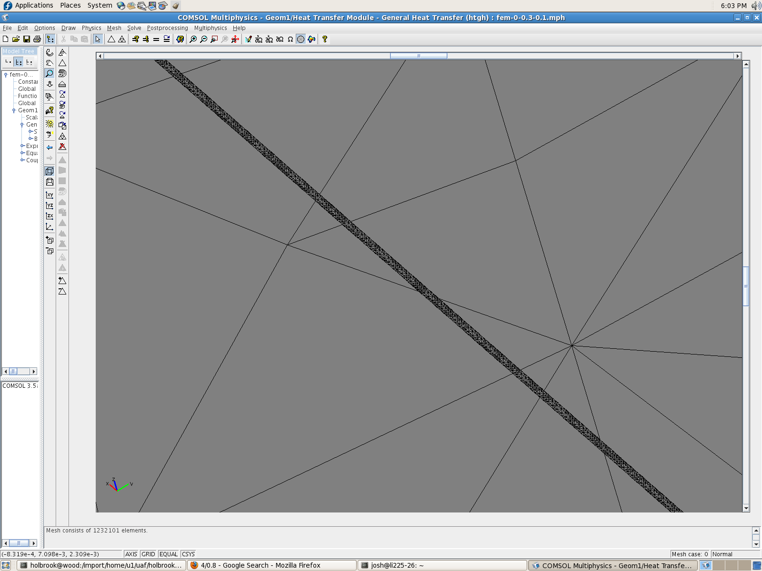

Slide 8
This Is Where I Explain The “Sort Of:”
 | No. Elements | Time to Complete
“Classic” | 35892 | 10 minutes
“Intermediate” | 159641 | 2 hours
“Nightmare” | 528945 | ??? (> 3 wks)

Slide 9
WHY DO WE SEE THIS OUTRAGEOUS BEHAVIOR?

Slide 10


A Valuable Lesson:
VS.
RAM courtesy pcextreme.net. HD courtesy ptdd.com. Thanks GIS.

Slide 11
What We CAN Do: Compare Results
No. Elems | Slope
35892 | 0.215
159641 | 0.198
% Err: | 8.64%
Similar solutions, but significantly different slopes!

Slide 12
What Have I Learned?
Hitting swap kills performance on more than just my web browser.
Having too coarse of a grid is part of why my results seemed “off” by ~10%
What Now?
Clearly, I need to run simulations at a finer grid (after Christmas break).
One may also ponder the question: Is there a better method for this problem, given my interest in dT/dt and not T(t) itself?
Can I make it through AGU without some numerical wizard discovering my error and/or causing me massive, grave embarrassment?? (Probably)

