Slide 1
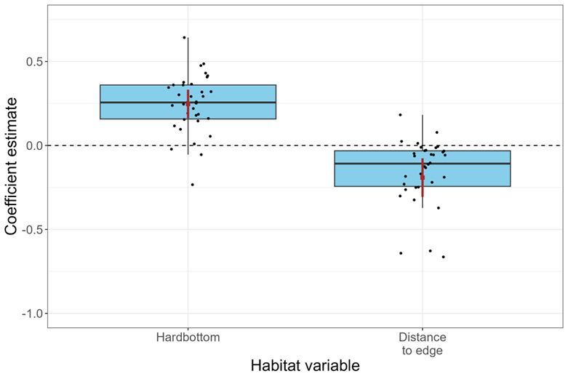
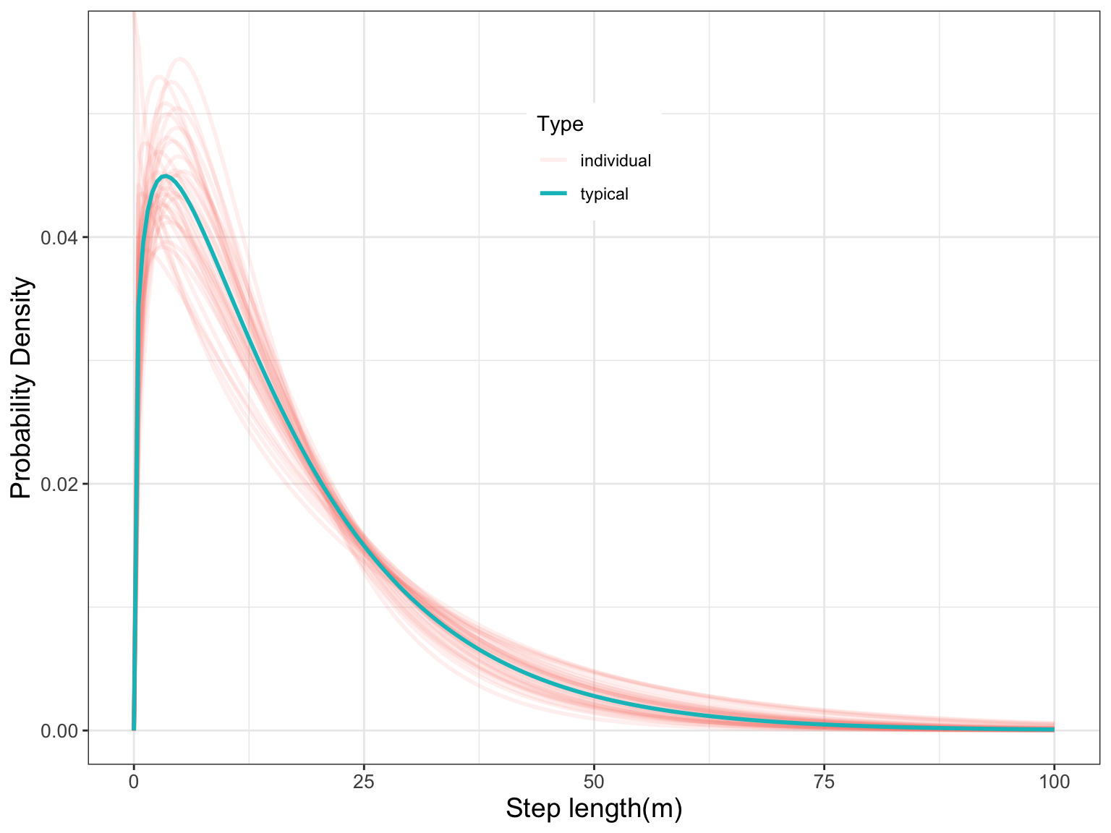
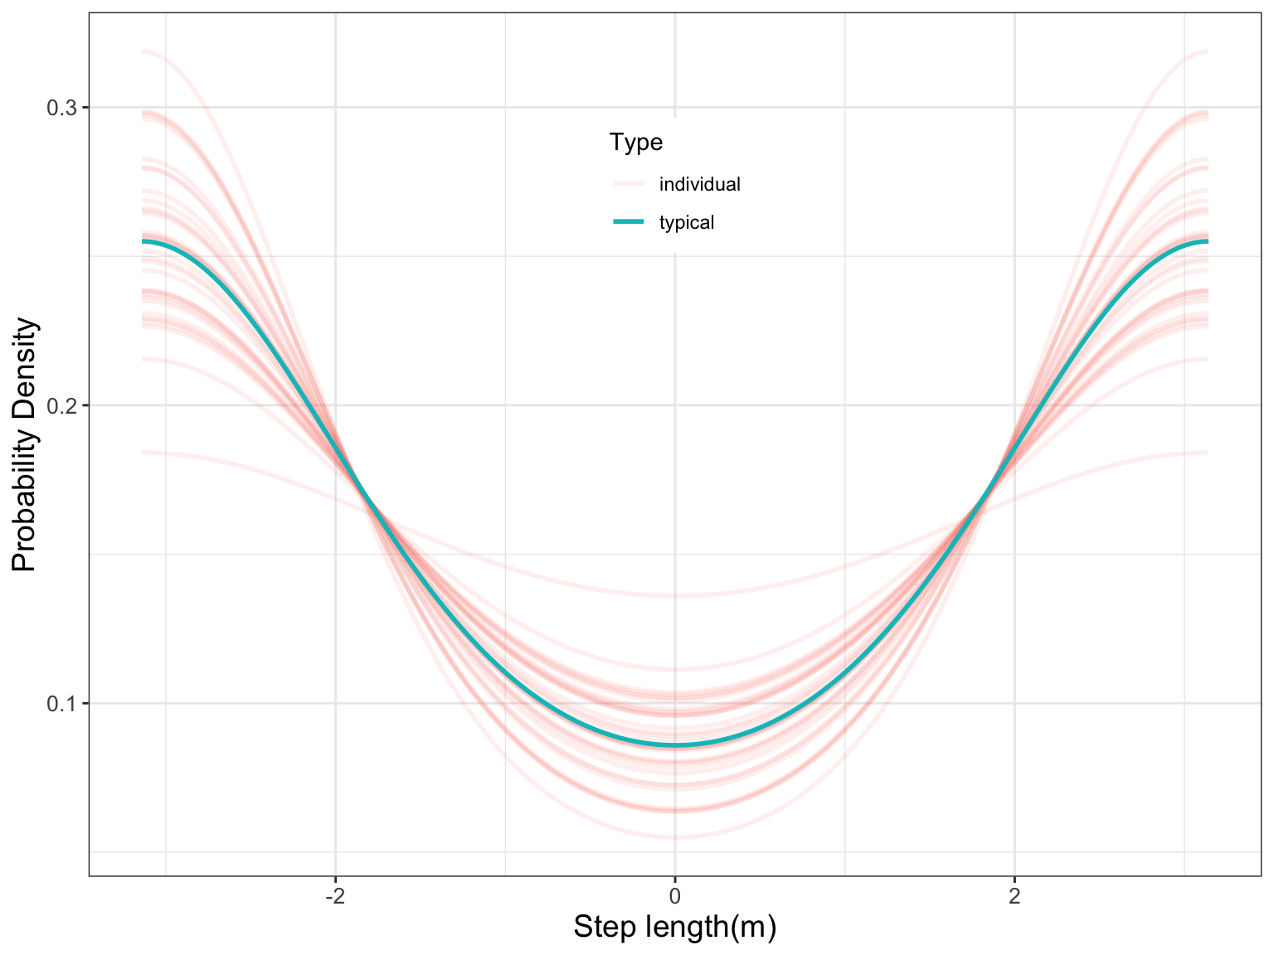
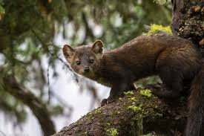


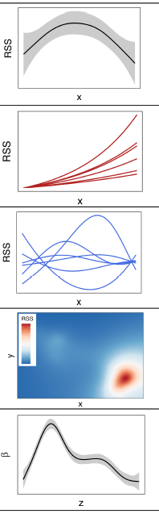
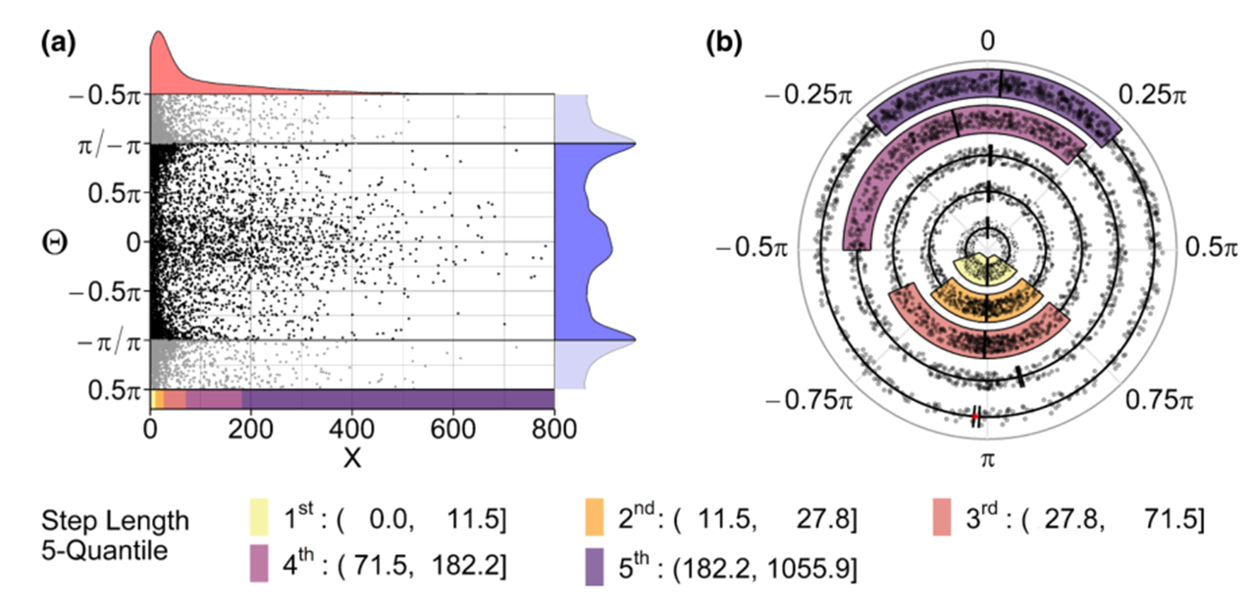
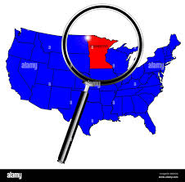

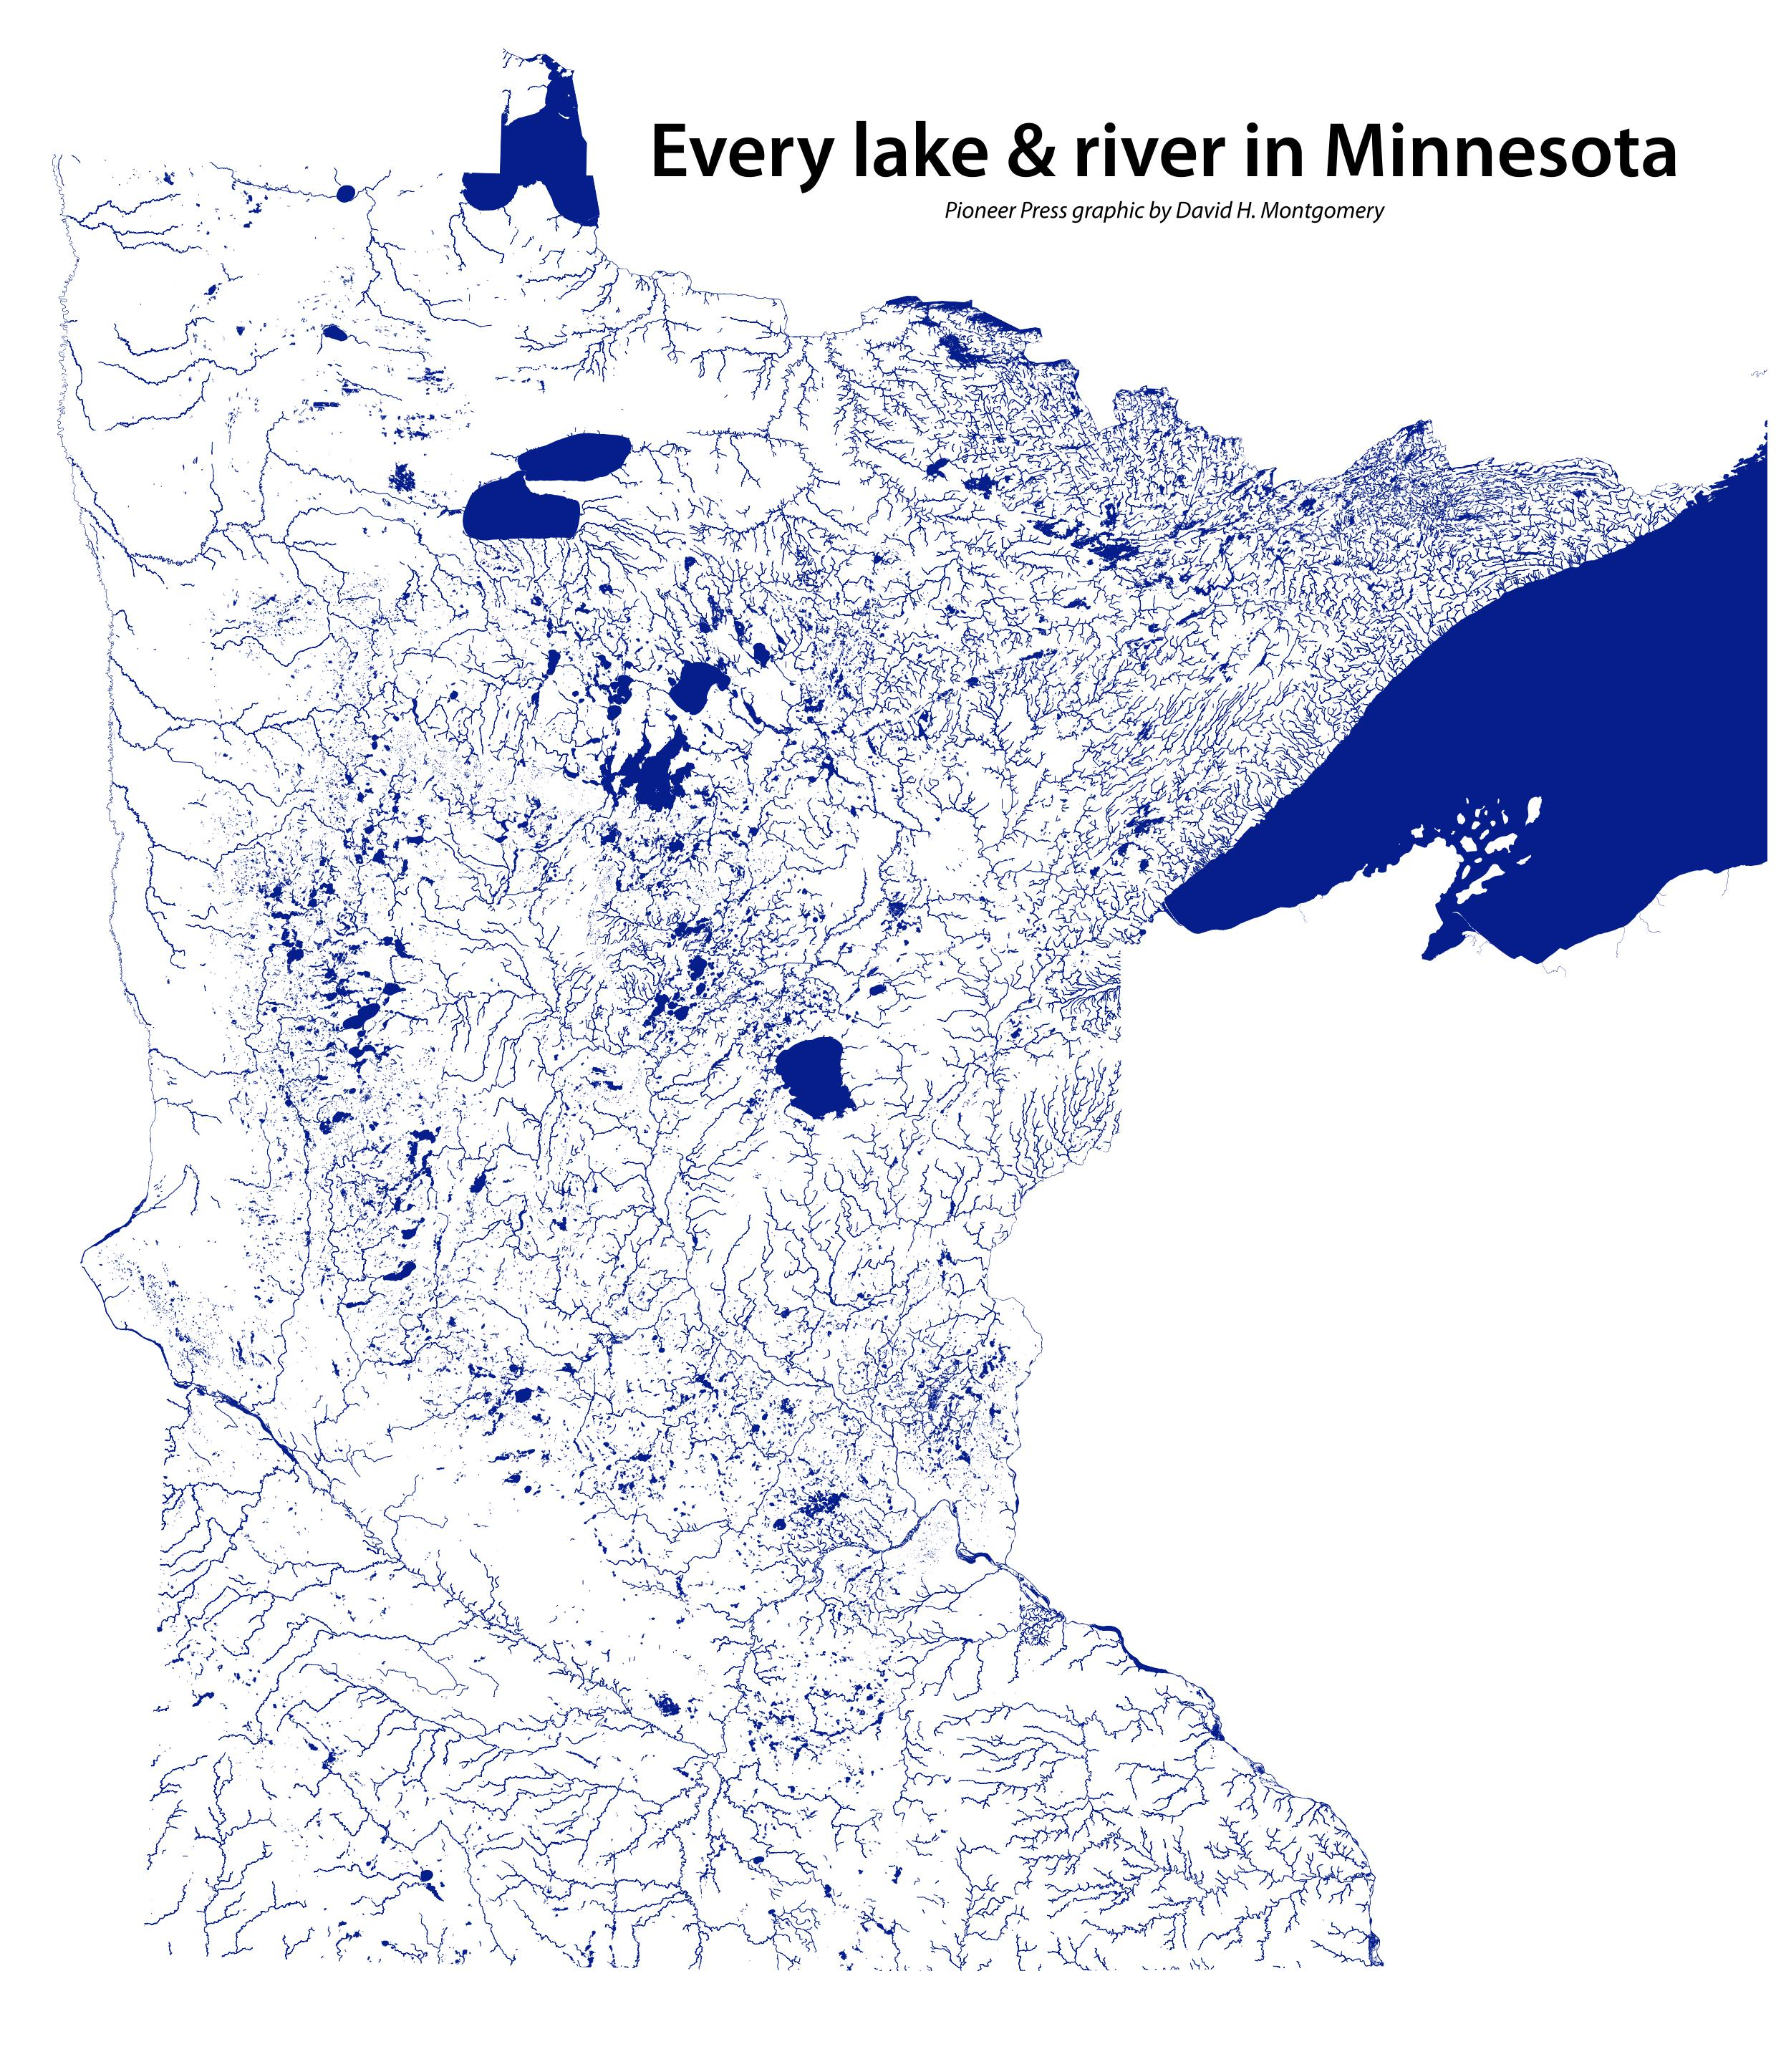
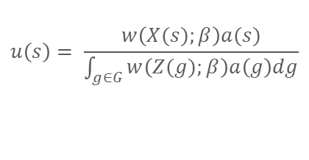
Study species:
Questions I am interested in:
How do continuous and discrete-time models compare when applied to real data?
What are the best ways to model and characterize individual variability?
Which features of complex ecological systems and messy ecological data do we need to model for robust inference?
$$u\left(s\right)= \frac{w\left(X(s);β\right)a(s)}{\int_{g∈G}{w\left(Z(g);β\right)a\left(g\right)dg}}$$
Challenges I lose sleep about:
Getting appropriate remote sensing layers (and coordinate reference systems!)
Developing truly predictive models that capture underlying mechanisms (rather than just associations)
How to train the next generation of ecologists now that we have unleashed AI
I am a Professor of Quantitative Ecology in the Department of Fisheries, Wildlife, and Conservation Biology at the University of Minnesota where I teach undergraduate and graduate-level courses in statistics. Prior to joining the faculty at the University of Minnesota, I worked for ten years as a research statistician at the Minnesota Department of Natural Resources and two and half years as a Biometrician with the Northwest Indian Fisheries Commission.
My collaboration with many highly engaged fisheries, wildlife, and conservation biologists have shaped my research interests in applied quantitative ecology. Much of my work focuses on how to choose, apply, and interpret appropriate statistical methods when confronted with messy ecological data.
John Fieberg @ University of Minnesota (jfieberg@umn.edu)
https://fieberg-lab.cfans.umn.edu/
Minneapolis / St. Paul

