Slide 1
AUSTRALIAN OPEN TENNIS PREDICTOR
JUSTIN FIELD

Slide 2
Why? SCOPE?
Tennis fanatic and Australian Open is on right now
Trying to predict winners of Aus Open matches with ML
  Using a Neural Network
Scope: Quarter Finals and Beyond (men’s matches)

Slide 3
DATA COLLECTION
Sourced data from tennis-data.co.uk, it has data for all ATP matches
  Data from 2011-2021 used
Pandas web scraping to collect current Aus Open results

Slide 4
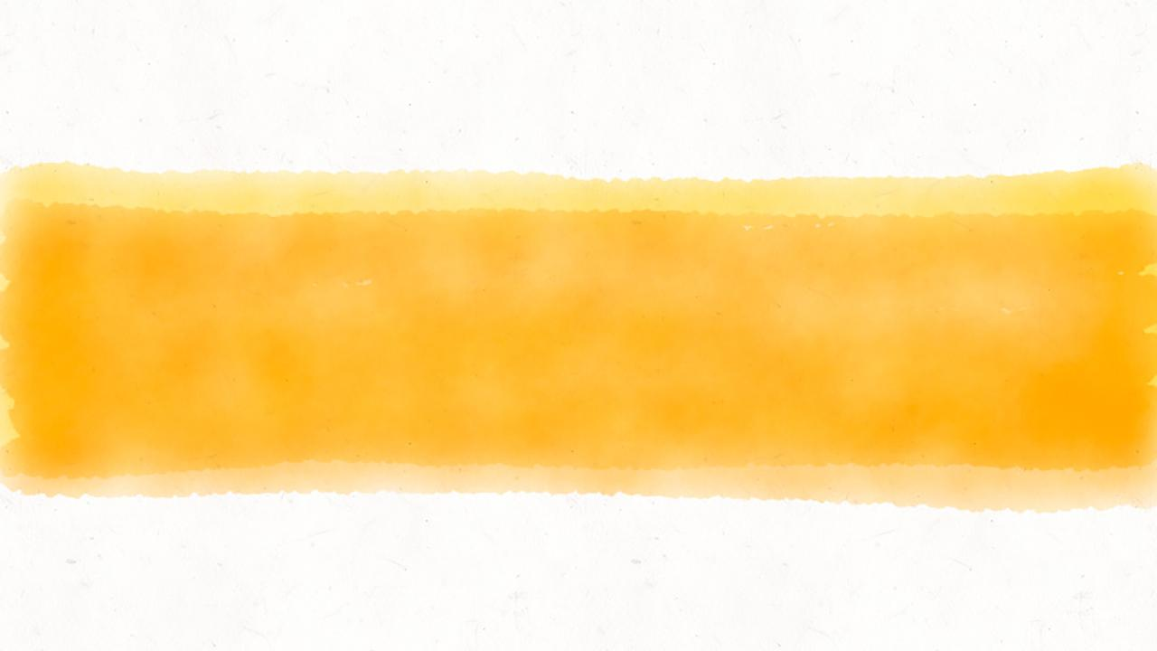
MY MACHINE LEARNING MODEL
Inputs (Features)
Hidden and Output Layers
Optimiser and Loss Function

Slide 5
SOME FEATURES OF THE MODEL
HEAD TO HEAD STATS
Calculations of head to head stats for each player, including (not exhaustive) on Hard Court (the Aus Open surface), and for all surfaces.
OVERALL WIN %
The players overall winning percentage, on different surfaces and with different match durations.
RANKINGS AND FORM
Player rankings and their ranking points before each tournament were compared – as well as form in the last 60 weeks (rounded up from 1 year), and 100 weeks (round up from 22 months which is how long the ATP rankings cycle currently is.)

Slide 6
HIDDEN & OUTPUT LAYERS
MODEL
Chose a sequential model for my neural network.
HIDDEN LAYERS
Two ReLu layers chosen as my hidden layers. They are generally the best choice for hidden layers as they don’t suffer from the vanishing gradient problem.
OUTPUT LAYER
Sigmoid function chosen for my output layer. It is great for binary classification. As the tennis matches have only two players this is ideal. The sigmoid function is useful for probabilities between 0 and 1.

Slide 7
HIDDEN & OUTPUT LAYERS
MODEL
Chose a sequential model for my neural network.
HIDDEN LAYERS
Two ReLu layers chosen as my hidden layers. They are generally the best choice for hidden layers as they don’t suffer from the vanishing gradient problem.
OUTPUT LAYER
Sigmoid function chosen for my output layer. It is great for binary classification. As the tennis matches have only two players this is ideal. The sigmoid function is useful for probabilities between 0 and 1.

Slide 8
OPTIMISER & LOSS FUNCTION
OPTIMISER
Adam optimiser chosen to obtain the proper global minimum.
LOSS FUNCTION
Binary cross-entropy loss function used as it is for binary output data as in my model.

Slide 9
SO HOW ACCURATE IS THIS MODEL? CAN I MAKE MONEY?

Slide 10
$49.50
76.8% accuracy
100%
PROFIT FROM FIRST 4 matches
MODEL GIVES CONFIDENCE
NOT RESPONSIBLE FOR ANY LOSSES YOU MAY INCUR BY FOLLOWING MY MODEL!

Slide 11
BEFORE LOOKING AT THE WEBSITE WHAT COULD BE IMPROVED?

Slide 12
WHAT I WOULD IMPROVE
AUTOMATIC UPDATE
Finding a way to automatically feed new data into the model, and it updates and re-renders dynamically (I’m sure this must be possible).
LEGITIMATE WAGERING
Spending time to figure out a legitimate strategy to bet certain amounts based on different odds etc.

Slide 13

Thanks!
any
questions
?
You can view my website @ https://jfield24.github.io/Final-Project/

