Slide 1
RTL:ASMD
concepts
register transfer level algorithmic state machine and datapath

Slide 2
Why?
A large digital system will have a large state table. Chop large problem into smaller pieces.
Chop into algorithmic state machines.
Chop algorithmic state machine into: registers (flip flop groups) control path and datapath

Slide 3
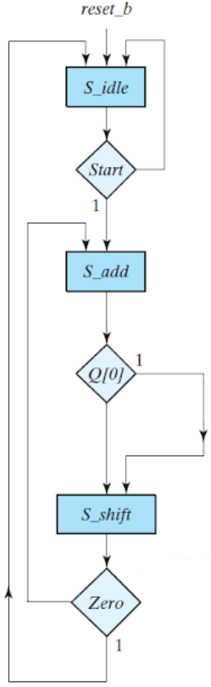
Starting with ASM
Multiplying involves … waiting for CPU signal to begin adding (or not) shifting and then repeating if not done

Slide 4
Spitting one thing into two : Control Path Data Path
One thing: Clean kids room, wait, add, shift
Control: Data: parent: clean room kids: clean room wait do nothing add add numbers in registers shift shift numbers in registers typically wires typically registers blocked non-blocked

Slide 5
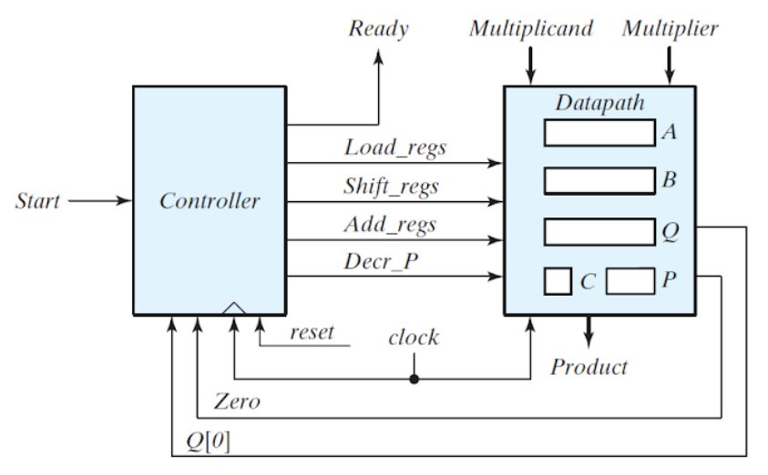
Block Diagram the one becoming two
Control Path Data Path

Slide 6
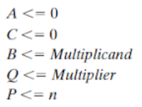





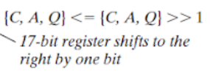
Decorate Control path and Data path

Slide 7
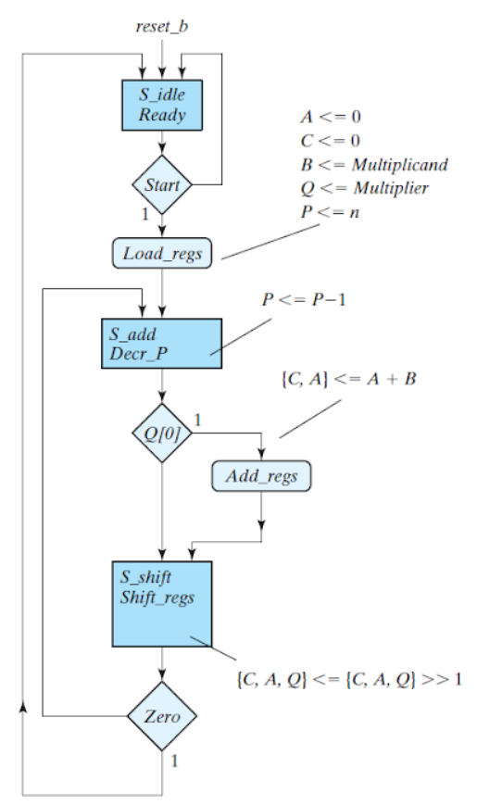
ASMD is the combination of the two

Slide 8
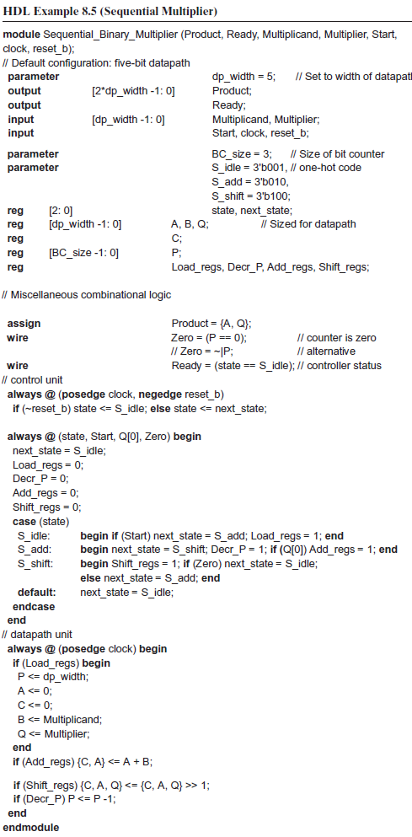
Translate ASMD to RTL
Setup
Control
Data

Slide 9
Looking at the code
can see ASM states = means blocking, sequential, line by line Load_reg output parent saying “clean up room”
can see ASM states = means non-blocking, parallel Load_reg input kids cleaning up room

Slide 10
Control Path
DataPath
Operations performed in block blocking .. sequential = clocked, synchronous batched if-then, case … loops Looks like flow chart More output than input Mostly assigning wires 1 and 0 Parent noticing room is messy, says: “clean up room.” Initiated in state A transferR1toR2 = 1 Conditionals coming from system inputs
operations performed in parallel non-blocking <= asynchronous speed of light no loops small bits of math decorating flow chart responses to control path Mostly changing/moving contents of registers Child cleaning up room Triggered in between states Executed in parallel in state B R2 ← R1 (data path notation) Conditionals coming from control path

