Slide 1
Introduction to Git and GitHub
Jacob Fiksel
PhD Candidate, JHSPH Biostatistics
Email: jfiksel@gmail.com
Twitter: @jfiksel1
GitHub: https://github.com/jfiksel

Slide 2

Has this happened to you?

Slide 3
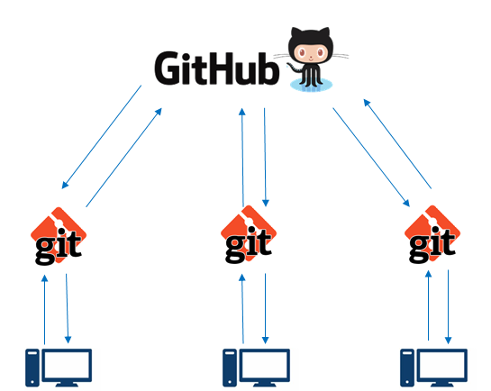
Git and GitHub allow for easy management and sharing of data analytic content

Slide 4


Difference between Git and GitHub
Version control system used on your computer
“Git manages the evolution of a set of files—called a repository or repo—in a sane, highly structured way. It is like the “Track Changes” feature from Microsoft Word, but more rigorous, powerful, and scaled up to multiple files” (Brian 2017)
Hosting service for git projects—essentially DropBox for git projects
Mainly used for collaboration and/or distributing code and software

Slide 5
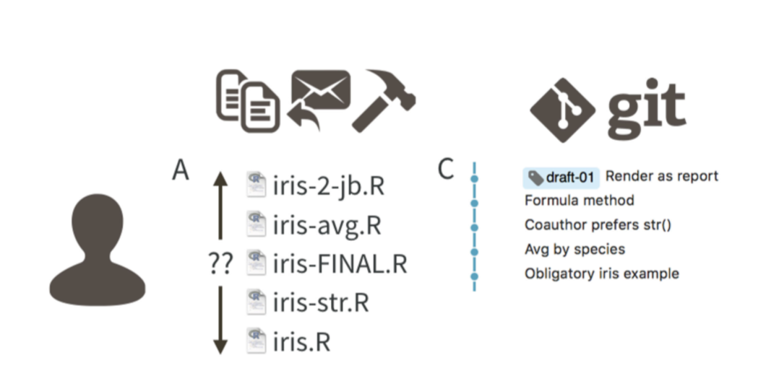
Git allows for tracking of a project through commit messages
Figure from Bryan (2017)

Slide 6
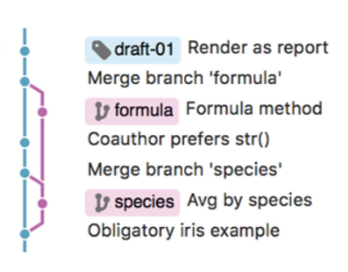
You can use branches when working as a team or on a new feature
Figure from Bryan (2017)

Slide 7
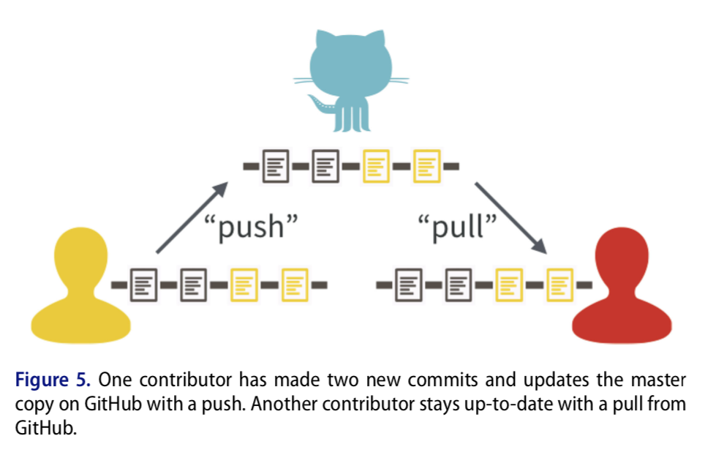
GitHub allows for easy collaboration on projects
Figure from Bryan (2017)

Slide 8
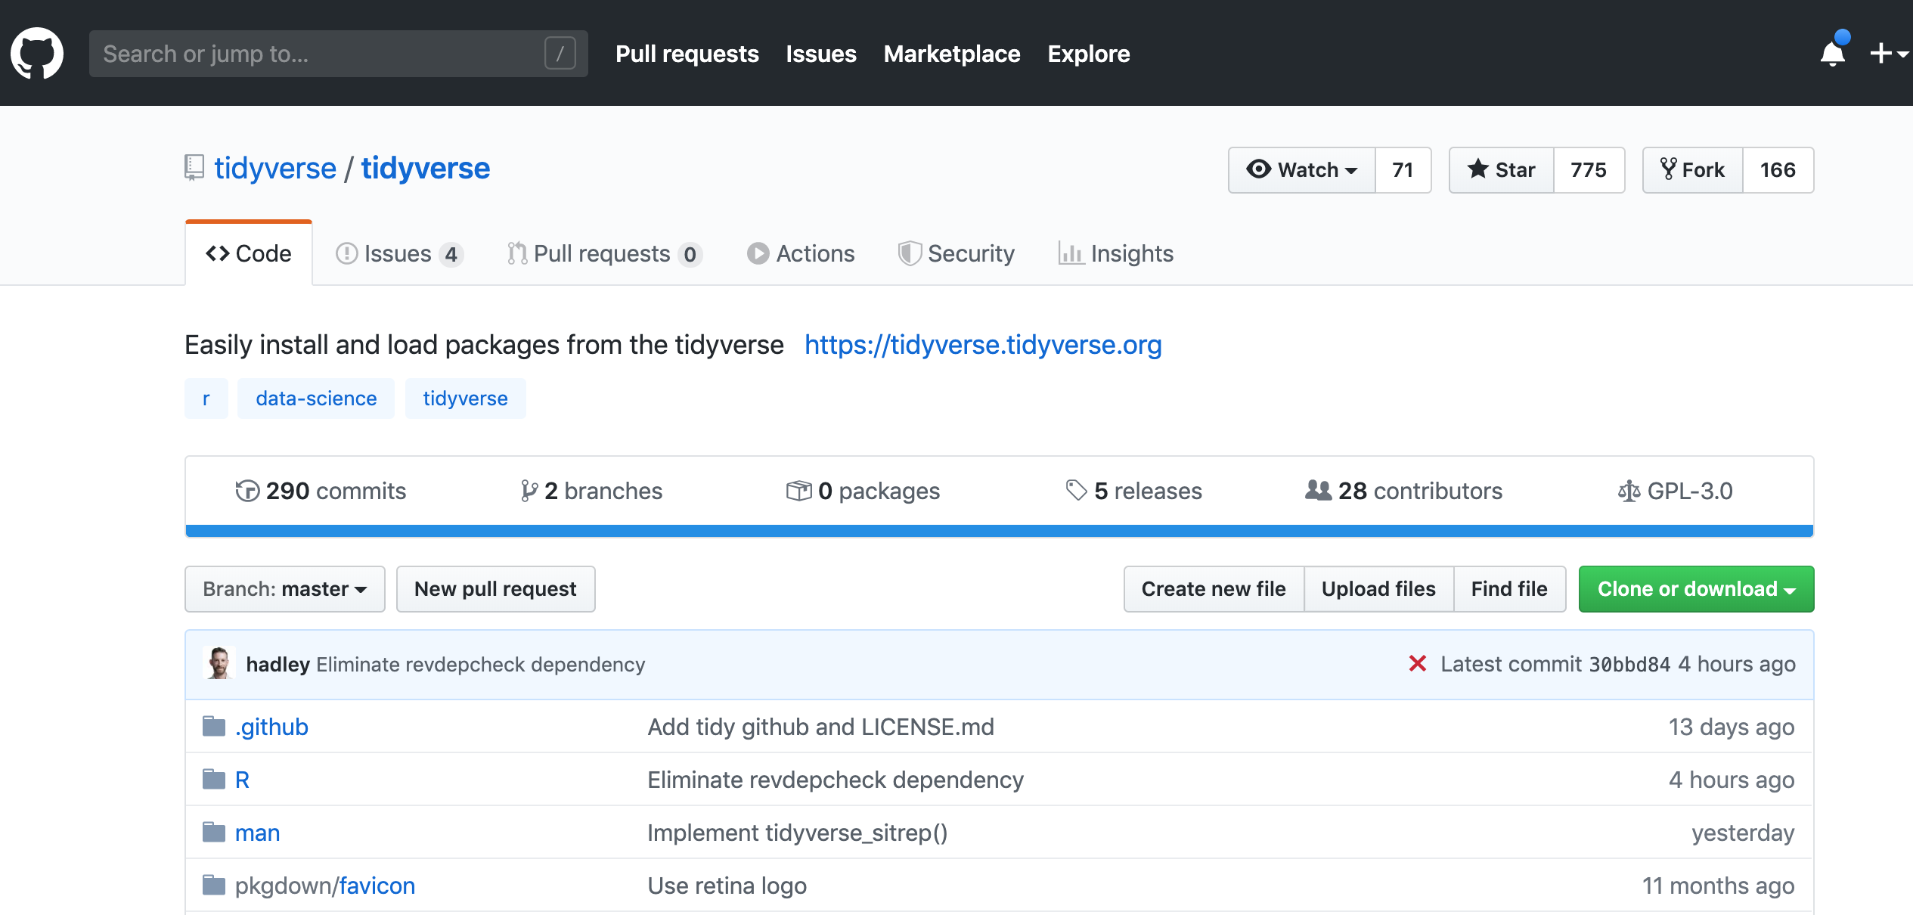
GitHub provides a great way to distribute software

Slide 9
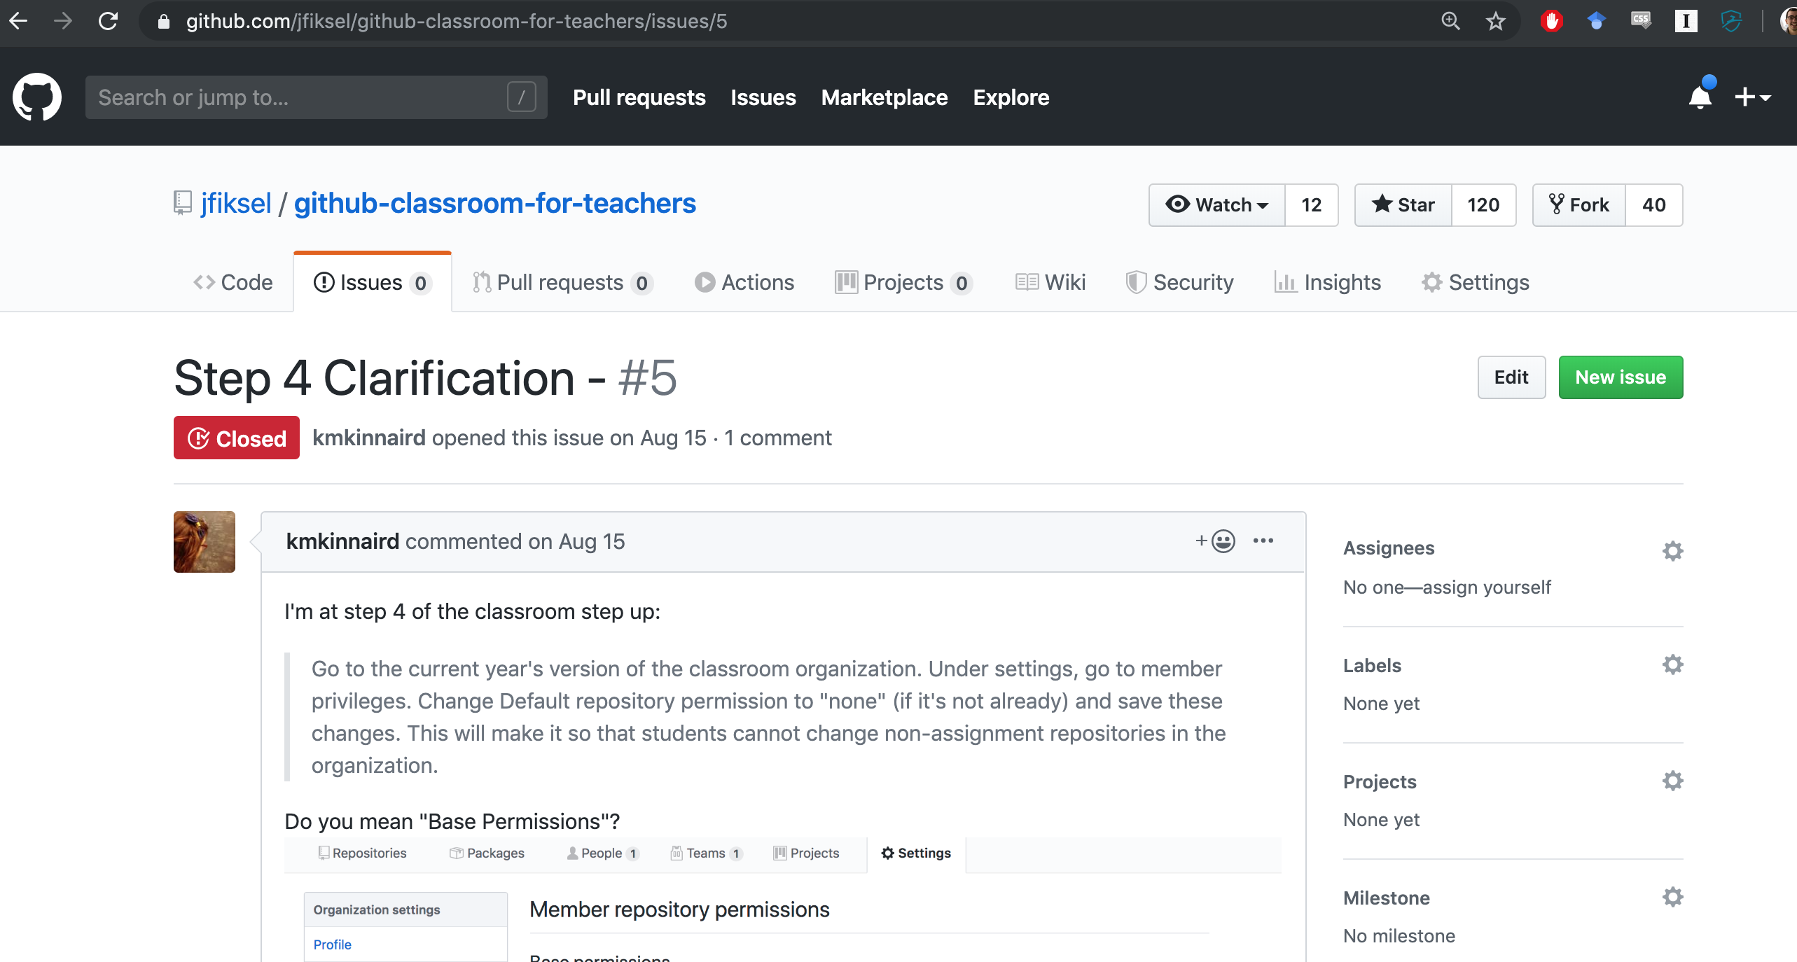
You can also submit issues if you’re having trouble with software

Slide 10
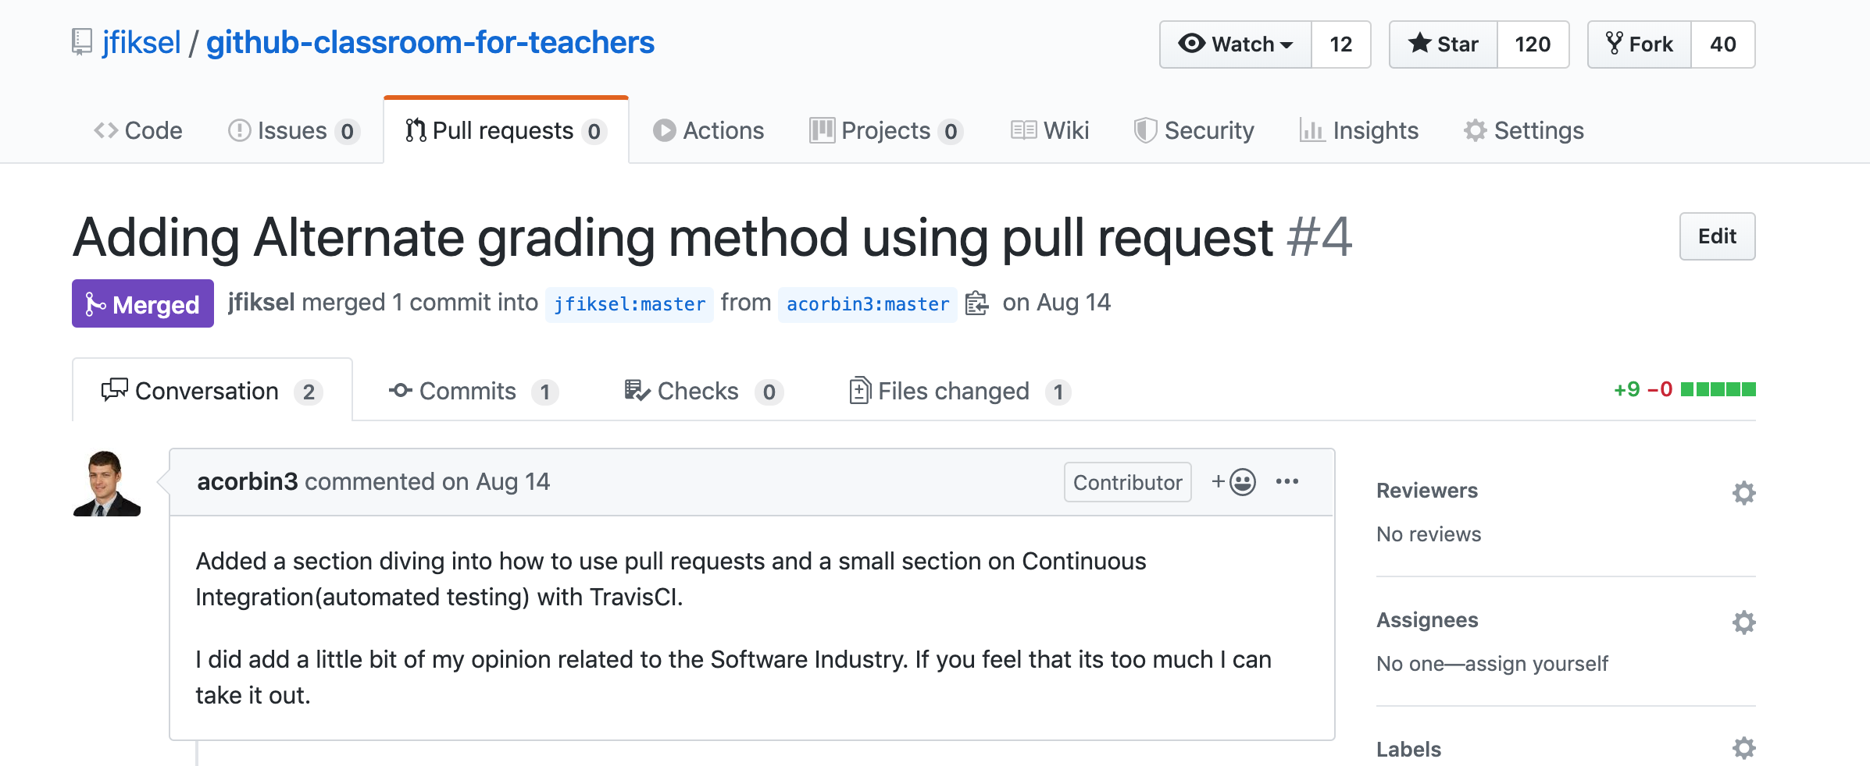
Pull requests allow you to collaborate on all public projects on GitHub!

Slide 11

Can easily distribute coding assignments to students
Knowing Git and GitHub is extremely valuable for working in industry, and this allows you to teach it to your students in a “controlled environment” (while also learning it yourself)
For more info: “Using GitHub Classroom to Teach Statistics” (Fiksel et al. 2019)

Slide 12
References
https://happygitwithr.com/
Extremely useful tool for learning Git and GitHub—based off using R/RStudio for analyses
https://learngitbranching.js.org/
Can help you visualize the process of using Git
“Excuse Me, Do You Have a Moment to Talk About Version Control?” (Bryan 2017)
Great paper for telling you why you should use Git and GitHub

Slide 13
You can view this presentation on my GitHub
https://github.com/jfiksel/intro_to_git_and_github

