Slide 1
Reducing RHEL9 STIG Performance Impacts
Jeremy Filizetti
jfilizetti AT ultrascale.net

Slide 2
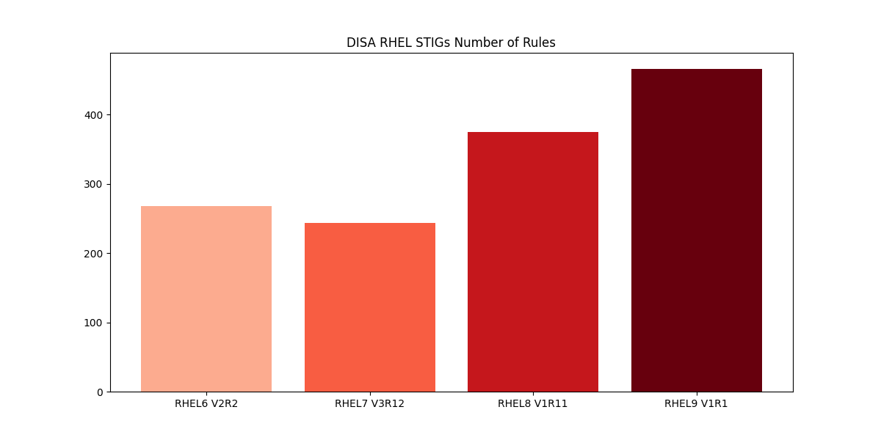
RHEL STIG Overview
Growing number of rules
  Software is more featured but this isn’t the only reason
  Increasing micro-management items
    3 rules to make sure a file is owned by root:root with specific permission

Slide 3
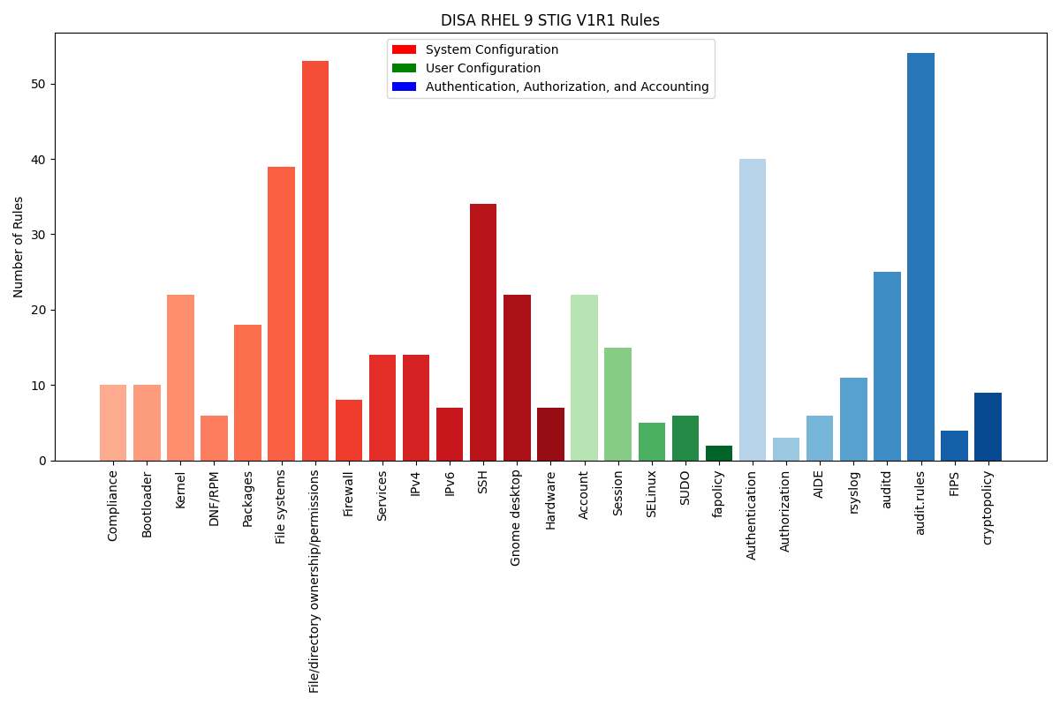
RHEL 9 Rules by Category
Organization has improved
  Some items fit in multiple categories
Bad recommendations remain
  Carving your disk up like a thanksgiving day turkey when using HDD
  File permissions still seem misunderstood by people creating it
  Some have the potential to create security issues themselves

Slide 4
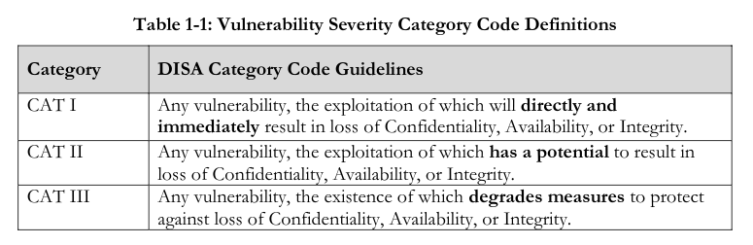
STIG Severity Guidelines
Severity ratings on many rules continue to be inaccurate
Some are downright off the wall

Slide 5
RHEL9 STIG Performance Testing
Many STIG configuration changes have minor impacts
A few items have major impacts
Testing was done to highlight several things
  Increased Latency
  Limiting throughput
  Wasted CPU
Names HBSS/McAfee/Trellix synonymously throughout

Slide 6
Equipment Used
Hardware
  Dell Poweredge R730
  2 – Intel E5-2620 v4
  128 GB RAM
  Storage on Intel Optane 900P
VM
  8 vcpu
  32 GB RAM
  qcow2 (no compression, backed by ext4 file system on optane)

Slide 7
Software Used
Linux perf
Flamegraphs
vmstat
Various custom python scripts to graph with matplotlib
LibreOffice for some graphs
draw.io for sequence diagram

Slide 8
Testing
Take a batch of small files and copy them
  Used linux kernel source (6.7.2)
    1.5 GB, 5382 directories, 82375 files
  Stored on a local file system
    No exceptions from fapolicy or McAfee/Trellix ENSL
  Copy files, copy extended attributes, set times (cp -a)
    Triggers audit actions to stress audit system

Slide 9
Rough sequence of tests
Tests ran for concurrency of 1 2 4 and 8
  echo 3 > /proc/sys/vm/drop_caches
  sudo perf record -o perf.cp.data -F 47 -a -g sudo -u jeremy /bin/time -f 'seconds %e system: %S user: %U' bash -c "seq 1 $concurrency | xargs -P 0 -i cp -a ~/linux-6.7.2 ~/dest_{} 2> /dev/null" 2>&1 | tee results.log
  sudo perf script -i perf.cp.data > perf.cp.data.script
  sudo perf report -i perf.cp.data --no-children --sort overhead,pid -F overhead,overhead_sys,overhead_us,pid --max-stack=0 --stdio | tee perf-report.log
  seq 1 $concurrency | xargs -P 0 -i rm -rf ~/dest_{}

Slide 10
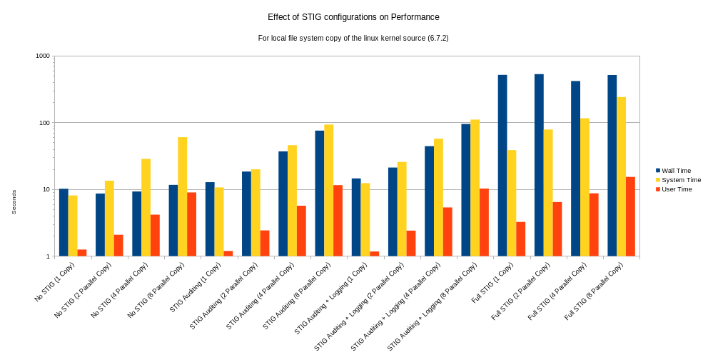
Performance isn’t that bad?
Wall Time in blue highlights increased latency

Slide 11
It is. Log scale is deceiving
Wall Time in blue highlights increased latency

Slide 12
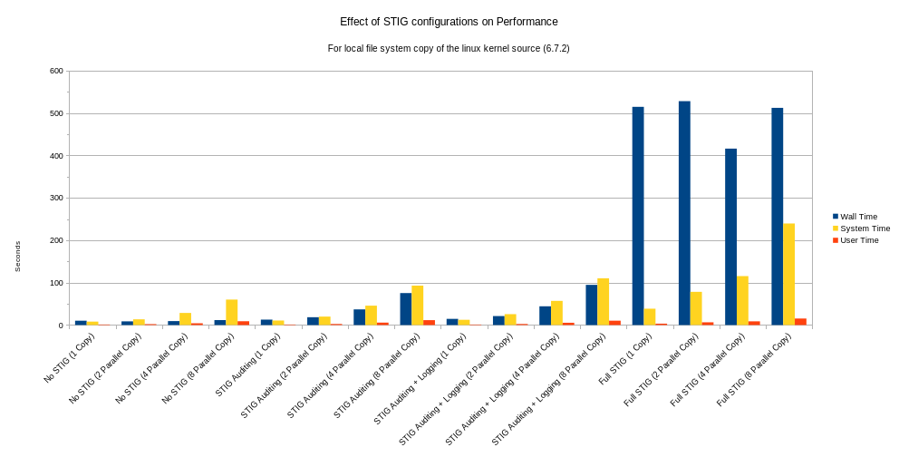
Performance is terrible

Slide 13
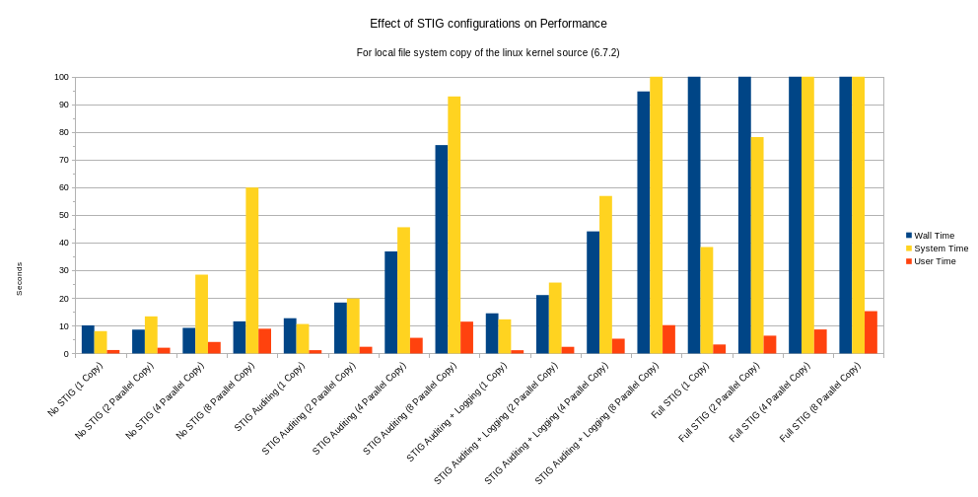
Performance is terrible (zoomed)

Slide 14
Performance Impact
Auditing
  1.5-6.5x longer wall time
  Up to 1.5x more CPU utilization
Auditing with audit logs sent to syslog
  1.4-8.2x longer wall time
  Up to 2x more CPU utilization
Full STIG
  44-61x longer wall time
  Up to 5.8x more CPU utilization

Slide 15
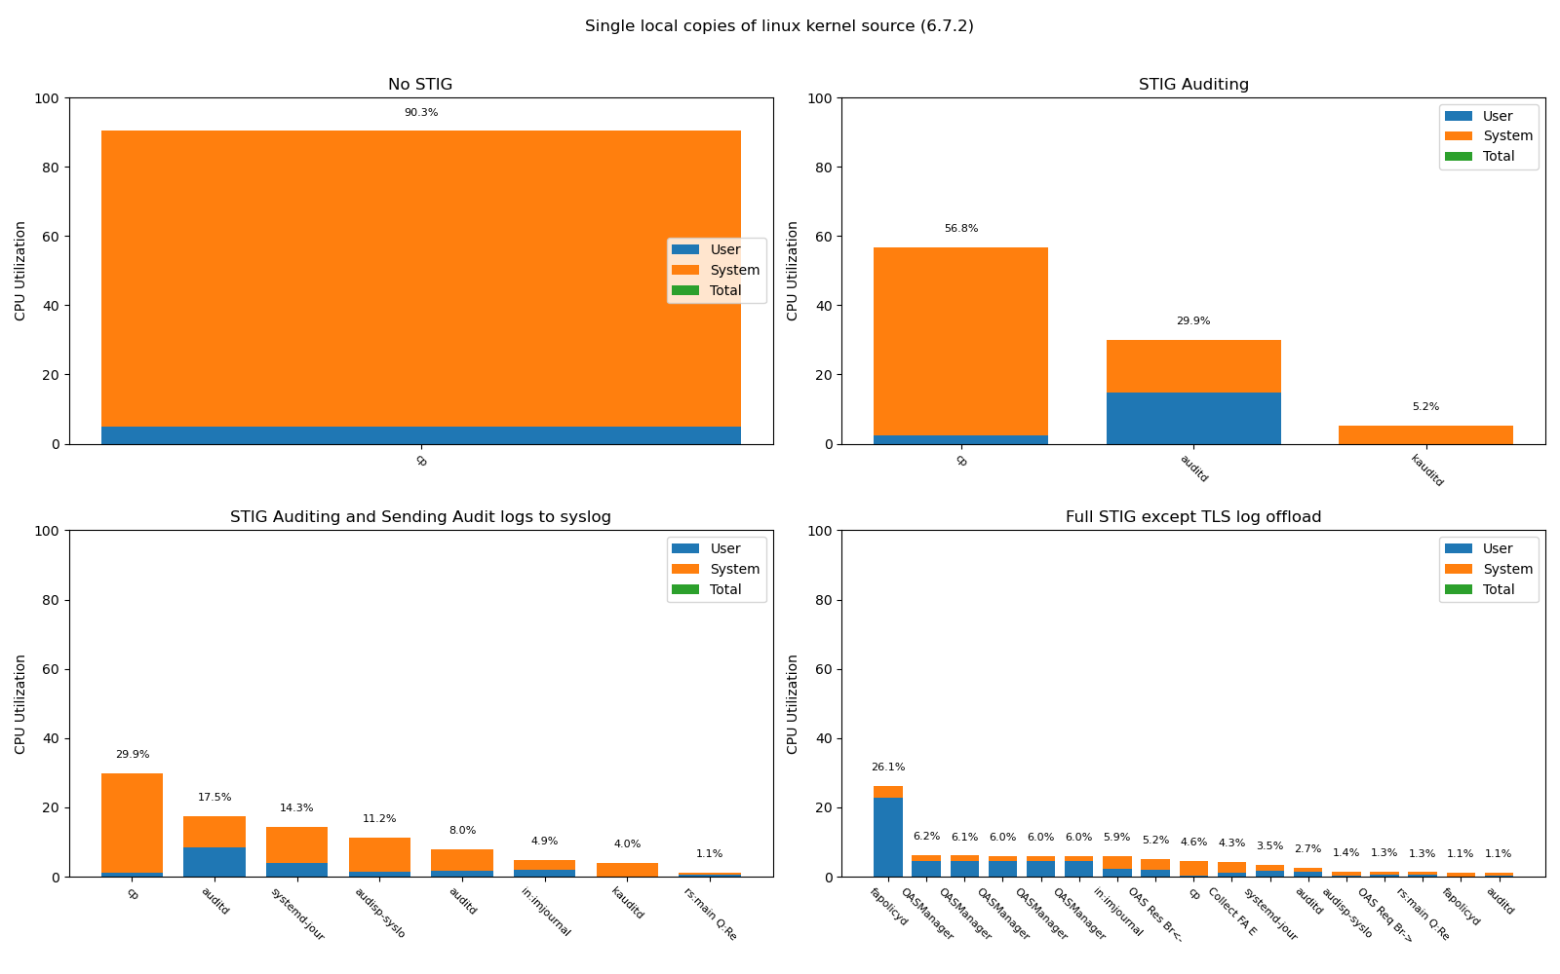
Comparisons on following slides
Baseline (top left):
This is how things should run
Auditing impact
(top right):
Auditing goes to audit daemon and auditd logging only.
Auditing and logging
(bottom left)
Duplicative logging due
to RHEL-09-652035.
But fixes deficiency of STIG log dropping due rate limiting. Added to /etc/rsyslog.conf:
$imjournalRatelimitInterval 0
$imjournalRatelimitBurst 0
Roughly the full STIG
(bottom right):
fapolicyd, McAfee impacts are visible in combination with auditing and logging.
By far the biggest impact is McAfee
Idle/swapper thread removed from results

Slide 16
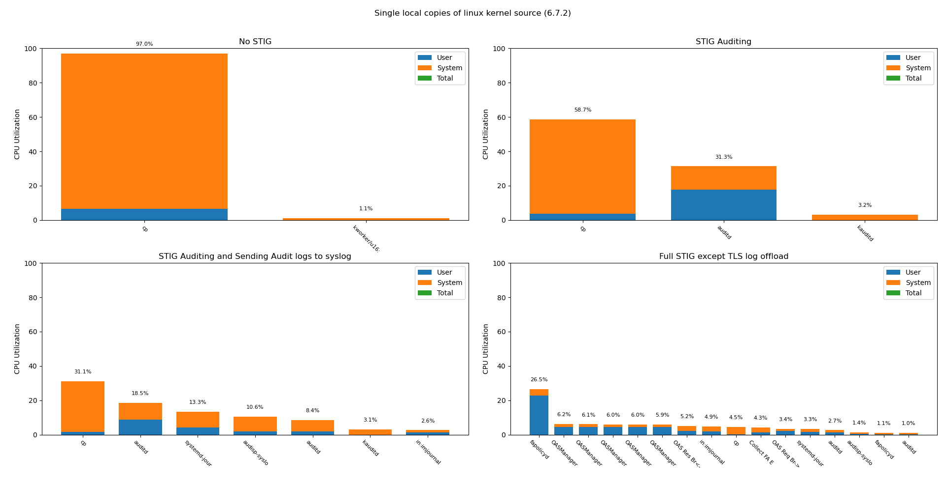
Single Copy (processes >1% CPU)

Slide 17
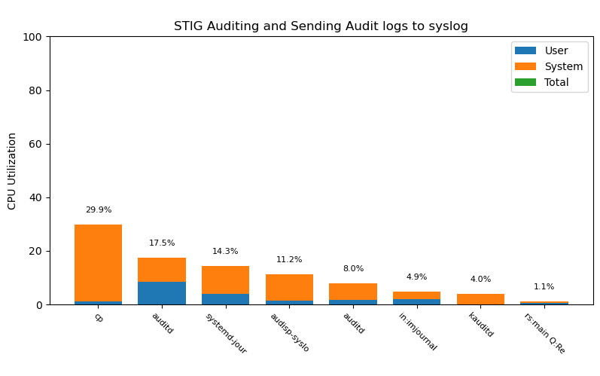
Duplicative Logging (RHEL-09-652035)
Audit dispatcher to syslog
systemd-journal
rsyslog

Slide 18
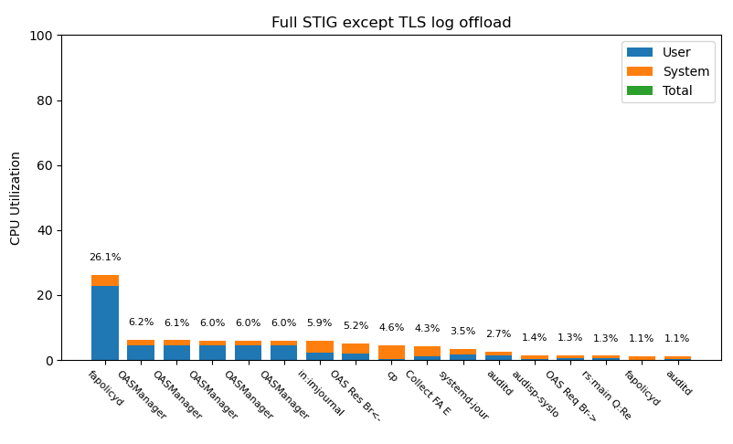
Full STIG consumed by “security” tools
fapolicyd
McAfee/Trellix

Slide 19
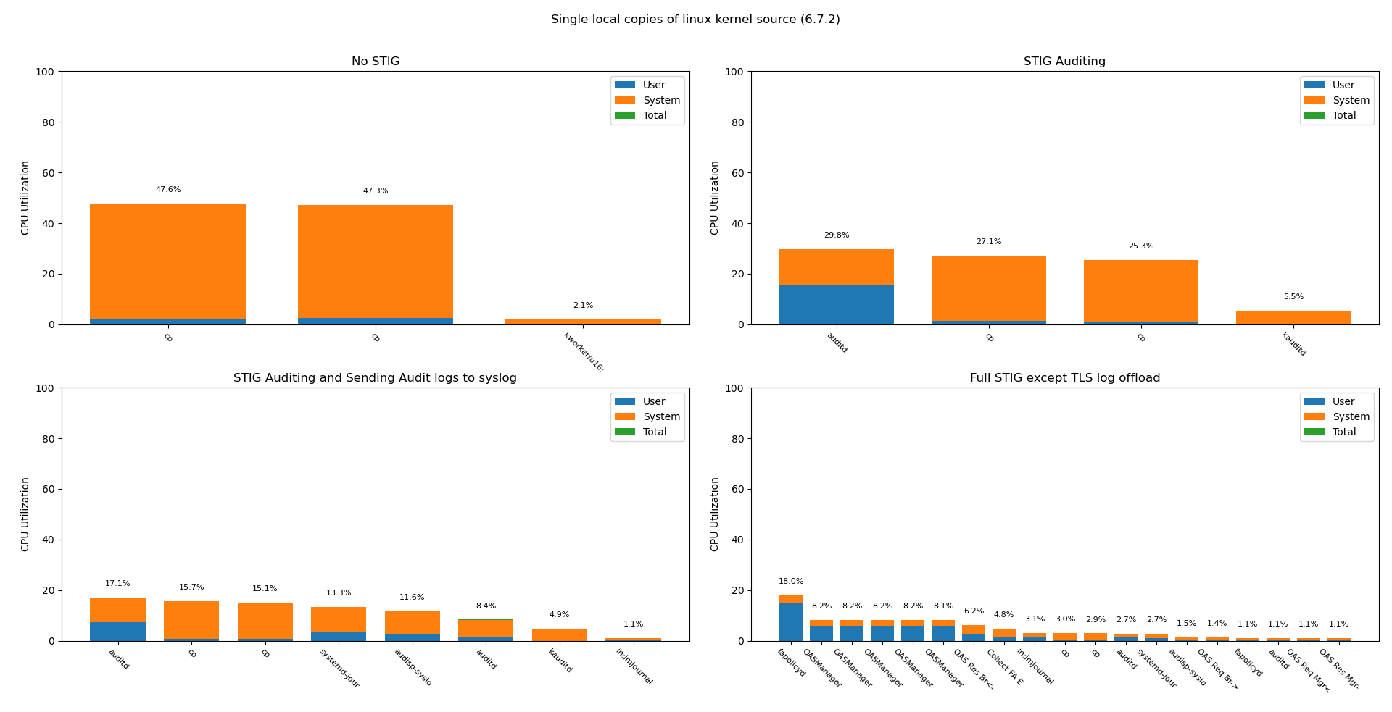
2 in Parallel (processes >1% CPU)
Auditing bottleneck

Slide 20
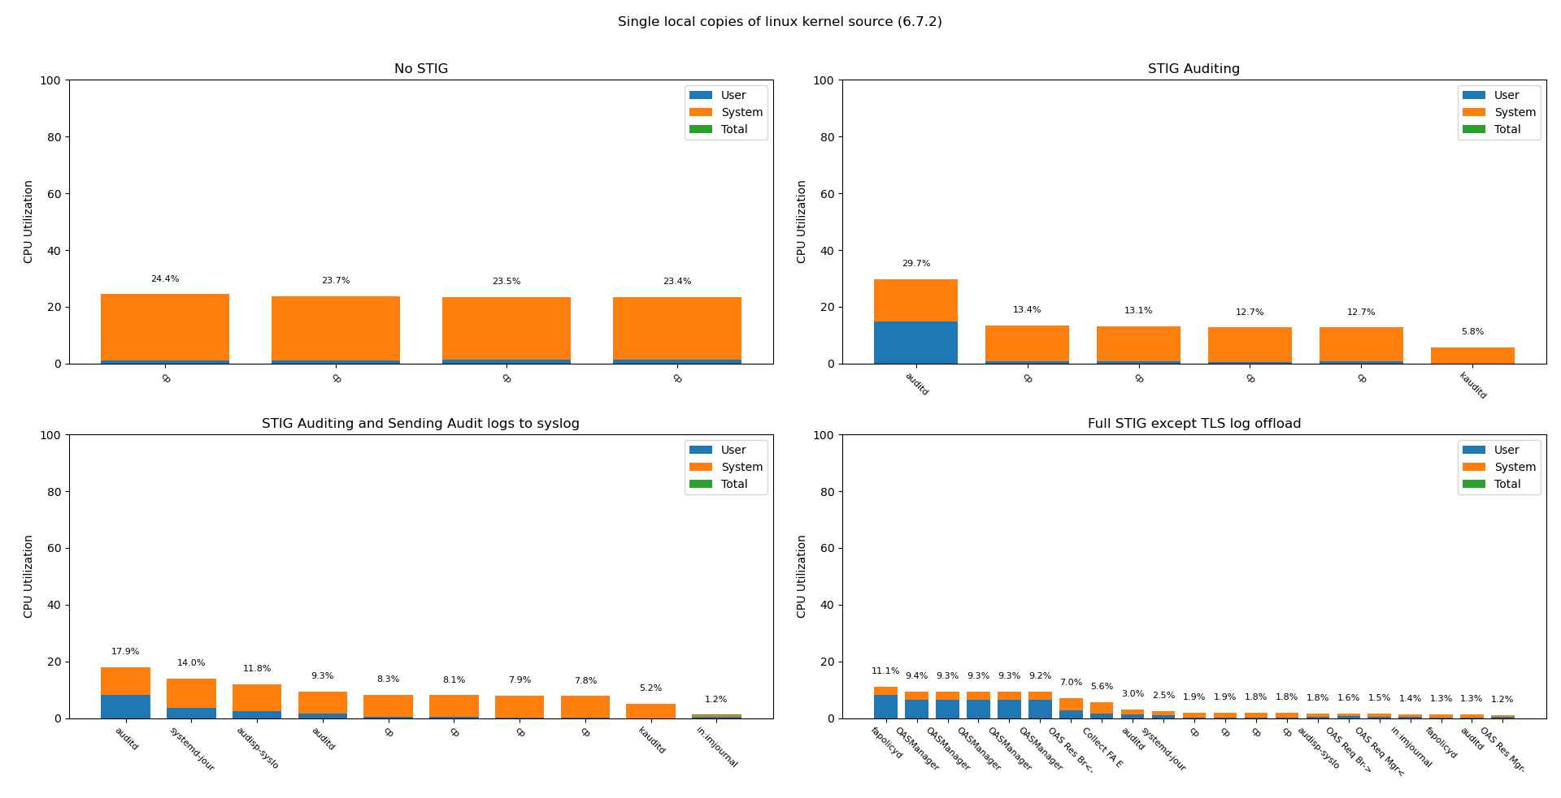
4 in Parallel (processes >1% CPU)
Auditing bottleneck

Slide 21
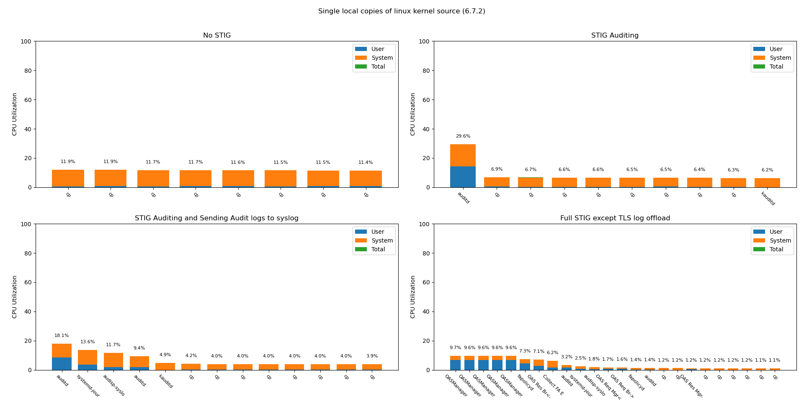
8 in Parallel (processes >1% CPU)
Auditing bottleneck

Slide 22
Tests in CPU Utilization graphs
Single copy
Remove files
Two copies in parallel
Remove files
Four copies in parallel
Remove files

Slide 23
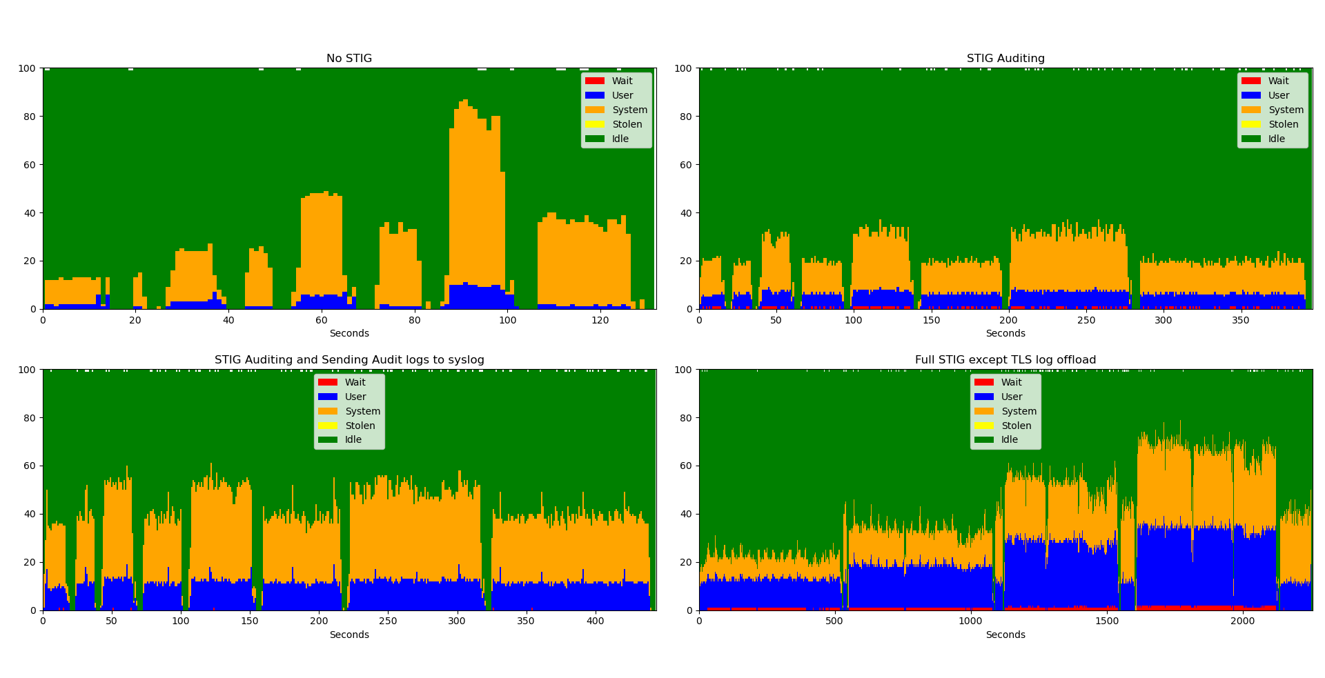
All Tests CPU Utilization

Slide 24
All Tests CPU Utilization (Annotated)
Copies are single threaded but with 8
close to all 8 vCPUs used
Performance starved by auditing bottleneck

Slide 25
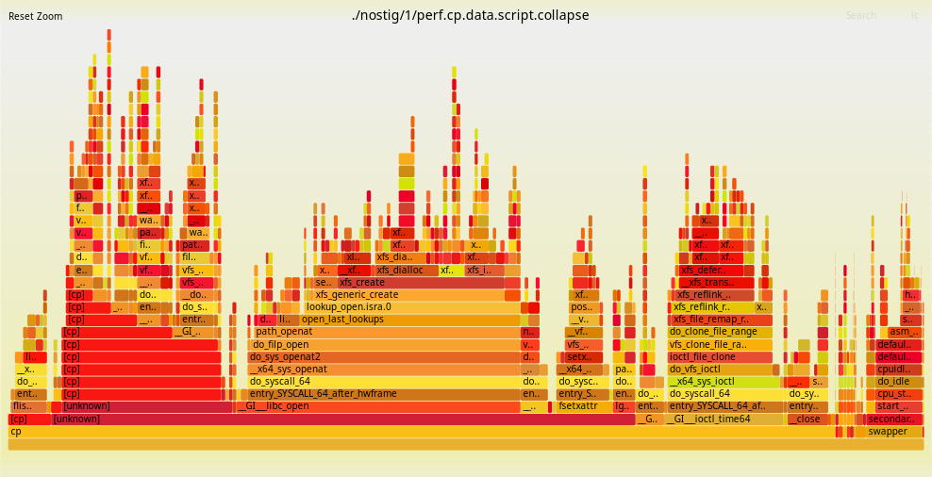
Single Copy No STIG

Slide 26
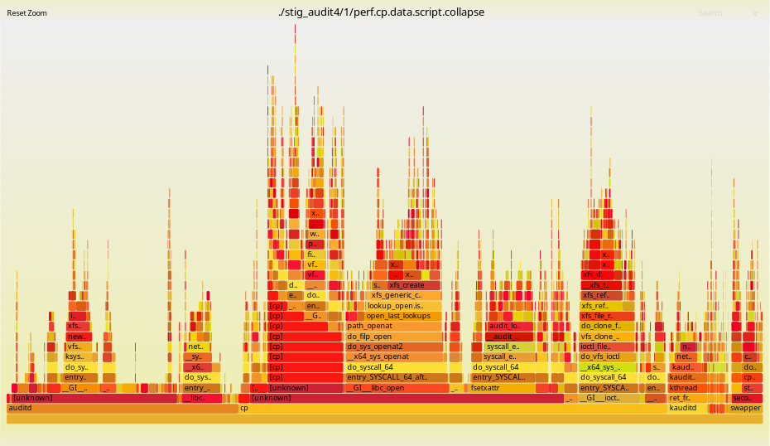
Single Copy STIG Auditing

Slide 27
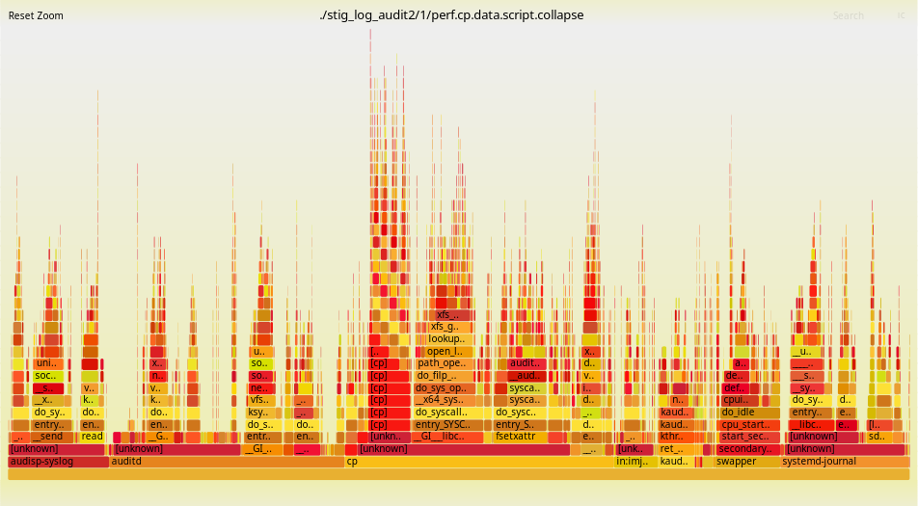
Single Copy STIG Auditing and Logging

Slide 28
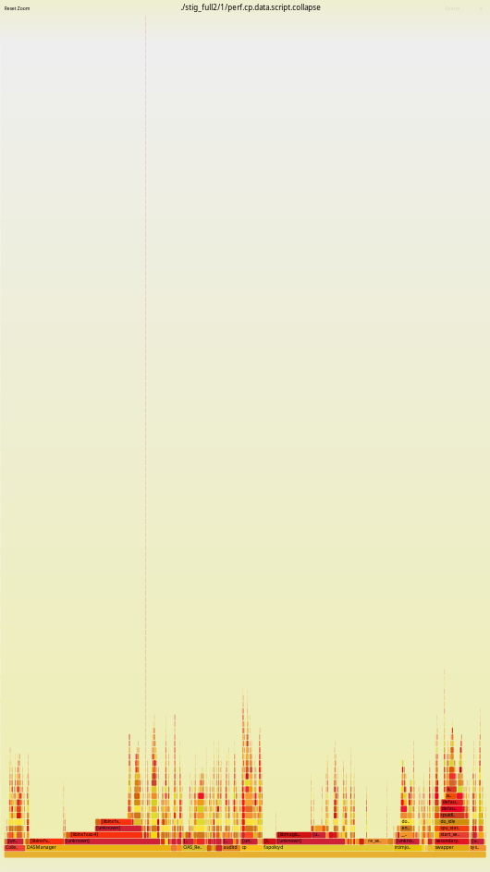
Single Copy Full STIG (without offload)

Slide 29
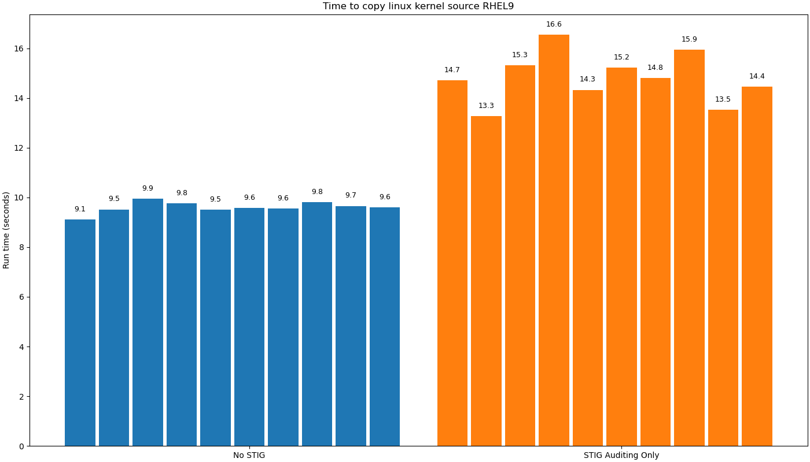
10 Runs (auditing impact)

Slide 30
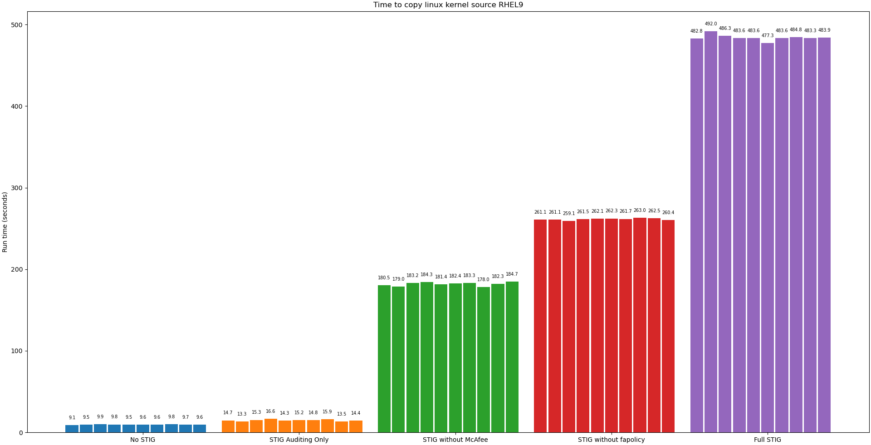
10 Runs (fapolicy, McAfee impact)

Slide 31
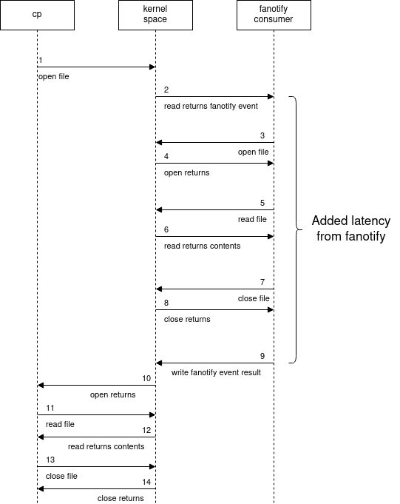
fapolicy and HBSS problems
Multiple fapolicy consumers
  HBSS/McAfee/Trellix
    Adds the most latency because on-demand scanning is being performed
  fapolicyd
    Default policy has several rules but is generally has less overhead then HBSS

Slide 32
Recommendations/Findings
Reduce Auditing
Don’t implement RHEL-09-652035
  Use a different way to offload audit logs
Don’t use fapolicy RHEL-09-433015
  There are many trivial ways to bypass
  Can’t ignore the cost
Don’t use HBSS (McAfee/Trellix) RHEL-09-211025
  Single biggest impact to system performance from the STIG
  Also trivial to bypass
  Keep systems up to date and run vetted software
  Traditional AV is antiquated thinking

Slide 33
Recommendations/Findings
Auditing in linux is a bottleneck
  Reduce auditing by removing pointless item (next slides)
  Auditing random DAC failures is just noise
DO audit methods of privilege escalation
  The STIG is incomplete here
  Audit execution of all privileged binaries (capabilities and SUID/SGID)
  Audit anything altering kernel modules
  Even better use secure boot and kernel lockdown mode
Use EDR (within reason) but only if it’s not a custom kernel modules
  eBPF enables all the functionality a reasonable EDR should need
Just because it’s in NIST SP 800-53 doesn’t mean its a good idea
  Push back when it degrades your performance or usability

Slide 34
Reduced Auditing Rules
-a always,exit -F arch=b33 -S execve -C uid!=euid -F euid=0 -k execpriv
-a always,exit -F arch=b64 -S execve -C uid!=euid -F euid=0 -k execpriv
-a always,exit -F arch=b32 -S execve -C gid!=egid -F egid=0 -k execpriv
-a always,exit -F arch=b64 -S execve -C gid!=egid -F egid=0 -k execpriv
-a always,exit -F arch=b32 -S delete_module -F auid>=1000 -F auid!=unset -k module_chng
-a always,exit -F arch=b64 -S delete_module -F auid>=1000 -F auid!=unset -k module_chng
-a always,exit -F arch=b32 -S init_module,finit_module -F auid>=1000 -F auid!=unset -k module_chng
-a always,exit -F arch=b64 -S init_module,finit_module -F auid>=1000 -F auid!=unset -k module_chng
-a always,exit -F path=/usr/bin/umount -F perm=x -F auid>=1000 -F auid!=unset -k privileged-mount
-a always,exit -F path=/usr/bin/chacl -F perm=x -F auid>=1000 -F auid!=unset -k perm_mod
-a always,exit -F path=/usr/bin/setfacl -F perm=x -F auid>=1000 -F auid!=unset -k perm_mod
-a always,exit -F path=/usr/bin/chcon -F perm=x -F auid>=1000 -F auid!=unset -k perm_mod
-a always,exit -F path=/usr/sbin/semanage -F perm=x -F auid>=1000 -F auid!=unset -k privileged-unix-update
-a always,exit -F path=/usr/sbin/setfiles -F perm=x -F auid>=1000 -F auid!=unset -k privileged-unix-update
-a always,exit -F path=/usr/bin/chage -F perm=x -F auid>=1000 -F auid!=unset -k privileged-chage
-a always,exit -F path=/usr/bin/chsh -F perm=x -F auid>=1000 -F auid!=unset -k priv_cmd
-a always,exit -F path=/usr/bin/crontab -F perm=x -F auid>=1000 -F auid!=unset -k privileged-crontab
-a always,exit -F path=/usr/bin/gpasswd -F perm=x -F auid>=1000 -F auid!=unset -k privileged-gpasswd
-a always,exit -F path=/usr/bin/kmod -F perm=x -F auid>=1000 -F auid!=unset -k modules
-a always,exit -F path=/usr/bin/newgrp -F perm=x -F auid>=1000 -F auid!=unset -k priv_cmd
-a always,exit -F path=/usr/sbin/pam_timestamp_check -F perm=x -F auid>=1000 -F auid!=unset -k privileged-pam_timestamp_check
-a always,exit -F path=/usr/bin/passwd -F perm=x -F auid>=1000 -F auid!=unset -k privileged-passwd
-a always,exit -F path=/usr/sbin/postdrop -F perm=x -F auid>=1000 -F auid!=unset -k privileged-unix-update
-a always,exit -F path=/usr/sbin/postqueue -F perm=x -F auid>=1000 -F auid!=unset -k privileged-unix-update
-a always,exit -F path=/usr/bin/ssh-agent -F perm=x -F auid>=1000 -F auid!=unset -k privileged-ssh
-a always,exit -F path=/usr/libexec/openssh/ssh-keysign -F perm=x -F auid>=1000 -F auid!=unset -k privileged-ssh
-a always,exit -F path=/usr/bin/su -F perm=x -F auid>=1000 -F auid!=unset -k privileged-priv_change
-a always,exit -F path=/usr/bin/sudo -F perm=x -F auid>=1000 -F auid!=unset -k priv_cmd
-a always,exit -F path=/usr/bin/sudoedit -F perm=x -F auid>=1000 -F auid!=unset -k priv_cmd
-a always,exit -F path=/usr/sbin/unix_chkpwd -F perm=x -F auid>=1000 -F auid!=unset -k privileged-unix-update
-a always,exit -F path=/usr/sbin/unix_update -F perm=x -F auid>=1000 -F auid!=unset -k privileged-unix-update
-a always,exit -F path=/usr/sbin/userhelper -F perm=x -F auid>=1000 -F auid!=unset -k privileged-unix-update
-a always,exit -F path=/usr/sbin/usermod -F perm=x -F auid>=1000 -F auid!=unset -k privileged-usermod
-a always,exit -F path=/usr/bin/mount -F perm=x -F auid>=1000 -F auid!=unset -k privileged-mount
-a always,exit -F path=/usr/sbin/init -F perm=x -F auid>=1000 -F auid!=unset -k privileged-init
-a always,exit -F path=/usr/sbin/poweroff -F perm=x -F auid>=1000 -F auid!=unset -k privileged-poweroff
-a always,exit -F path=/usr/sbin/reboot -F perm=x -F auid>=1000 -F auid!=unset -k privileged-reboot
-a always,exit -F path=/usr/sbin/shutdown -F perm=x -F auid>=1000 -F auid!=unset -k privileged-shutdown
-a always,exit -F arch=b32 -S umount -F auid>=1000 -F auid!=unset -k privileged-umount
-w /etc/sudoers -p wa -k identity
-w /etc/sudoers.d/ -p wa -k identity
-w /etc/group -p wa -k identity
-w /etc/gshadow -p wa -k identity
-w /etc/security/opasswd -p wa -k identity
-w /etc/passwd -p wa -k identity
-w /etc/shadow -p wa -k identity
-w /var/log/faillock -p wa -k logins
-w /var/log/lastlog -p wa -k logins
-f 2
-e 2
--loginuid-immutable

Slide 35
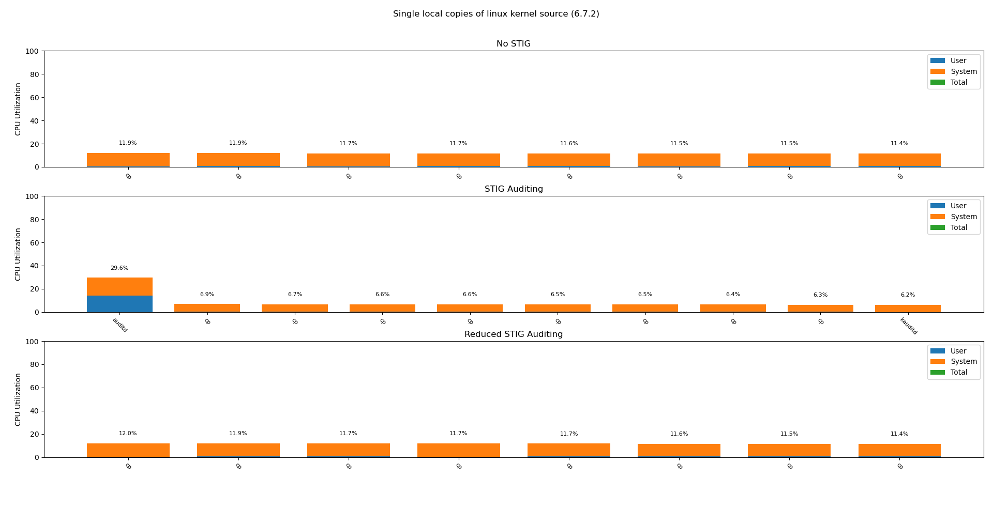
Reduced Auditing Impact

Slide 36
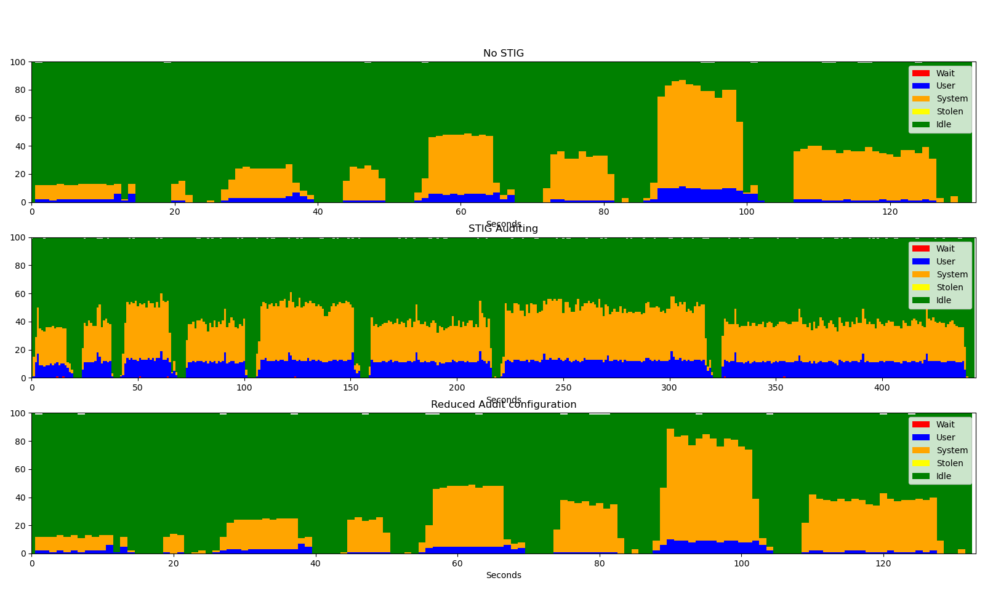
Reduced Auditing Impact

Slide 37
Future work / Other issues
There are plenty of issues I haven’t touched on
  Not directly performance related
  Captured in other documents
Working on approval to release ansible playbook for those interested
Working on a set of eBPF/bpftrace one liners to characterize the performance impacts

Slide 38

Conclusion
Don’t let bad “security” recommendations destroy your system’s performance

