Slide 1
Enhance your monitoring with RTL-SDR
@JayFoxtrot

Slide 2
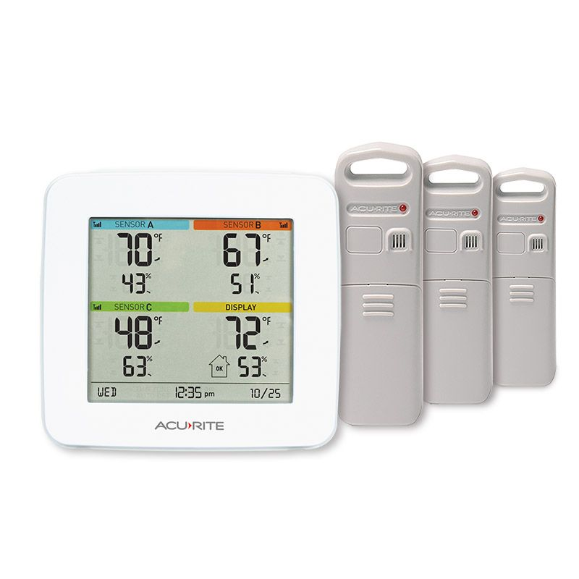
Simple Monitoring of Temperature and Humidity
Acurite temp and humidity 3-pack
  Reasonably priced ($70 on amazon)
  One console which has temp/humidity sensor
  Decent range (within 300 ft)

Slide 3
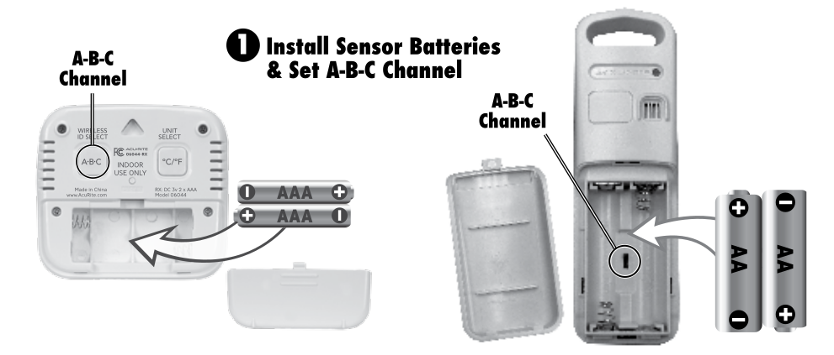
Simple Monitoring of Temperature and Humidity Problems
Instantaneous data but no history
No logging and notifications
Can’t increase sensors (channel selectors support only A, B, C)

Slide 4
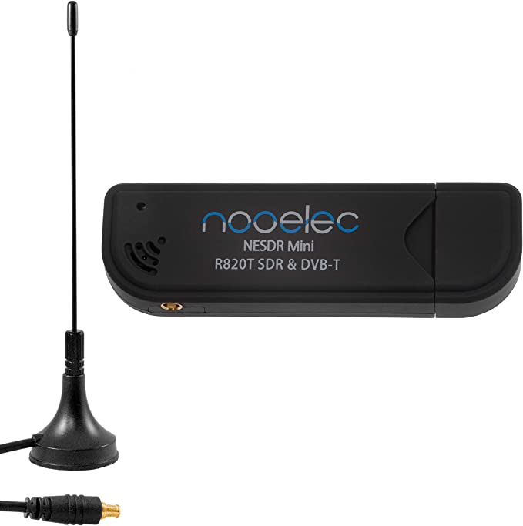
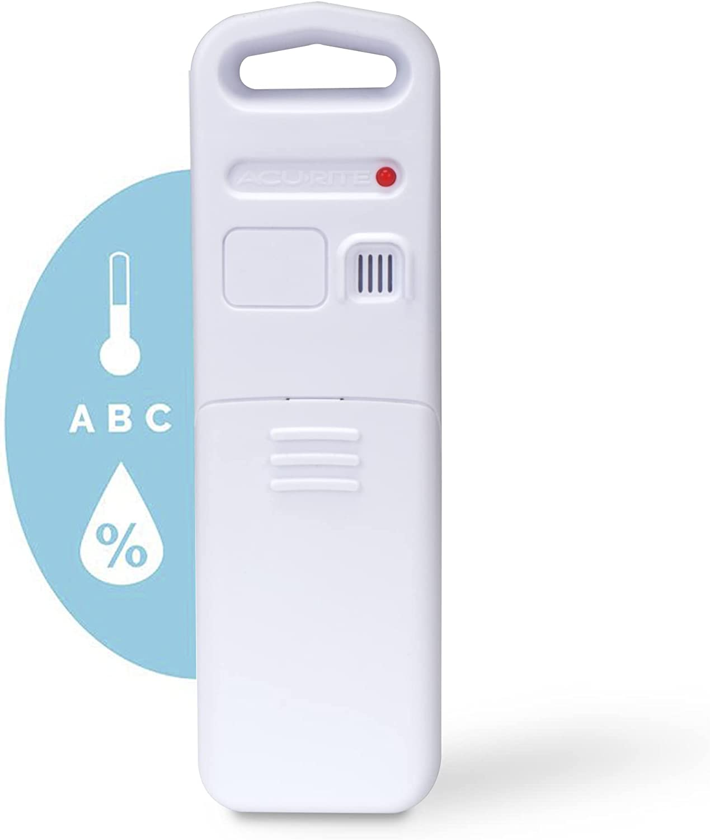
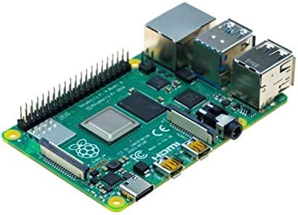
SDR to the rescue
Add a computer and a cheap SDR dongle
  Raspberry Pi ($30-$100)
  Noo Electric RTL-SDR ($27 amazon)
  Additonal sensors 06002M ($35 amazon)

Slide 5
Raspberry Pi
Plug in RTL-SDR USB adapter
Run rtl_433 code
  Decodes data from temp sensors
Run a time series database (InfluxDB)
  Any TSDB can work
Grafana to host dashboard

Slide 6
Building and Installing rtl_433
Easy to build/install on rasbian
  Instructions in the documentation
  But rough steps:
sudo apt install -y librtlsdr-dev
git clone https://github.com/merbanan/rtl_433.git
cd rtl_433
mkdir build
cd build
cmake ..
make -j $(nproc)
cd ..
./build/src/rtl_433 -d rtl_tcp -C customary -F json | ~/temp_to_influx.py

Slide 7
Running rtl_433
Sample Output
pi@stream1:~ $ rtl_433/build/src/rtl_433 -d rtl_tcp -C customary -F json
rtl_433 version 21.12-160-geee869e7 branch master at 202210252023 inputs file rtl_tcp RTL-SDR
Use -h for usage help and see https://triq.org/ for documentation.
Trying conf file at "rtl_433.conf"...
Trying conf file at "/home/pi/.config/rtl_433/rtl_433.conf"...
Trying conf file at "/usr/local/etc/rtl_433/rtl_433.conf"...
Trying conf file at "/etc/rtl_433/rtl_433.conf"...
Registered 191 out of 223 device decoding protocols [ 1-4 8 11-12 15-17 19-23 25-26 29-36 38-60 63 67-71 73-100 102-105 108-116 119 121 124-128 130-149 151-161 163-168 170-175 177-197 199 201-215 217-223 ]
rtl_tcp input from localhost port 1234
connect: Connection refused
rtl_tcp connected to localhost:1234 (Tuner: R820T)
Sample rate set to 250000 S/s.
Tuner gain set to Auto.
Tuned to 433.920MHz.
baseband_demod_FM: low pass filter for 250000 Hz at cutoff 25000 Hz, 40.0 us
{"time" : "2023-01-29 19:40:51", "model" : "Acurite-Tower", "id" : 14435, "channel" : "C", "battery_ok" : 1, "temperature_F" : 68.900, "humidity" : 41, "mic" : "CHECKSUM"}
{"time" : "2023-01-29 19:40:52", "model" : "Acurite-Tower", "id" : 15574, "channel" : "C", "battery_ok" : 1, "temperature_F" : 69.440, "humidity" : 43, "mic" : "CHECKSUM"}
{"time" : "2023-01-29 19:40:52", "model" : "Acurite-Tower", "id" : 15574, "channel" : "C", "battery_ok" : 1, "temperature_F" : 69.440, "humidity" : 43, "mic" : "CHECKSUM"}
{"time" : "2023-01-29 19:40:52", "model" : "Acurite-Tower", "id" : 15574, "channel" : "C", "battery_ok" : 1, "temperature_F" : 69.440, "humidity" : 43, "mic" : "CHECKSUM"}
{"time" : "2023-01-29 19:40:52", "model" : "Acurite-Tower", "id" : 15441, "channel" : "C", "battery_ok" : 1, "temperature_F" : 47.300, "humidity" : 55, "mic" : "CHECKSUM"}
{"time" : "2023-01-29 19:40:52", "model" : "Acurite-Tower", "id" : 15441, "channel" : "C", "battery_ok" : 1, "temperature_F" : 47.300, "humidity" : 55, "mic" : "CHECKSUM"}
{"time" : "2023-01-29 19:40:52", "model" : "Acurite-Tower", "id" : 15441, "channel" : "C", "battery_ok" : 1, "temperature_F" : 47.300, "humidity" : 55, "mic" : "CHECKSUM"}

Slide 8
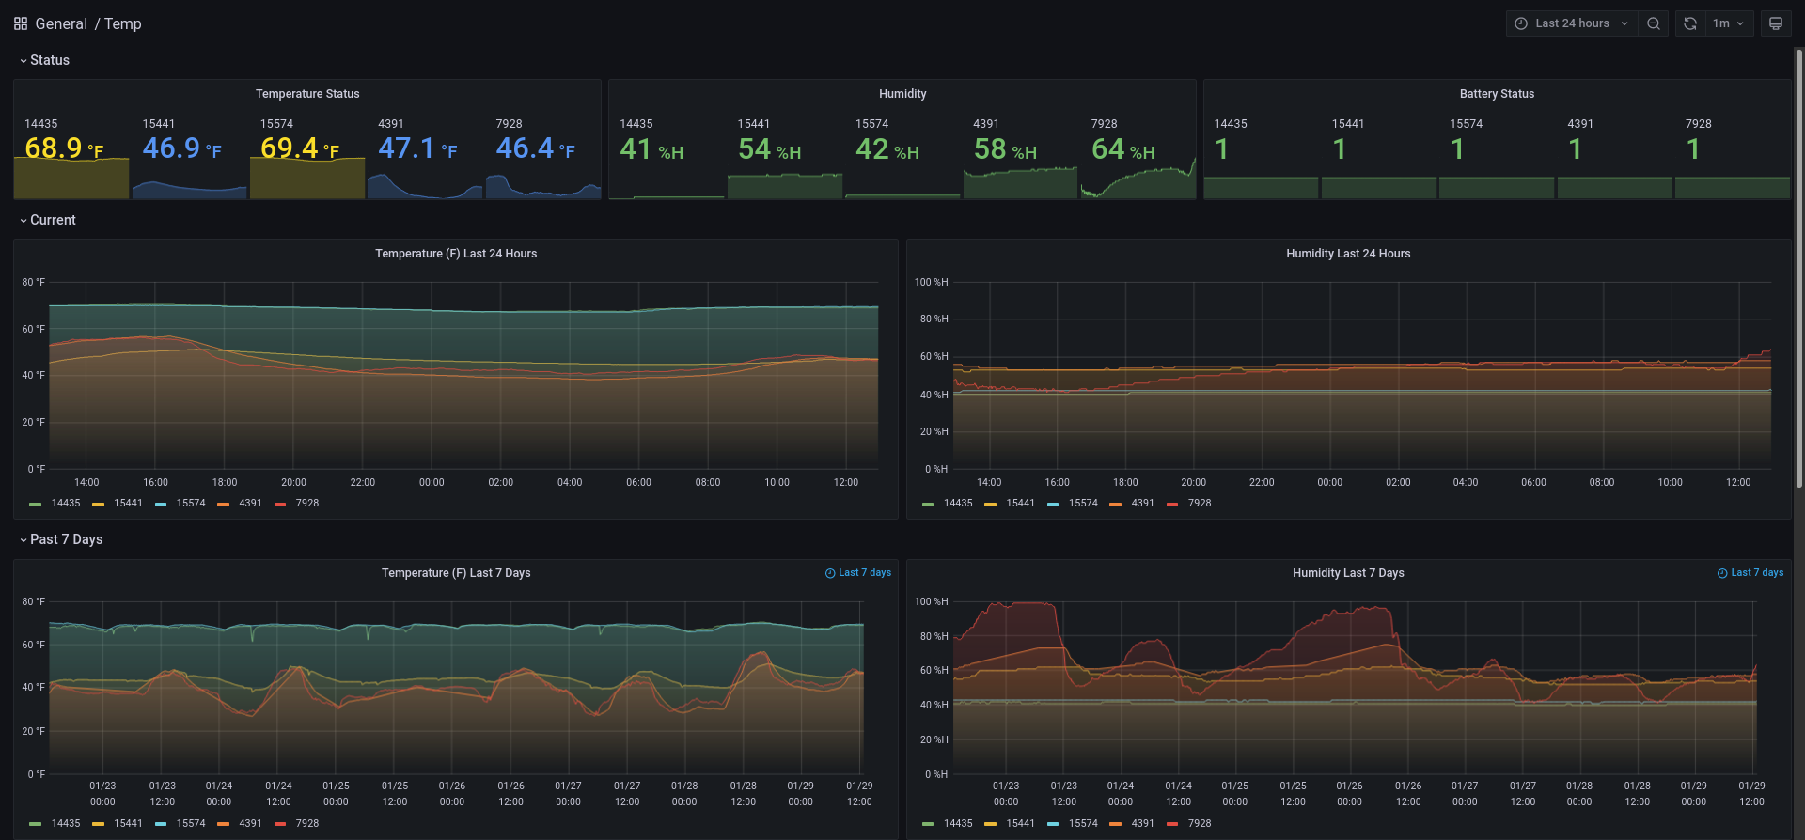
Grafana Temp Dashboards

Slide 9
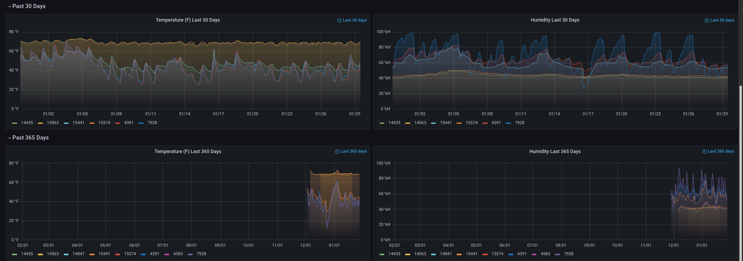
Grafana Temp Dashboards

Slide 10
Power Monitoring
Many homes have Itron Smart Meters
  Power company reads them once a month from a vehicle in close proximity
  Some have cellular capabilities to eliminate the need for close proximity

Slide 11
Power Monitoring
Data is seldom accessible to users from the power company
NOVEC launched a new customer portal last year
Users can now download their data
Already had access to the last year of monthly data

Slide 12
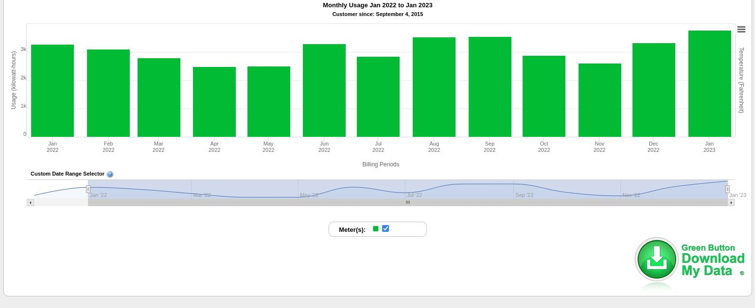
Power Monitoring

Slide 13
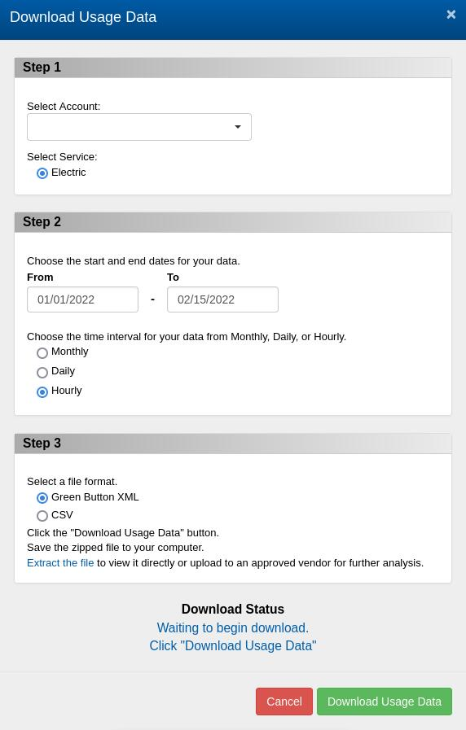
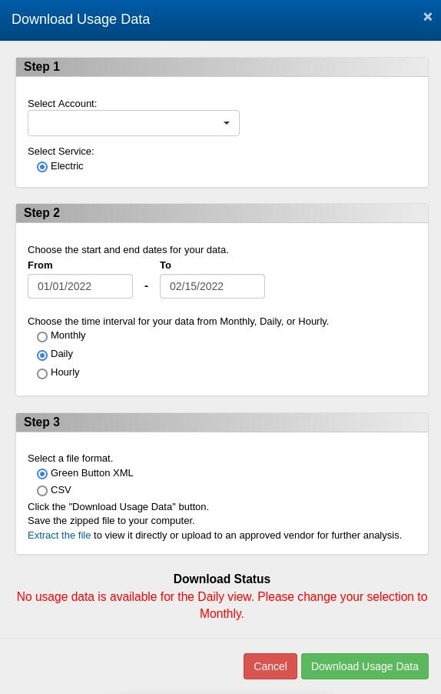
Power Monitoring
Great idea…
but not available

Slide 14
RTL-SDR and rtlamr
Where NOVEC fails, open-source delivers
  https://github.com/bemasher/rtlamr
  https://github.com/bemasher/rtlamr-collect
Go code to decode Itron power meters and insert into a Influx DB

Slide 15
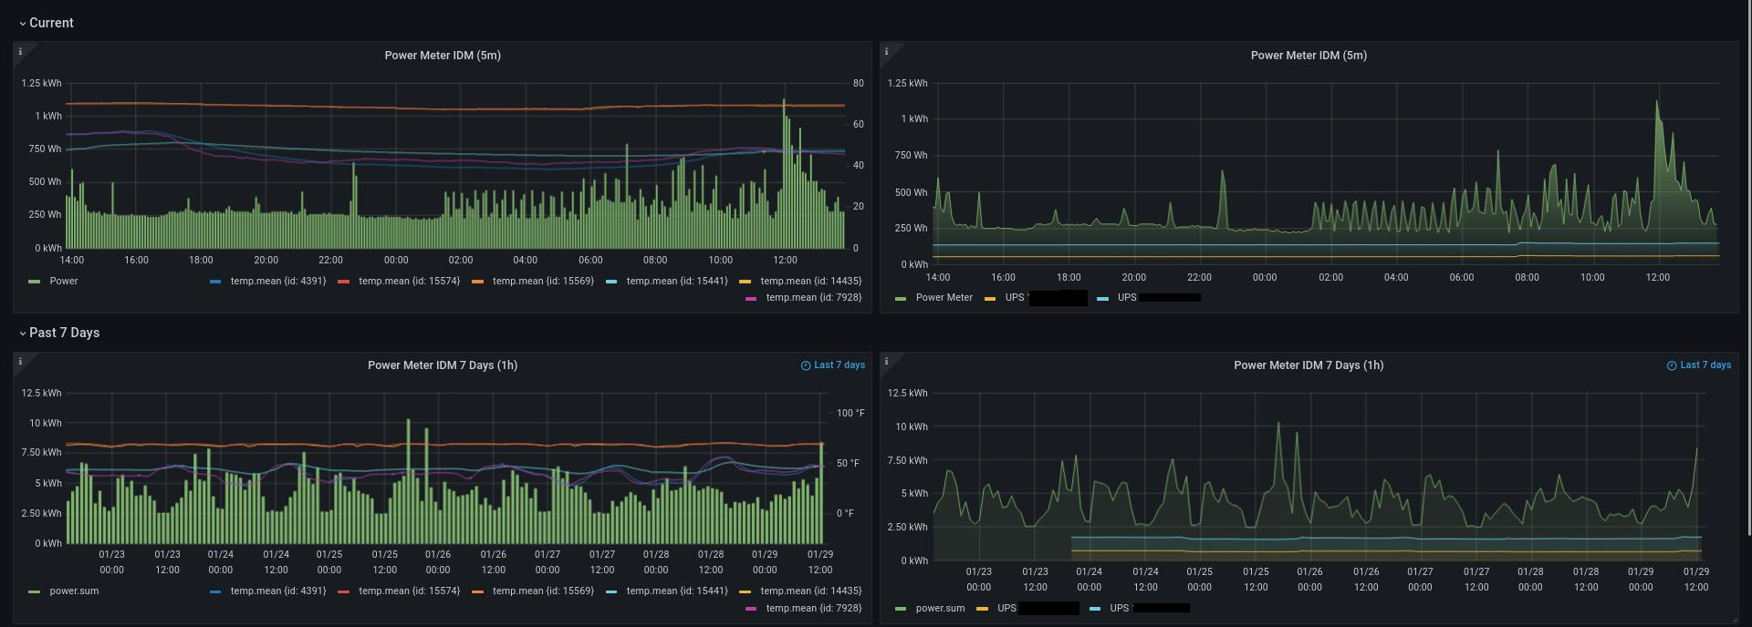
Grafana Power Dashboards

Slide 16
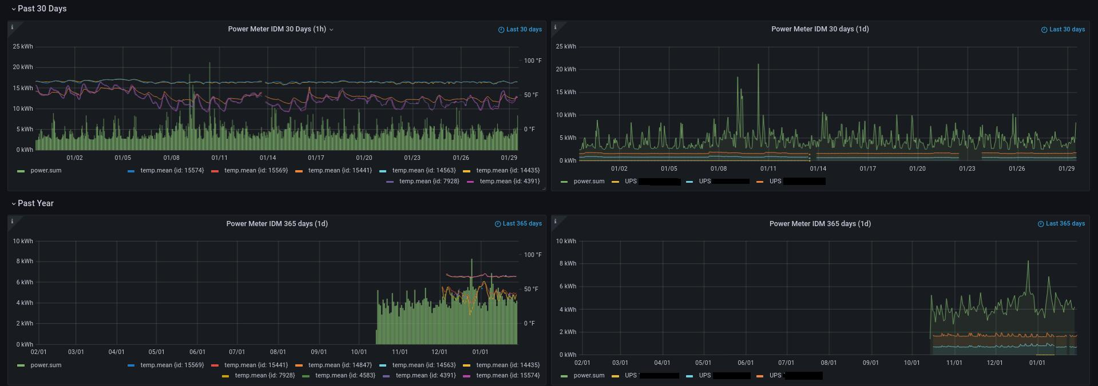
Grafana Power Dashboards

Slide 17
Resources:
https://github.com/bemasher/rtlamr
https://github.com/bemasher/rtlamr-collect
https://github.com/merbanan/rtl_433.git
https://github.com/hmatuschek/libsdr.git

