Slide 1
Bitching about the RHEL STIG
And other ramblings
@JayFoxtrot

Slide 2
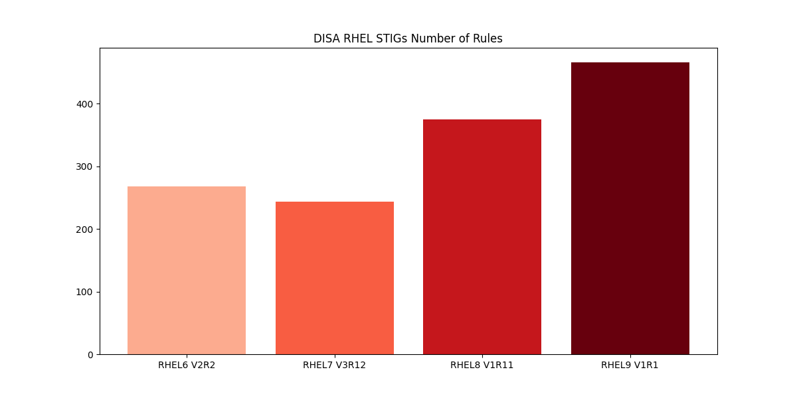
RHEL STIG Requirement creep

Slide 3
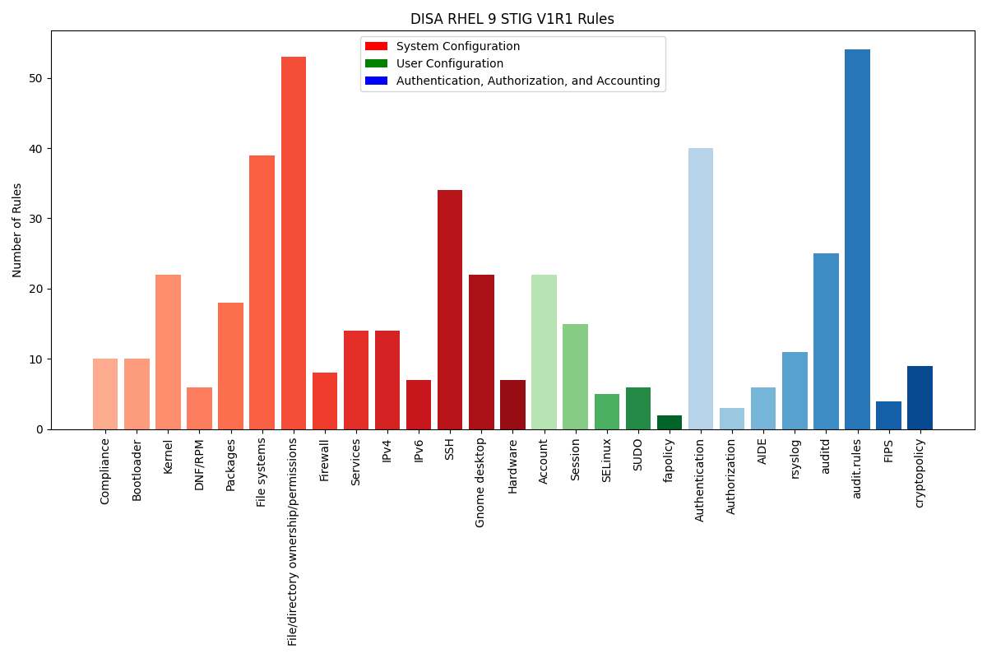
RHEL 9 Rules by Category

Slide 4
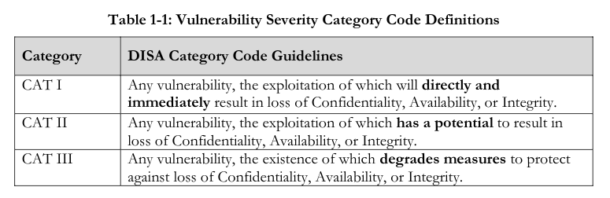
STIG Severity

Slide 5
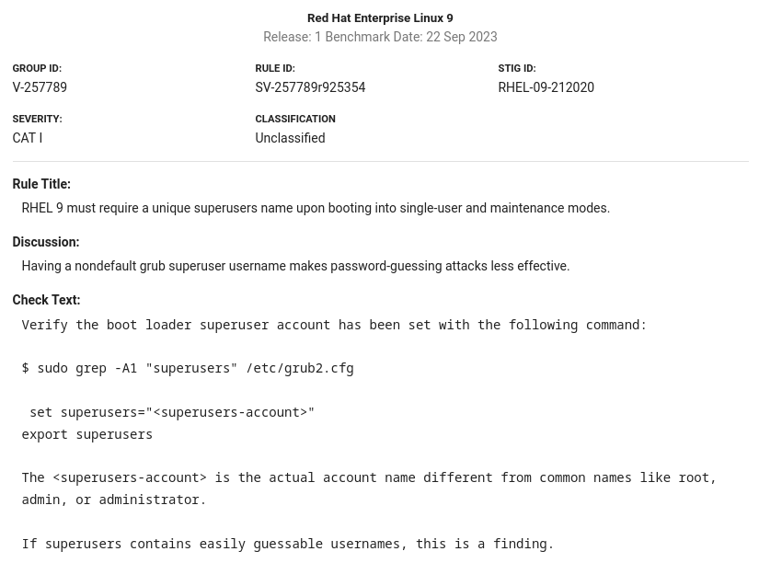
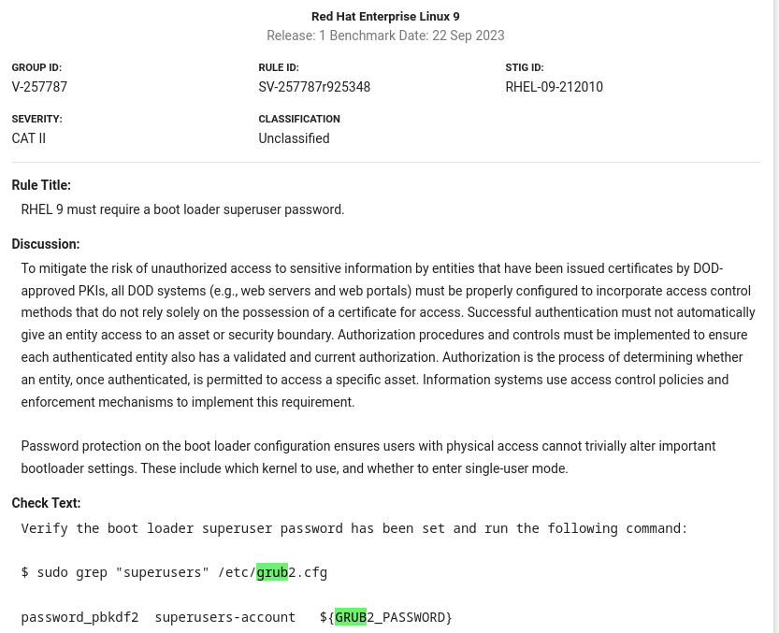
RHEL 9 STIG

Slide 6
grub2 username /password
Password stored in a separate file in RHEL/Fedora
Called user.cfg
In RHEL8 just delete or rename user.cfg file from EFI partition
On RHEL9/Fedora a little more complicated

Slide 7
grub2 user.cfg example
Example:
root@system1:~# find /boot -name user.cfg | xargs cat
GRUB2_PASSWORD=grub.pbkdf2.sha512.10000.FF26431B77CFC9BADBDEF7F8DEF5684997EDCE2C7797D35A760B1D8CF276737E0C312D92C2AE219B0921D1719A9A47317D37C4C6EE4F4D45E235911259421A7D.A40AAD92E26A1DBC1FE7FC95000073D49150BBAC20F2EDB5C3F08F098476939378AAB9023DD657CD12E7680E94B906B43C7D24F1668A0E6453453C50556383AE

Slide 8
What are we bypassing?
root@system1:~# find /boot -name grub.cfg -ls
4 -rwx------ 1 root root 146 Dec 31 22:22 /boot/efi/EFI/fedora/grub.cfg
8 -rwx------ 1 root root 6825 Dec 31 21:02 /boot/grub2/grub.cfg
root@system1:~# cat /boot/efi/EFI/fedora/grub.cfg
search --no-floppy --fs-uuid --set=dev 40a48cb0-a44b-49de-a7c0-db5adb726b5f
set prefix=($dev)/grub2
export $prefix
configfile $prefix/grub.cfg

Slide 9
What are we bypassing?
Prefix is used in several places
When “configfile” loads the real grub:
root@system1:/home/jeremy# grep prefix /boot/grub2/grub.cfg
elif [ -s $prefix/grubenv ]; then
if [ -f ${prefix}/user.cfg ]; then
source ${prefix}/user.cfg
elif [ -z "${config_directory}" -a -f $prefix/custom.cfg ]; then
source $prefix/custom.cfg

Slide 10
What are we bypassing?
Mainly in this section:
### BEGIN /etc/grub.d/01_users ###
if [ -f ${prefix}/user.cfg ]; then
source ${prefix}/user.cfg
if [ -n "${GRUB2_PASSWORD}" ]; then
set superusers="root"
export superusers
password_pbkdf2 root ${GRUB2_PASSWORD}
fi
fi
### END /etc/grub.d/01_users ###

Slide 11
UEFI Shell
Lots of functionality to manipulate files on a FAT32 partition
EFI uses a FAT32 partition
Manipulate grub files
Seems to be gone form Dell servers
Only works when not in secure boot on Supermicro servers

Slide 12
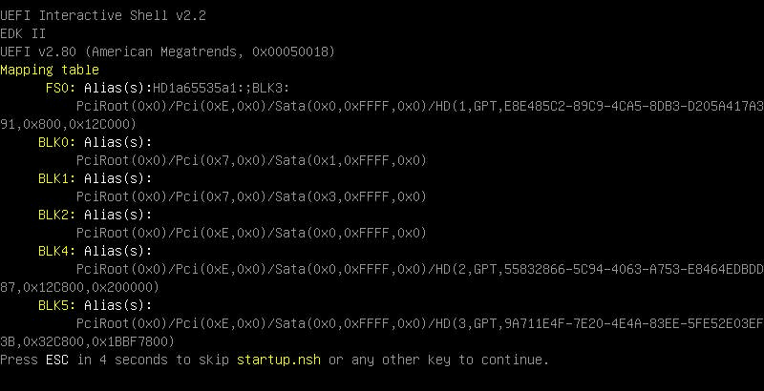
UEFI Shell - Boot

Slide 13
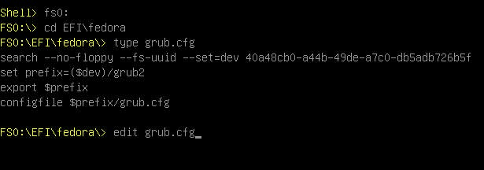
UEFI Shell - edit grub.cfg

Slide 14
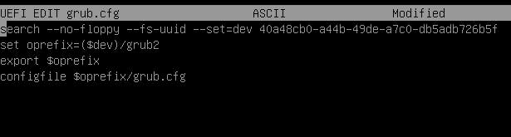
UEFI Shell – change prefix

Slide 15
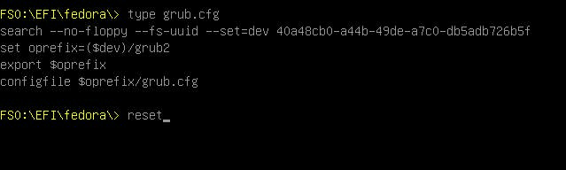
UEFI Shell - reboot

Slide 16
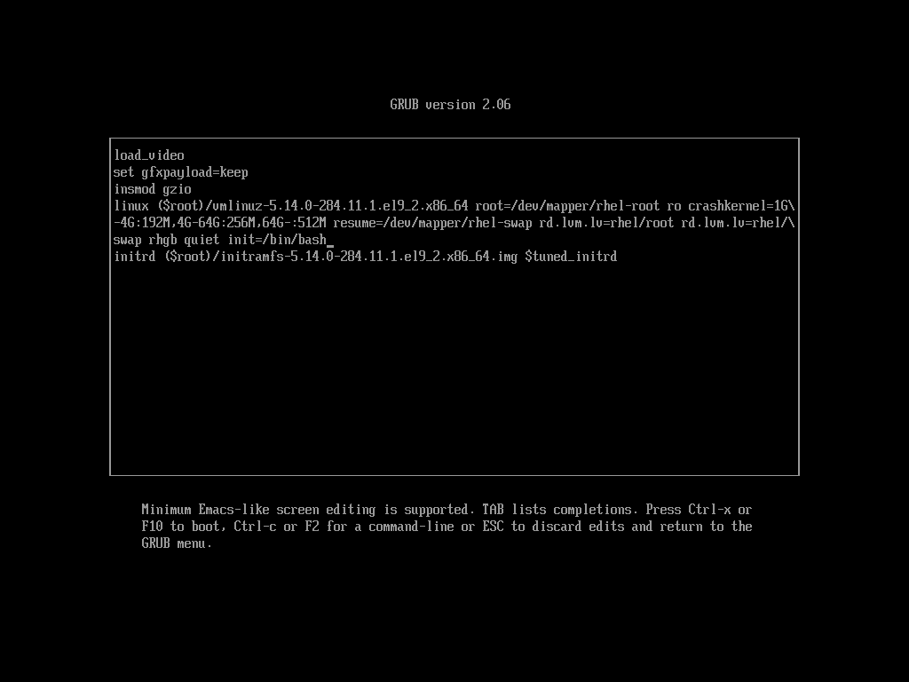
Use bash for init

Slide 17
Use bash for init

Slide 18
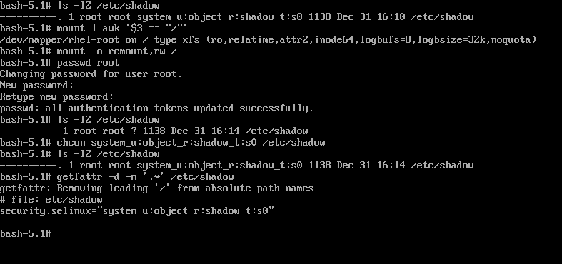
Change the root password

Slide 19
Consequences
No logs
  /bin/bash isn’t systemd won’t start logging
    System is booted read only initially anyways
  Confidentiality, Integrity, and Availability all compromised

Slide 20
Prevention
Password protected BIOS/UEFI
Secure boot
Measured boot
Disk Encryption
  TPM unlock
    Not flawless: https://pulsesecurity.co.nz/advisories/tpm-luks-bypass

Slide 21
Dell Server Locked out
Dealing with a locked out setup/system password
Use iDRAC to remove the setting from the BIOS

Slide 22
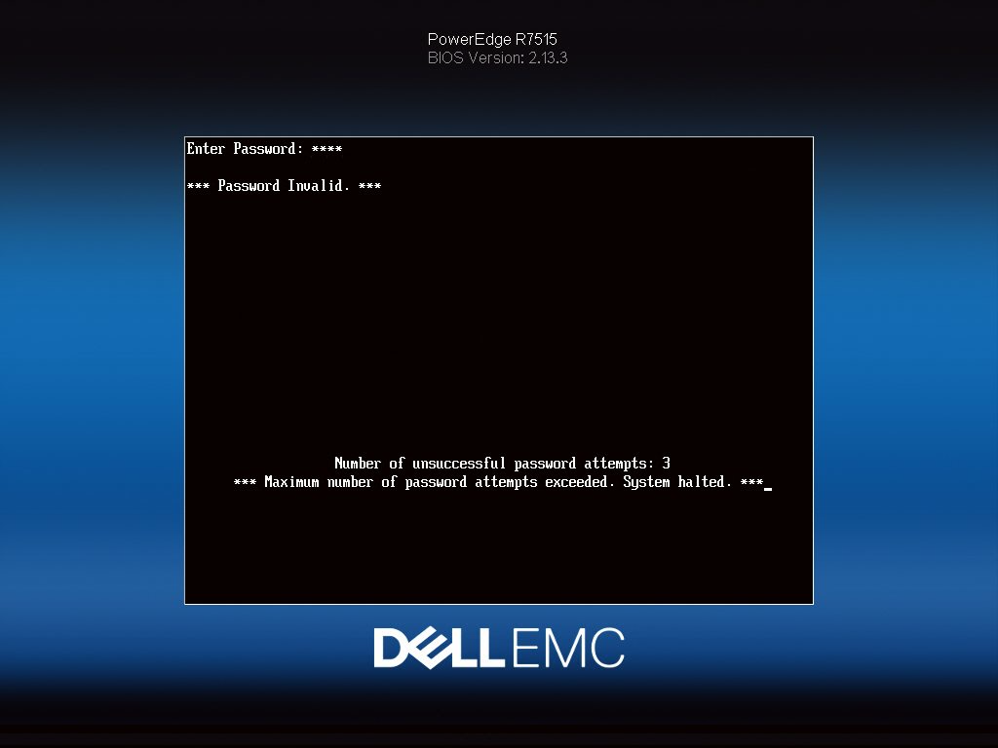
Dell Setup and System Password

Slide 23
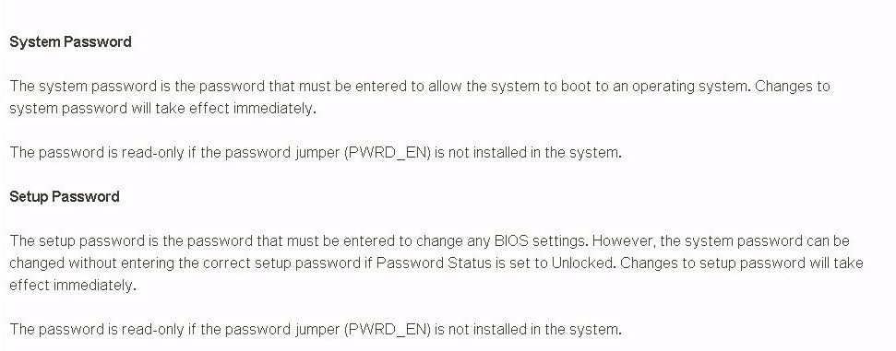
Dell Setup and System Password

Slide 24
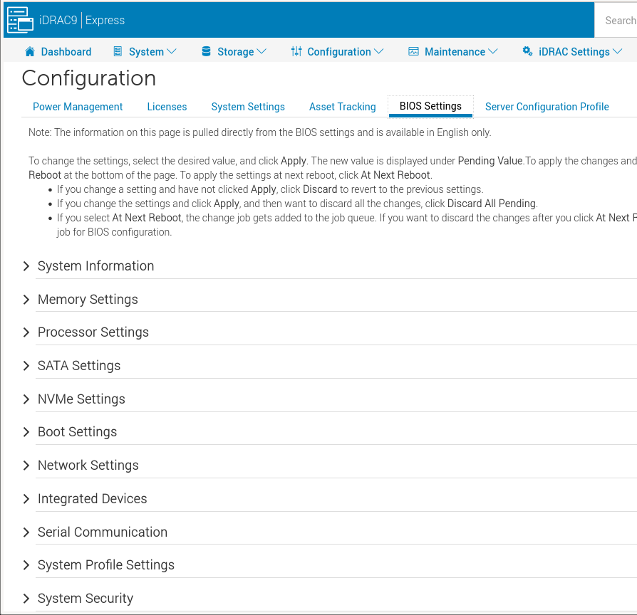
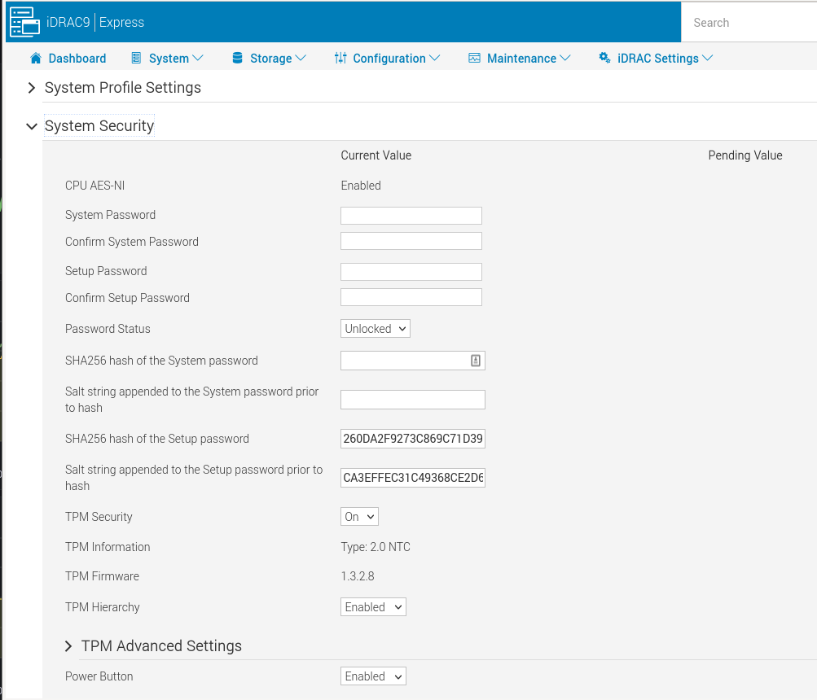
Dell Setup and System Password

Slide 25
Dell Setup and System Password
Doesn’t seem to be a way to remove password
But you can set it to something else
Then you can go into setup and clear it
Even though no hash shows up system has a password set

Slide 26
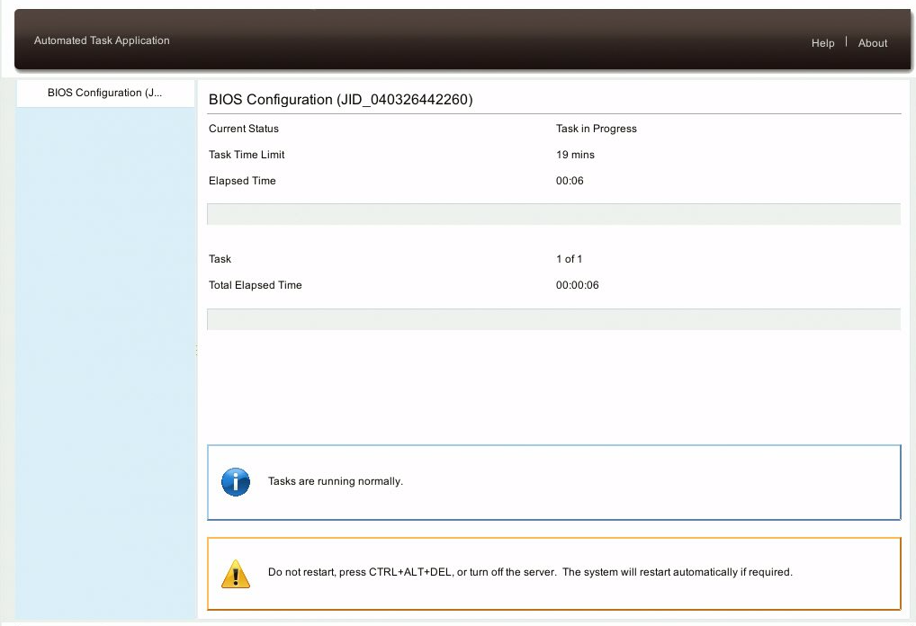
Dell Setup and Admin Password

