Slide 1
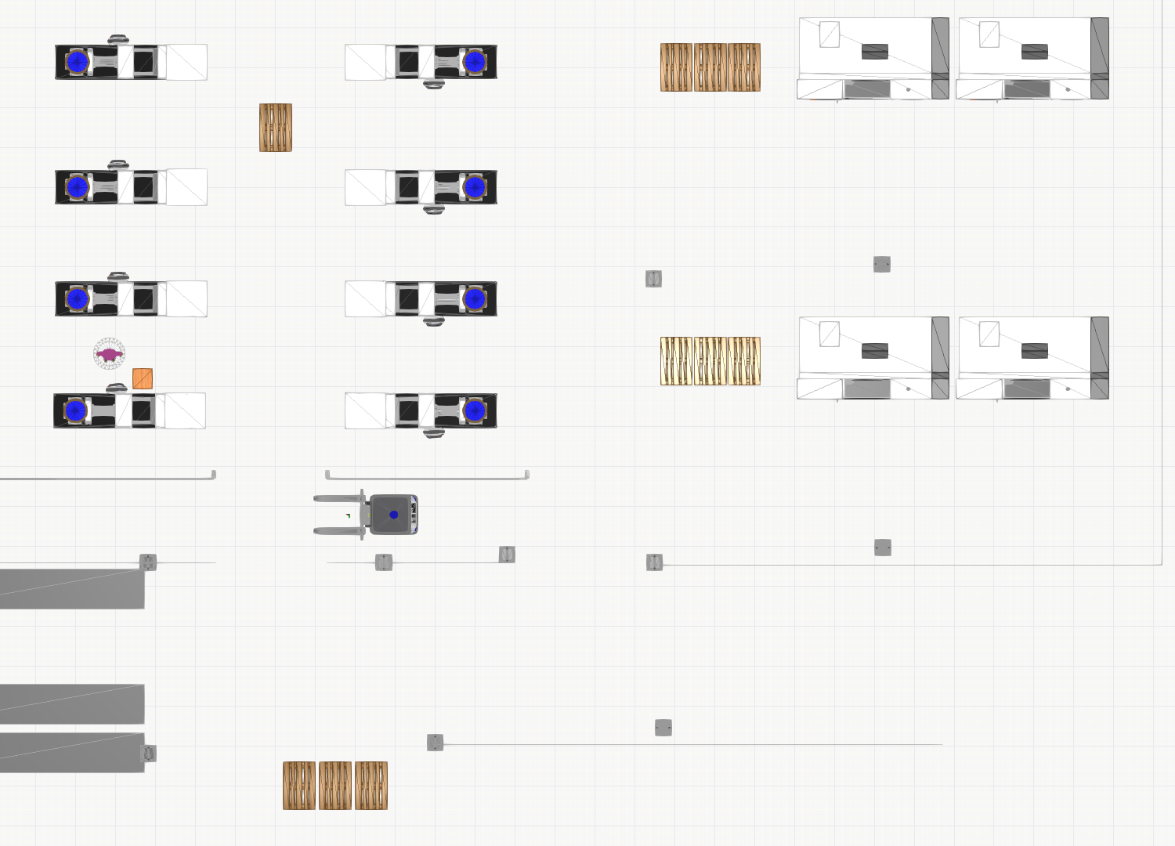
Production area
Machine 2
Packaging area
Machine 1
Warehouse area

Slide 4
$pack-2-1
$pack-2-3
$prod
$pack-1-1
$pack-1-3
$wh-1 $wh-2 $wh-3

