Slide 1
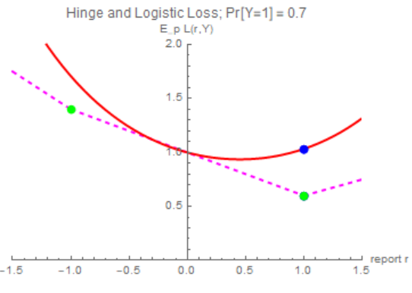
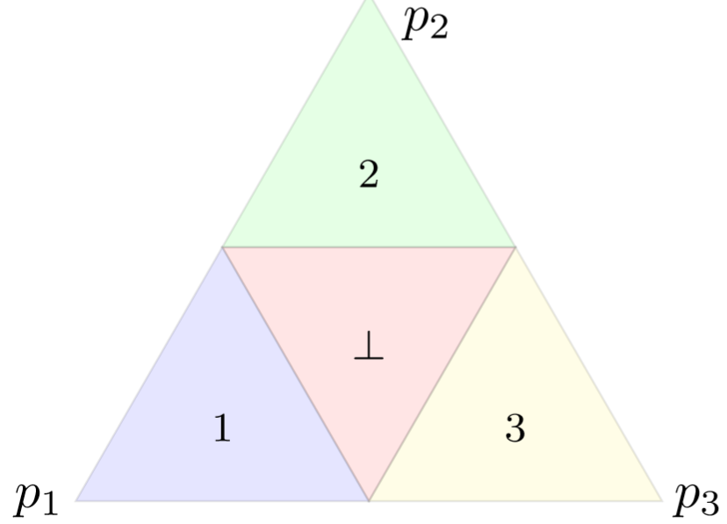
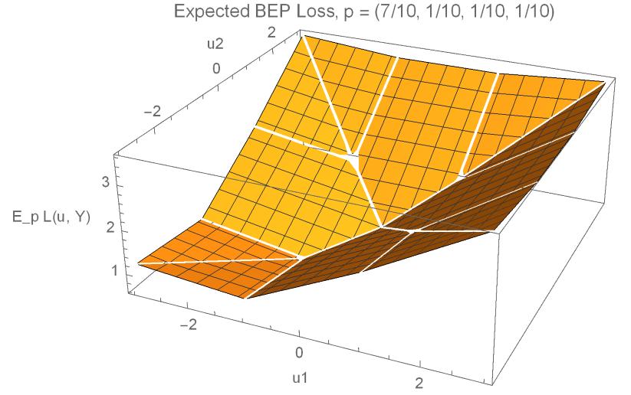
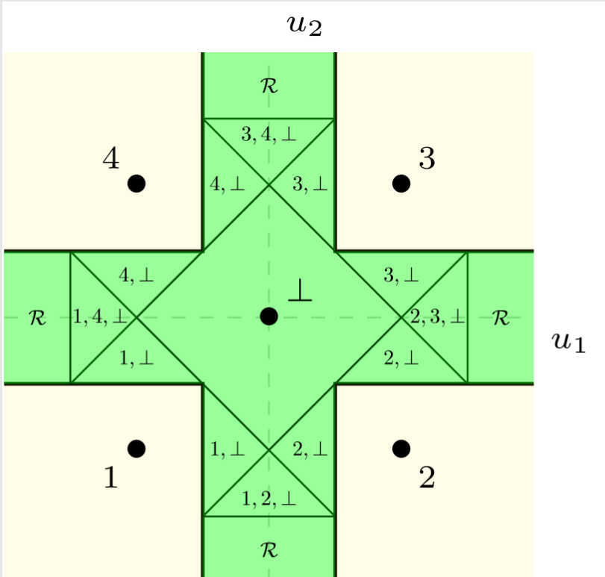
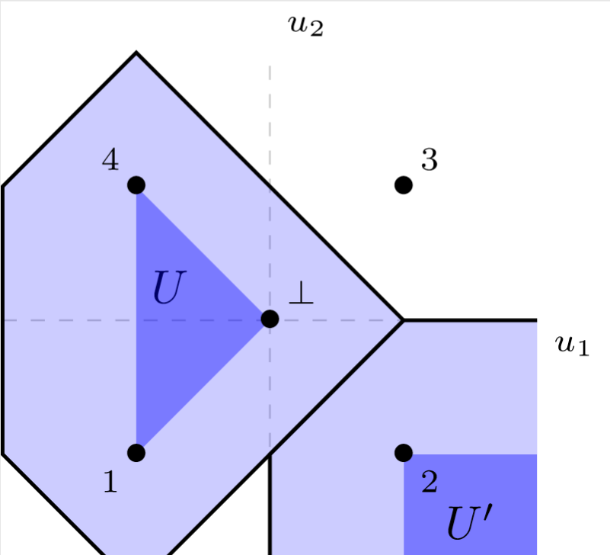
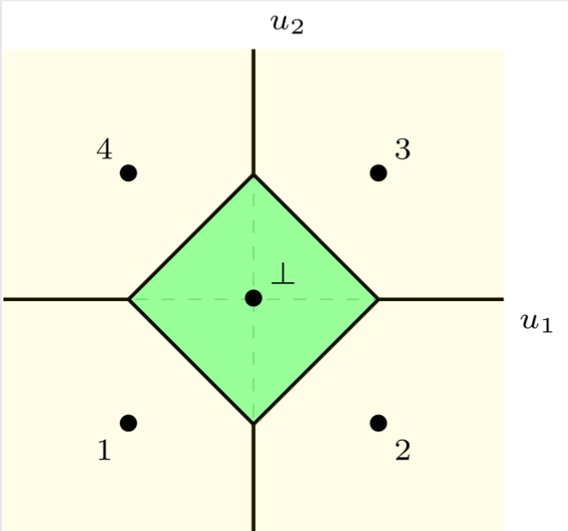
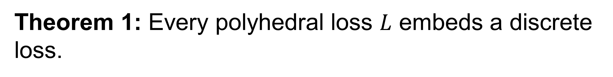
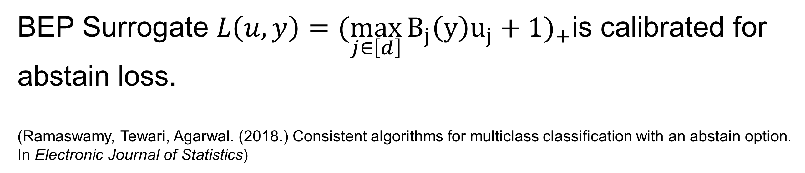
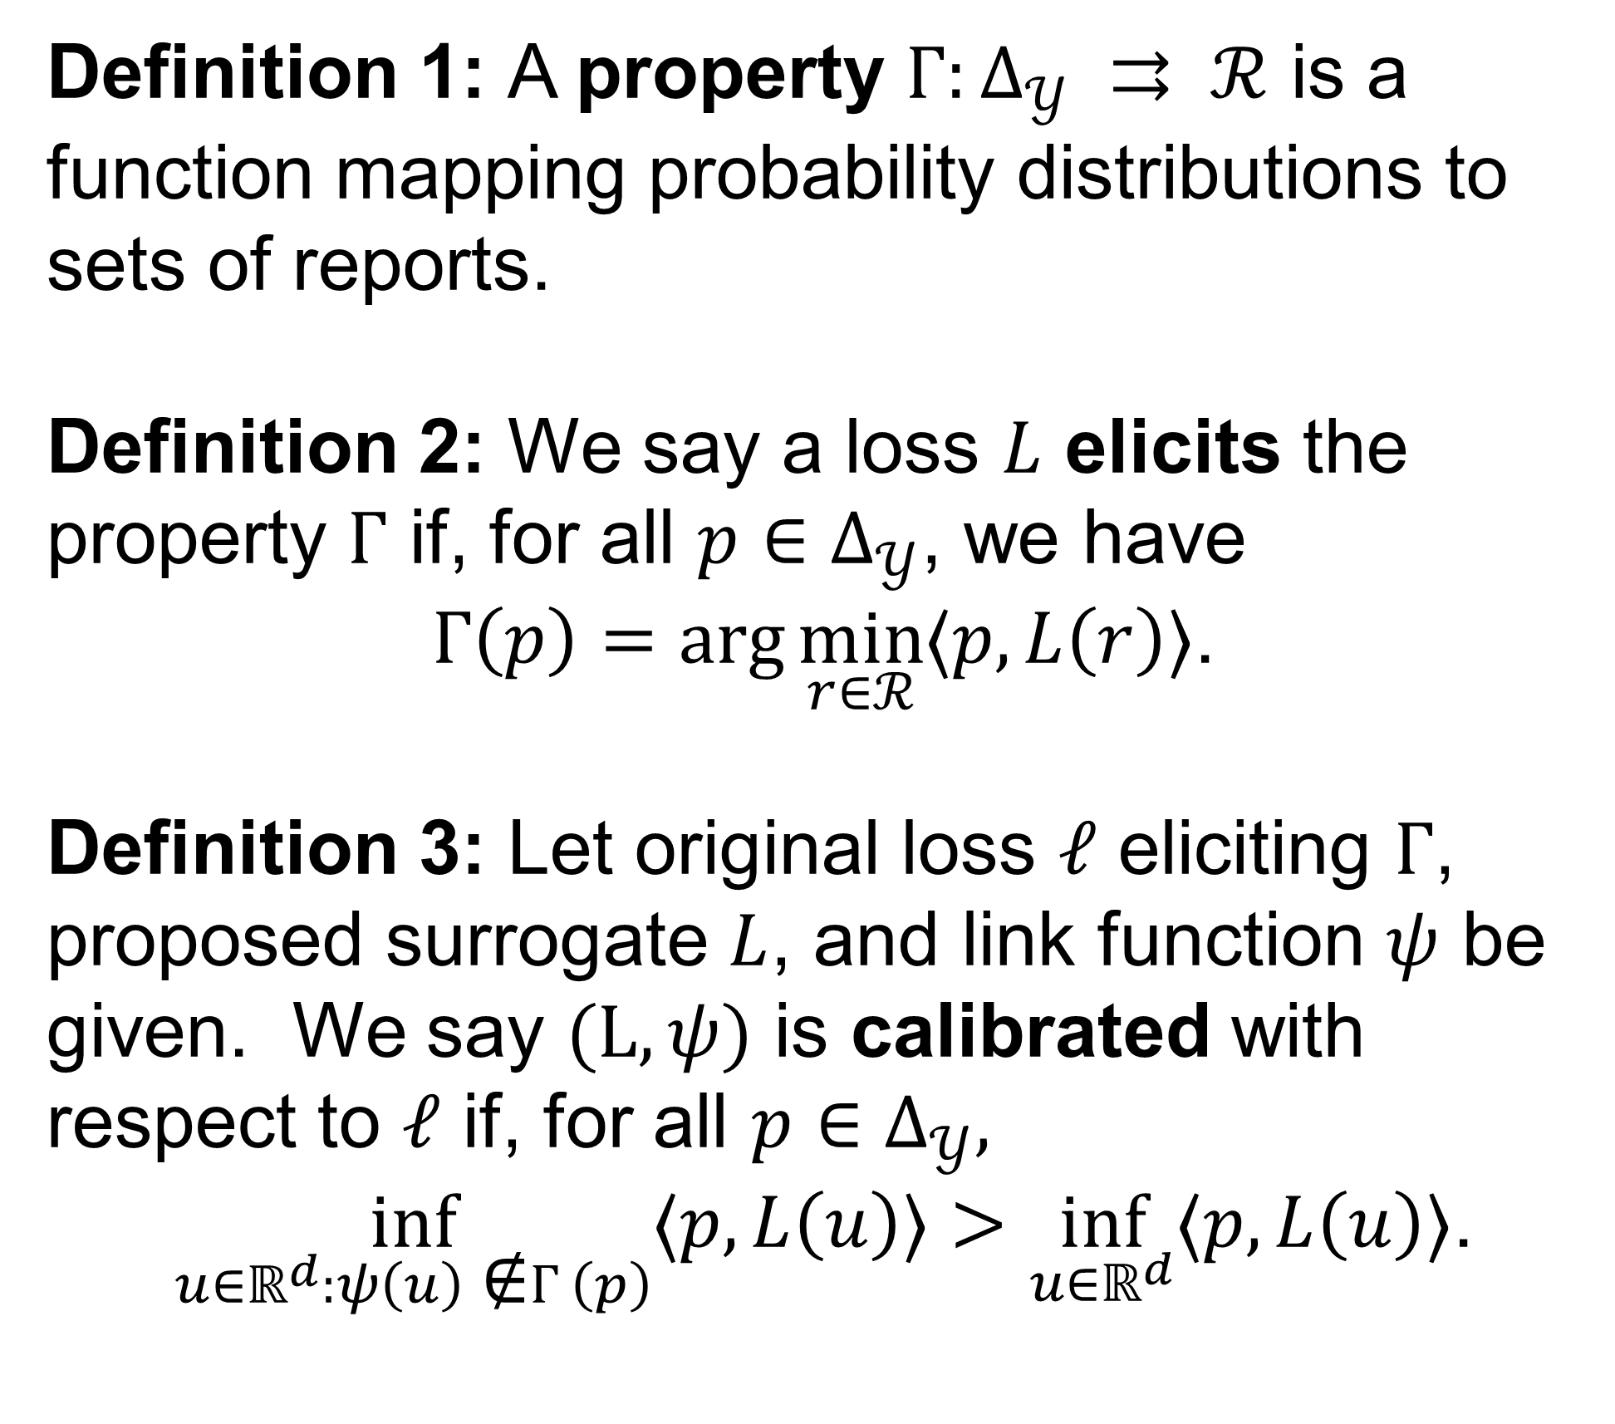


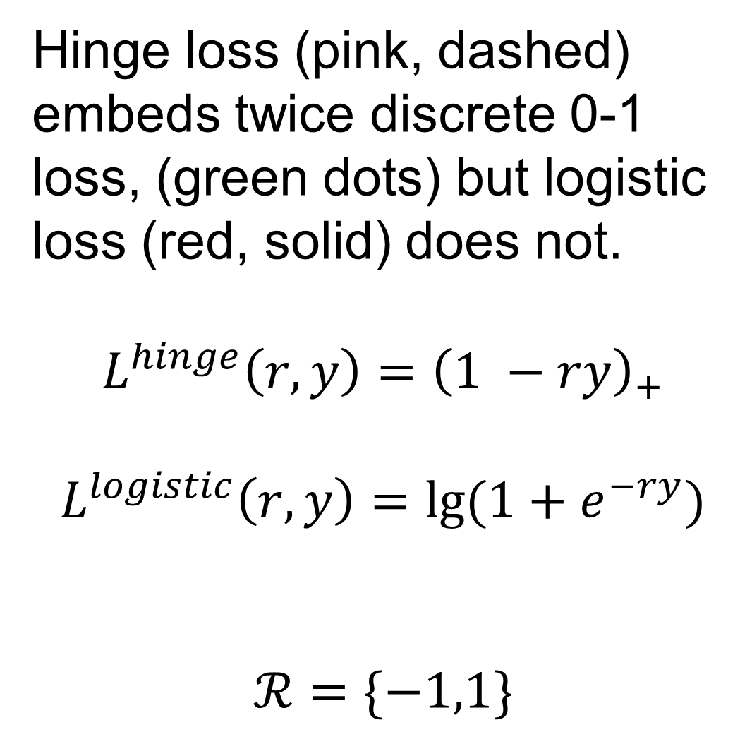
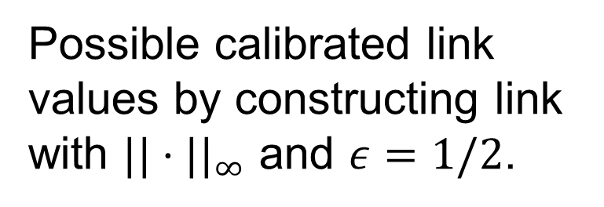
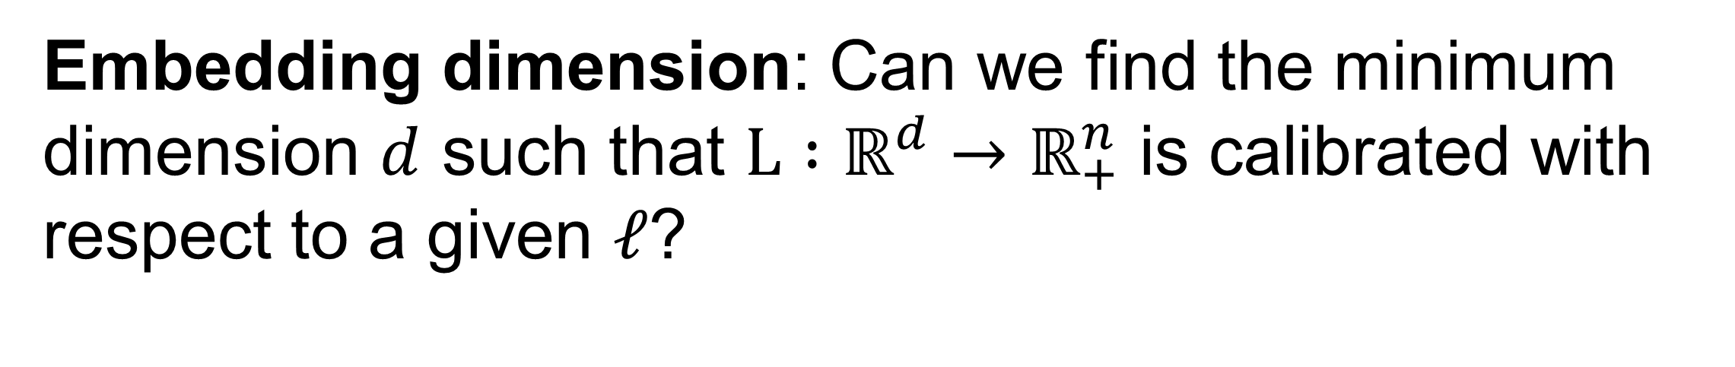
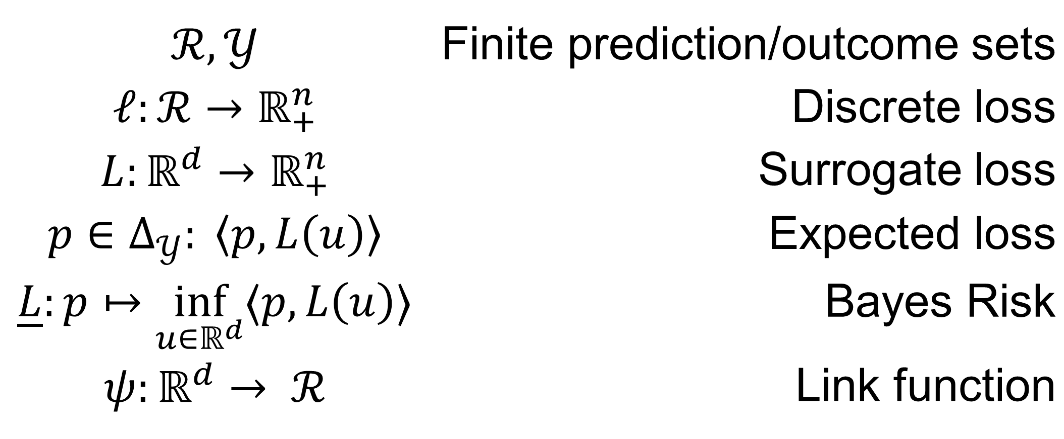
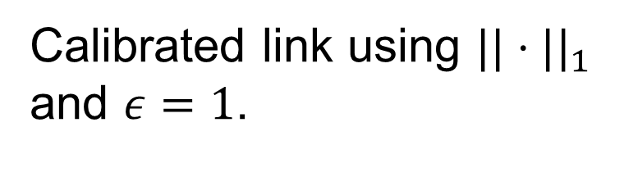
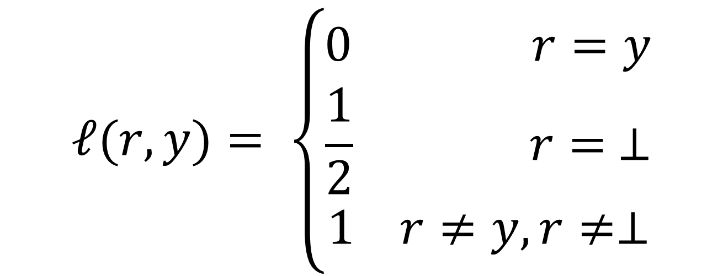
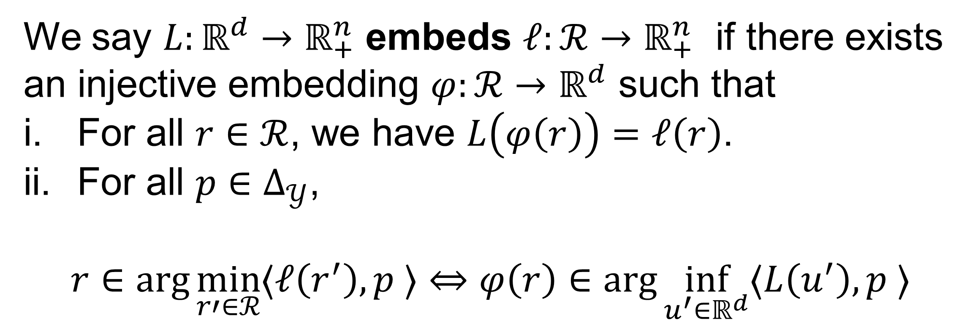

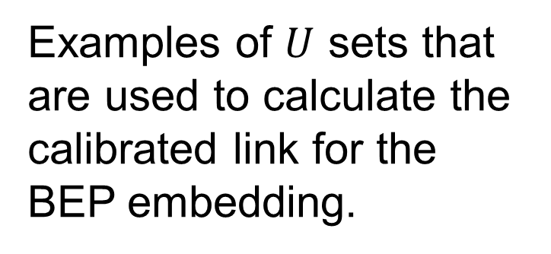
An Embedding Framework for Calibrated Polyhedral Surrogates
Jessie Finocchiaro¹, Rafael Frongillo¹, Bo Waggoner^{1,2}
¹University of Colorado Boulder, ²Microsoft Research
Overview
Example 1: Hinge Loss
Embedding Framework
In classification-like problems, we often seek surrogate losses to escape the intractability of directly optimizing the given discrete loss (e.g. 0-1 loss for classification). Current surrogates are typically designed in an ad hoc manner, with calibration not guaranteed. Motivated by recent polyhedral (piecewise linear convex) surrogate losses in the literature, we introduce an embedding framework to design calibrated, polyhedral surrogates for a given discrete loss.
We say $L:ℝ^{d}→ℝ_{+}^{n}$ embeds $ℓ:ℛ→ℝ_{+}^{n}$ if there exists an injective embedding $φ:ℛ→ℝ^{d}$ such that
For all $r∈ℛ$, we have $L\left(φ\left(r\right)\right)=ℓ\left(r\right)$.
For all $p∈Δ_{𝒴}$,
$$r∈\arg{\min_{r′∈ℛ}{⟨ℓ\left(r^{′}\right), p ⟩}}⇔φ\left(r\right)∈\arg{\inf_{u^{′}∈ℝ^{d}}{⟨L\left(u^{′}\right), p ⟩}}$$
Hinge loss (pink, dashed) embeds twice discrete 0-1 loss, (green dots) but logistic loss (red, solid) does not.
$$L^{hinge}\left(r,y\right)={\left(1 −ry\right)}_{+}$$
$$L^{logistic}\left(r,y\right)=lg⁡(1+e^{−ry})$$
$$ℛ=\{−1,1\}$$
Results
Prop 1: $L$ embeds $ℓ$ if and only if $\underline{L}$ = $\underline{ℓ}.$
Setting
Example 2: Abstain Loss
Prop 2: A loss $L$ embeds a discrete loss if and only if $\underline{L}$ is polyhedral.
$$ℛ,𝒴$$ | Finite prediction/outcome sets
$$ℓ:ℛ→ℝ_{+}^{n}$$ | Discrete loss
$$L:ℝ^{d}→ℝ_{+}^{n}$$ | Surrogate loss
$$p∈Δ_{𝒴}: \left\langle p, L\left(u\right)\right\rangle$$ | Expected loss
$$\underline{L}:p↦\inf_{u∈ℝ^{d}}⟨p, L\left(u\right)⟩$$ | Bayes Risk
$$ψ:ℝ^{d}→ ℛ$$ | Link function
Theorem 1: Every polyhedral loss $L$ embeds a discrete loss.
$$ℓ(r,y)= \left\{\begin{aligned}0 r=y \\ \frac{1}{2} r= ⊥ \\ 1 r≠y, r≠⊥\end{aligned}\right.$$
Theorem 2: Every discrete loss $ℓ$ is embedded by a polyhedral loss.
Calibrated Links
Theorem 3: $L$ embeds $ℓ$ implies there is a calibrated link from $L$to $ℓ$.
Properties and Calibration
Definition 1: A property $Γ:Δ_{𝒴} ⇉ ℛ$ is a function mapping probability distributions to sets of reports.
Definition 2: We say a loss $L$ elicits the property $Γ$ if, for all $p∈Δ_{𝒴}$, we have
$Γ\left(p\right)=\arg{\min_{r∈ℛ}{⟨p, L\left(r\right)⟩}}$.
Definition 3: Let original loss $ℓ$ eliciting $Γ$, proposed surrogate $L$, and link function $ψ$ be given. We say $(L, ψ)$ is calibrated with respect to $ℓ$ if, for all $p∈Δ_{𝒴},$
$\inf_{u∈ℝ^{d}:ψ\left(u\right) \text{∉}Γ\left(p\right)}{⟨p, L\left(u\right)⟩}>\inf_{u∈ℝ^{d}}{⟨p, L\left(u\right)⟩}$.
Possible calibrated link values by constructing link with $||⋅||_{∞}$ and $ε=1/2$.
Examples of $U$ sets that are used to calculate the calibrated link for the BEP embedding.
Calibrated link using $||⋅||_{1}$ and $ε=1$.
BEP Surrogate $L\left(u,y\right)={(\max_{j∈\left[d\right]}{B_{j}\left(y\right)u_{j}+1})}_{+}$is calibrated for abstain loss.
(Ramaswamy, Tewari, Agarwal. (2018.) Consistent algorithms for multiclass classification with an abstain option. In Electronic Journal of Statistics)
Future Work
Embedding dimension: Can we find the minimum dimension $d$ such that $L :ℝ^{d}→ℝ_{+}^{n}$ is calibrated with respect to a given $ℓ$?

