Slide 1
Embedding Dimension of Polyhedral Losses
Jessie Finocchiaro, Rafael Frongillo, Bo Waggoner
CU Boulder
Conference on Learning Theory 2020

Slide 2
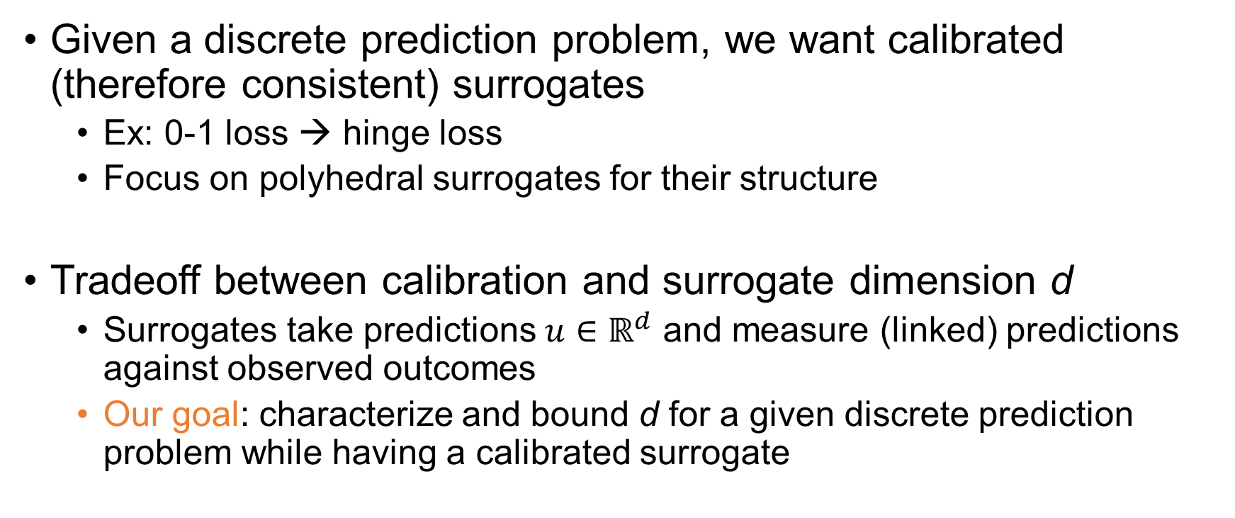
The problem
Given a discrete prediction problem, we want calibrated (therefore consistent) surrogates
Ex: 0-1 loss → hinge loss
Focus on polyhedral surrogates for their structure
Tradeoff between calibration and surrogate dimension d
Surrogates take predictions $u∈ℝ^{d}$ and measure (linked) predictions against observed outcomes
Our goal: characterize and bound d for a given discrete prediction problem while having a calibrated surrogate

Slide 3
Results
Complete characterization of losses that can be embedded on the real line
Quadratic feasibility program for general dimensions

