Slide 1
Embedding Dimension of Polyhedral Losses
Jessie Finocchiaro, Rafael Frongillo, Bo Waggoner
CU Boulder
Conference on Learning Theory 2020

Slide 2
Background: Prediction Tasks
Machine learning is often used as a predictive tool
Supervised models learn a hypothesis minimizing average loss over a training dataset
Loss functions take predictions and measure error against observed outcome
Target loss function often intuitive, but hard to optimize
Instead, optimize a corresponding surrogate loss
Want minimizing empirical risk of surrogate to correspond to optimizing empirical risk of target
Notes:
Machine learning is often used as a predictive tool
Supervised models learn a hypothesis minimizing average loss over a training dataset
Loss functions take predictions and measure error against observed outcome
Target loss function often intuitive, but hard to optimize
Instead, optimize a corresponding surrogate loss
Want minimizing empirical risk of surrogate to correspond to optimizing empirical risk of target

Slide 3
Proxies for statistical guarantees
Instead want to optimize a surrogate with good ERM bounds
One requirement for ERM bounds is consistency
In finite prediction setting, consistency iff calibration.
Finocchiaro et al. (2019) show embedding implies calibration.
Discrete prediction tasks
Embedding
Calibration
Consistency
ERM bounds
Notes:
Instead want to optimize a surrogate with good ERM bounds
One requirement for ERM bounds is consistency
In finite prediction setting, consistency iff calibration.
Finocchiaro et al. (2019) show embedding implies calibration.

Slide 4
How to learn prediction tasks
Discrete prediction tasks
Embedding
Calibration
Consistency
ERM bounds

Slide 5
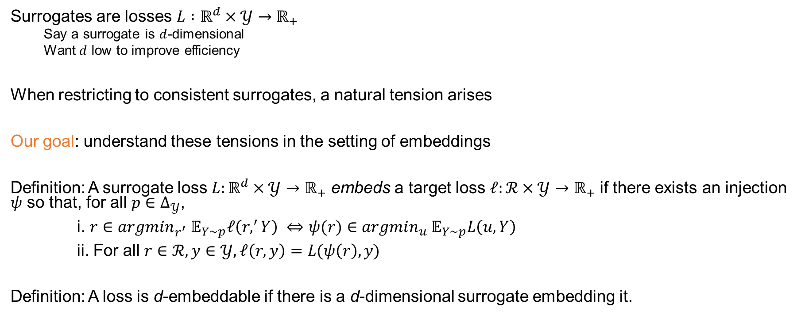
The gap: tension between dimension and consistency
Surrogates are losses $L :ℝ^{d}×𝒴→ℝ_{+}$
Say a surrogate is $d$-dimensional
Want $d$ low to improve efficiency
When restricting to consistent surrogates, a natural tension arises
Our goal: understand these tensions in the setting of embeddings
Definition: A surrogate loss $L:ℝ^{d}×𝒴→ℝ_{+}$ embeds a target loss $ℓ:ℛ×𝒴→ℝ_{+}$ if there exists an injection $ψ$ so that, for all $p∈Δ_{𝒴}$,
i. $r∈argmin_{r^{′}} 𝔼_{Y∼p}ℓ\left(r,^{′}Y\right) ⇔ψ(r)∈argmin_{u} 𝔼_{Y∼p}L\left(u, Y\right)$
ii. For all $r∈ℛ, y∈𝒴, ℓ\left(r,y\right)=L(ψ\left(r\right), y)$
Definition: A loss is d-embeddable if there is a d-dimensional surrogate embedding it.
Notes:
Surrogates are losses $L :ℝ^{d}×𝒴→ℝ_{+}$
Say a surrogate is $d$-dimensional
Want $d$ low to improve efficiency
When restricting to consistent surrogates, a natural tension arises
Our goal: understand these tensions in the setting of embeddings
Definition: A surrogate loss $L:ℝ^{d}×𝒴→ℝ_{+}$ embeds a target loss $ℓ:ℛ×𝒴→ℝ_{+}$ if there exists an injection $ψ$ so that, for all $p∈Δ_{𝒴}$,
i. $r∈argmin_{r^{′}} 𝔼_{Y∼p}ℓ\left(r,^{′}Y\right) ⇔ψ(r)∈argmin_{u} 𝔼_{Y∼p}L\left(u, Y\right)$
ii. For all $r∈ℛ, y∈𝒴, ℓ\left(r,y\right)=L(ψ\left(r\right), y)$
Definition: A loss is d-embeddable if there is a d-dimensional surrogate embedding it.

Slide 6
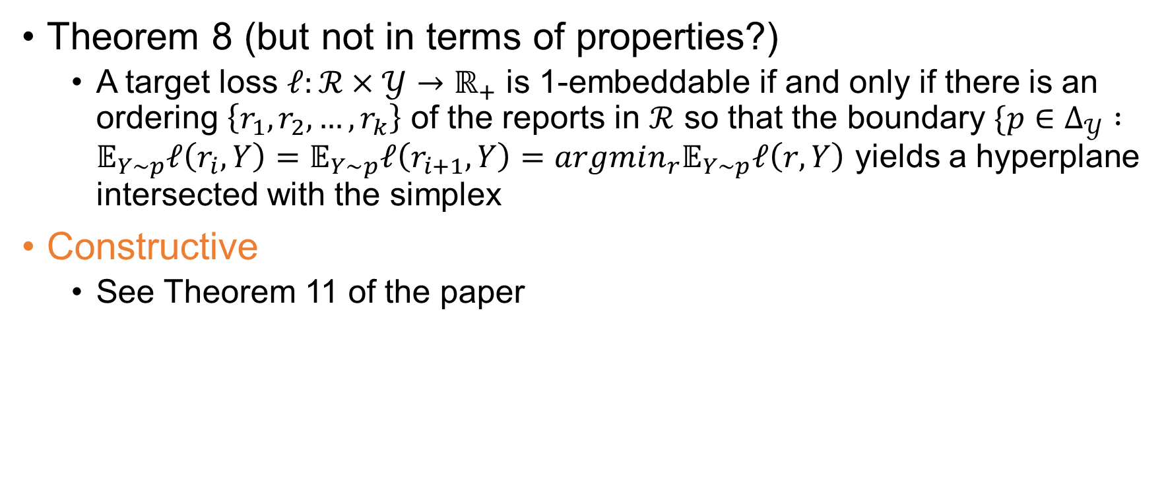

$ℝ$: Full characterization
Theorem 8 (but not in terms of properties?)
A target loss $ℓ:ℛ×𝒴→ℝ_{+}$ is 1-embeddable if and only if there is an ordering $\left\{r_{1},r_{2},…, r_{k}\right\}$ of the reports in $ℛ$ so that the boundary $\{p∈Δ_{𝒴} :𝔼_{Y∼p}ℓ\left(r_{i}, Y\right)=𝔼_{Y∼p}ℓ\left(r_{i+1}, Y\right)=argmin_{r}𝔼_{Y∼p}ℓ\left(r, Y\right)$ yields a hyperplane intersected with the simplex
Constructive
See Theorem 11 of the paper

Slide 7
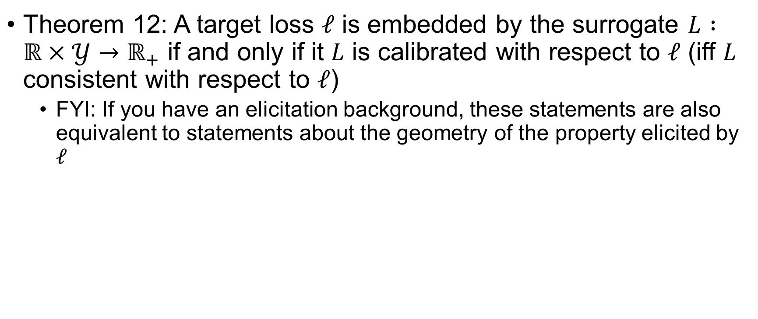
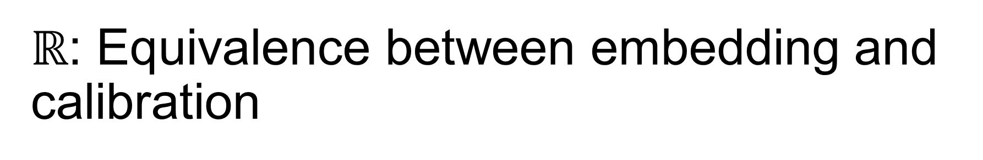
$ℝ$: Equivalence between embedding and calibration
Theorem 12: A target loss $ℓ$ is embedded by the surrogate $L :ℝ×𝒴→ℝ_{+}$ if and only if it $L$ is calibrated with respect to $ℓ$ (iff $L$ consistent with respect to $ℓ$)
FYI: If you have an elicitation background, these statements are also equivalent to statements about the geometry of the property elicited by $ℓ$

Slide 8
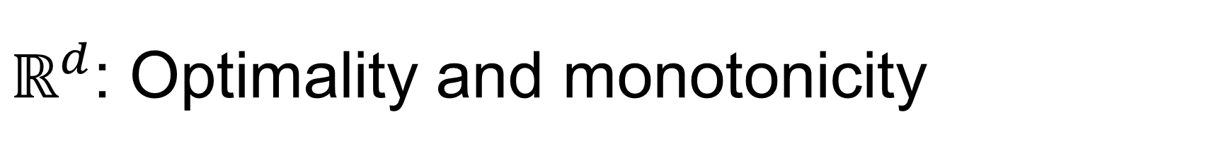
$ℝ^{d}$: Optimality and monotonicity
Theorem 15

Slide 9

$ℝ^{d}$: The (optimality) tool-- polytopes
Introduce polytopes
Half space and vertex space constructions

Slide 10
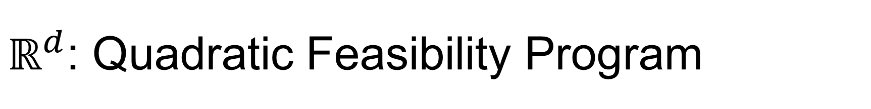
$ℝ^{d}$: Quadratic Feasibility Program
QFP
Since iff, it’s hard…

Slide 11
Abstain: intro
Discrete loss, Hari bound

Slide 12
Abstain: n=3
D = 2 for all alpha in (0,1)

Slide 13
Abstain, alpha = 1/2: n>= 5
D = 2 for all alpha in (0,1)

Slide 14


Summary
And open questions
Thank you

