Slide 1
Embedding Dimension of Polyhedral Losses
Jessie Finocchiaro, Rafael Frongillo, Bo Waggoner
CU Boulder
Conference on Learning Theory 2020

Slide 2
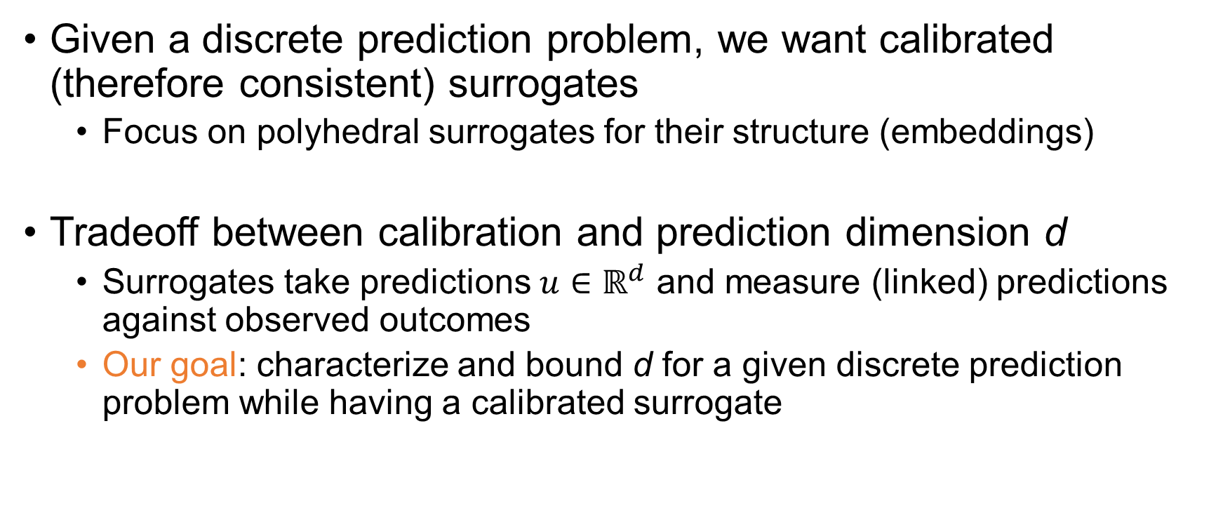
The problem
Given a discrete prediction problem, we want calibrated (therefore consistent) surrogates
Focus on polyhedral surrogates for their structure (embeddings)
Tradeoff between calibration and prediction dimension d
Surrogates take predictions $u∈ℝ^{d}$ and measure (linked) predictions against observed outcomes
Our goal: characterize and bound d for a given discrete prediction problem while having a calibrated surrogate

Slide 3
Results
Complete characterization of 1-d losses
On real line, embedding and consistency are equivalent
Quadratic feasibility program for general dimensions

