Slide 1
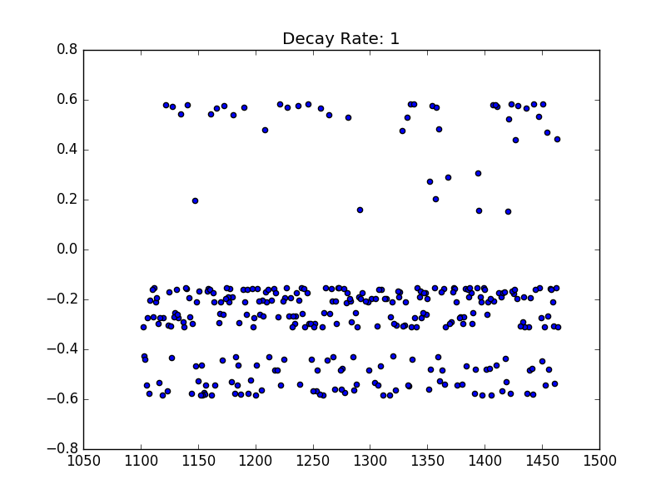
Bracket Buster – March Madness
Josiah Buxton, Jessica Finocchiaro, Christopher Godley, Stephen Smart, Adam Winchell
Problem and data
Algorithms
In 2014, Kaggle started a competition to build March Madness brackets.
Kaggle dataset includes
Detailed data for every season and tournament game back to 2003
Compact data for every season and tournament back to 1985
Given data features include
Teams*
Scores*
Number of overtimes*
Winning team location (home/away/neutral)*
Field goals made / attempted
3 pointers goals made / attempted
Offensive/defensive rebounds
Assists
Turnovers
Steals
Blocks
Personal fouls
* indicates a feature in the compact dataset
We tested our feature vectors on the following Algorithms with default (unless otherwise specified) parameters:
Decision Tree
Logistic Regression
K-Nearest Neighbors-- Fine-tuned: 9 NN
Support Vector Classifier
AdaBoost
Neural Networks
Results
Algorithm Performance by training on the 2003-2017 seasons, cross-validated with 2003-2016 tournament results, and tested on the 2017 tournament
Feature Engineering
Algorithm | Test Accuracy | Variance
K-Nearest Neighbors
Support Vector Classifier
Decision Tree
Adaboost
Decision Tree
Neural Network
Our algorithms learned on 70 features, some hand-crafted and some provided.
Some of the hand-crafted features include:
Offensive/defensive rebound percentage
Running average score of the season
Field goal / 3-point percentage
End of season streak
Longest length winning streak
Momentum
Season win_percentage
Number of games played
Bracket seed
KenPom Data, including
Luck
ELO Score
“Adjusted” offense/defense
How your offense/defense compares to the rest of the NCAA
Figure 1: Team number vs. our generated momentum feature. Teams with higher momentum have been performing better as of late.
Analysis
Precautionary steps
While baseline performance for predicting the outcome of a game is 50%, we also compare our results to a bracket the solely selects the higher ranked team, which achieves accuracy of 26% across the tournament .
Our best method for predicting a full bracket was ____ with an overall tournament accuracy of _____, where accuracy = # of correct predicted winners / total games in the tournament.
In preliminary work, we tested performance of K-Nearest Neighbors incrementally adding one feature at a time to see each feature's effect on performance.
One primary concern we had was overfitting by creating too many features.
Trained on seasons, cross-validated on tournaments, tested on 2017 bracket.
Notes:
<number>

