Slide 1

Folie 1
Data-Warehouse-Projekt Verbraucherpreisindex
Fischlmayr und Huemer 5CHIF

Slide 2
Metadaten
Letzte Änderung: 20.09.2021
Download: 06.10.2021
Datenverantwortliche Stelle: Statistik Austria, Guglgasse 13, 1110 Wien, Austria
Veröffentlichende Stelle: Statistik Austria
Email: open.data@statistik.gv.at
Lizenz: Creative Commons Attribution License 3.0
Aktualisierungszyklus: monatlich
Kategorie: Wirtschaft und Tourismus
Quelle: https://www.data.gv.at/katalog/dataset/4f6afdb2-3347-3029-ade8-bea3a2714077
1

Slide 3
Benötigte Dimensionen
C-VPIZR-0 (Zeitraum der Erhebung)
F-VPIMZBM (Verbraucherpreisindex)

Slide 4
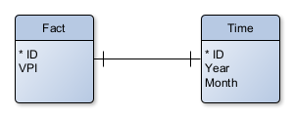
Datenmodel

Slide 5
Create Tables
Fact-Table
Time-Table
Relations
CREATE TABLE fact_vpi (
id NUMBER(8) NOT NULL,
vpi NUMBER(6, 2),
time_id NUMBER(8)
);
CREATE UNIQUE INDEX fact__idx ON
fact_vpi (
time_id
ASC );
ALTER TABLE fact_vpi ADD CONSTRAINT fact_pk PRIMARY KEY ( id );
CREATE TABLE time_vpi (
id NUMBER(8) NOT NULL,
month NUMBER(2),
year NUMBER(4),
fact_id NUMBER(8)
);
CREATE UNIQUE INDEX time__idx ON
time_vpi (
fact_id
ASC );
ALTER TABLE time_vpi ADD CONSTRAINT time_pk PRIMARY KEY ( id );
ALTER TABLE fact
ADD CONSTRAINT fact_time_fk FOREIGN KEY ( time_id )
REFERENCES time ( id )
ON DELETE CASCADE;
ALTER TABLE time
ADD CONSTRAINT time_fact_fk FOREIGN KEY ( fact_id )
REFERENCES fact ( id )
ON DELETE CASCADE;

Slide 6
Insert Data
drop SEQUENCE fact_seq;
drop SEQUENCE time_seq;
drop SEQUENCE fact_id_seq;
drop SEQUENCE time_id_seq;
create SEQUENCE fact_seq minvalue 1 START with 1 increment by 1;
create SEQUENCE time_seq minvalue 1 START with 1 increment by 1;
create SEQUENCE fact_id_seq minvalue 1 START with 1 increment by 1;
create SEQUENCE time_id_seq minvalue 1 START with 1 increment by 1;
truncate table fact_vpi cascade;
truncate table time_vpi cascade;
insert into fact_vpi(id, vpi, time_id) select fact_seq.nextval, st.vpi, time_id_seq.nextval from vpi_staging st;
insert into time_vpi(id, year, month, fact_id) select time_seq.nextval, st.year, st.month, fact_id_seq.nextval from vpi_staging st;

Slide 7
Pivot-Table
Select * from
(
Select t.month, t.year, f.vpi
from time_vpi t join fact_vpi f on (f.time_id = t.id))
pivot(
avg(vpi)
for year in ('1967', '1968', '1969',
'1970', '1971', '1972', '1973', '1974', '1975', '1976', '1977', '1978', '1979',
'1980', '1981', '1982', '1983', '1984', '1985', '1986', '1987', '1988', '1989',
'1990', '1991', '1992', '1993', '1994', '1995', '1996', '1997', '1998', '1999',
'2000', '2001', '2002', '2003', '2004', '2005', '2006', '2007', '2008', '2009',
'2010', '2011', '2012', '2013', '2014', '2015', '2016', '2017', '2018', '2019',
'2020', '2021')
);

Slide 8
Group By
Select Year
From Fact_Vpi F Join Time_Vpi T On (F.Time_Id = T.Id)
Group By Cube (Year);
Select Month
From Fact_Vpi F Join Time_Vpi T On (F.Time_Id = T.Id)
Group By Cube (Month);
Select Vpi
From Fact_Vpi F Join Time_Vpi T On (F.Time_Id = T.Id)
Group By Cube (Vpi);

Slide 9
Folie 8
VPI per Jahr
Quelle: https://www.data.gv.at am 06.10.2021
8

Slide 10
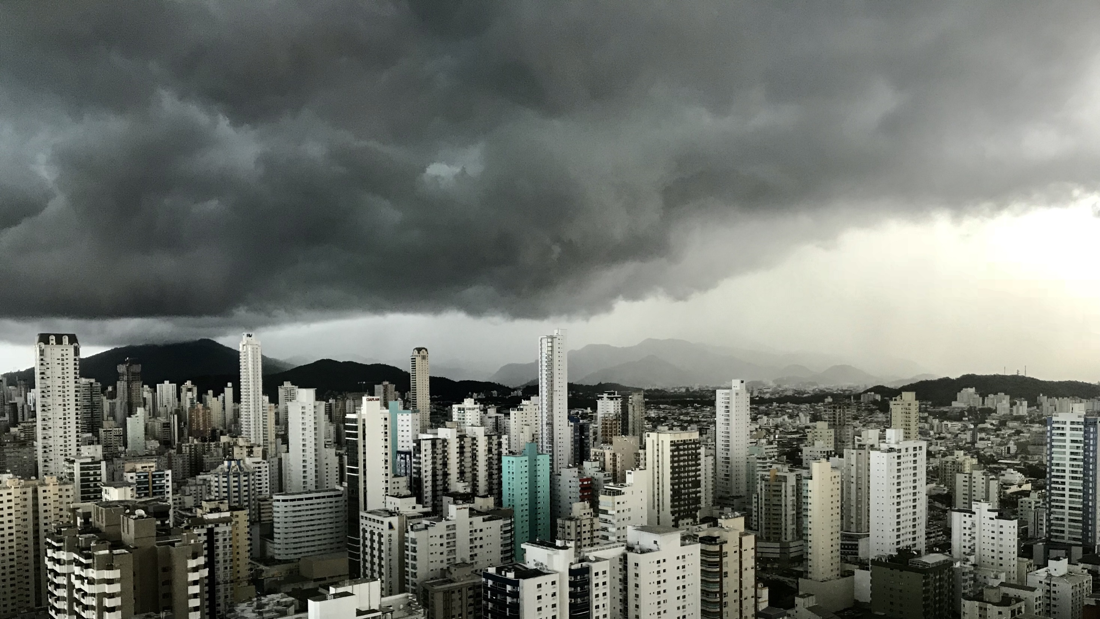
Folie 11
VIELEN DANK

