Slide 1
Predicting Cognitive Decline Micro Projects 1, 2, 3, & 4 https://github.com/jfisher43/ana500
James Fisher
6-2-2024

Slide 2
Problem Statement
According to CDC (2019), cognitive decline is on the rise within the United States and represents a public health issue impacting millions of Americans.
Significant data are publicly available, analysis of which may help to better understand predictors.
This project will assess several factors potentially predictive of self-reported worsening confusion or memory loss.
Research Question: Is self-reported worsening confusion or memory loss in adults age 45 and older predicted by age, sex, race/ethnicity, chronic disease, or traumatic childhood events?

Slide 3
Hypothesis Formulation
Hypotheses:
Self-reported worsening confusion or memory loss in adults age 45 and older is partially predicted by age, sex, race/ethnicity, chronic disease, and/or traumatic childhood events.
Self-reported data may indicate predictors of memory problems and confusion.
Data modeling will identify groups more likely to experience these issues.
Understanding groups at increased risk of worsening memory and confusion could help public health professionals prioritize appropriate interventions.

Slide 4
Acquire Data
SOURCE: Behavioral Risk Factor Surveillance System (BRFSS) – 2022 Data
The BRFSS, conducted by the Centers for Disease Control, is a collection of health-related data taken from telephone surveys of participants 18 or older, with data from all 50 US states.
VARIABLES OF INTEREST:
Target/outcome:
Worsening confusion or memory loss
Demographics
Age
Sex
Race/ethnicity
Socioeconomic
Household income
Social
Educational attainment
Marital Status
Active duty veteran
Feelings of social isolation

Slide 5
Acquire Data (2)
VARIABLES OF INTEREST (cont.):
Health / Disease
Physical health status
Mental health status
BMI
Stroke
Heart attack
Coronary heart disease
Depressive disorder
Activity Habits
Average sleep
Past-month exercise
Early Childhood Experiences (for subset analysis)
Lived with someone who was in prison or jail
Parents divorced/separated
Parent/adults beat each other
Parent/adult beat respondent
Parent/adult swore and insulted
Adult molested as a child

Slide 6
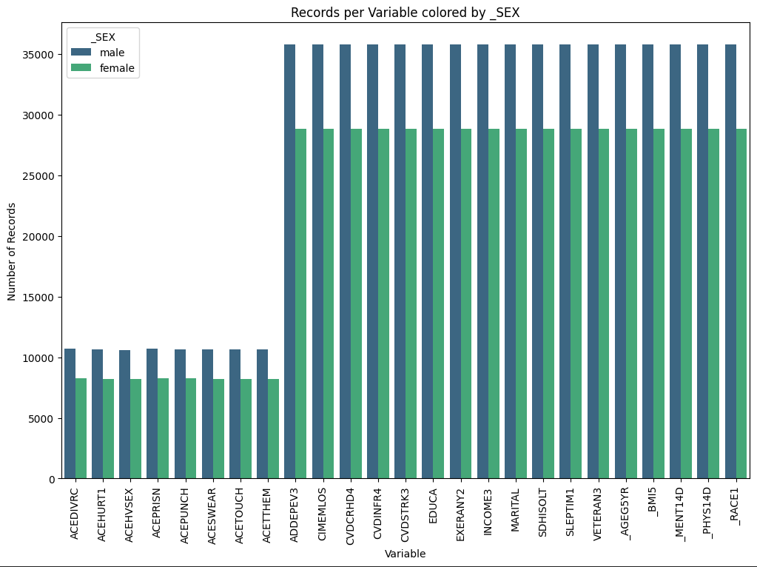
Prepare
Multi-level categorical variables grouped where appropriate to simplify.
Missing values were replaced utilizing mode imputation for categorical values and mean imputation for continuous variables.
This maintains data integrity while ensuring consistent analysis.
Minimizes the impact of missing data on the results.
Total of 64,675 records in primary output dataset.
Adverse childhood experience (ACE) variables only available for a subset of total records.

Slide 7
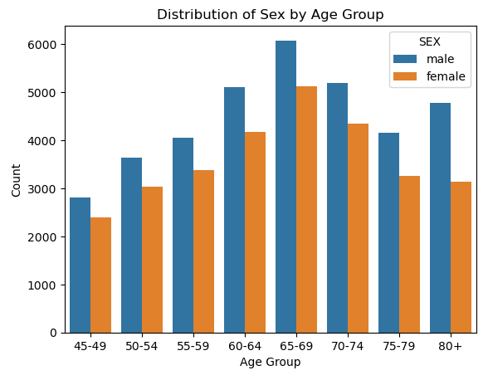
Data Demographics: Age & Sex
Large quantity of respondents across all age groups included in data.
Distribution is roughly normal with a slight left skew.
Respondents 65-69 years old are disproportionately represented.

Slide 8
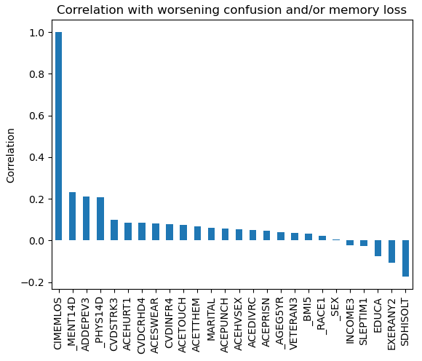
Analyze data
Several variables are positively correlated with worsening memory and/or confusion (CIMEMLOS).
Reported days of “not good” mental health (_MENT14D)
Reported days of “not good” physical health (_PHYS14D)
History of diagnosed depressive disorder (ADDEPEV3)
Previous stroke (CVDSTRK3)
Higher income and educational attainment associated with less memory problems and/or mental confusion

Slide 9
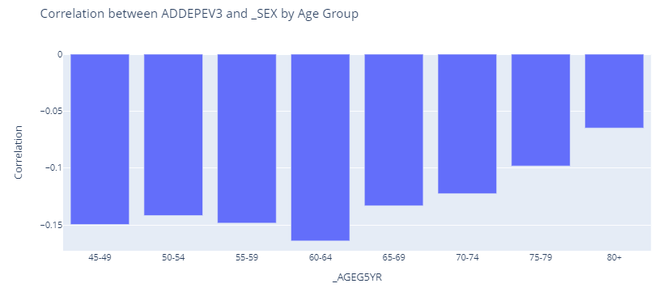
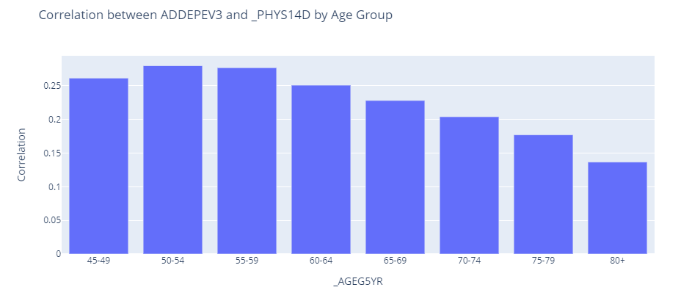
Report
Variable differences between those experiencing memory problems and confusion appear more pronounced in younger adults than older adults.
Several predictors appear to have a greater bearing on memory problems and confusion in younger respondents compared with older respondents, including:
Respondent gender
Overall physical health
Overall mental health
Adverse childhood experiences

Slide 10
Model Approach & Outputs
Overview
MLR
SVM
RFM
NNTF
Summary
All models will attempt to predict worsening memory problems and/or confusion
ACE variables only available for a limited number of respondent records
COHORT 1 (n = 64,675) will consider all predictors except adverse childhood experiences (ACE)
COHORT 2 (n = 18,793) adds in these ACE variables to the model and considers only the 18,793 respondent records for which all predictors, including ACE data, are available.
Included machine learning models:
Multiple Logistic Regression – see slides 11-12
Support Vector Machine (SVM) – see slides 13-14
Random Forest – see slides 15-16
Neural Network with Karas & TensorFlow – see slides 17-19

Slide 11
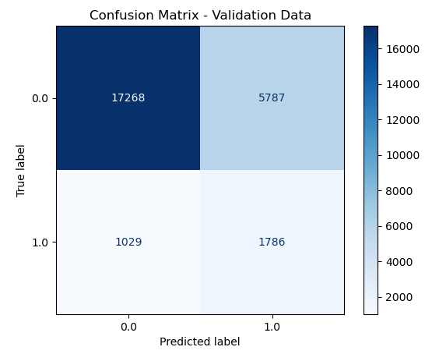
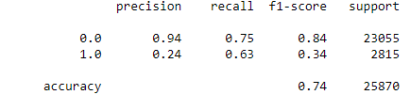
Cohort 1: Multiple Logistic Regression (MLR) Model (excluding ACE variables, n = 64,675)
Overview
MLR
SVM
RFM
NNTF
Summary
Our MLR model accurately predicts about 74% of cases
The model predicts the majority class (0; no worsening memory problems and/or confusion) with 94% precision
Precision for the minority class (1; presence of worsening memory problems and/or confusion) is only 24%
Low performance predicting presence of confusion and/or memory problems suggests need for model improvement

Slide 12
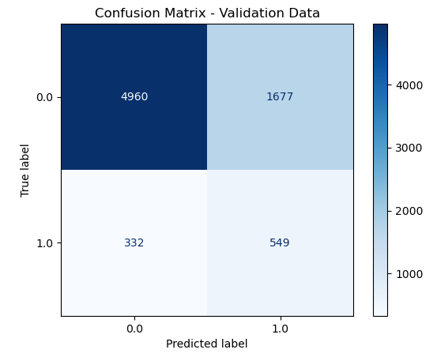

Cohort 2: Multiple Logistic Regression (MLR) Model (including ACE variables, n = 18,793)
Overview
MLR
SVM
RFM
NNTF
Summary
Addition of ACE variables and application to smaller dataset did not materially change model performance
Cohort 2 accuracy was ~73%
Identical precision (94%) and recall (75%) for negative class
Slightly higher precision (25%) compared to Cohort 1 (24%)
Slightly lower recall (62%) compared to Cohort 1 (63%)
Performance < 75% predicting confusion and/or memory problems suggests need for model improvement

Slide 13

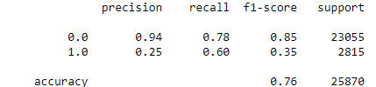
Cohort 1: Support Vector Machine (SVM) Model (excluding ACE variables, n = 64,675)
Overview
MLR
SVM
RFM
NNTF
Summary
SVM model accurately predicts about 76% of cases
~2% better than Logistic Regression
The model predicts the majority class (0; no worsening memory problems and/or confusion) with same precision as MLR (94%)
Precision for the minority class (1; presence of worsening memory problems and/or confusion) is only 25%
~1% better precision than MLR

Slide 14
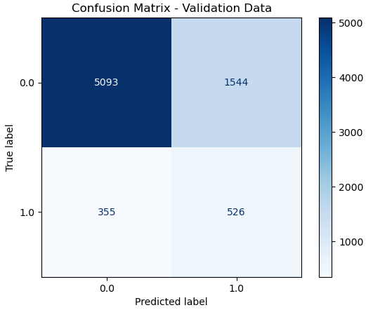
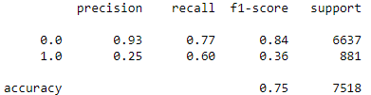
Cohort 2: Support Vector Machine (SVM) Model (including ACE variables, n = 18,793)
Overview
MLR
SVM
RFM
NNTF
Summary
SVM accuracy for Cohort 2 predictions about 2% higher than MLR model (75% vs 73%)
Addition of ACE variables decreased model accuracy by ~1%
SVM had slightly higher recall for negative class (77% vs 75%) and slightly lower for positive class (60% vs 62%).
SVM had slightly lower precision for both negative class (93% vs 94%) and approximately equal for positive class (25%)

Slide 15
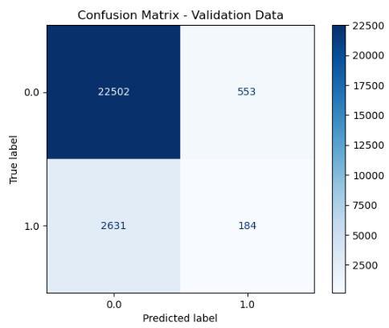
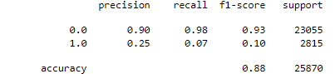
Cohort 1: Random Forest Model (excluding ACE variables, n = 64,675)
Overview
MLR
SVM
RFM
NNTF
Summary
Random Forest Model accurately predicts about 88% of cases
Majority class predicted with 90% precision and 98% recall
Minority class predicted with 25% precision and 7% recall
Terrible performance on sensitivity and specificity of accurately predicting worsening confusion and confusion

Slide 16
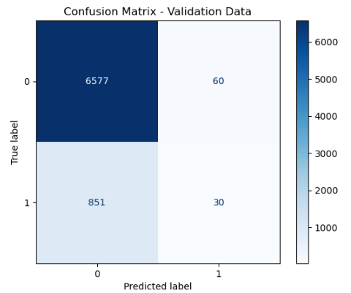

Cohort 2: Random Forest Model (including ACE variables, n = 18,793)
Overview
MLR
SVM
RFM
NNTF
Summary
Addition of ACE variables and application to smaller dataset increased precision and decreased recall of positive class
Overall accuracy of 88%
High precision (89%) and recall (99%) for negative class
Very low F1-Score for positive class (0.06)

Slide 17
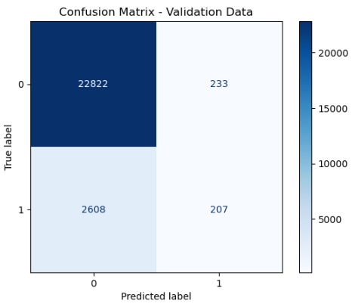

Cohort 1: Neural Network Model with TensorFlow (NNTF) (excluding ACE variables, n = 64,675)
Overview
MLR
SVM
RFM
NNTF
Summary
NNTF model shows 89% overall accuracy
Significantly higher performance on precision for positive class (0.47) than other models, but low recall (0.07)
Precision for negative class equal to RFM (0.90) but much higher for NNTF (0.47 vs 0.25)
Low recall for positive class due to large class imbalance

Slide 18


Cohort 2: Neural Network Model with TensorFlow (NNTF) (including ACE variables, n = 18,793)
Overview
MLR
SVM
RFM
NNTF
Summary
NNTF Recall for positive class (0.12) higher than RFM (0.03) but lower than SVM (0.60)
Addition of adverse childhood event (ACE) variables into NNTF model decreased overall accuracy by ~2%
Inclusion of key ACE variables could increase practical utility of final model
Low positive class Recall indicates additional steps necessary to improve performance:
Class balancing
Adjusted class weights
Model tuning

Slide 19
Cohort 2: Neural Network Model with TensorFlow (NNTF) (including ACE variables, n = 18,793)
Overview
MLR
SVM
RFM
NNTF
Summary
NNTF Recall for positive class (0.12) higher than RFM (0.03) but lower than SVM (0.60)
Addition of adverse childhood event (ACE) variables into NNTF model decreased overall accuracy by ~2%
Low positive class Recall indicates additional steps necessary to improve performance:
Class balancing
Adjusted class weights
Model tuning

Slide 20
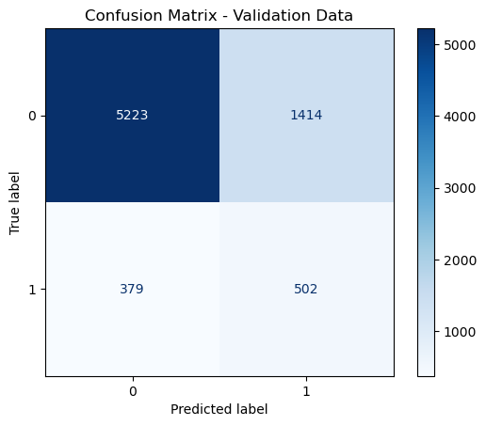
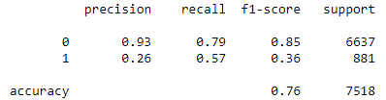
Cohort 2: Neural Network Model with TensorFlow (NNTF) (including ACE variables, n = 18,793)
Overview
MLR
SVM
RFM
NNTF+
Summary
FINE TUNED MODEL
Inclusion of key ACE variables in Cohort 2 could increase practical utility of final model
Class balancing, adjusting class weights, and model tuning significantly shifted Cohort 1 NNTF performance:
Positive class recall (capture of true positive cases) increased from 12% to 57%
Overall accuracy decreased from 87% to 76% due to decreased negative class recall (0.97 to 0.79)
F1-Score for positive class (i.e., successful prediction of respondents with worsening memory loss or confusion) doubled, from 0.18 to 0.36

Slide 21
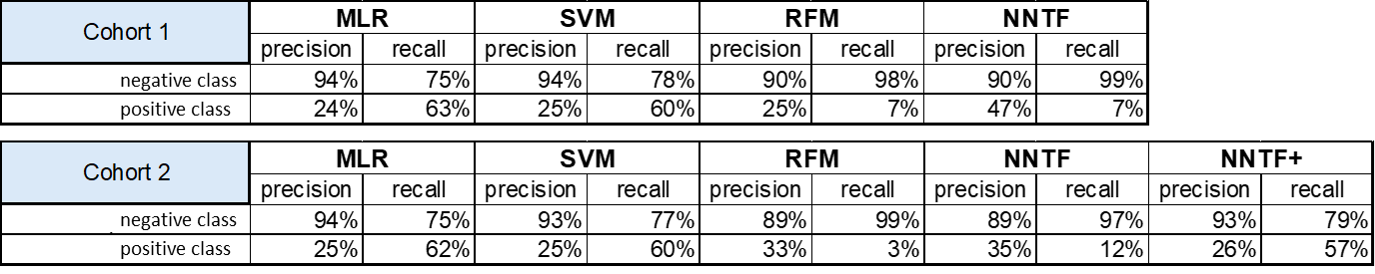
Summary: Model Comparison & Selection
Overview
MLR
SVM
RFM
NNTF
Summary
Considering the priority on recall for the positive class to help positively identify people at increased risk of memory problems and severe confusion:
Cohort 1: The highest recall was from MLR (63%) and SVM (60%), though both have low precision; While NNTF has higher precision (47%), it has very low recall (7%)
Cohort 2: Highest recall achieved using MLR (62%) and SVM (60%) NNTF+ model (with class balancing) has a lower recall (57%) but balances recall and precision compared to other models
Recommendation is to choose MLR model because it more scalable, interpretable, and computationally efficient than SVM.
While NNTF+ shows promise, it fails to beat MLR and SVM recall rates for the positive class

Slide 22
Takeaways & Next Steps
This study considered whether self-reported worsening confusion or memory loss in adults age 45 and older can be predicted by age, sex, race/ethnicity, chronic disease, or traumatic childhood events?
Four different machine learning models were evaluated with an emphasis on maximizing recall for the positive class to help positively identify people at increased risk of memory problems and severe confusion
MLR and SVM models were found to perform best
However, MLR is recommended on account of its scalability and interpretability
Next step is to deploy model at scale to identify people more likely to experience worsening memory problems and/or confusion.

Slide 23
References
Casanova, R., Saldana, S., Lutz, M. W., Plassman, B. L., Kuchibhatla, M., & Hayden, K. M. (2020). Investigating predictors of cognitive decline using machine learning. Journal of Gerontology, 75(4), 733–742. https://doi.org/10.1093/geronb/gby054
Centers for Disease Control and Prevention (CDC). Chronic diseases and cognitive decline – A public health issue. Alzheimer’s Disease and Healthy Aging: Data Briefs. U.S. Government. Retrieved from https://www.cdc.gov/aging/publications/chronic-diseases-brief.html

