Slide 1
Predicting Cognitive Decline Micro-Project 2 https://github.com/jfisher43/ana500
James Fisher
5-19-2024

Slide 2
Problem Statement
According to CDC (2019), cognitive decline is on the rise within the United States and represents a public health issue impacting millions of Americans.
Significant data are publicly available, analysis of which may help to better understand predictors.
This project will assess several factors potentially predictive of self-reported worsening confusion or memory loss.
Research Question: Is self-reported worsening confusion or memory loss in adults age 45 and older predicted by age, sex, race/ethnicity, chronic disease, or traumatic childhood events?

Slide 3
Hypothesis Formulation
Hypotheses:
Self-reported worsening confusion or memory loss in adults age 45 and older is partially predicted by age, sex, race/ethnicity, chronic disease, and/or traumatic childhood events.
Self-reported data may indicate predictors of memory problems and confusion.
Data modeling will identify groups more likely to experience these issues.
Understanding groups at increased risk of worsening memory and confusion could help public health professionals prioritize appropriate interventions.

Slide 4
Acquire
SOURCE: Behavioral Risk Factor Surveillance System (BRFSS) – 2022 Data
The BRFSS, conducted by the Centers for Disease Control, is a collection of health-related data taken from telephone surveys of participants 18 or older, with data from all 50 US states.
VARIABLES OF INTEREST:
Target/outcome:
Worsening confusion or memory loss
Demographics
Age
Sex
Race/ethnicity
Social
Educational attainment
Marital Status
Active duty veteran
Feelings of social isolation
Socioeconomic
Household income

Slide 5
Acquire
VARIABLES OF INTEREST (cont.):
Health / Disease
Physical health status
Mental health status
BMI
Stroke
Heart attack
Coronary heart disease
Depressive disorder
Activity Habits
Average sleep
Past-month exercise
Early Childhood Experiences (for subset analysis)
Lived with someone who was in prison or jail
Parents divorced/separated
Parent/adults beat each other
Parent/adult beat respondent
Parent/adult swore and insulted
Adult molested as a child

Slide 6
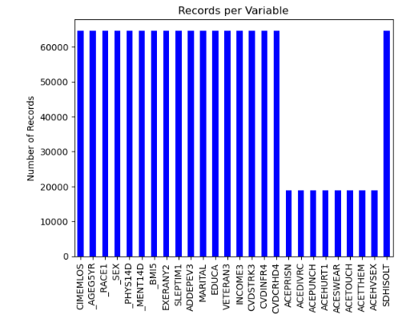
Prepare
Multi-level categorical variables grouped where appropriate to simplify.
Missing values were replaced utilizing mode imputation for categorical values and mean imputation for continuous variables.
Total of 64,675 records in primary output dataset.
Adverse childhood experience (ACE) variables only available for a subset of total records.

Slide 7
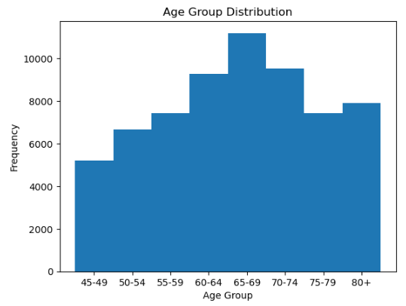
Analyze data
Large quantity of respondents across all age groups included in data.
Distribution is roughly normal with a slight left skew.
Respondents 65-69 years old are disproportionately represented.

Slide 8
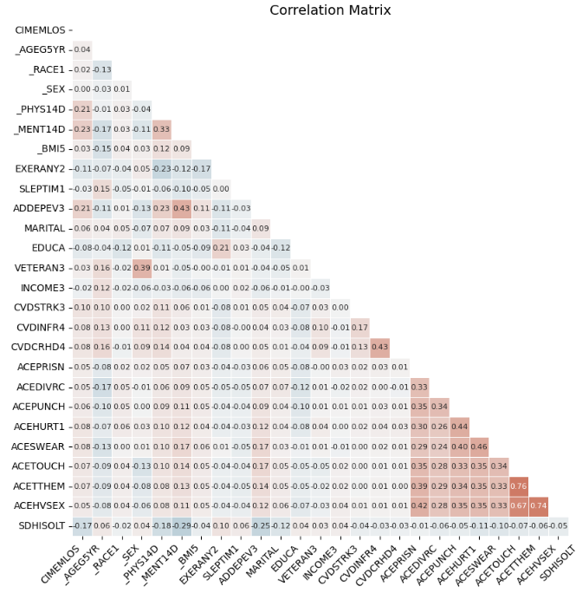
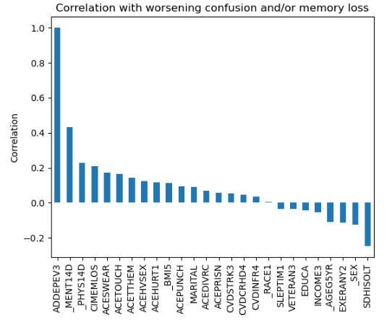
Analyze data
Several variables are positively correlated with worsening memory and/or confusion (ADDEPEV3).

Slide 9
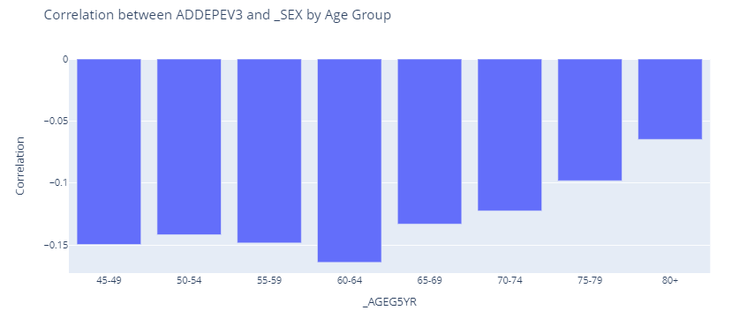
Report
Variable differences between those experiencing memory problems and confusion appear more pronounced in younger adults than older adults.
Some predictors appear less correlated in older age groups.

Slide 10
Report
[To update with models derived from Micro Project 3]

Slide 11
Act
<apply results, connect results with the chosen problem statement or business question>

Slide 12
References
Casanova, R., Saldana, S., Lutz, M. W., Plassman, B. L., Kuchibhatla, M., & Hayden, K. M. (2020). Investigating predictors of cognitive decline using machine learning. Journal of Gerontology, 75(4), 733–742. https://doi.org/10.1093/geronb/gby054
Centers for Disease Control and Prevention (CDC). Chronic diseases and cognitive decline – A public health issue. Alzheimer’s Disease and Healthy Aging: Data Briefs. U.S. Government. Retrieved from https://www.cdc.gov/aging/publications/chronic-diseases-brief.html

