Slide 1
Predicting Cognitive Decline Micro-Project 3 https://github.com/jfisher43/ana500
James Fisher
5-26-2024

Slide 2
Problem Statement
According to CDC (2019), cognitive decline is on the rise within the United States and represents a public health issue impacting millions of Americans.
Significant data are publicly available, analysis of which may help to better understand predictors.
This project will assess several factors potentially predictive of self-reported worsening confusion or memory loss.
Research Question: Is self-reported worsening confusion or memory loss in adults age 45 and older predicted by age, sex, race/ethnicity, chronic disease, or traumatic childhood events?

Slide 3
Hypothesis Formulation
Hypotheses:
Self-reported worsening confusion or memory loss in adults age 45 and older is partially predicted by age, sex, race/ethnicity, chronic disease, and/or traumatic childhood events.
Self-reported data may indicate predictors of memory problems and confusion.
Data modeling will identify groups more likely to experience these issues.
Understanding groups at increased risk of worsening memory and confusion could help public health professionals prioritize appropriate interventions.

Slide 4
Acquire
SOURCE: Behavioral Risk Factor Surveillance System (BRFSS) – 2022 Data
The BRFSS, conducted by the Centers for Disease Control, is a collection of health-related data taken from telephone surveys of participants 18 or older, with data from all 50 US states.
VARIABLES OF INTEREST:
Target/outcome:
Worsening confusion or memory loss
Demographics
Age
Sex
Race/ethnicity
Socioeconomic
Household income
Social
Educational attainment
Marital Status
Active duty veteran
Feelings of social isolation

Slide 5
Acquire
VARIABLES OF INTEREST (cont.):
Health / Disease
Physical health status
Mental health status
BMI
Stroke
Heart attack
Coronary heart disease
Depressive disorder
Activity Habits
Average sleep
Past-month exercise
Early Childhood Experiences (for subset analysis)
Lived with someone who was in prison or jail
Parents divorced/separated
Parent/adults beat each other
Parent/adult beat respondent
Parent/adult swore and insulted
Adult molested as a child

Slide 6
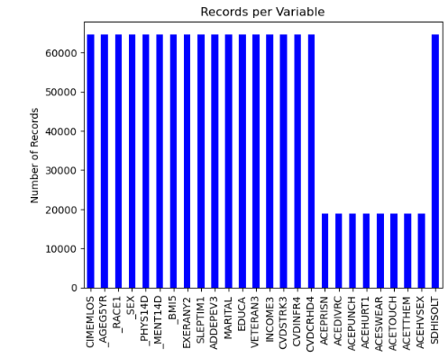
Prepare
Multi-level categorical variables grouped where appropriate to simplify.
Missing values were replaced utilizing mode imputation for categorical values and mean imputation for continuous variables.
This maintains data integrity while ensuring consistent analysis.
Minimizes the impact of missing data on the results.
Total of 64,675 records in primary output dataset.
Adverse childhood experience (ACE) variables only available for a subset of total records.

Slide 7
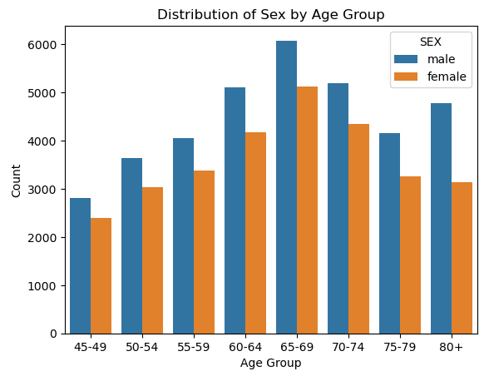
Analyze data: Age & Sex
Large quantity of respondents across all age groups included in data.
Distribution is roughly normal with a slight left skew.
Respondents 65-69 years old are disproportionately represented.

Slide 8
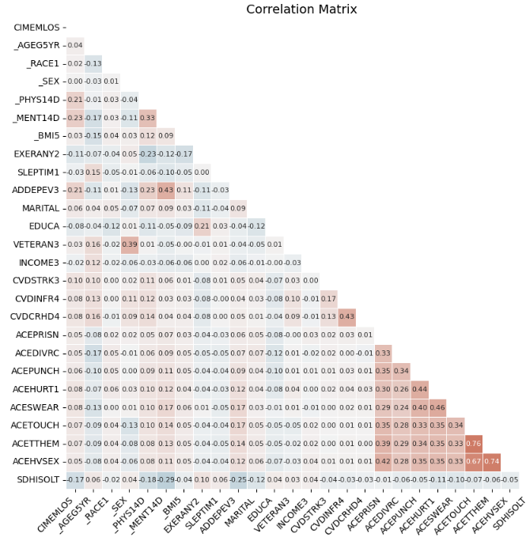
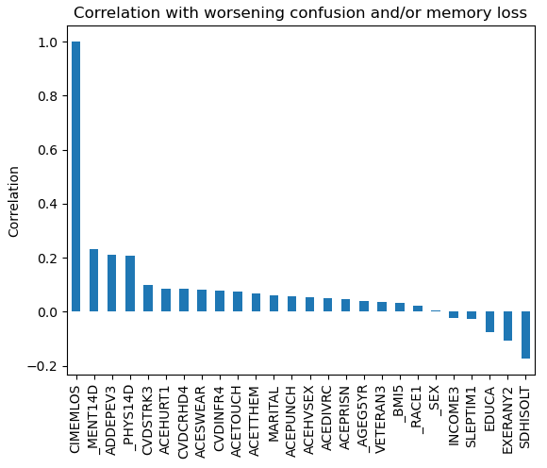
Analyze data
Several variables are positively correlated with worsening memory and/or confusion (CIMEMLOS).

Slide 9
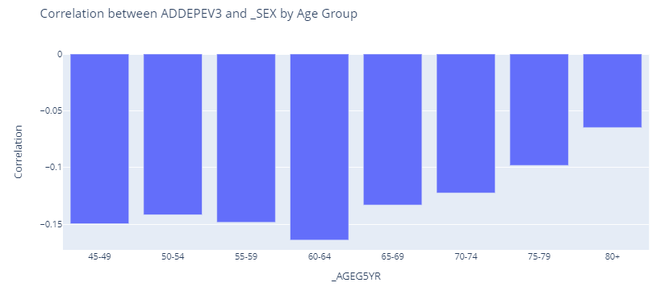
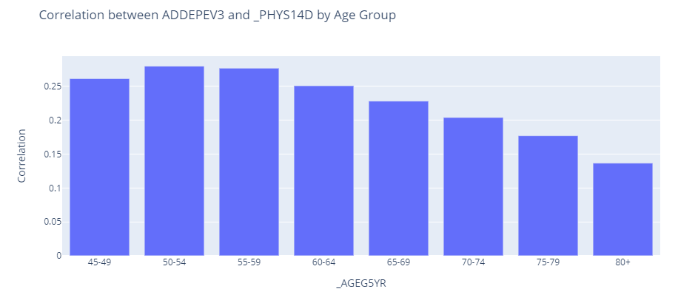
Report
Variable differences between those experiencing memory problems and confusion appear more pronounced in younger adults than older adults.
Several predictors appear to have a greater bearing on memory problems and confusion in younger respondents compared with older respondents, including:
Respondent gender
Overall physical health
Overall mental health
Adverse childhood experiences

Slide 10
Model Approach & Outputs
All models will attempt to predict worsening memory problems and/or confusion
ACE variables only available for a limited number of respondent records
COHORT 1 (n = 64,675) will consider all predictors except adverse childhood experiences (ACE)
COHORT 2 (n = 18,793) adds in these ACE variables to the model and considers only the 18,793 respondent records for which all predictors, including ACE data, are available.
Included machine learning models:
Multiple Logistic Regression
Support Vector Machine (SVM)

Slide 11
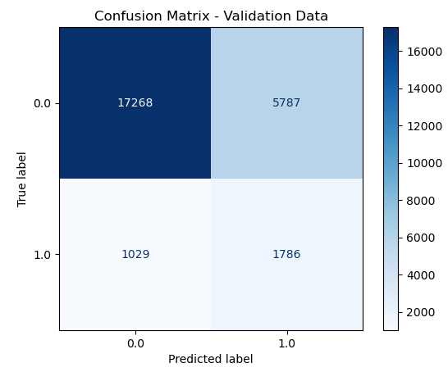
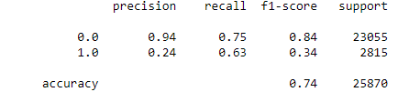
Cohort 1: Multiple Logistic Regression (MLR) Model (excluding ACE variables, n = 64,675)
Our MLR model accurately predicts about 74% of cases
The model predicts the majority class (0; no worsening memory problems and/or confusion) with 94% precision
Precision for the minority class (1; presence of worsening memory problems and/or confusion) is only 24%
Low performance predicting presence of confusion and/or memory problems suggests need for model improvement

Slide 12
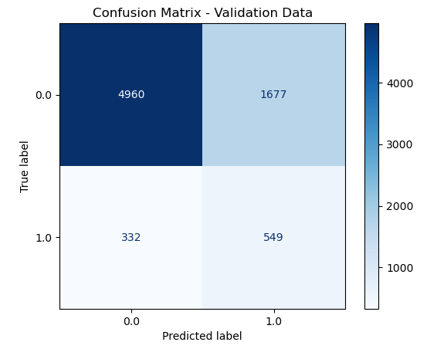

Cohort 2: Multiple Logistic Regression (MLR) Model (including ACE variables, n = 18,793)
Addition of ACE variables and application to smaller dataset did not materially change model performance
Cohort 2 accuracy was ~73%
Identical precision (94%) and recall (75%) for negative class
Slightly higher precision (25%) compared to Cohort 1 (24%)
Slightly lower recall (62%) compared to Cohort 1 (63%)
Performance < 75% predicting confusion and/or memory problems suggests need for model improvement

Slide 13

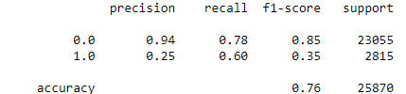
Cohort 1: Support Vector Machine (SVM) Model (excluding ACE variables, n = 64,675)
SVM model accurately predicts about 76% of cases
~2% better than Logistic Regression
The model predicts the majority class (0; no worsening memory problems and/or confusion) with same precision as MLR (94%)
Precision for the minority class (1; presence of worsening memory problems and/or confusion) is only 25%
~1% better precision than MLR

Slide 14
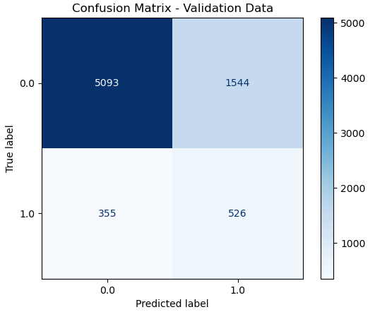
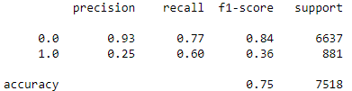
Cohort 2: Support Vector Machine (SVM) Model (including ACE variables, n = 18,793)
SVM accuracy for Cohort 2 predictions about 2% higher than MLR model (75% vs 73%)
Addition of ACE variables decreased model accuracy by ~1%
SVM had slightly higher recall for negative class (77% vs 75%) and slightly lower for positive class (60% vs 62%).
SVM had slightly lower precision for both negative class (93% vs 94%) and approximately equal for positive class (25%)

Slide 15
Report: Next Steps
Additional machine learning models will be considered in Micro Project #4
Comparison between models and final model selection will be provided in Micro Project #4

Slide 16
Act
<apply results, connect results with the chosen problem statement or business question>

Slide 17
References
Casanova, R., Saldana, S., Lutz, M. W., Plassman, B. L., Kuchibhatla, M., & Hayden, K. M. (2020). Investigating predictors of cognitive decline using machine learning. Journal of Gerontology, 75(4), 733–742. https://doi.org/10.1093/geronb/gby054
Centers for Disease Control and Prevention (CDC). Chronic diseases and cognitive decline – A public health issue. Alzheimer’s Disease and Healthy Aging: Data Briefs. U.S. Government. Retrieved from https://www.cdc.gov/aging/publications/chronic-diseases-brief.html

