Slide 1
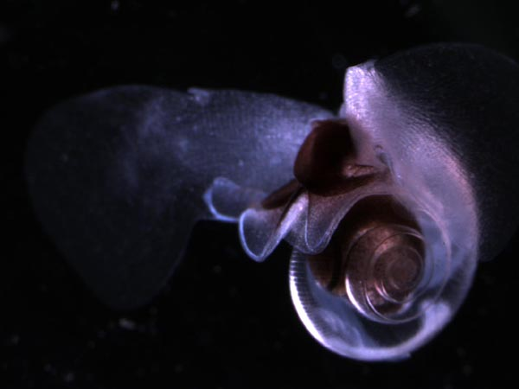


Variable patterns in pteropod abundance between the shelf and slope from two decades of observations off Newport Oregon, USA
Jennifer L. Fisher¹, Bill Peterson², Hongsheng Bi³, Brandon Chasco²
¹Cooperative Institute for Marine Resources Studies, Oregon State University, Newport, OR , USA
²NOAA, Northwest Fisheries Science Center, Hatfield Marine Science Center, Newport, OR, USA
³University of Maryland, Center for Environmental Science, USA

Slide 2
Upwelling regions have reduced habitat with respect to aragonite saturation
From Bednarsek at al. 2014

Slide 3
Severe shell dissolution was observed in regions with corrosive water
Shelf
Slope
From Bednarsek at al. 2014

Slide 4
Objectives of this study
Determine the seasonal and inter-annual patterns of aragonite saturation and Limacina sp. on the shelf and slope
Investigate whether patterns in Limacina sp. abundance are correlated with aragonite saturation or other environmental parameters
Develop a model with a suite of environmental parameters that best characterize changes in Limacina sp. abundance

Slide 5
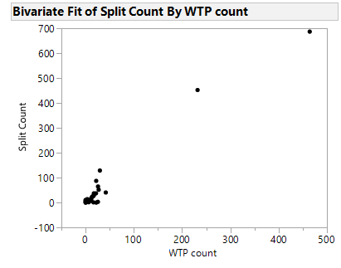
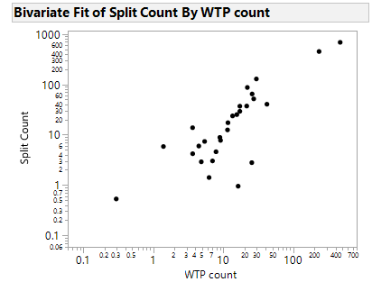
Methods caveats…
Samples are from the vertical net
Sampled with a stimple pipette for copepods
Are these good abundance estimates?
n= 52 samples

Slide 6
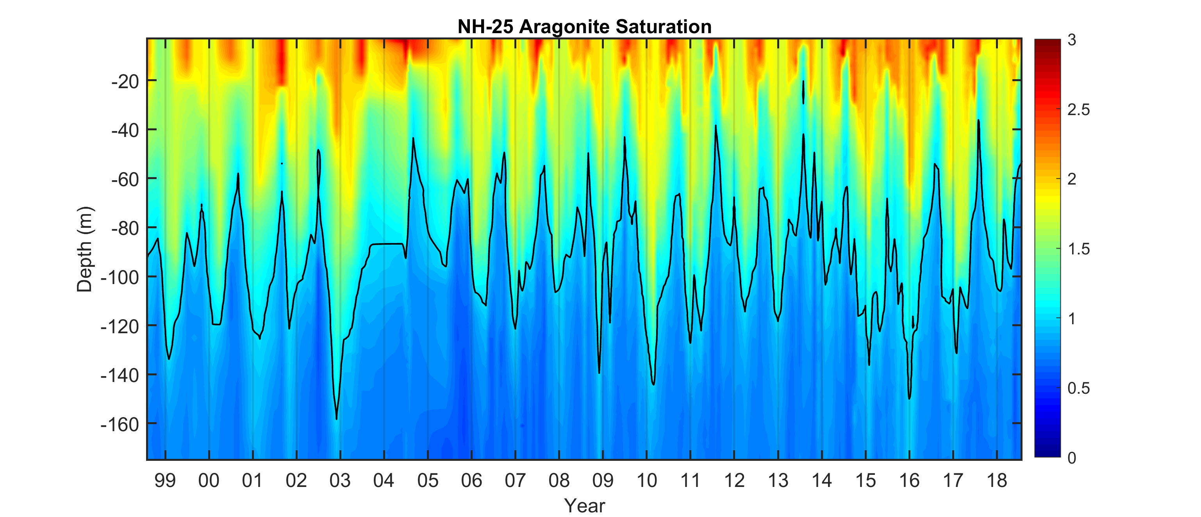
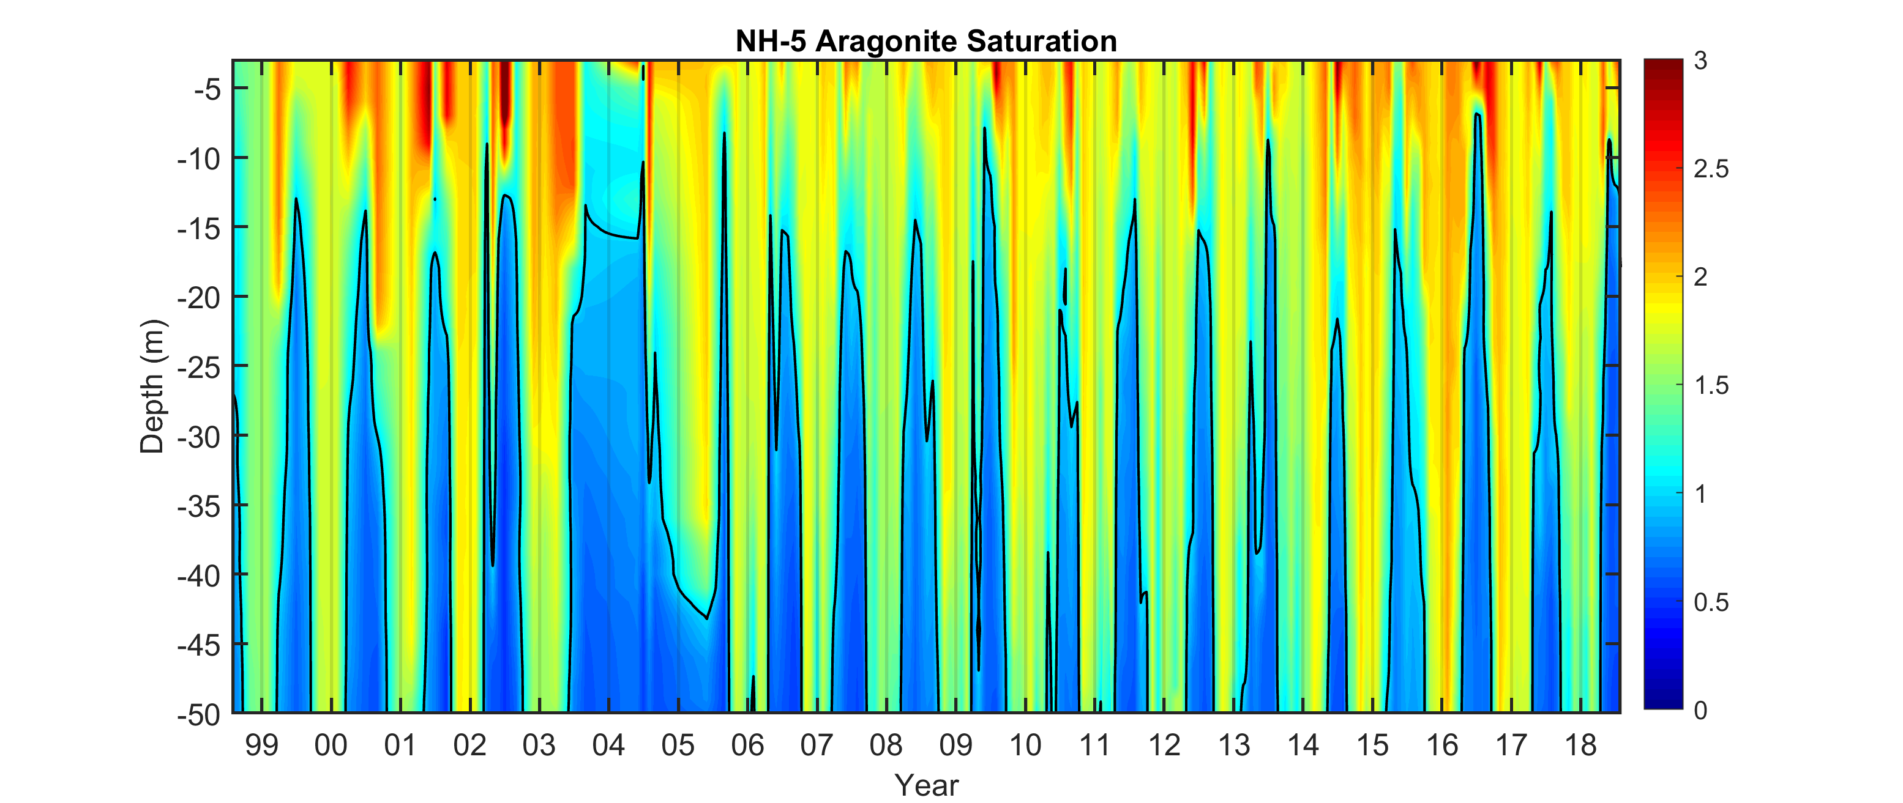
More suitable habitat on the slope compared to the shelf
Slope station
Shelf station

Slide 7
More suitable pteropod habitat on the slope compared to the shelf
Slope station
Shelf station

Slide 8
Patterns of undersaturated water consistent between 2011 (Bednarsek et al. 2014) and present study
During peak period of undersaturation
% individuals encountering sever dissolution:
Shelf = 75%
Slope = 25%
From Bednarsek at al. 2014

Slide 9
Long term trends in Limacina helicina

Slide 10
Long term trends in Limacina helicina

Slide 11
Long term trends in Limacina helicina

Slide 12
Long term trends in Limacina sp. on the slope correlated with % of water column undersaturated
% undersaturated
r = -0.43 +7 mo. lag
NPGO is correlated to upwelling source waters in this region (JO Peterson et al. 2013)
NPGO
r = -0.33 0 mo. lag

Slide 13
Long term trends in Limacina sp. on the shelf variable and not correlated with aragonite or NPGO

Slide 14
Generalized Linear Model preliminary results working towards zero-inflated model
 | Slope- NH-25 |  | Shelf- NH-5
Effect
Year | * |  | *
Month | * |  | *
% water Ω<1 | * |  | *
NPGO | * |  | *
PDO | -- |  | --
ONI | -- |  | --

Slide 15
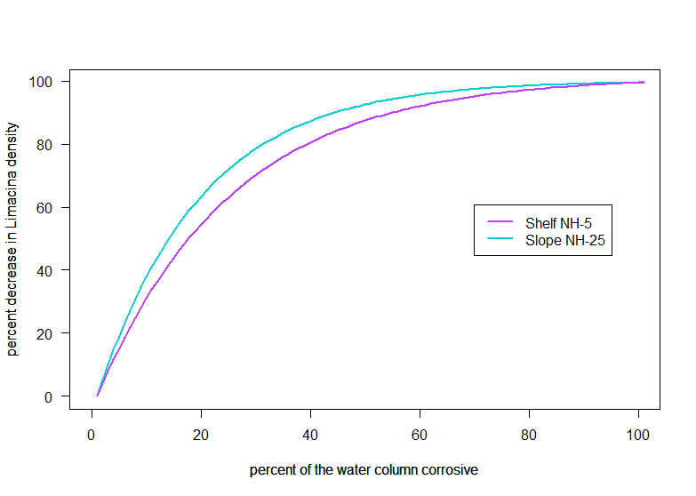
Limacina sp. decreases rapidly in response to the fraction of the water column that is corrosive

Slide 16
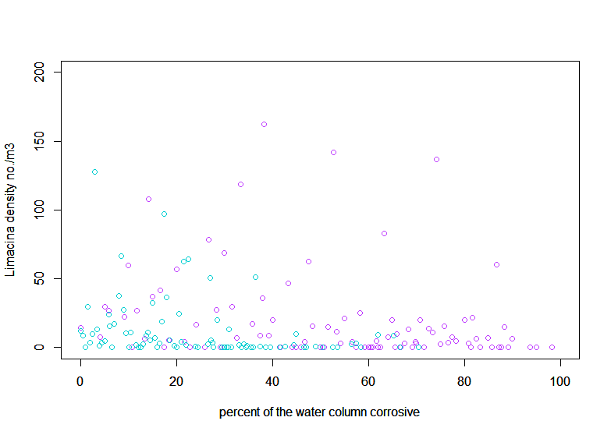
Limacina sp. decreases rapidly in response to the fraction of the water column that is corrosive

Slide 17
Summary- nearshore
Shelf dominated (80%) by corrosive water seasonally creating habitat unsuitable for Limacina sp.
Limacina sp. abundance drops dramatically when the shelf waters are most corrosive
Long term trends in Limacina sp. abundance not correlated with other variables

Slide 18
Summary- offshore
Suitable habitat available during most of the year, with corrosive water occupying 30% of the upper 100 m during July - Oct
Limacina sp. abundance peaks in May when the water is not corrosive
Long term trends in pteropod abundance are correlated with the % of the water column undersaturated and with the NPGO

Slide 20







Acknowledgements
Samantha Zeman, Kym Jacobson, Cheryl Morgan, Jay Peterson, Leah Feinberg, Tracy Shaw, Jennifer Menkel, Jesse F. Lamb, Toby Auth, Julie Keister, Aaron Chappell, Bobby Ireland, Thomas Murphy, Ryan Rykaczewski, Rian Hooff, Ramiro Riquelmo, Jaime Gomez, Mitch Vance, Hui Lui

Slide 21
Long term decline in pteropods observed off Vancouver Island, BC
Mackas and Galbraith (2012)

Slide 22
Long term trends in Limacina sp. on the slope correlated with aragonite saturation and NPGO
% undersaturated
r = -0.43 +7 mo. Lag
NPGO
r = -0.33 0 mo. lag

Slide 23
Conclusions
Limacina sp. do not appear to be declining over the 20-year time series
However, Limacina sp. abundance appears to be strongly influenced by the fraction of the water column that is corrosive
Future ocean conditions with increased corrosivity will reduce pteropod habitat and likely lead to declines

Slide 24
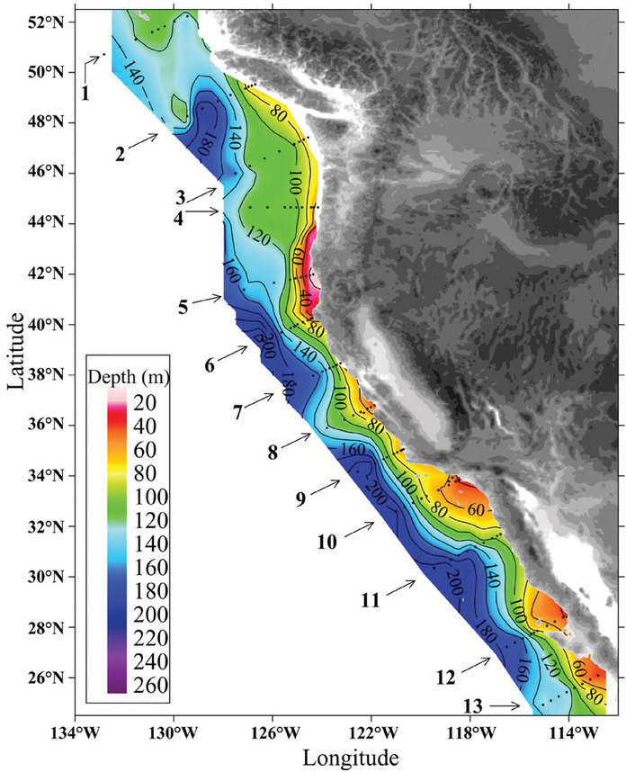
Upwelling regions have reduced habitat with respect to aragonite saturation
High CO₂ water that upwells onto the shelf has a low saturation value with respect to aragonite (Ω_{ar})
When Ω_{ar} <1 the water is undersaturated (or corrosive) and marine organisms with CaCO₃ shells are susceptible to dissolution
From Feely et al. 2008

Slide 25
Summer upwelling stronger on the shelf compared to the slope
Slope station
Shelf station

