Slide 1
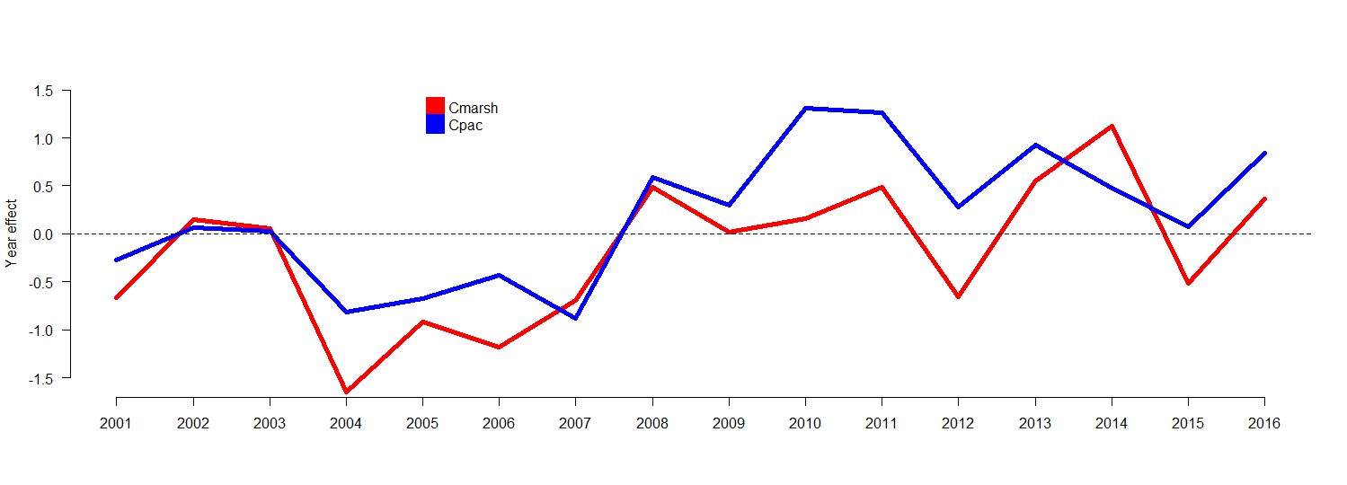
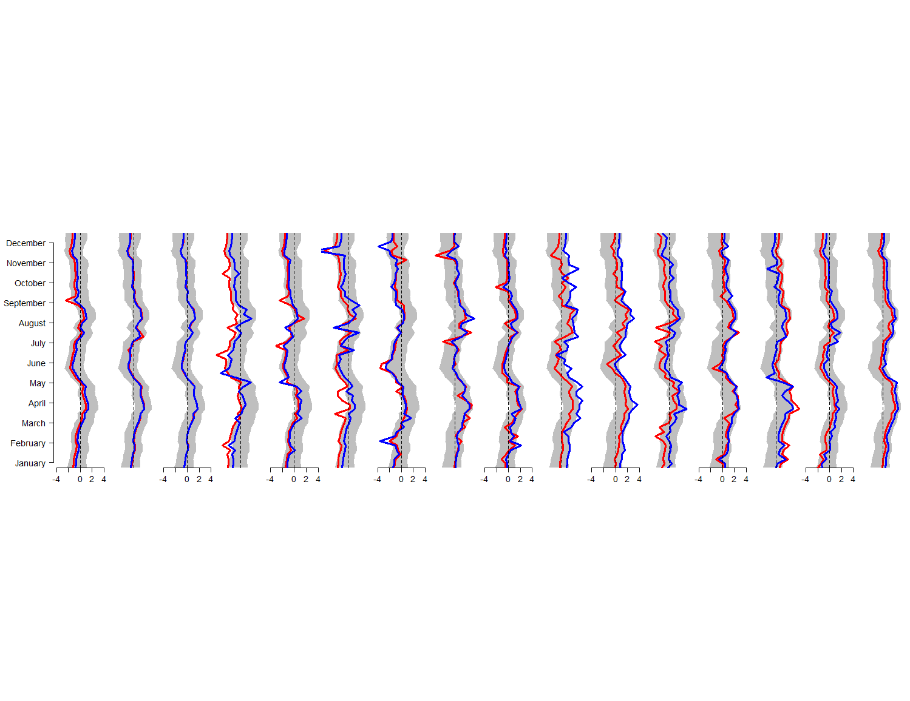

Slide 2
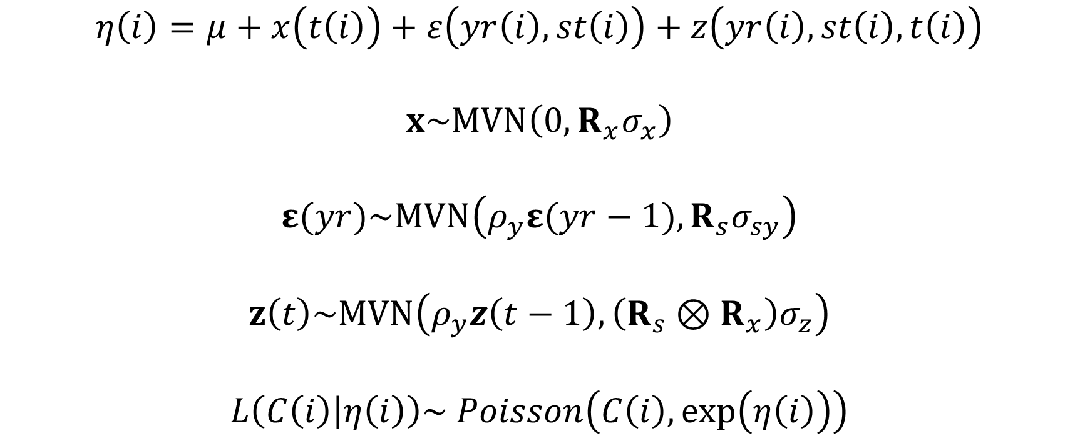
$$η\left(i\right)=μ+x\left(t\left(i\right)\right)+ε\left(yr\left(i\right),st\left(i\right)\right)+z\left(yr\left(i\right),st\left(i\right),t\left(i\right)\right)$$
$$x\sim MVN\left(0, R_{x}σ_{x}\right)$$
$$ε(yr)\sim MVN\left(ρ_{y}ε(yr−1), R_{s}σ_{sy}\right)$$
$$z\left(t\right)\sim MVN\left(ρ_{y}z\left(t−1\right), \left(R_{s}⊗R_{x}\right)σ_{z}\right)$$
$$L\left(C\left(i\right) | η\left(i\right)\right)\sim Poisson\left(C\left(i\right),\exp\left(η\left(i\right)\right)\right)$$
Notes:
x(t(i)) seasonal effect for the ith observation
Epsilon(yr(i), s(i)) is the interaction between year and species
Z(t) is the station, year, and seasonal
$η\left(i\right)$ is the linear link function
The likelihood of the observation given the exponent of the link function is a Poisson distribution.
MVN stands for multivariate normal.

