Slide 1
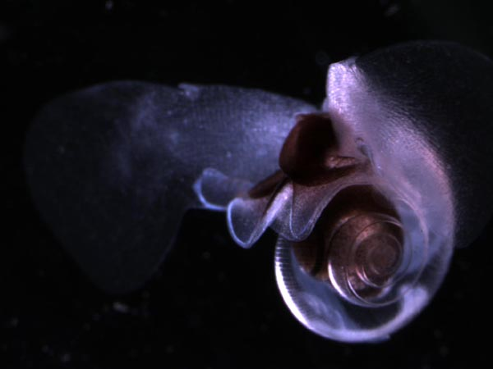


Variable patterns in pteropod abundance between the shelf and slope from two decades of observations off Newport Oregon, USA
Jennifer L. Fisher¹, Bill Peterson², Will White³
¹Cooperative Institute for Marine Resources Studies, Oregon State University
²NOAA, Northwest Fisheries Science Center, Hatfield Marine Science Center
³Department of Fisheries and Wildlife, Oregon State University

Slide 2
Severe shell dissolution was observed in regions with corrosive water
Shelf
Slope
From Bednarsek at al. 2014

Slide 3
Objectives of this study
Determine the seasonal and inter-annual patterns of aragonite saturation and Limacina sp. on the shelf and slope
Investigate whether patterns in Limacina sp. abundance are correlated with aragonite saturation or other environmental parameters
Develop a model with a suite of environmental parameters that best characterize changes in Limacina sp. abundance

Slide 4
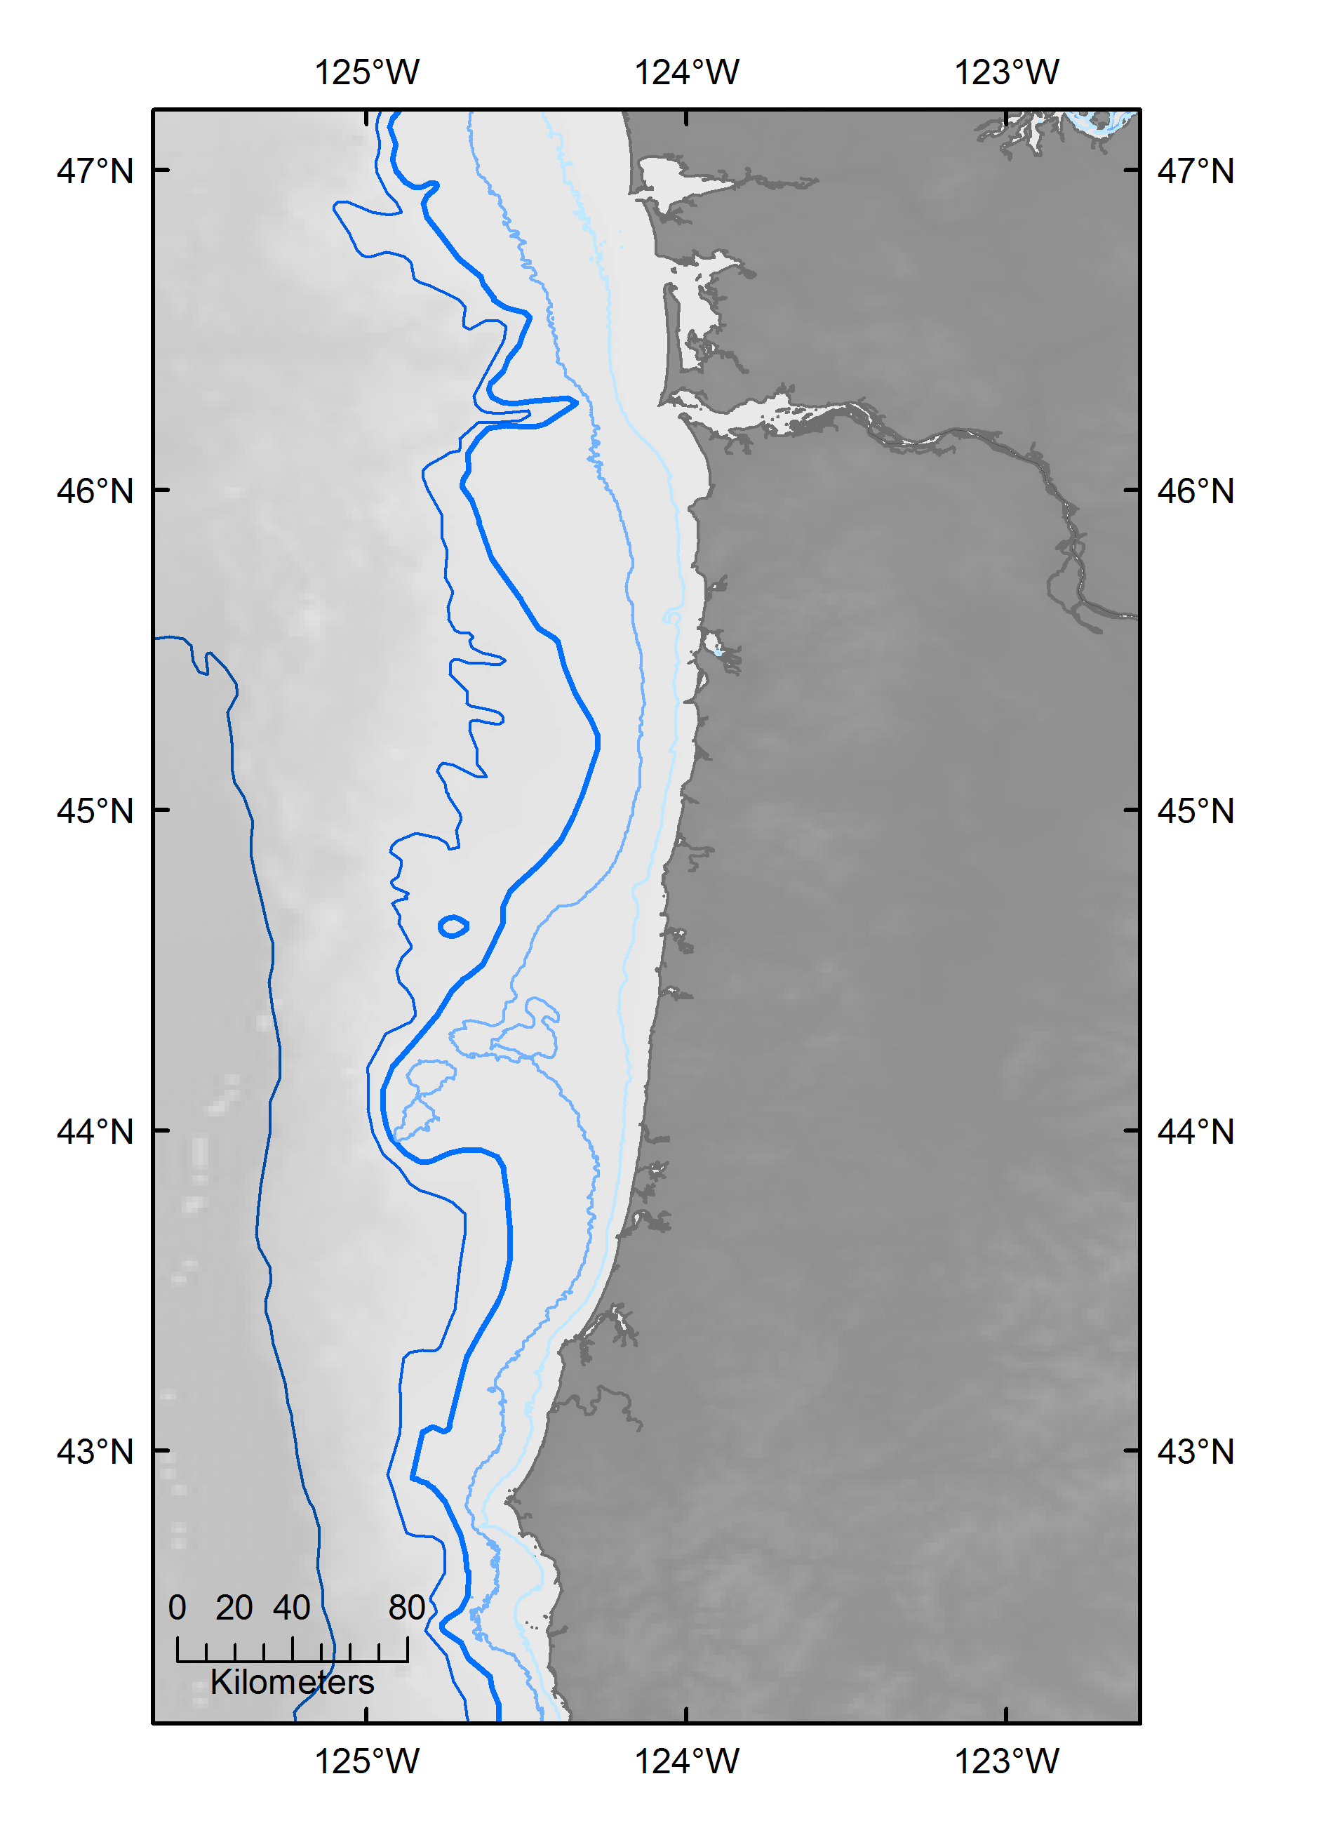
Methods
Washington
Newport Hydrographic Line
Sampled biweekly/monthly 1996-present
2 stations
Shelf- NH-5 (60 m)
Slope NH-25 (300 m)
Pteropod collections
Limacina helicina
½ m vertical net (202-um)
upper 100 m or 2 m off the bottom
Aragonite saturation
Derived from CTD- temperature and oxygen (Juranek et al. 2009)
2006 – present (most consistent)
Time series analysis and GLM
Determine seasonal and long term trends (decompose in R)
Quantify effect of environmental variables on pteropod density
Columbia River
Newport Hydrographic Line
NH-25
300 m
NH-5
60 m
Oregon
Cape Blanco

Slide 5
More suitable pteropod habitat on the slope compared to the shelf
Slope station
Shelf station

Slide 6
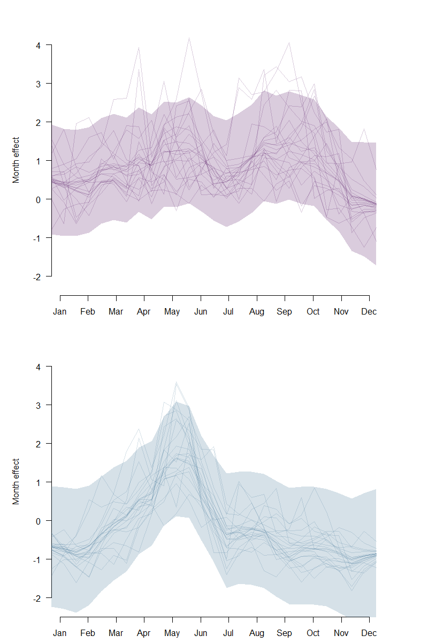
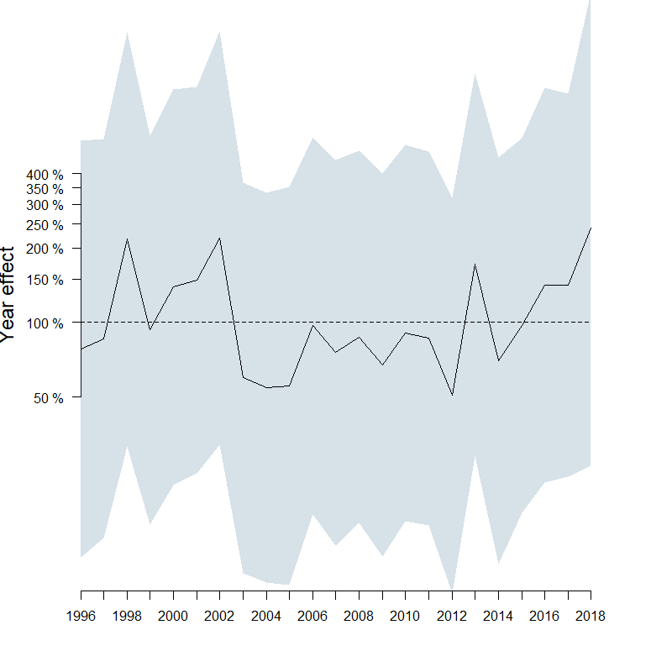
End Goal for this class…
Time series model (gls) with AR response and env. covariates
State-space model (MARSS) with env. covariates
Nice figures representing the seasonal and long term effects

Slide 7
Goals/steps for this class (in R)…
Query pteropod and environmental data from MS Access database
Calculate monthly anomalies for bio and env
Plot monthly raw and anomaly data for bio and env
Plot the climatology of bio and env
Determine the autocorrelation order (e.g., AR1, AR2) for the pteropod dataset (test with AIC)
Build the time series model, is it linear or non-linear, make it a state space model
Lag the env vars with variable lags and add them as covariates to the model

