Slide 2
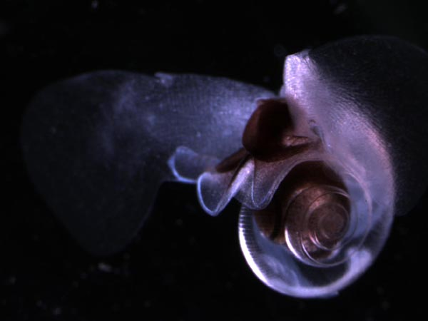
Variable patterns in pteropod abundance between the shelf and slope from two decades of observations off Newport Oregon, USA
Learning R (with the help of Google)
Jennifer L. Fisher
Department of Fisheries and Wildlife

Slide 3
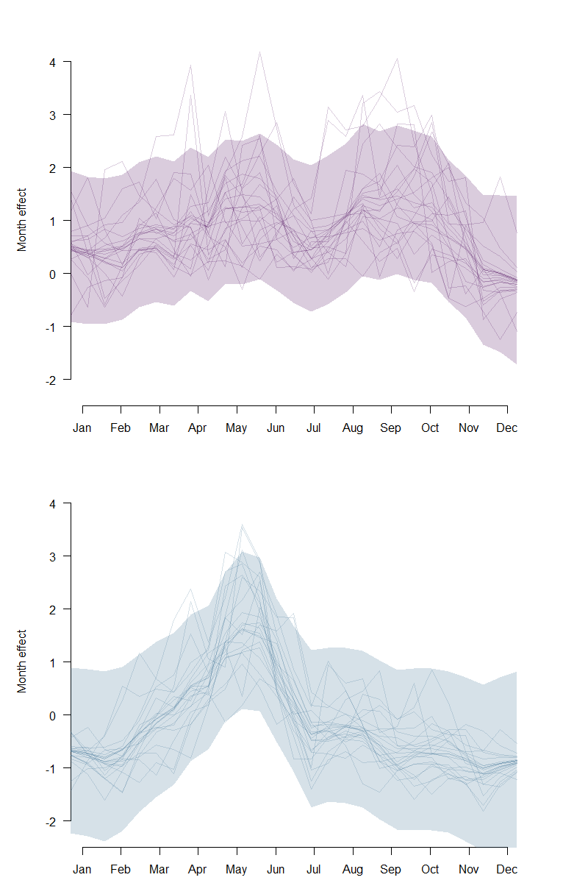
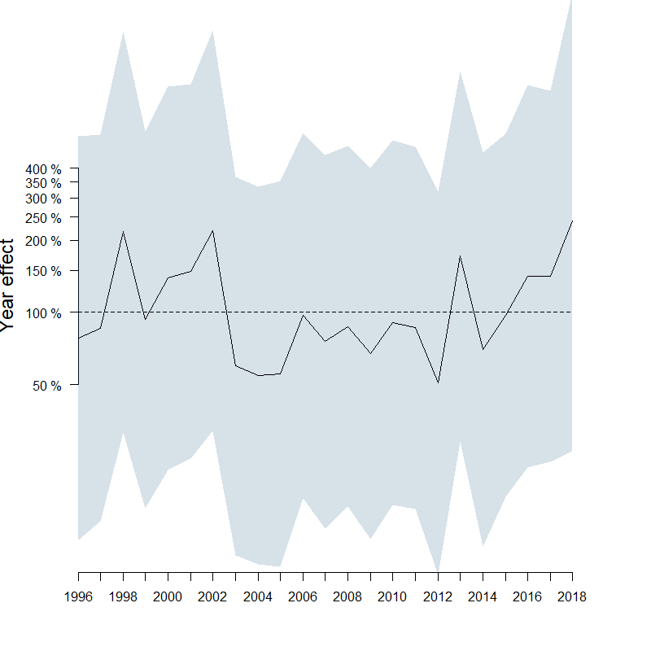
End Goal for this class…
Time series model (gls) with AR response and env. covariates
State-space model (MARSS) with env. covariates
Nice figures representing the seasonal and long term effects

Slide 4
Goals/steps for this class (in R)…
copepod
Query pteropod and environmental data from MS Access database
Calculate monthly anomalies for bio and env
Plot monthly raw and anomaly data for bio and env
Plot the climatology of bio and env
Determine the autocorrelation order (e.g., AR1, AR2) for the pteropod dataset (test with AIC)
Build the time series model, is it linear or non-linear, make it a state space model
Lag the env vars with variable lags and add them as covariates to the model

Slide 5
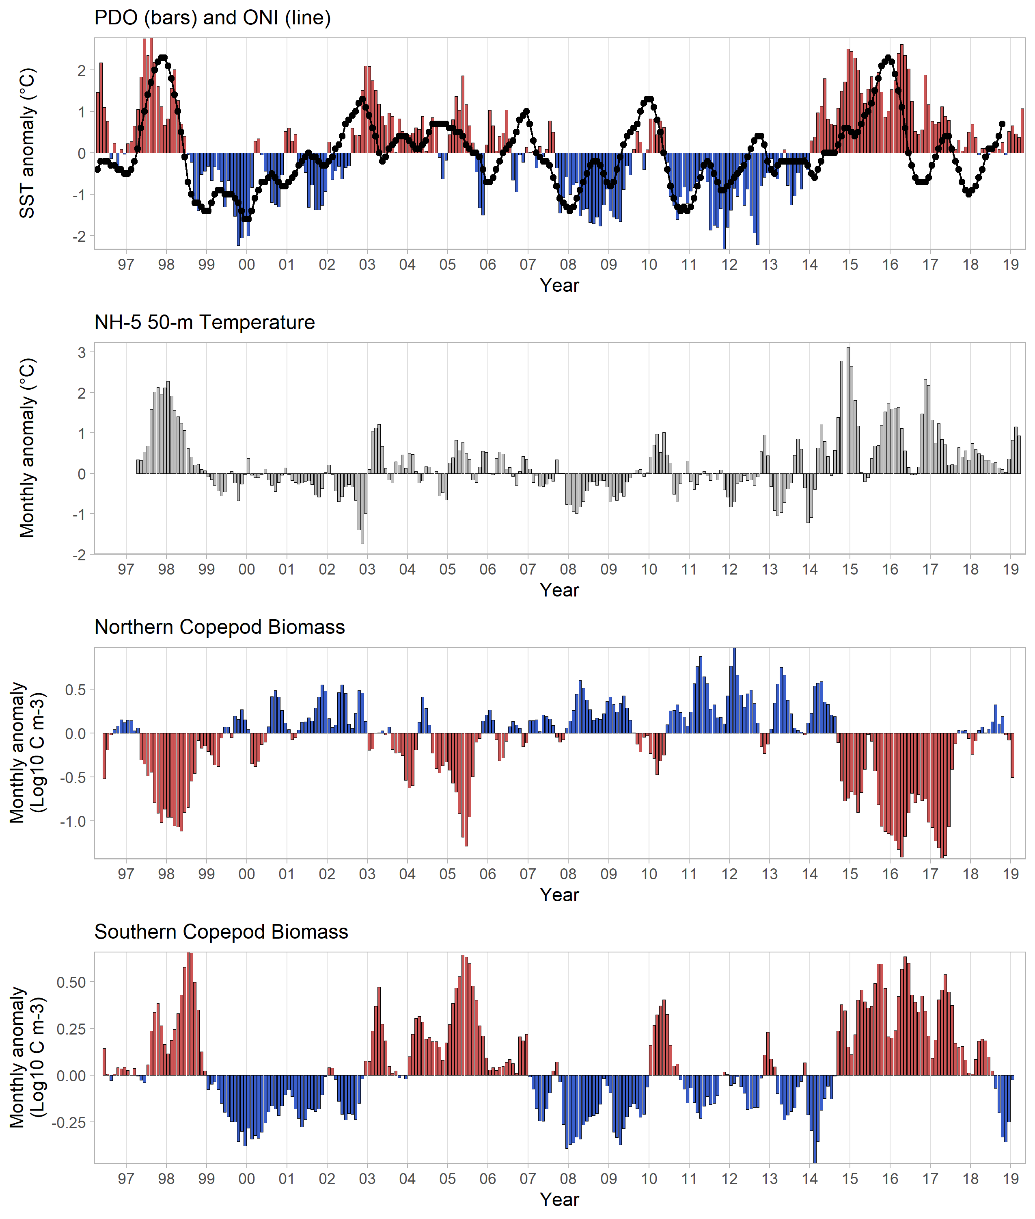
Tweaks to do still:
Alternate y-axis for ONI
Remove dup y-axis labels
Pad the y-axis lims
Add other variables

Slide 6
Hang-ups (besides working with R):
Starting with 100s of files
How to deal with small changes you don’t want to commit
At times difficulty moving between machines (merging)
 | OUTSTANDING | ACCEPTABLE | NEEDS IMPROVEMENT
Research | Significant progress on research relative to initial presentation* | At least one clear example of incremental progress on research relative to initial presentation* | No evidence of progress on research relative to initial presentation
Reproducibility | Exact workflow could be easily reproduced by someone else, working from repository+ | The workflow is reproducible in principle, given enough work and in conversation with the original author | Workflow mostly only exists within a specific machine and author
Presentation | In addition to following best practices, slides are beautiful and clearly transmit their message | -Roughly 10 minutes of content (no more than 5 slides) -Figures follow best practices for data visualization | One or more of the follow: -figures do not follow best practices -over time -over slide limit

