Slide 1
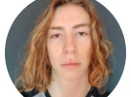

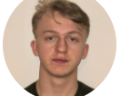
Hl7 UK Educational competition – team 5
Joshua FITZMAURICE, Noah Holmes, VISHAl Dhayalan

Slide 2
Problem
We have been tasked to write a CQL script to convert a Patients Observations/Conditions to an MDT Care Level given a set of rules as follows:
  N/A if Benign pigmented skin lesion (finding)
  1 if Basal cell carcinoma (morphologic abnormality)
  2 if Malignant melanoma, no International Classification of Diseases for Oncology subtype (morphologic abnormality)
  3 if Age < 19

Slide 3
What we did
First, we went through the “Hello World” step-by-step given to us.
This gave us the basics to be able to write CQL code and use FHIR.
Further from this we looked at coding in Dataphoria. This proved beneficial as it gave us a skeleton to base our code around.
We then learnt to fetch data, including observations, from the FHIR server for a specified Patient.
Being able to do this meant we can test our scripts more efficiently.

Slide 4
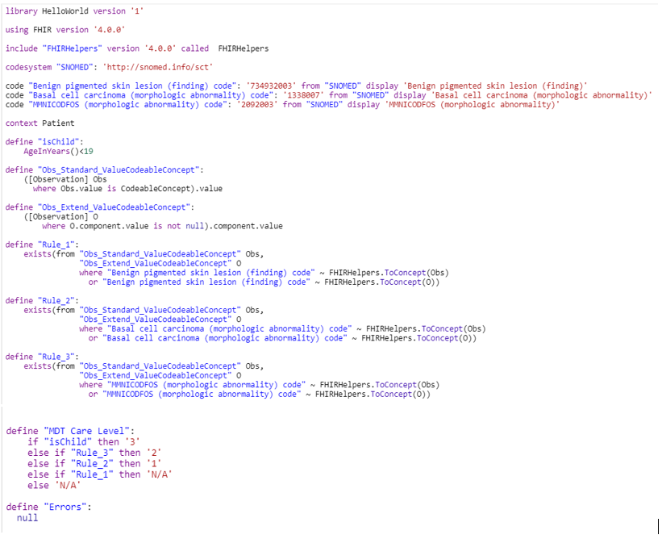
Technical solution

Slide 5
Testing
The first Patient we tested our code on was the Patient with ID: 1, in Dataphoria. This patient had no Observations at all and was also around 70 years old. This means they should fall into the N/A category. The result we got was N/A
We then tested on another Patient (ID: 570 in Dataphoria). This patient had some Observations, but none that we had to test for. However, the patient was under 19 so should receive a care level of 3. The result we got was 3.
We wanted to do more testing on patients with different Observations. However, we could not find any existing patients with such observations and had difficulties creating/updating patients with chosen observations.

Slide 6
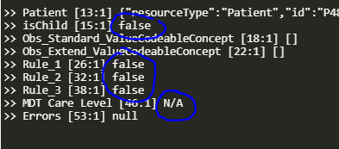
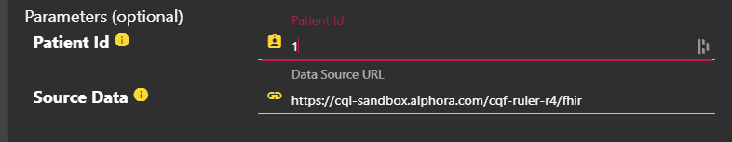
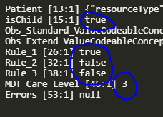
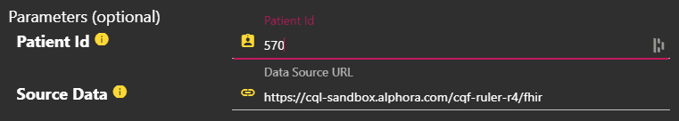
Testing (Continued)

Slide 7
Evaluation of groups performance
We came into this competition with very little knowledge on CQL, FHIR, JSON or CRUD operations so were rather limited and had to learn quickly.
We overcame a lot of these barriers by referring to the documentation for FHIR, since this proved to be the most difficult part.
Another part where we struggled was uploading our solutions using Postman to get information on Patients.
We also tried creating new patients with the Observations we were looking for. But again we struggled with this and could not complete this.

Slide 8
Clinical applications
The use of CQL and FHIR servers seem to have many good applications in clinical decision making.
We have created today, although small, a CQL script that could be used to decide which patients require more care. This has its obvious uses as you would want to prioritise people with worse conditions.
Other clinical applications could be the use of grouping a set of observations which are common with certain medical conditions. This could be used by medical staff to more quickly and accurately identify these conditions – Which could be the difference between life and death.

Slide 9
Thankyou
We would also like to thankyou to the organisers and judges for giving us the opportunity to take part in this competition. It has proven to be a nice challenge to take part in.
Today has been a big learning experience. Going from not knowing anything to do with CQL, FHIR, JSON or CRUD operations to being able to create a working CQL script to work on FHIR data was no easy feat.

