Slide 1
Introduction to Natural Language Processing
G. VARDANYAN, ILL
LENS ML SCHOOL 2021

Slide 2
Outline
What is NLP about
How to make a machine comprehend words
One-hot vs distributed encoding
Semantic representation space
Some key concepts and ideas
Popular implementations
Fun with word games
Neural machine translation
Where to find more

Slide 3
NLP
You are [probably] here
Text and speech search
Document retrieval
Text categorization
Text classification
Person identification
Sentiment analysis
Speech recognition
Machine translation
Automated customer service
Q/A based chatbots
Machine compositions
(Fake) news generations
…
Physics
Computer
Science
Data
Science
Linguistics
NLP
NLP is what powers Siri, Alexa, Cortana, Ok google, …

Slide 4
Word Meanings
The text (or speech) is a sequence of words
But what is the meaning of a word?
Human learns the meanings of words (in the native language) through association
Human learns a first foreign language through association with the native one
Human learns another foreign language through association with the native or the first foreign language, etc.
But how to make a machine understand what a word means?

Slide 5
Encodings
The answer is through associations, but with what? – numbers!
Computers are known to be good with numbers
Imagine if we substitute the word apple by a number, would it depend on the natural language?
The most naïve way to encode words is one-of-N or one-hot encoding

Slide 6
One-hot Encoding
Man
0 0 0 1
Imagine our vocabulary consists of 4 words:
Man, Woman, King, Queen
Will need a vector of size N
Where N is the size of vocabulary
If you are a programmer, you can already smell that this is redundant
Why can’t we have just the same bit for Man/Woman ?
Not so easy, then what would you do with apple/pear/kaki ?
Should they go to separate bits then?
Woman
0 0 1 0
King
0 1 0 0
Queen
1 0 0 0

Slide 7
Distributed Encoding
Man
0.1 0.9
But why to restrict the bits to integers, let them float
If they are floaing, we capture more information, so why can’t we have less dimensionality?
Let’s fix the size of the vector to let’s say 2
Can we then perhaps name the axes?
But wait, what does royalty mean?
Can we generalize to the whole vocabulary?
Woman
0.1 0.1
King
0.9 0.9
Queen
0.9 0.1
Royalty
Masculinity

Slide 8
Semantic Space
Abstract multidimensional space of semantic representations
We can fix the number of dimensions upfront, but far less than the size of vocabulary, let’s say 100D
Provides virtually continuum number of axes (linear combinations of those) with human tractable meanings, such as royalty
Major milestone in NLP
To visualize 100D space, you need some sort of dimensionality reduction, e.g. PCA, t-SNE
http://projector.tensorflow.org

Slide 9
word2vec
But how to learn the distributed representations of the words?
Using the context – the neighbouring words in the data
Assuming the ensemble of contexts is characteristic for a word
Maximize the conditional probability of predicting the target
Bag-of-words vs skip-grams
Negative sampling and hierarchical softmax for performance
Hidden layer embeddings are the vectors we are after
https://www.tensorflow.org/tutorials/text/word2vec
https://github.com/fchollet/deep-learning-with-python-notebooks/blob/master/6.1-using-word-embeddings.ipynb

Slide 10
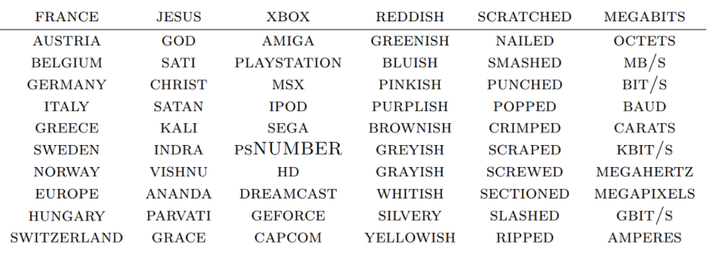
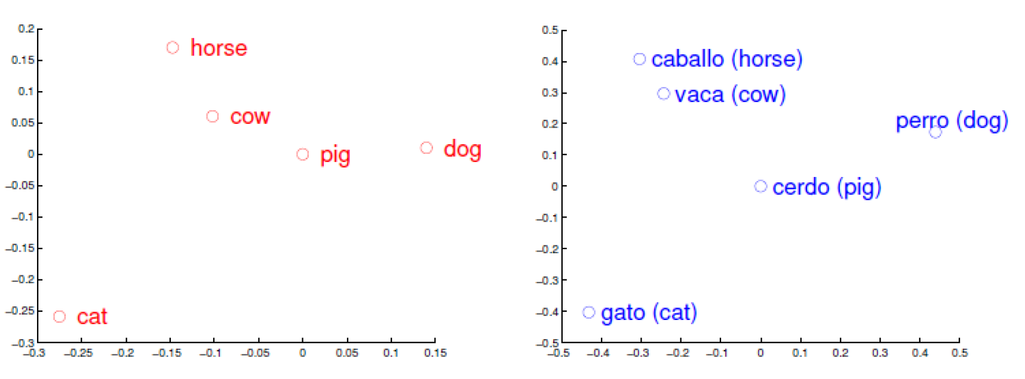
Regularities and Similarities
It turns out that with a reasonably sized vectors it is able to capture semantic and syntactic relationships among the words
Moreover vectors learned on similar corpora in different languages produce similar patterns
France – Paris = UK – London
went – go = took – take
hero – heroine = actor – actress
Word similary based on cosine
distance in semantic space. (Collobert et al.)

Slide 11
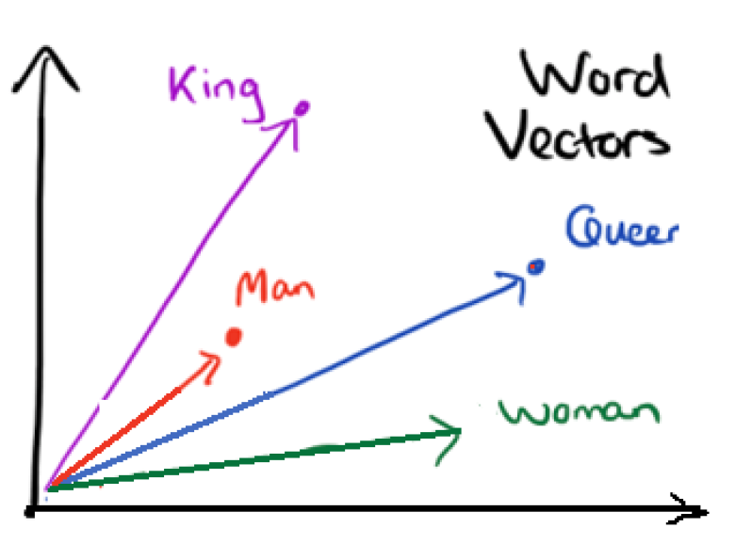
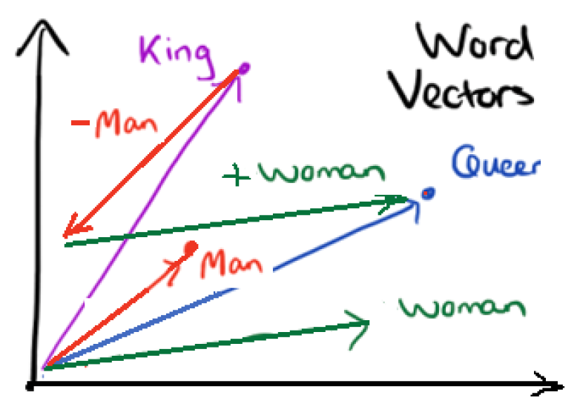
Word Games
We managed to associate words with vectors
Can we do algebra with them?
king – man + woman = ? Queen!

Slide 12
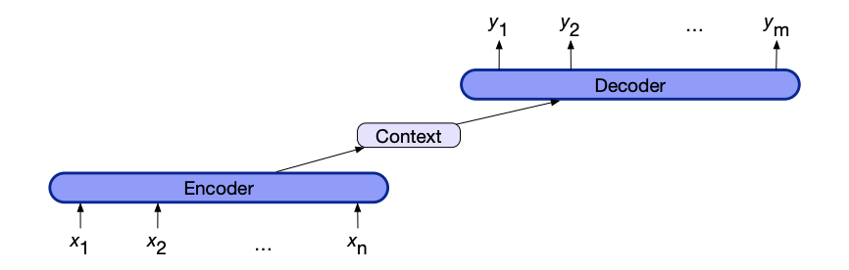
Neural Machine Translation
Encoder-decoder architectures or sequence-to-sequence models
Supervised learning on large sets of sentence pairs
Learns sentence to sentence translations

Slide 13
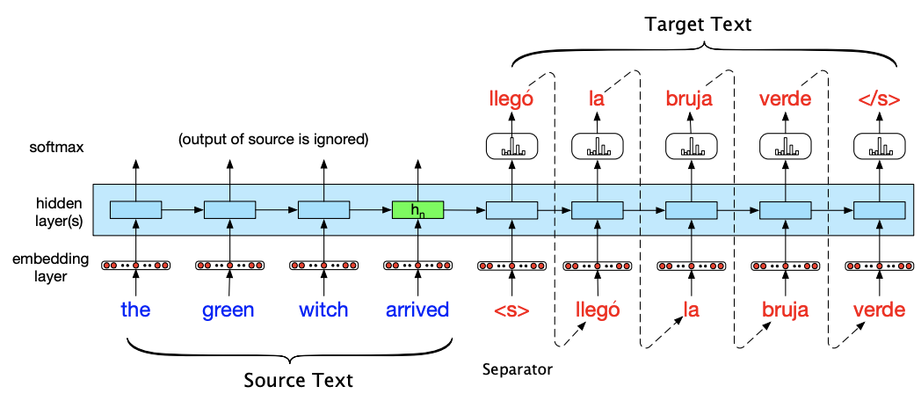
Encoder-Decoder Architecture
From Chapter 11, Speech and Laguage Processing, Daniel Jurafsky et al.

Slide 14
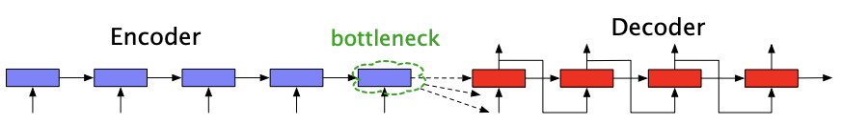
Attention
Is a mechanism to use information from all the hidden states and not just the last one at decoding time
Can be additive or multiplicative
https://www.tensorflow.org/tutorials/text/nmt_with_attention

Slide 15
Libraries, Datasets, References
Gensim – https://radimrehurek.com/gensim/index.html
Spacy – https://spacy.io
NLTK – https://nltk.org – traditional methods
Word-to-vec – https://code.google.com/archive/p/word2vec/ T.Mikolov et al., https://arxiv.org/pdf/1310.4546.pdf https://papers.nips.cc/paper/2013/file/9aa42b31882ec039965f3c4923ce901b-Paper.pdf
Glove – https://nlp.stanford.edu/projects/glove/
Bilingual sentence pairs – http://www.manythings.org/bilingual/
http://colah.github.io/posts/2014-07-NLP-RNNs-Representations/
Natural Language Processing (almost) from scratch, Ronan Collobert et al. https://arxiv.org/pdf/1103.0398v1.pdf
Speech and Laguage Processing, Daniel Jurafsky, James H. Martin https://web.stanford.edu/~jurafsky/slp3/ed3book.pdf
Word representations: A simple and general method for semi-supervised learning, Joseph Turian et al., http://www.iro.umontreal.ca/~lisa/pointeurs/turian-wordrepresentations-acl10.pdf

