Slide 1
Introduction to Recurrent Neural Networks
G. VARDANYAN, ILL
LENS ML SCHOOL 2021

Slide 2
Outline
References
Sequential data
The notion of recurrence
The impact of history
Backpropagation through time
Limitations of simple RNN
Gating - LSTM and GRU

Slide 3
References
Chapter 15, Hands-on Machine Learning with Scikit-Learn and Tensorflow, Aurélien Géron, https://github.com/ageron/handson-ml2
Chapter 6, Deep Learning with Python, Fraçois Chollet, https://github.com/fchollet/deep-learning-with-python-notebooks

Slide 4
Sequential Data is Everywhere
Time series
Voice is a sequence of amplitude/frequencies
Text is a sequence of sentences/words/characters
Video is a sequence of images
Music is a sequence of notes
DNA is a sequence of acids
…

Slide 5
Notion of Recurrence
So far we were dealing with feedforward networks
Recurrent node passes its own output to itself as input
Analogue of recurrent functions in programming*
∑
∑
∑

Slide 6
The History/Memory
Feedforward networks are memoryless
Recurrent nodes can capture memory
The output of the node at time t depends not only on the input at t, but also its own output at t-1
Y(t)
Y(t-1)
∑
X(t)

Slide 7
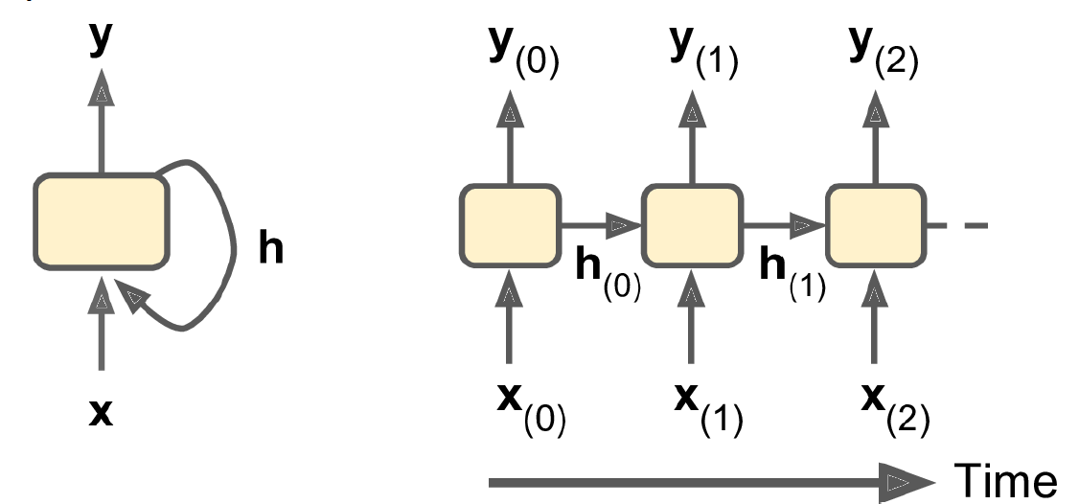
Unrolling Through Time
Y(t) = g(X(t), Y(t-1))
Y(t-1) = g(X(t-1), Y(t-2))
…
Y(t) = f(X(0), X(1), …, X(t))
h stands for history or hidden state
In simple case it is exactly the y, but generally speaking it doesn’t have to be*

Slide 8

Mind that
Often we care about immediate past
Le chat_ noir_.
La chatte noire.
But sometimes distant past also matters
The cat, which already ate …, [to be] still hungry. -> was
The cats, which already ate …, [to be] still hungry. -> were
Order is natural in chronological events – time series
In other sequences we might also need to reverse the order
Kitty is a bad name for a cat.
Hello Kitty is her favorite brand.

Slide 9
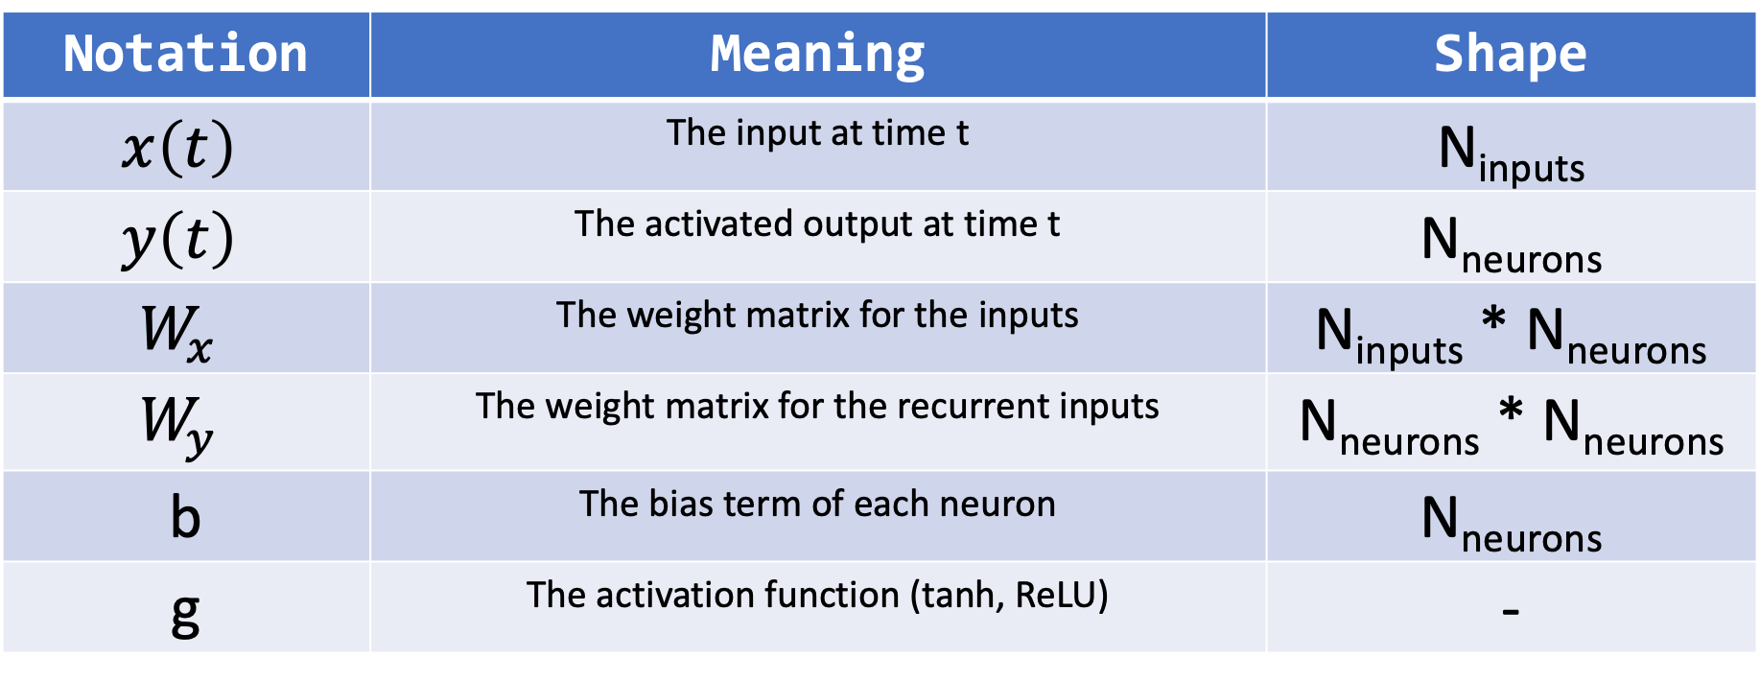
The Math and Notations
$$y\left(t\right)=g(W_{x}^{T} ∙ x\left(t\right)+ W_{y}^{T} ∙ y\left(t−1\right)+b)$$
Notation | Meaning | Shape
$$x\left(t\right)$$ | The input at time t | N_{inputs}
$$y\left(t\right)$$ | The activated output at time t | N_{neurons}
$$W_{x}$$ | The weight matrix for the inputs | N_{inputs} * N_{neurons}
$$W_{y}$$ | The weight matrix for the recurrent inputs | N_{neurons} * N_{neurons}
b | The bias term of each neuron | N_{neurons}
g | The activation function (tanh, ReLU) | -

Slide 10
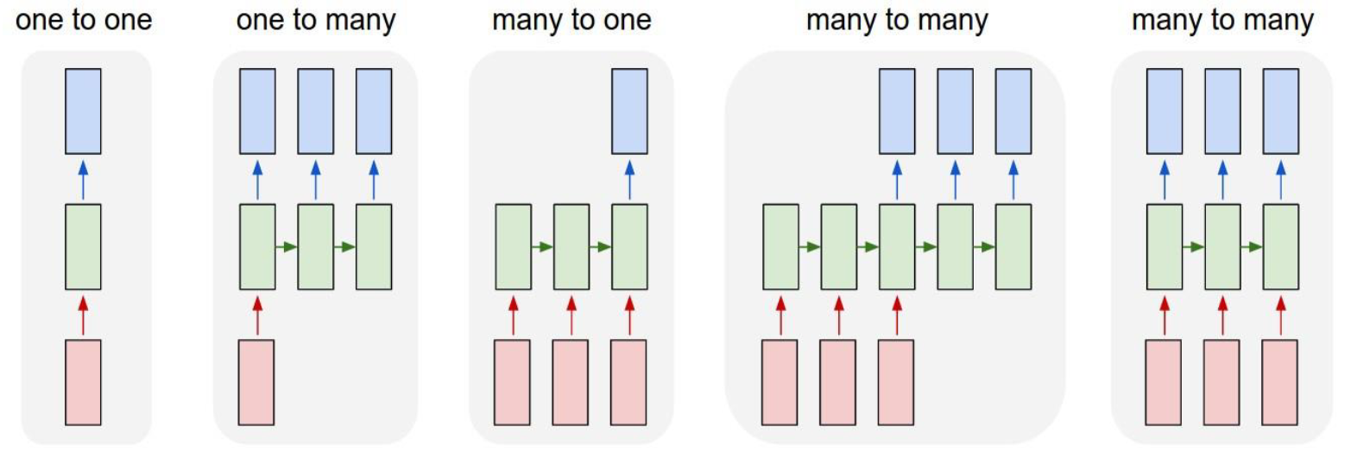
I/O
a)
b)
c)
d)
e)
a) Single input single output
b) Image captioning
c) Sentiment analysis, action analysis
d) Neural machine translation
e) Labeling frames in a video

Slide 11
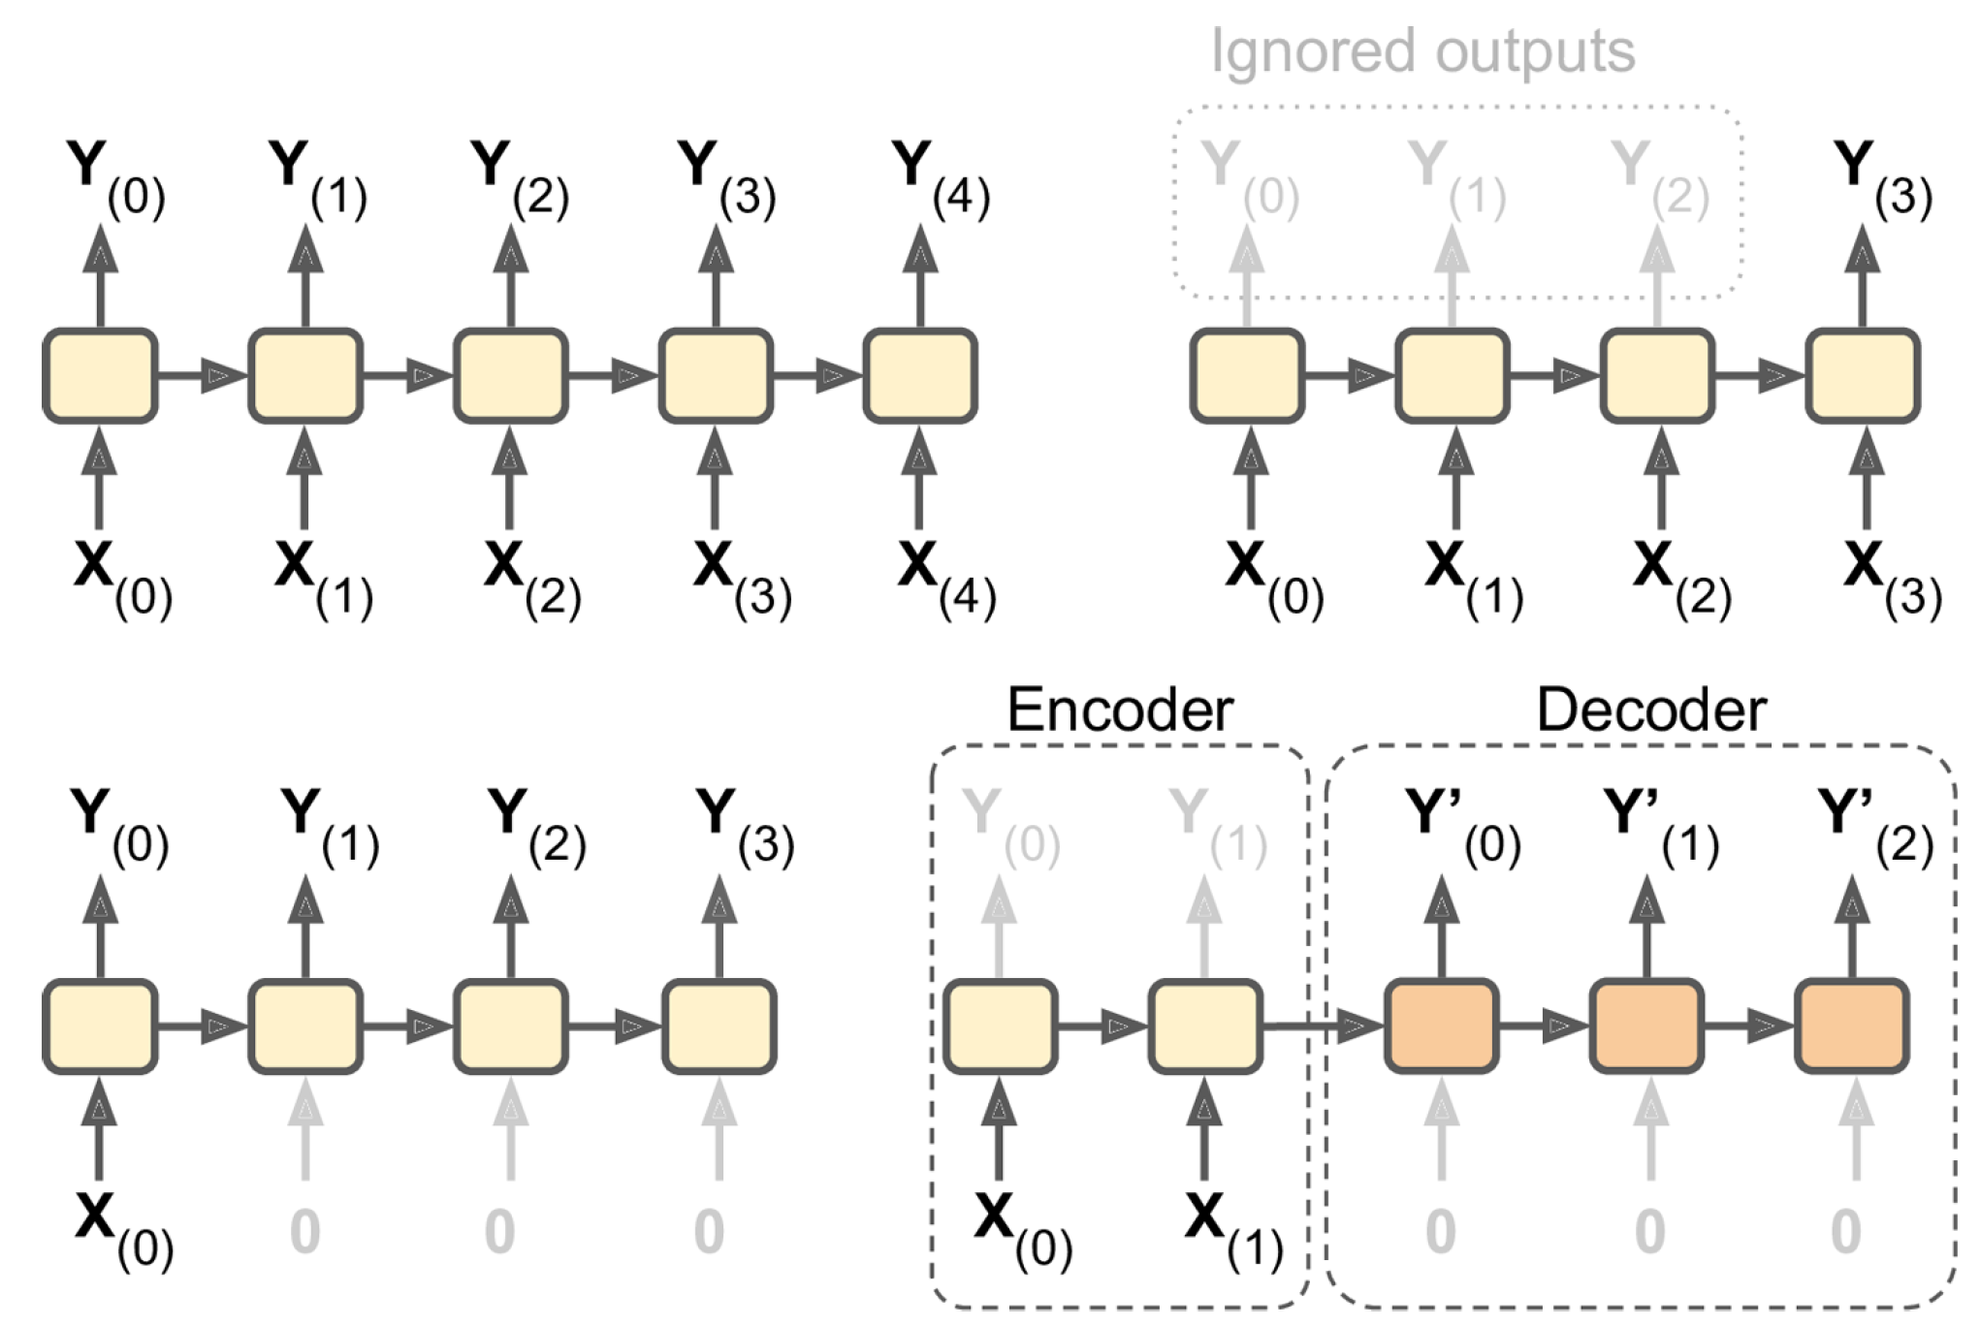
I/O

Slide 12
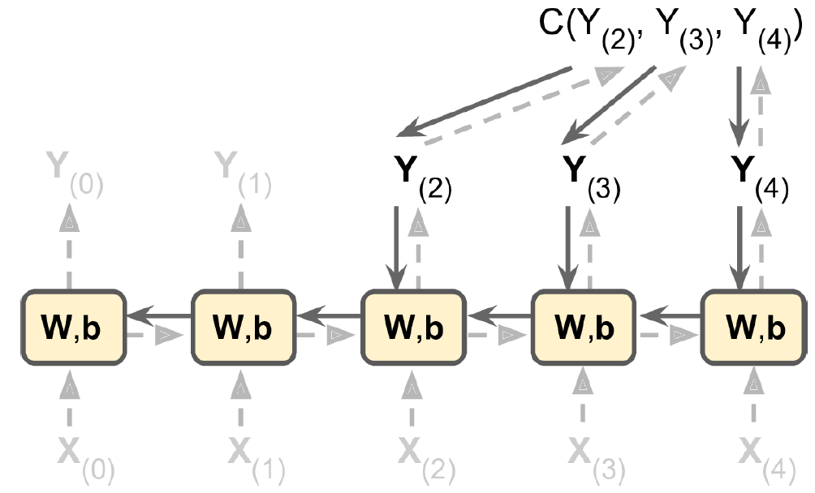
Backpropagation Through Time
Forward pass: grey dashed lines
Backward pass: solid black lines
W, b are NOT functions of t

Slide 13
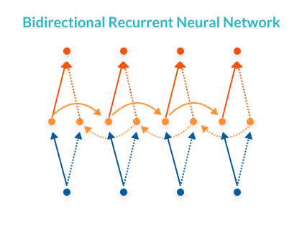

Bidirectional RNNs
$\vec{h_{t}}=f(\vec{W}x_{t}+ \vec{V}\vec{h_{t−1}}+ \vec{b})$
$\overset{⃖}{h_{t}}=f\left(\overset{⃖}{W}x_{t}+ \overset{⃖}{V}\overset{⃖}{h_{t+1}}+ \overset{⃖}{b}\right)$
$\hat{y_{t}}=g(U\left[\vec{h_{t}};\overset{⃖}{h_{t}}\right]+c)$
x_{t}
h_{t}
y_{t}
Left to right order: solid lines
Right to left order: dotted lines
Bidirectional Recursive Neural Networks for Token-Level Labeling with Structure, Ozan Irsoy, Claire Cardie, https://arxiv.org/pdf/1312.0493.pdf

Slide 14
Limitations of Simple RNNs
Struggles with long-term memory
Not suited for long sequences
Information from earlier nodes gets lost
Difficult to capture long-range correlations
Adding more layers will lead to vanishing gradient
Etc.

Slide 15
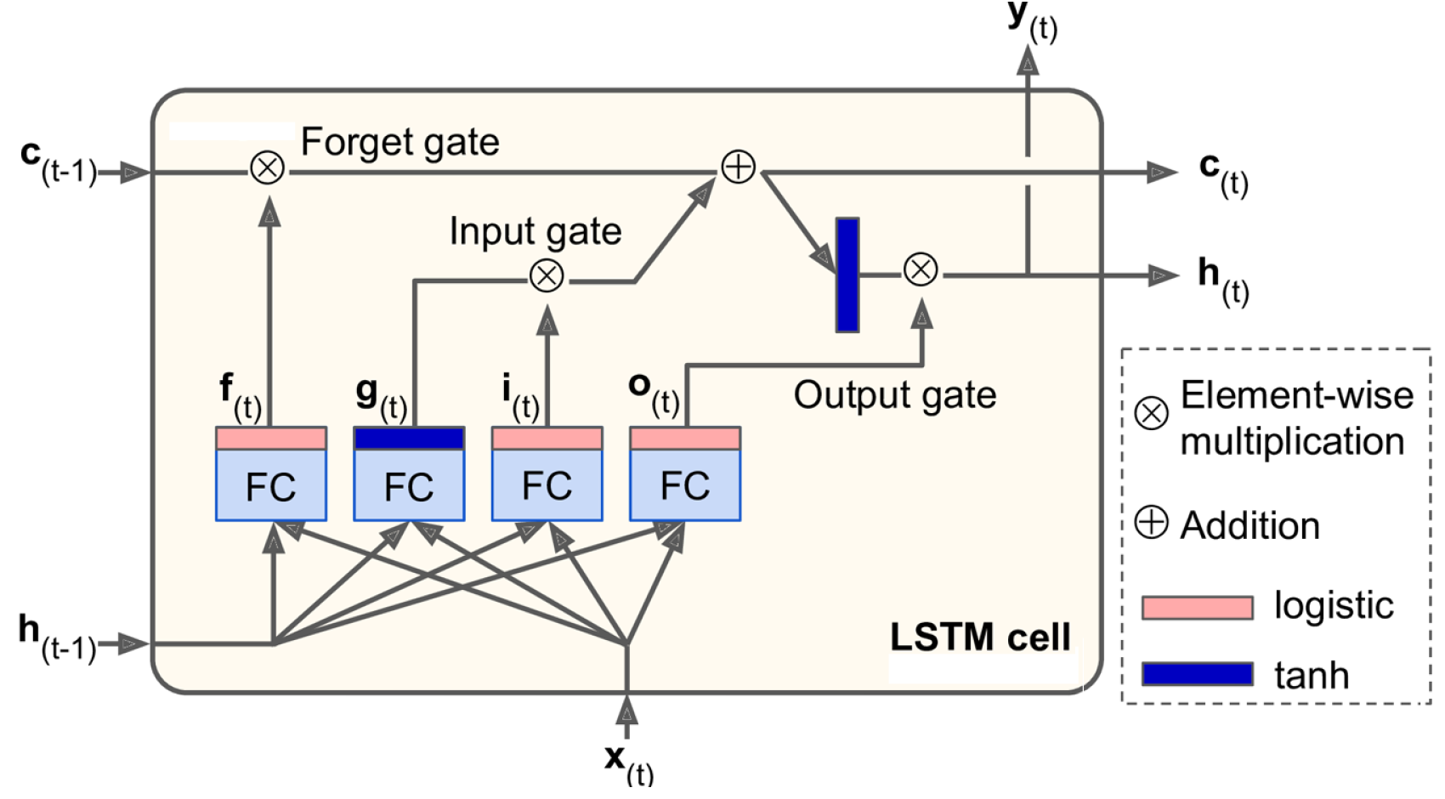
Long-Short-Term-Memory (LSTM)
Key idea: disentangle long-term and short-term memories - gating

Slide 16
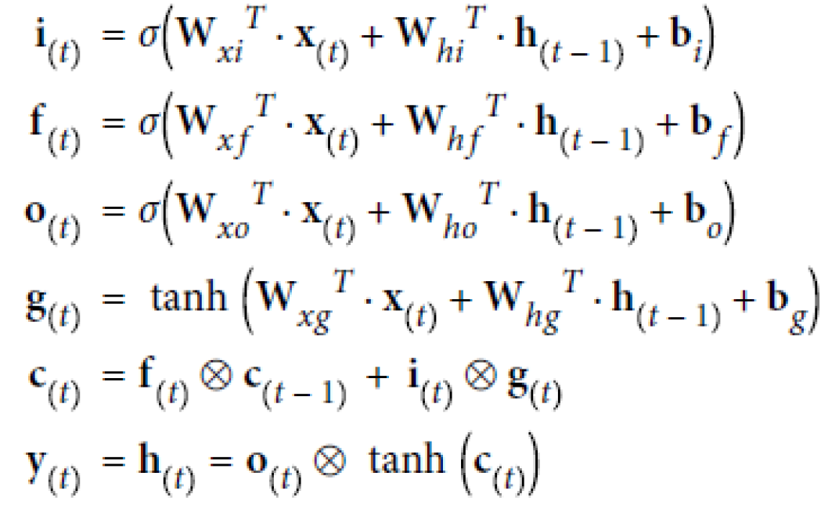
LSTM
Long Short-Term Memory, S. Hochreiterand J. Schmidhuber, Neural Computation 9(8):1735-80

Slide 17
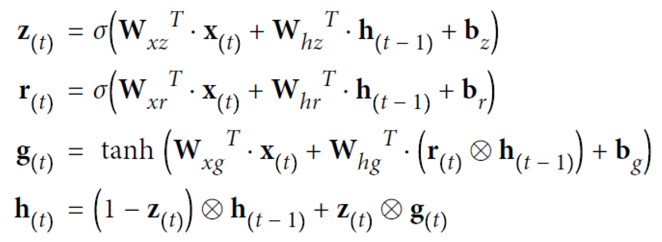
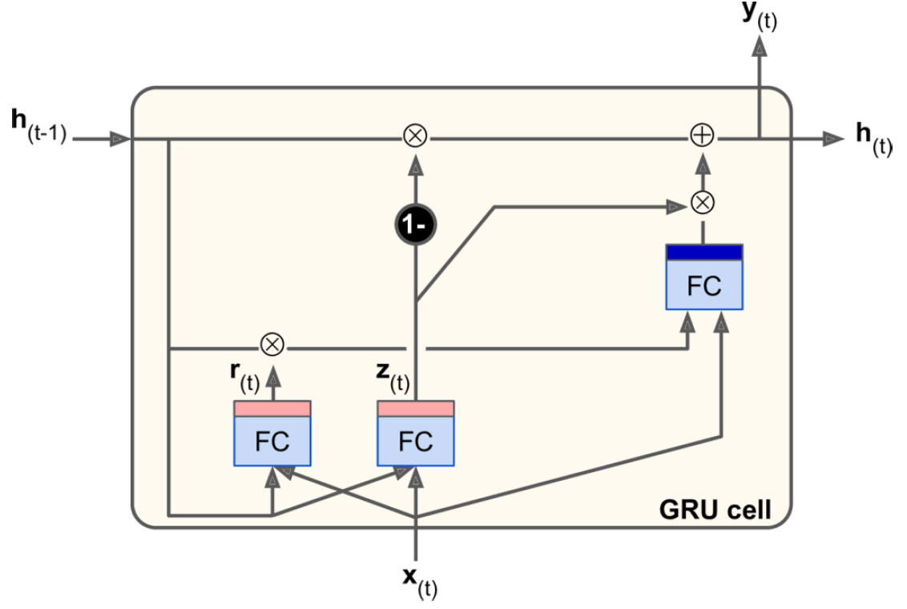
Gated Recurrent Unit - GRU
Gated Recurrent Unit, Kyunghyun Cho et al., https://arxiv.org/pdf/1406.1078.pdf

Slide 18
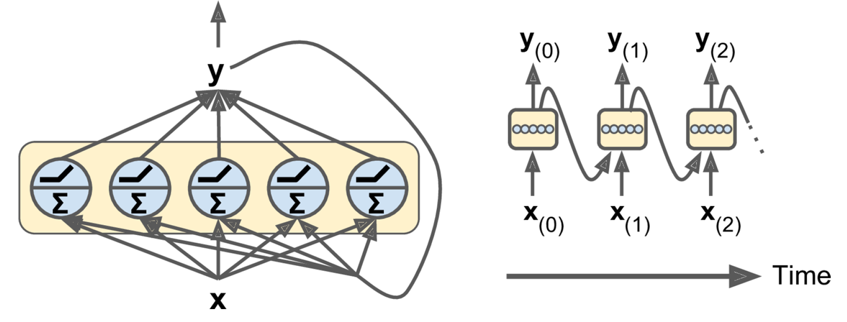
Recurrent Layers
In practice we need layers of nodes. Moreover we stack up many layers (deep RNN).

Slide 19
Good News
You don’t have to code these yourselves
Tensorflow and keras have done it for you
In the most optimal and rather friendly-to-use way
So let’s try it out!

Slide 20
Tensorflow vs Keras
Keras provides higher level API
It emerged originally as a separate library https://keras.io/
It was possible to choose the backend: tensorflow, theano, …
Tensorflow liked keras so much that now includes it
Tensorflow | Keras
Low level API – single neurons | High level API – layers of neurons
API in many languages C++, Python, … | Python only
More control, more flexible | More friendly, less (but still enough) control
More technical, you need to be a good programmer | Complete architectures in just few lines of code
Ideal for production use and/or non-standard problems and research | Ideal for prototyping and standard problems

