Slide 1

THE RODINA
Captured by Success on Vimeo
Captured by Success
2015
Lukas Bucher

Slide 2


THE RODINA
Lukas Bucher

Slide 3
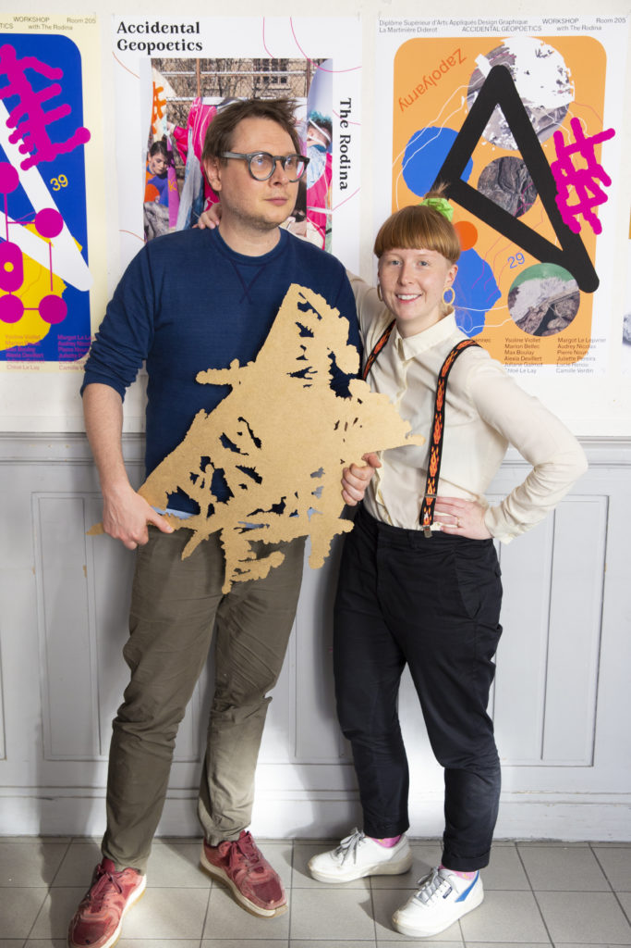
THE RODINA
The Rodina
Vit Ruller
Tereza Ruller

Slide 4
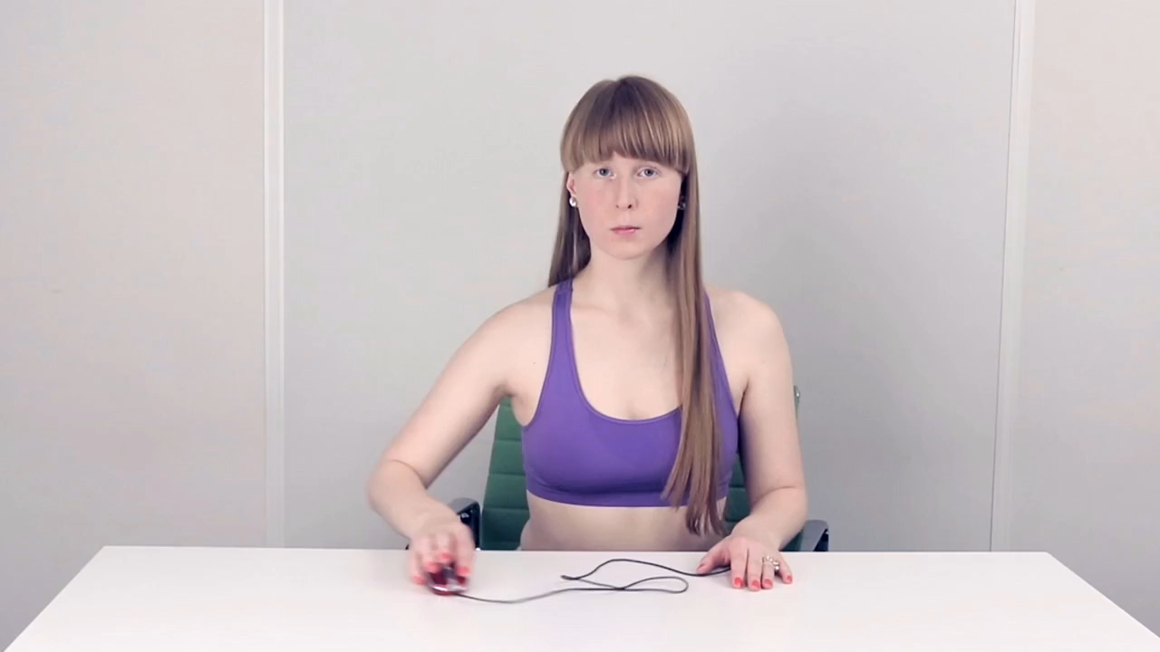
Dutch Education on Vimeo
Dutch education
Dutch Education
2014

Slide 5
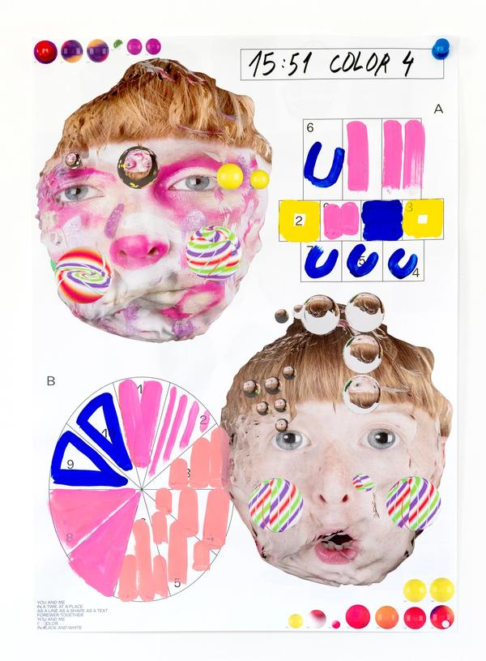
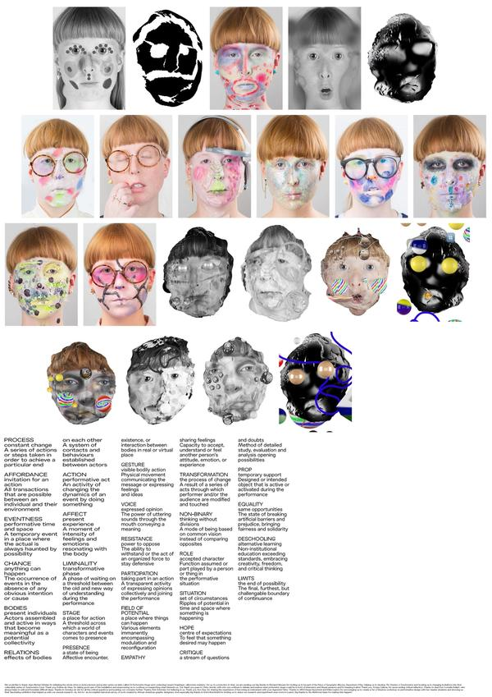
You and Me
You and Me
2018

Slide 6

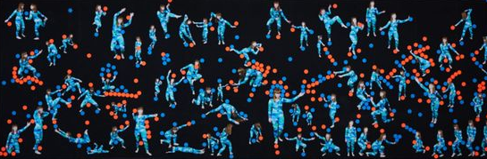
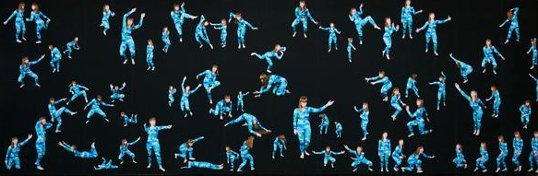
Visitor is present
Visitor is Present
2016

Slide 7
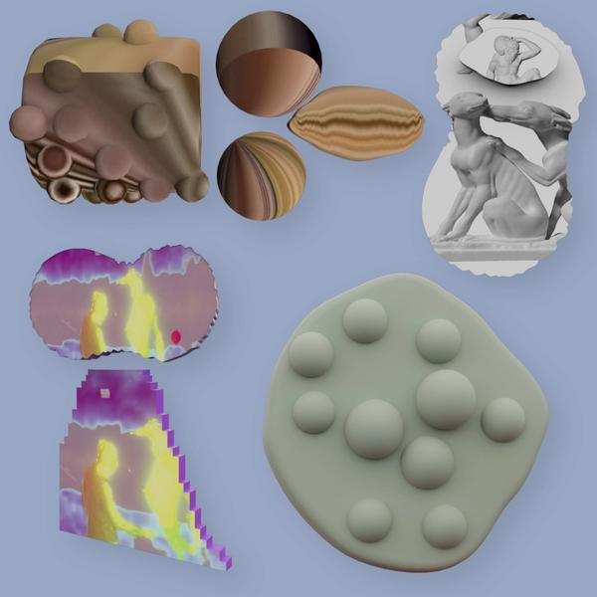
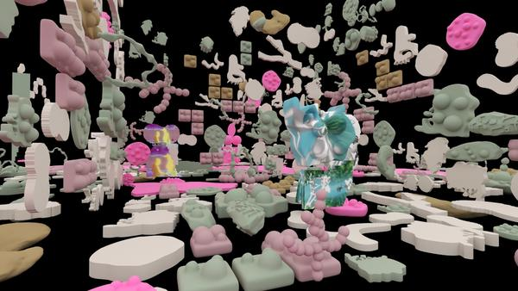
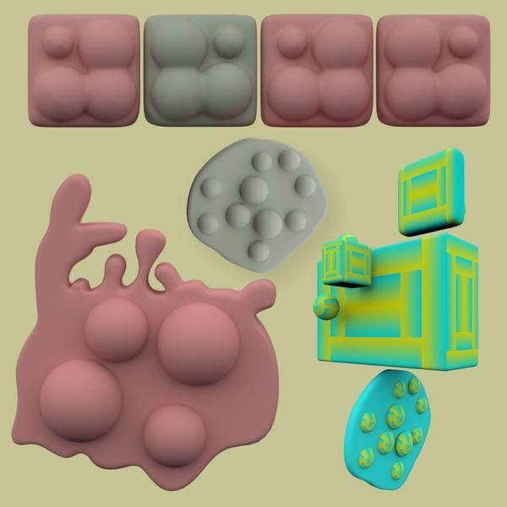
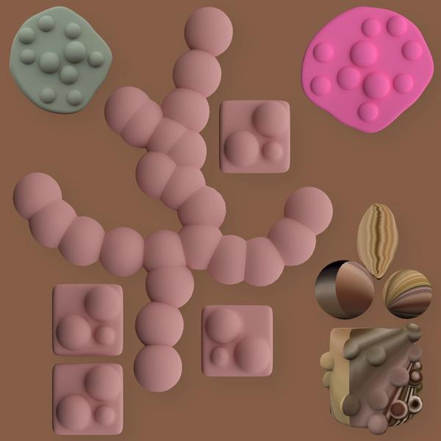
Worlding
Spatial affairs
Spatial Affairs. Worlding
2021

Slide 8
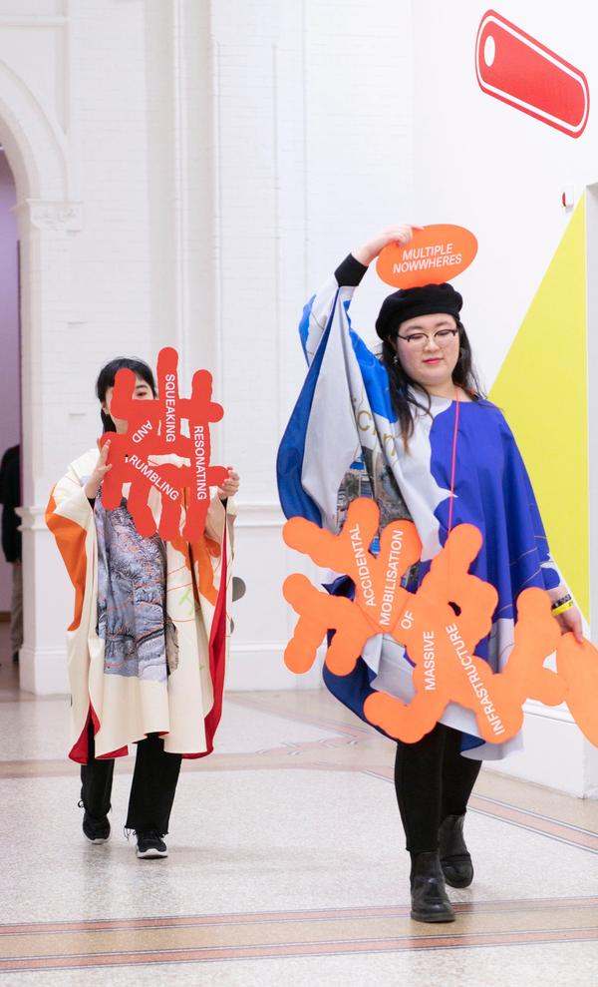
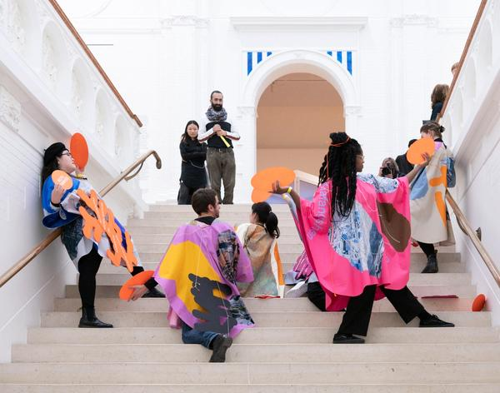
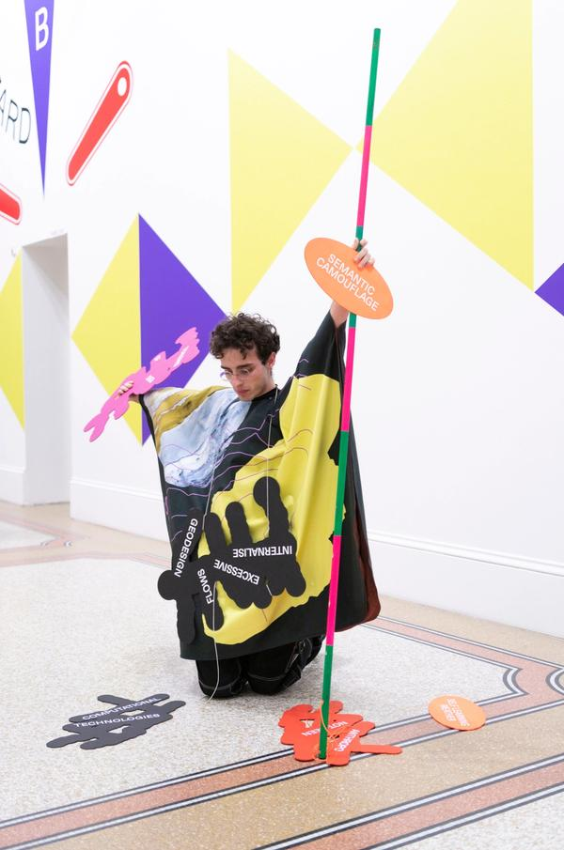
Accidental geopoetics
Accidental Geopoetics
2019

Slide 9

ragen?
Fotograf Magazine
2020

