Slide 1


Slide 2



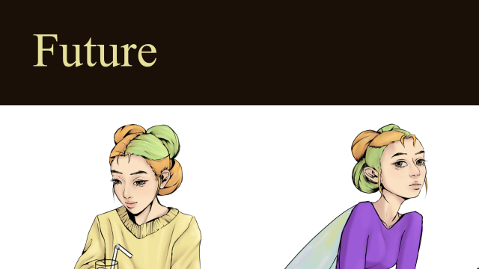
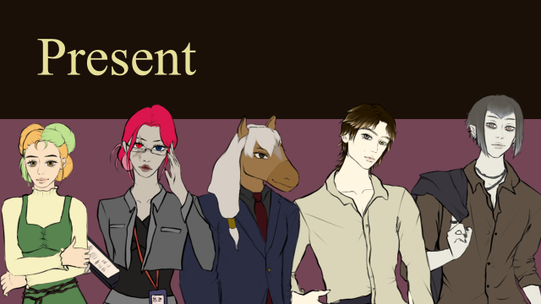
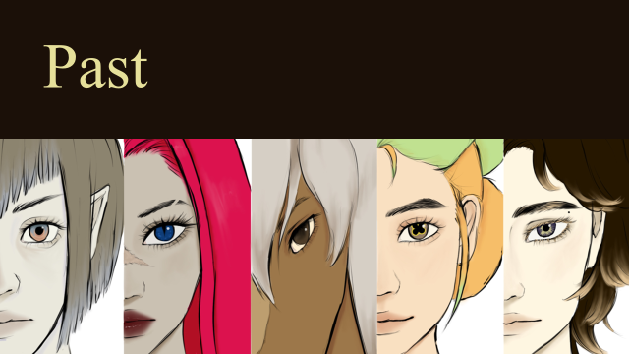


Hearts across Dimensions | DI Mentoring 3. Semester | Angelika Gort & Lukas Bucher | Mentored by Zoe Röllin

Slide 3
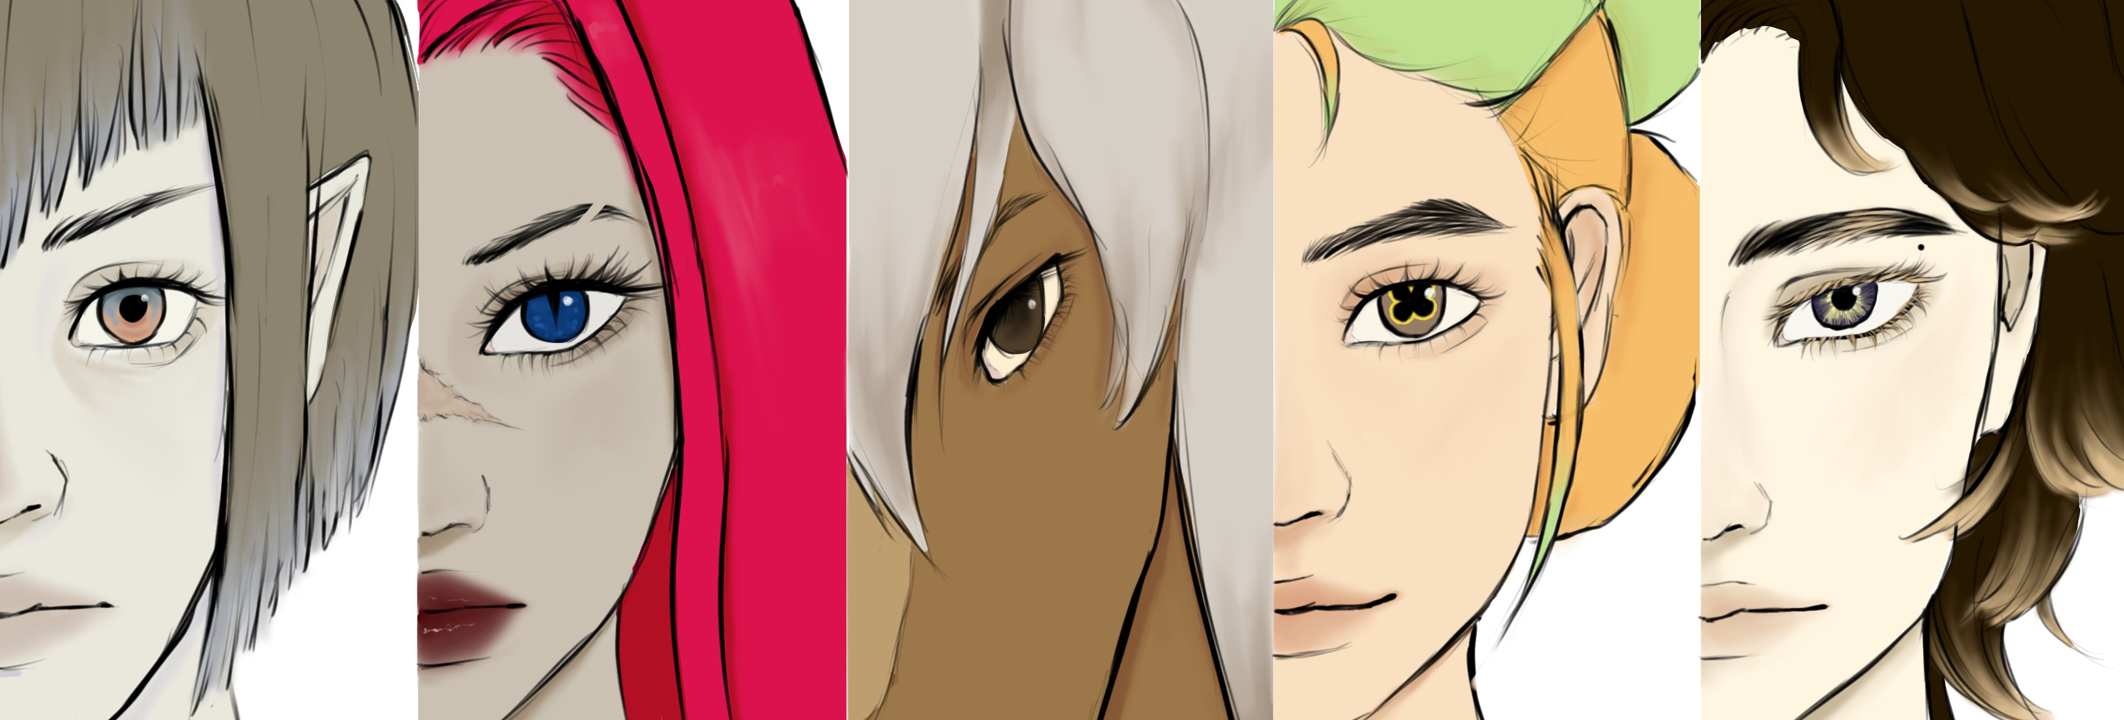
Past

Slide 4
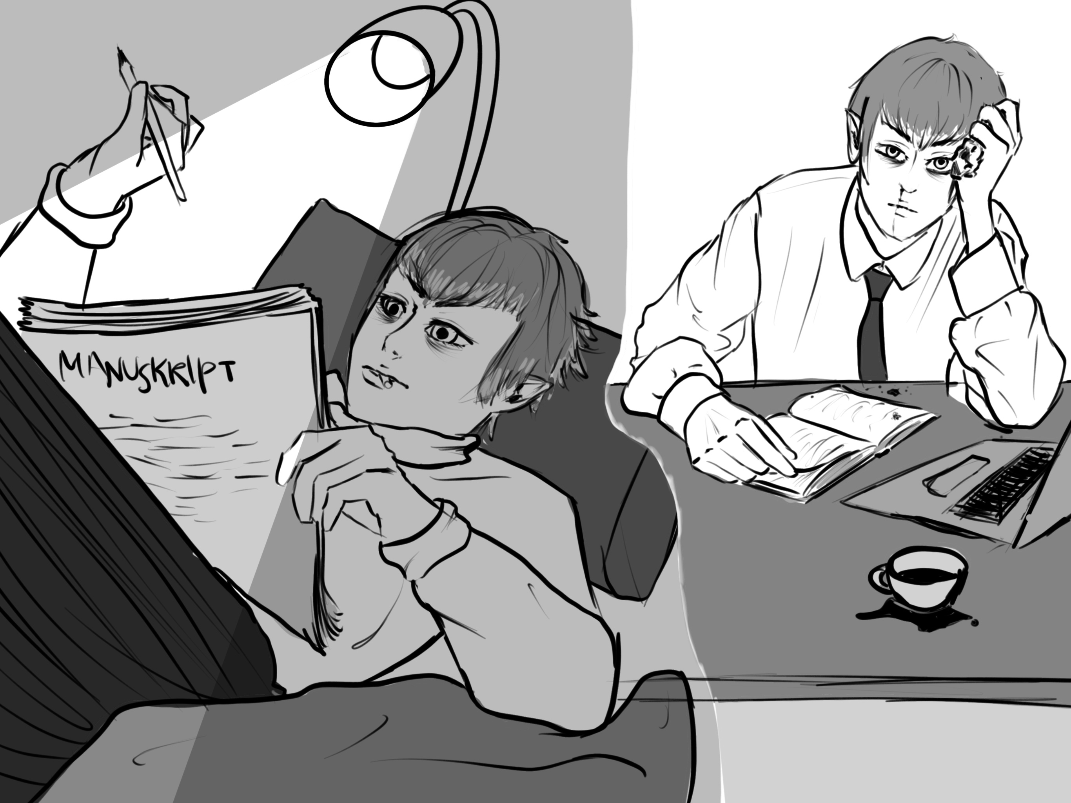
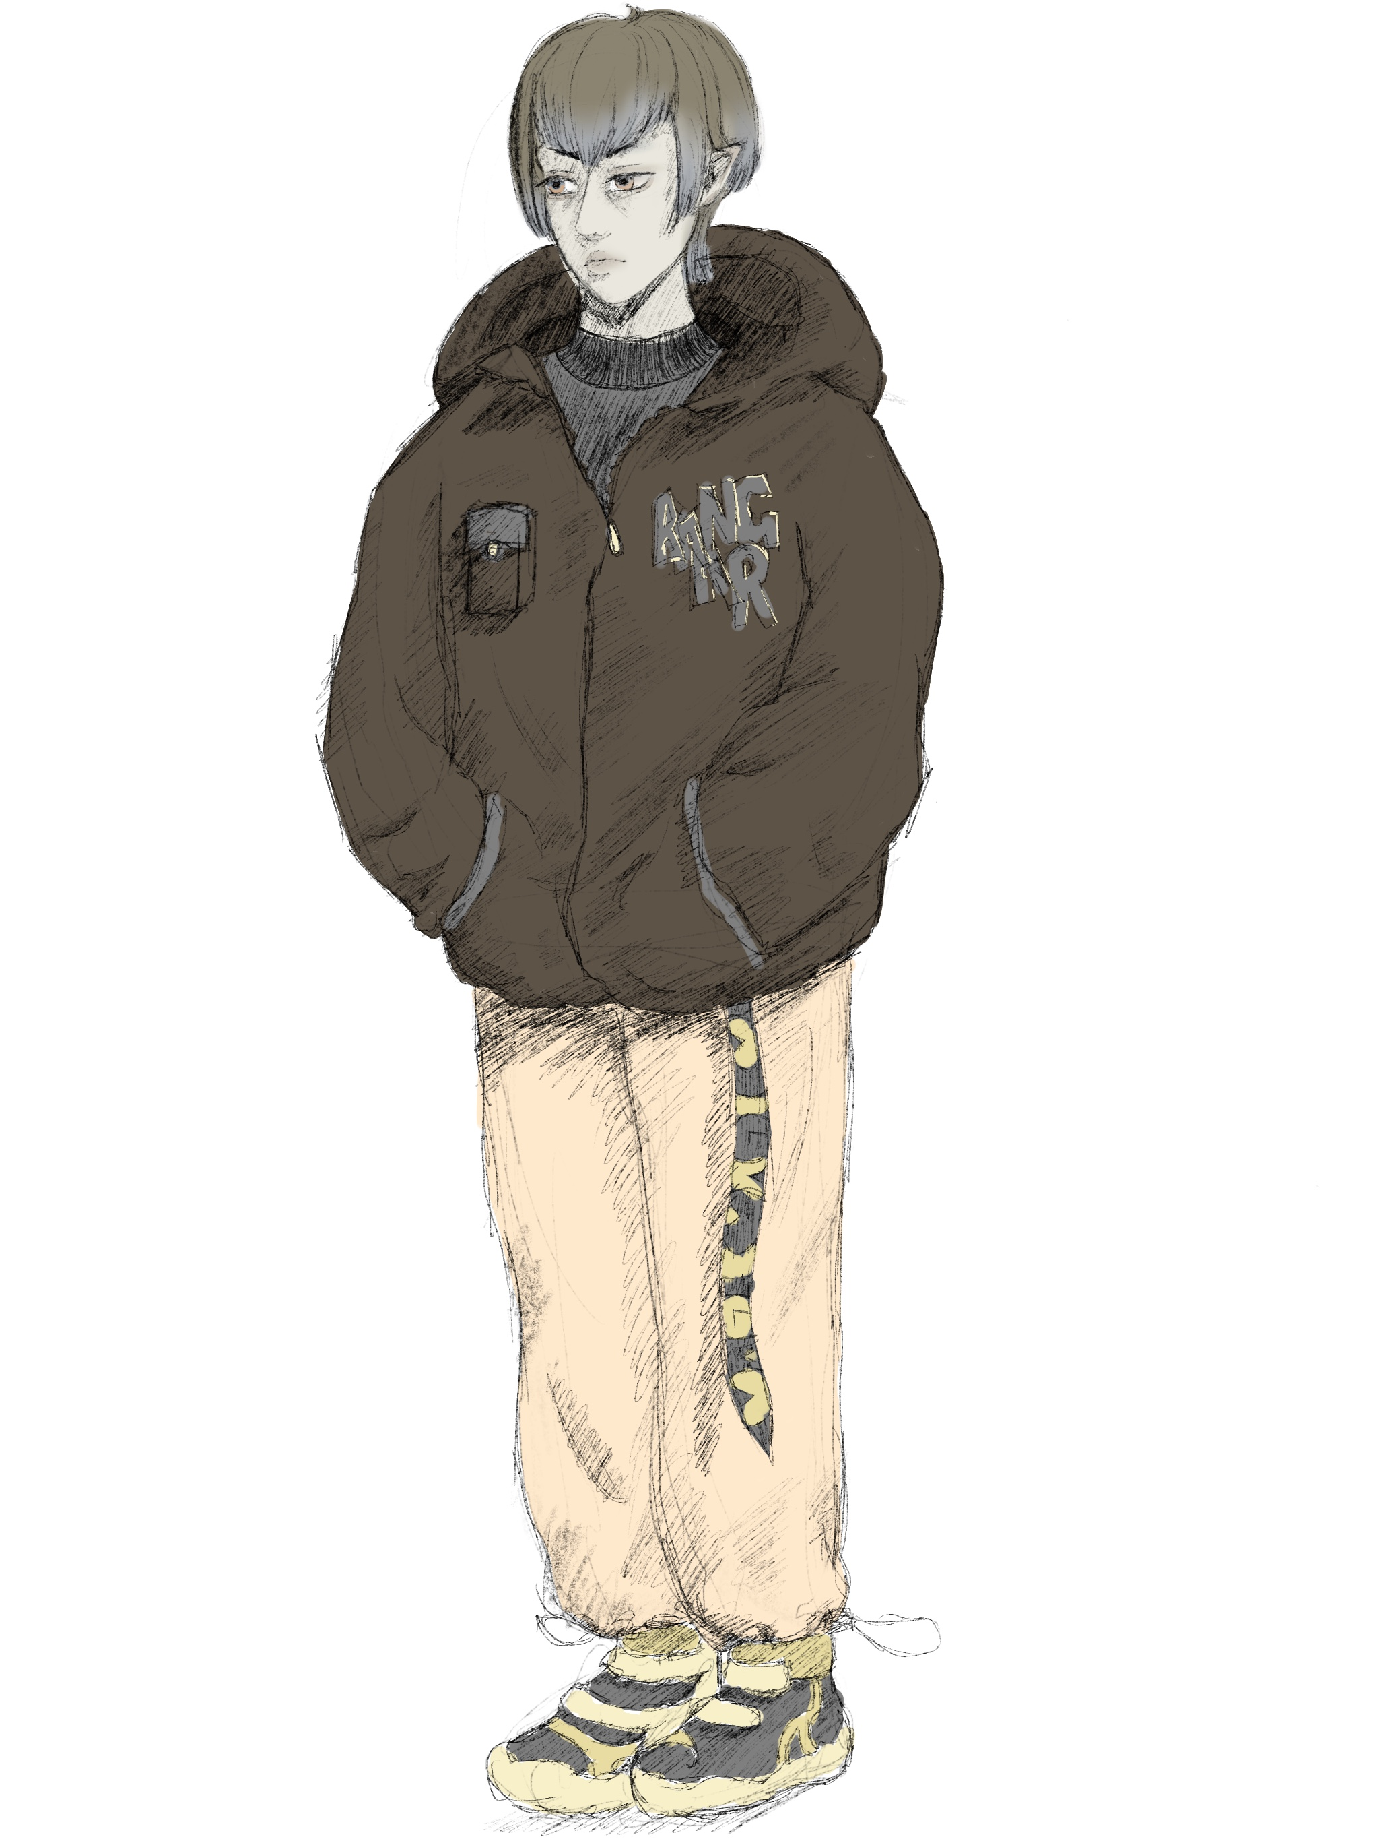
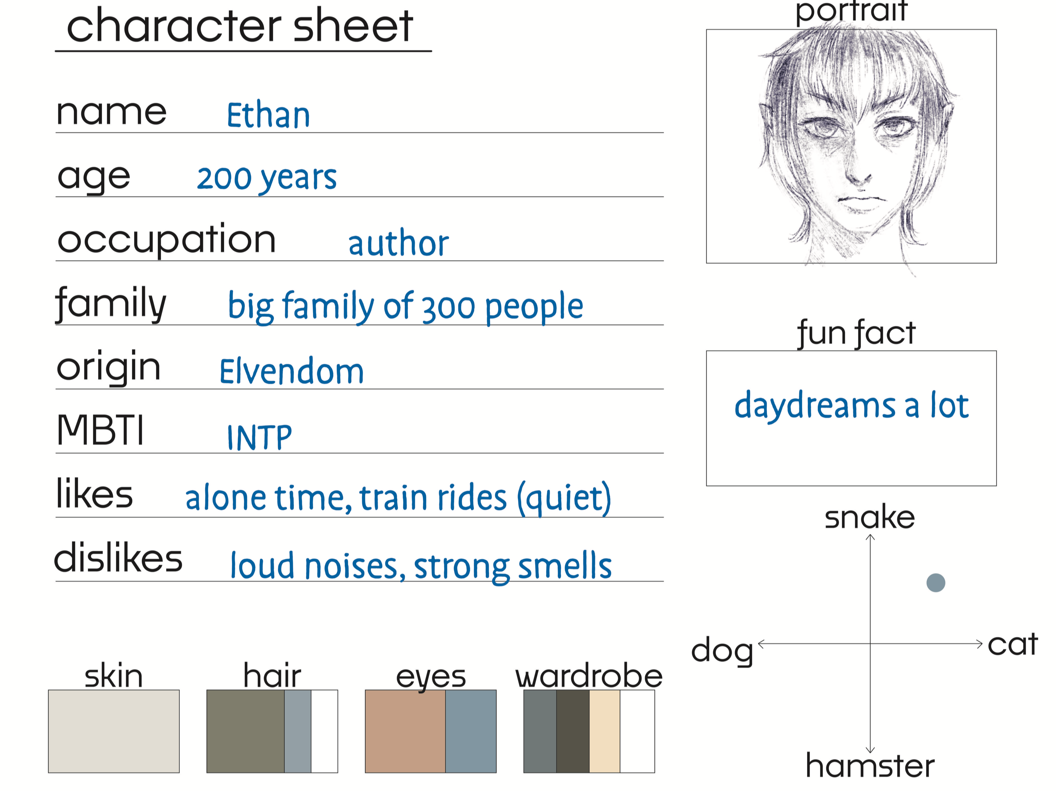
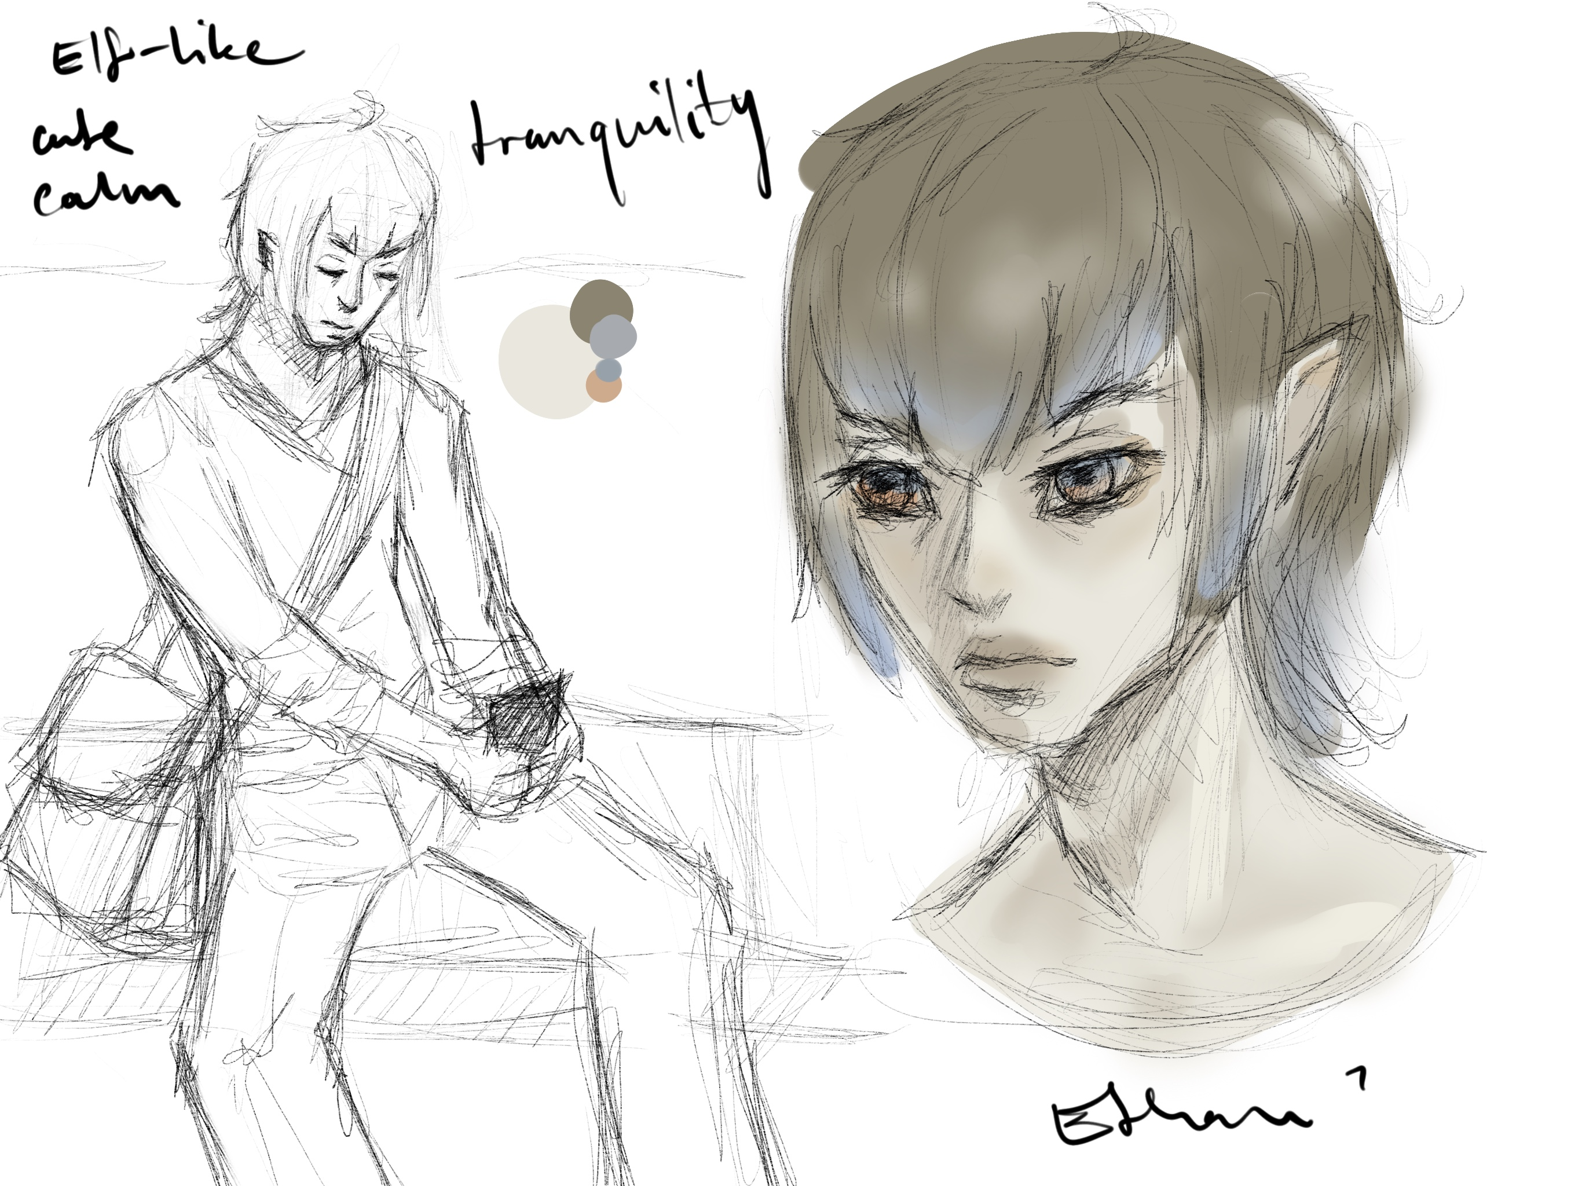

Slide 5
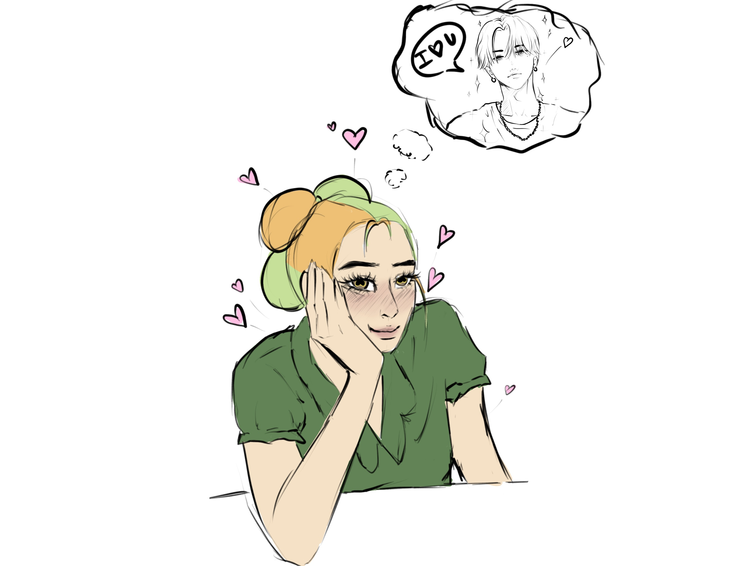
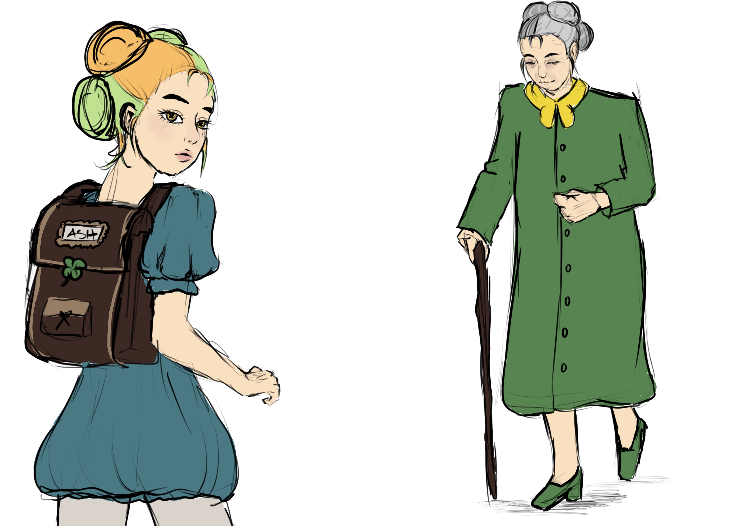
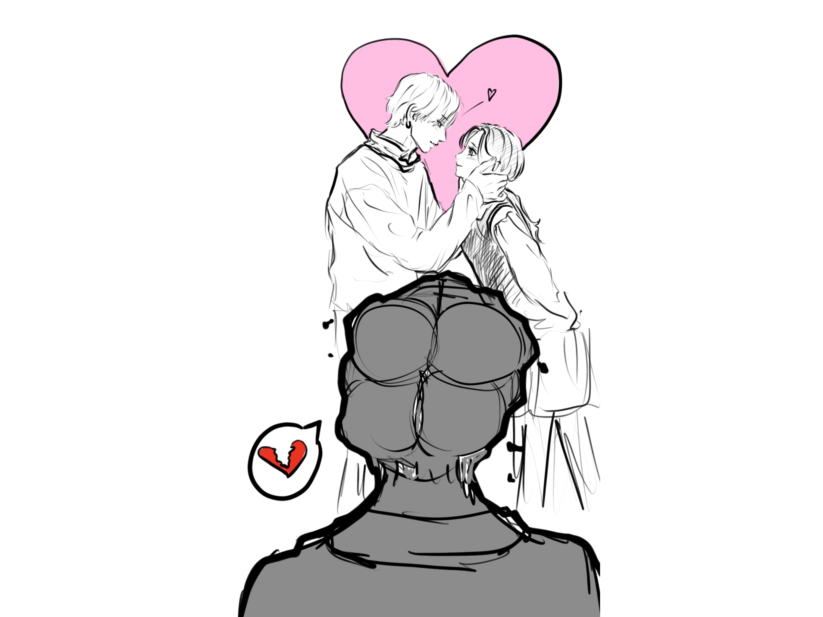

Slide 6
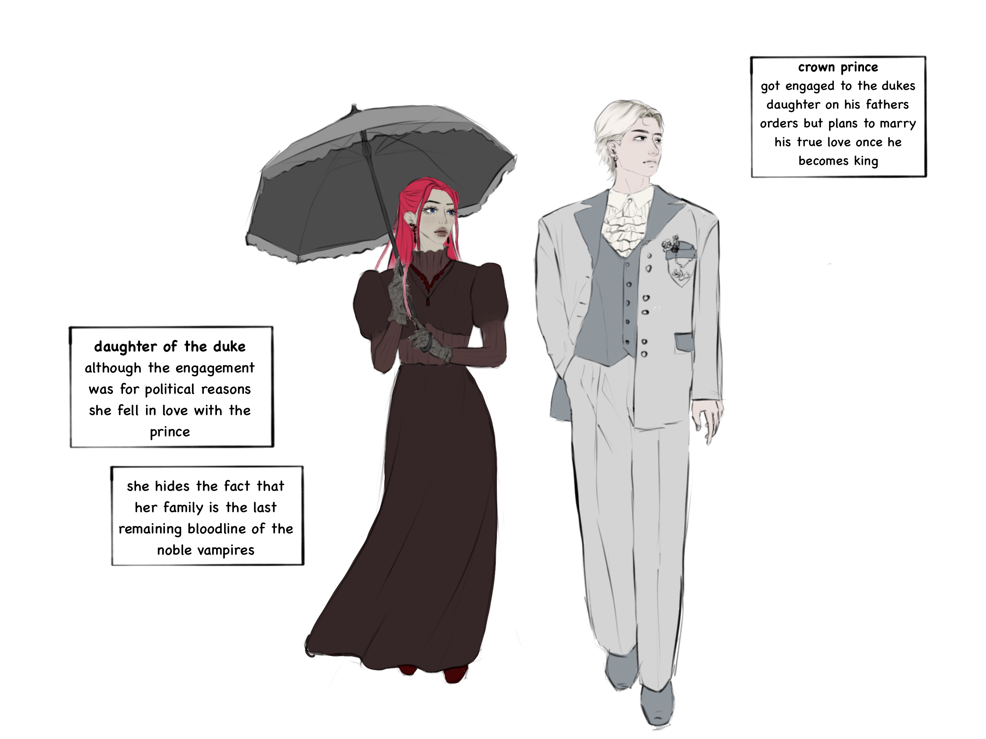
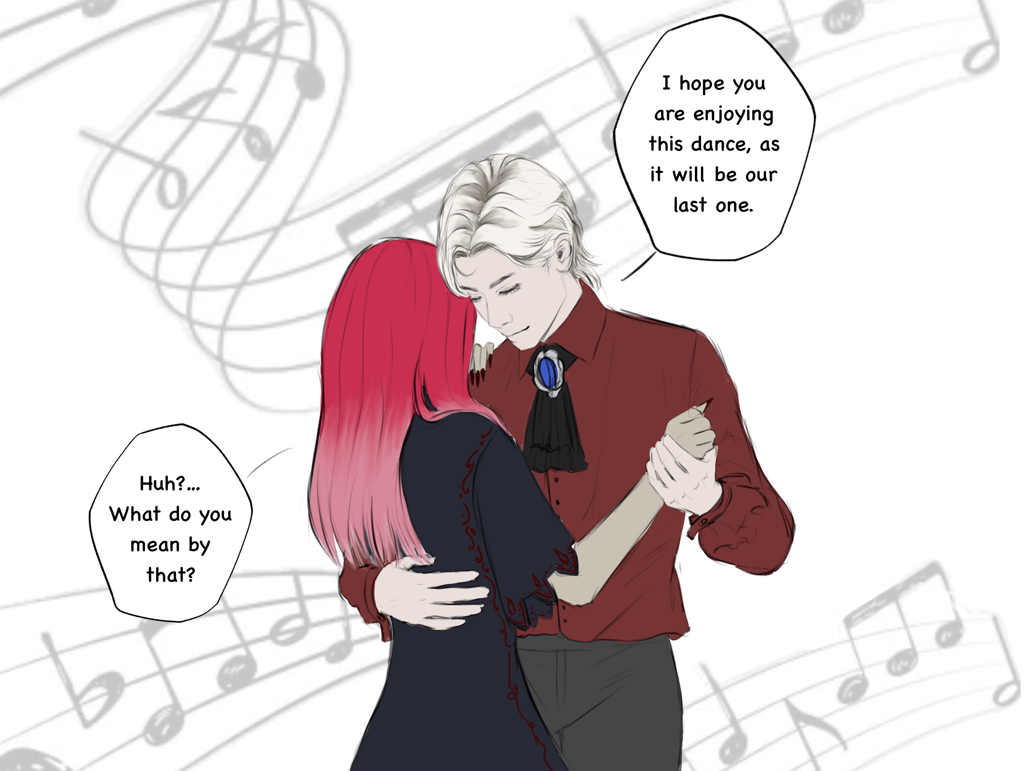
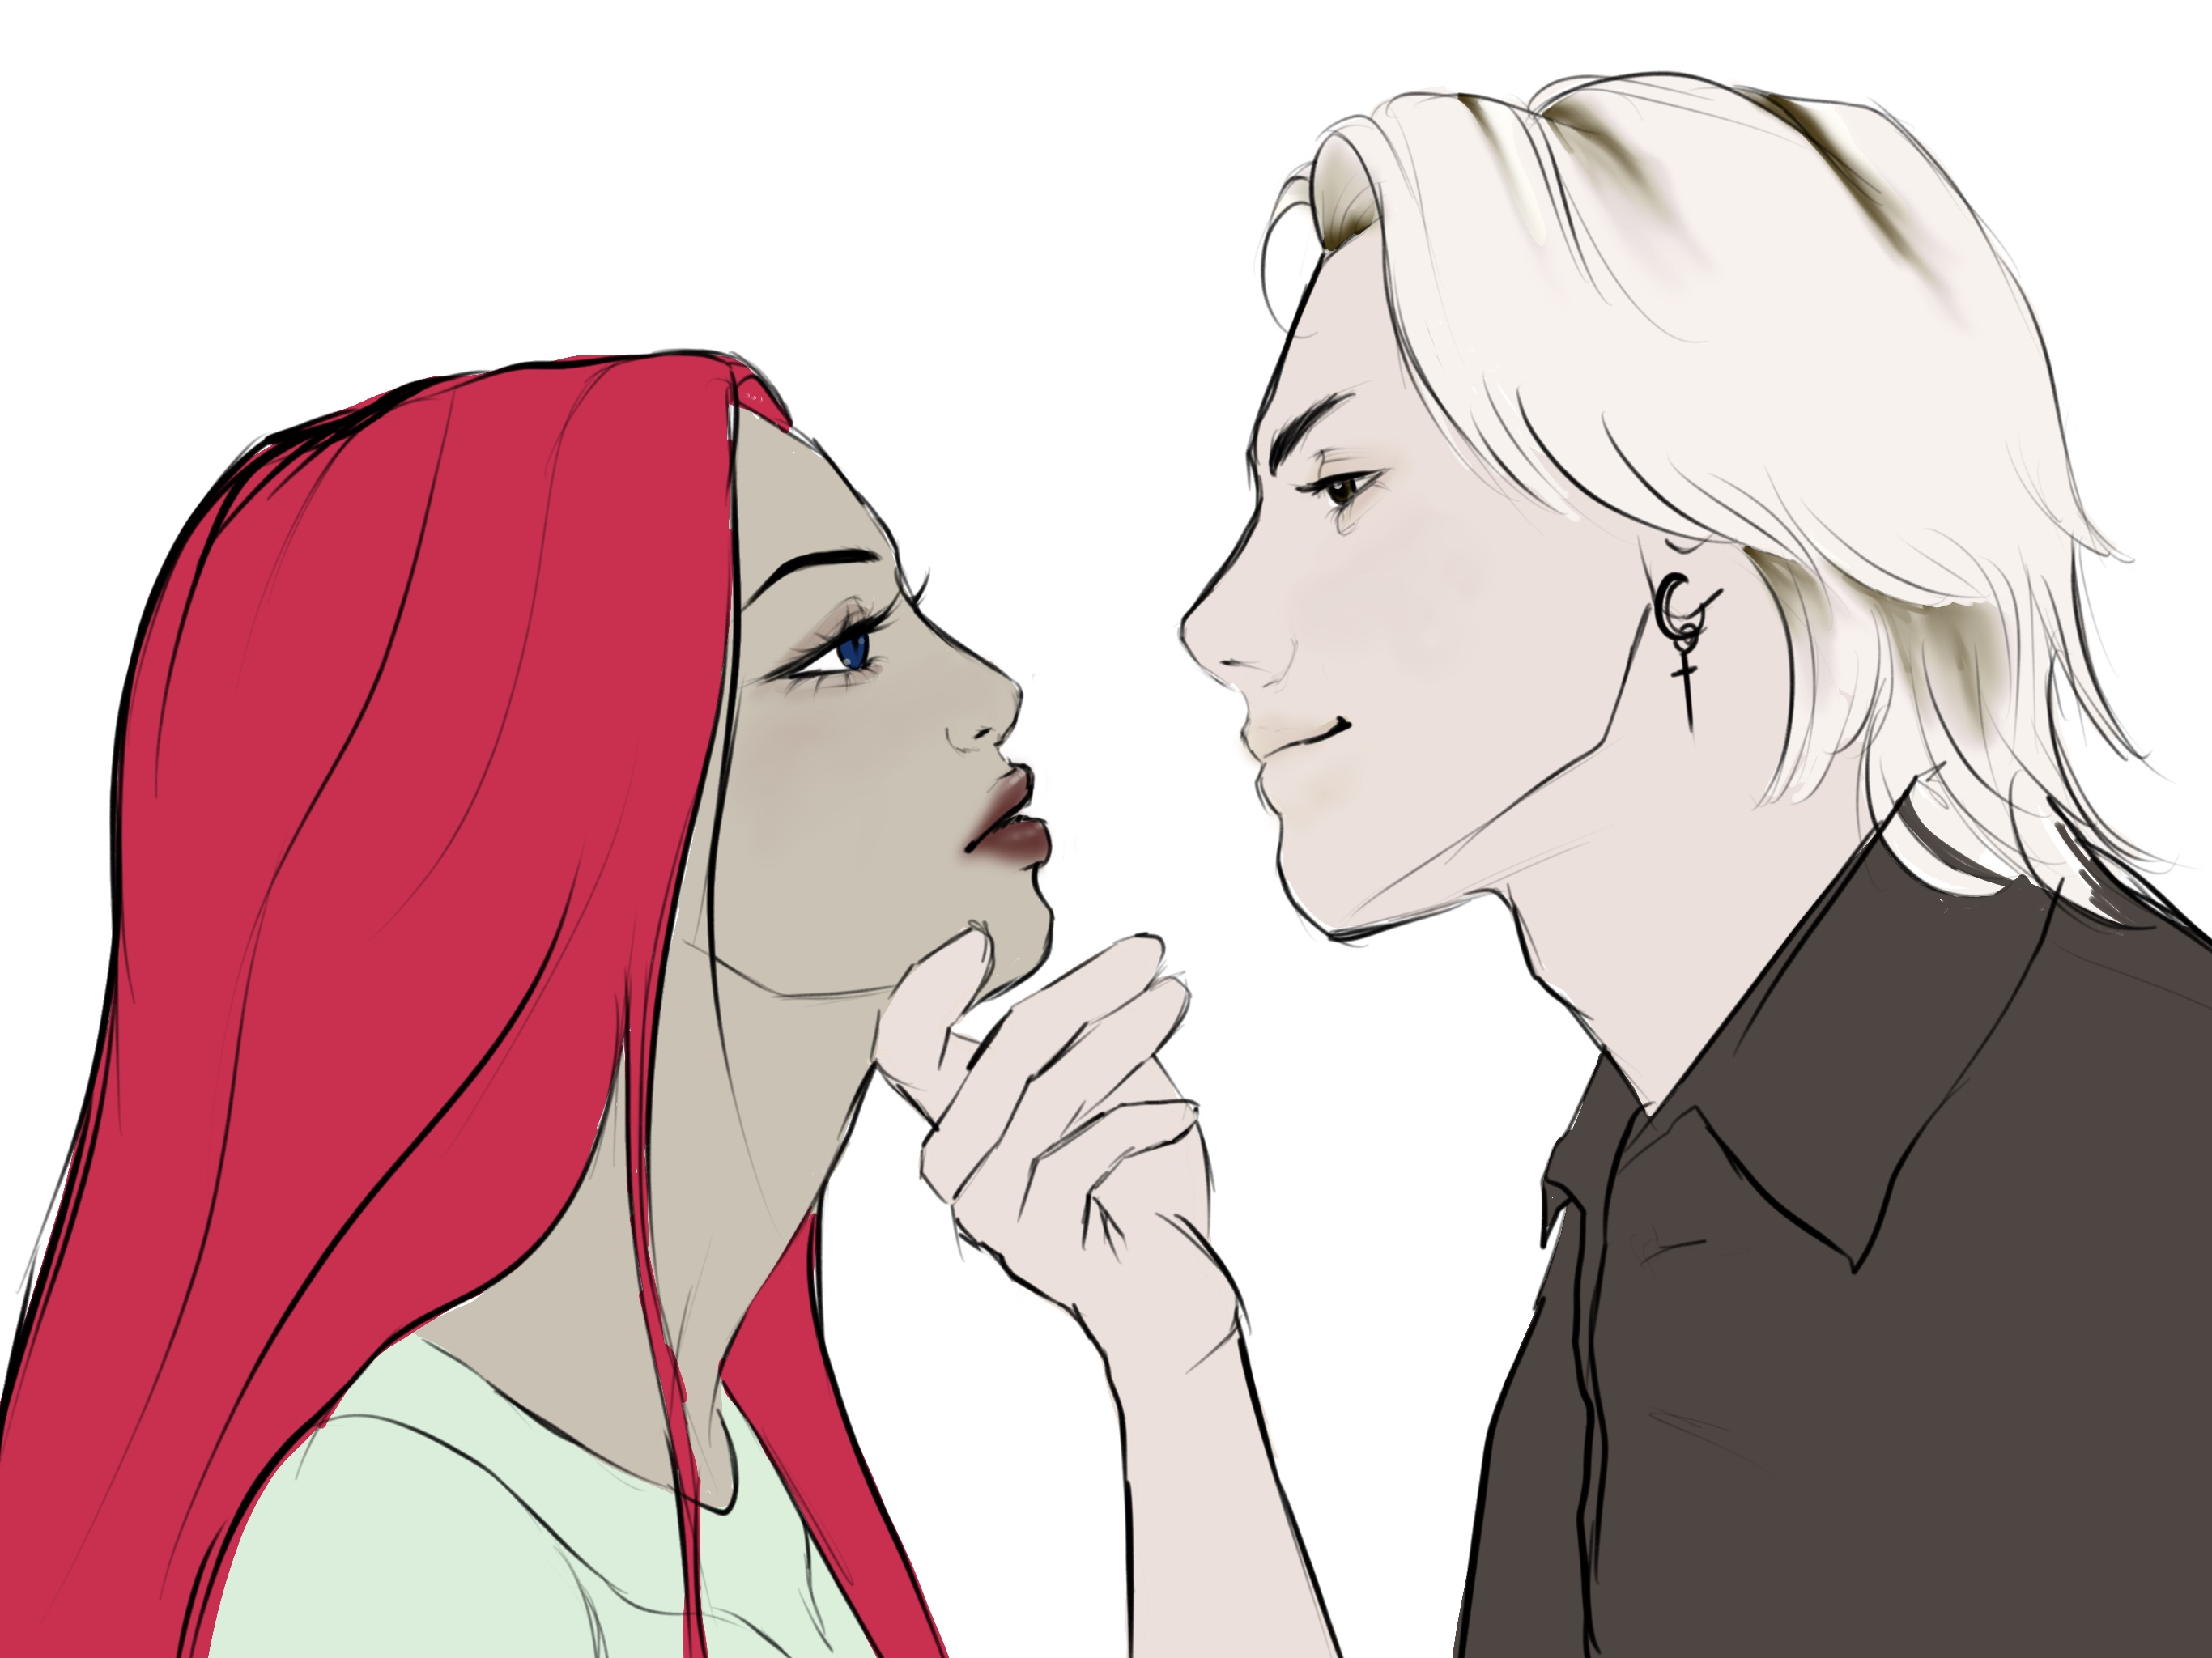

Slide 7
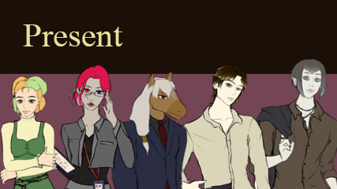
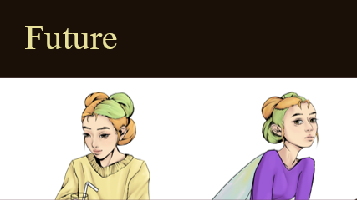
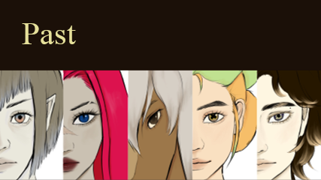
Hearts across Dimensions | DI Mentoring 3. Semester | Angelika Gort & Lukas Bucher | Mentored by Zoe Röllin

Slide 8
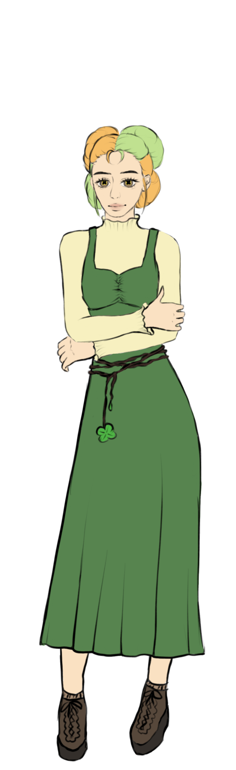
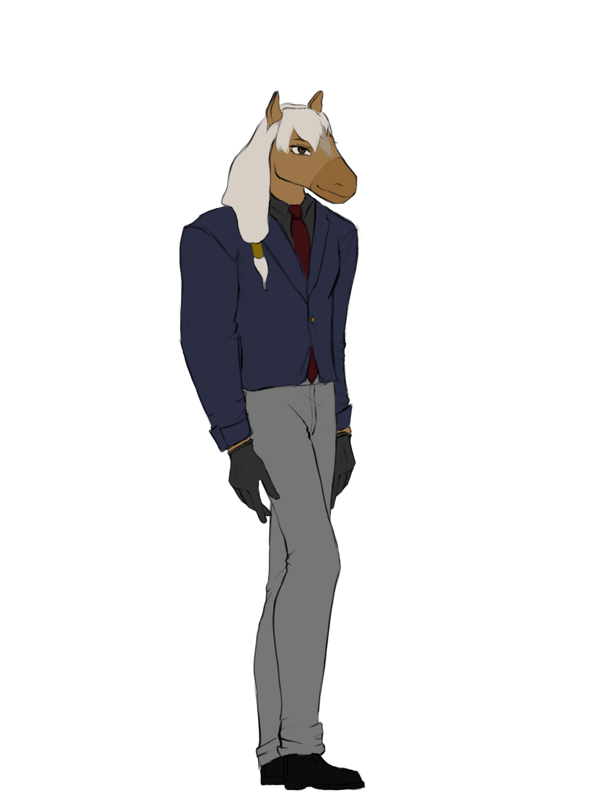
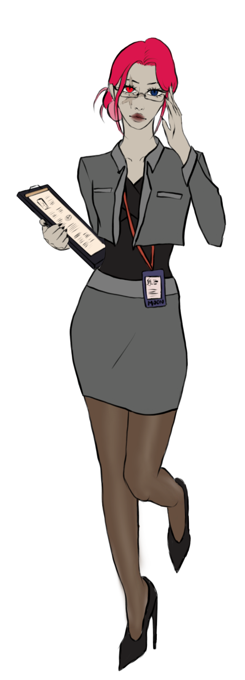
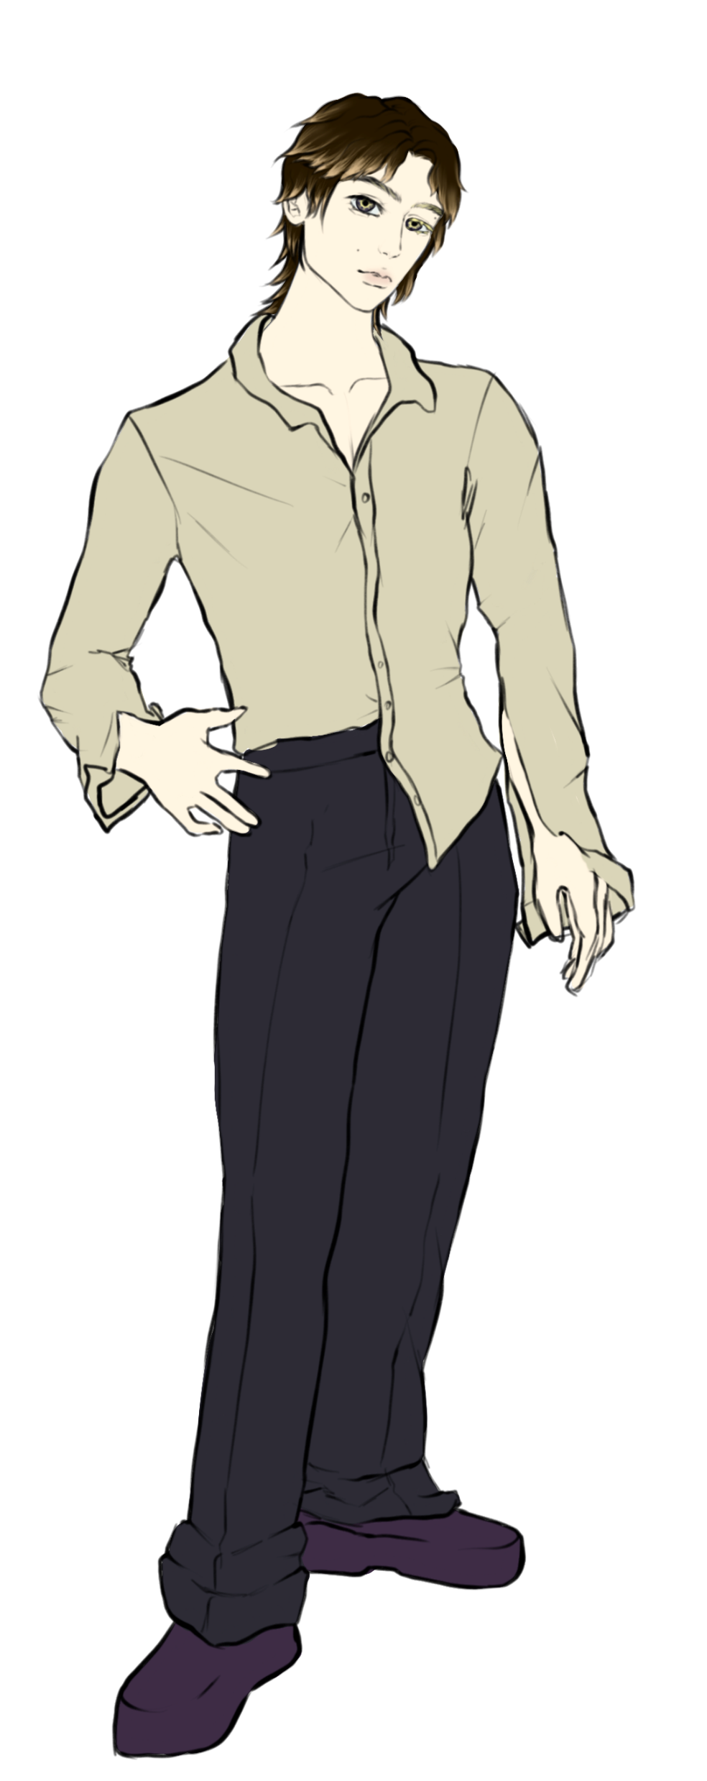
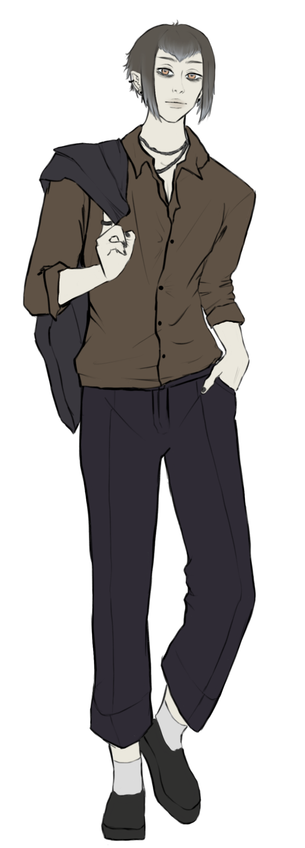
Present
Scarlet Moon
Aleph
Ethan
Ash Clover
Mr. Horse

Slide 9
Present
Scarlet Moon
Aleph
Ethan
Ash Clover
Mr. Horse

Slide 10
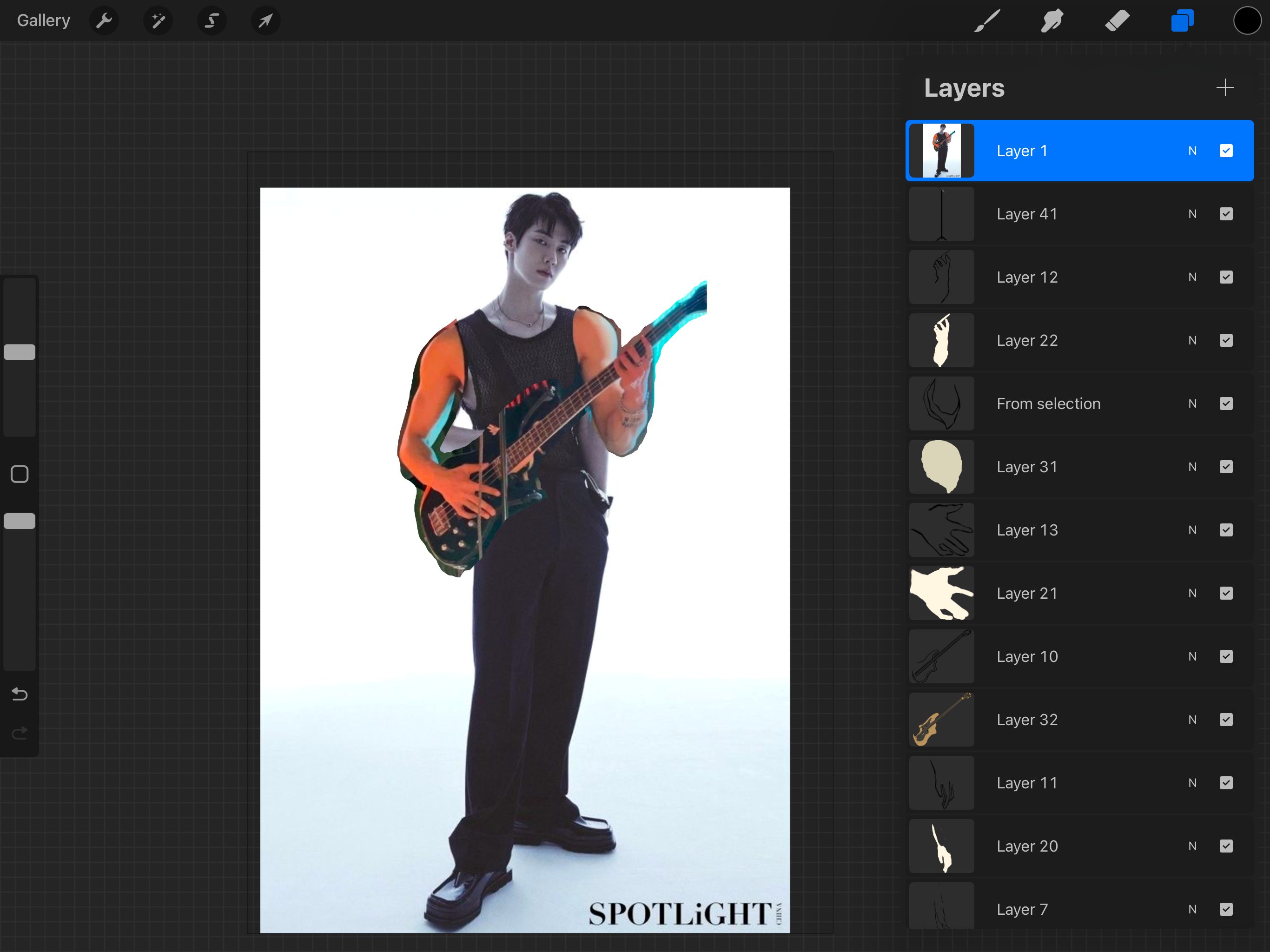

Slide 11
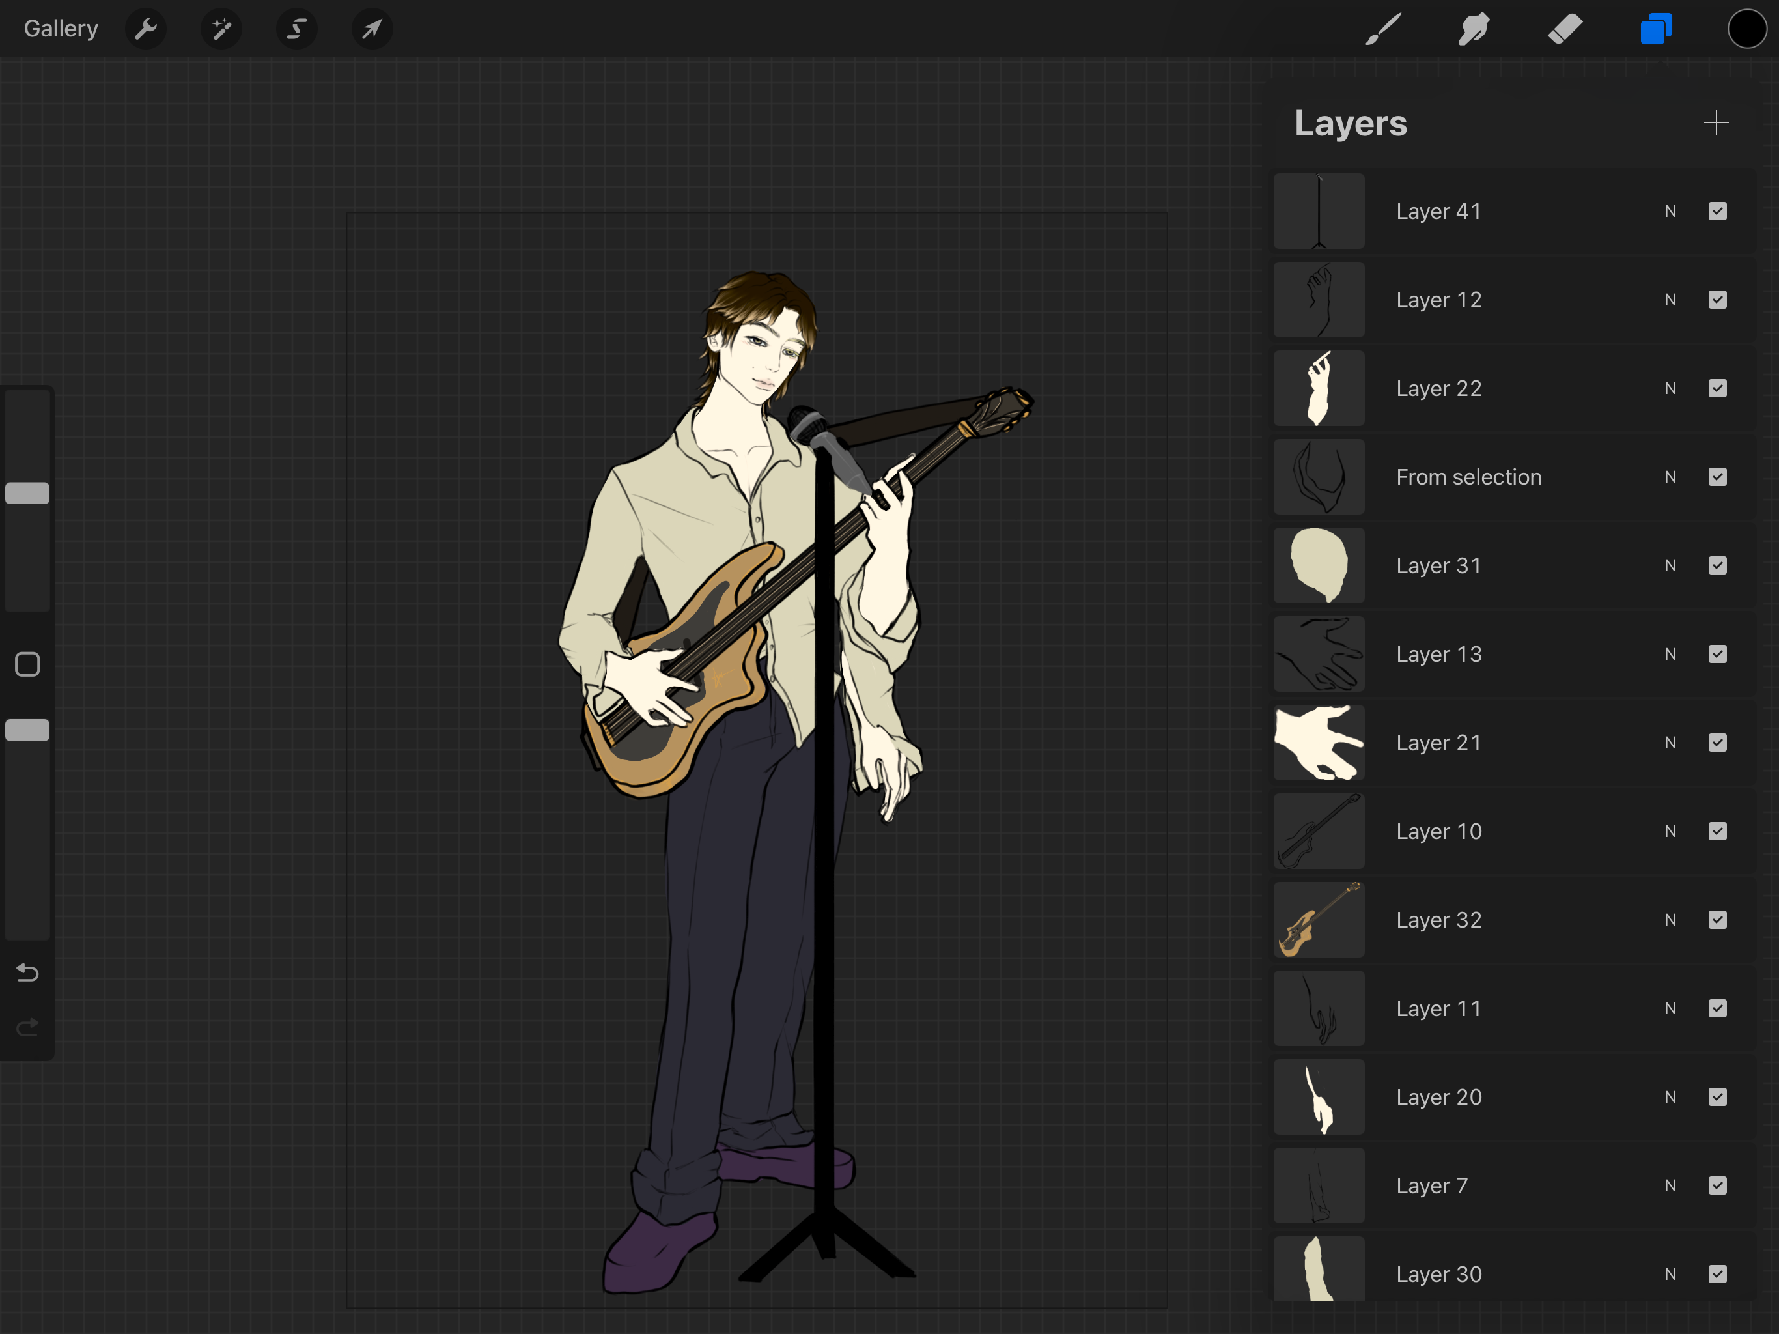

Slide 12
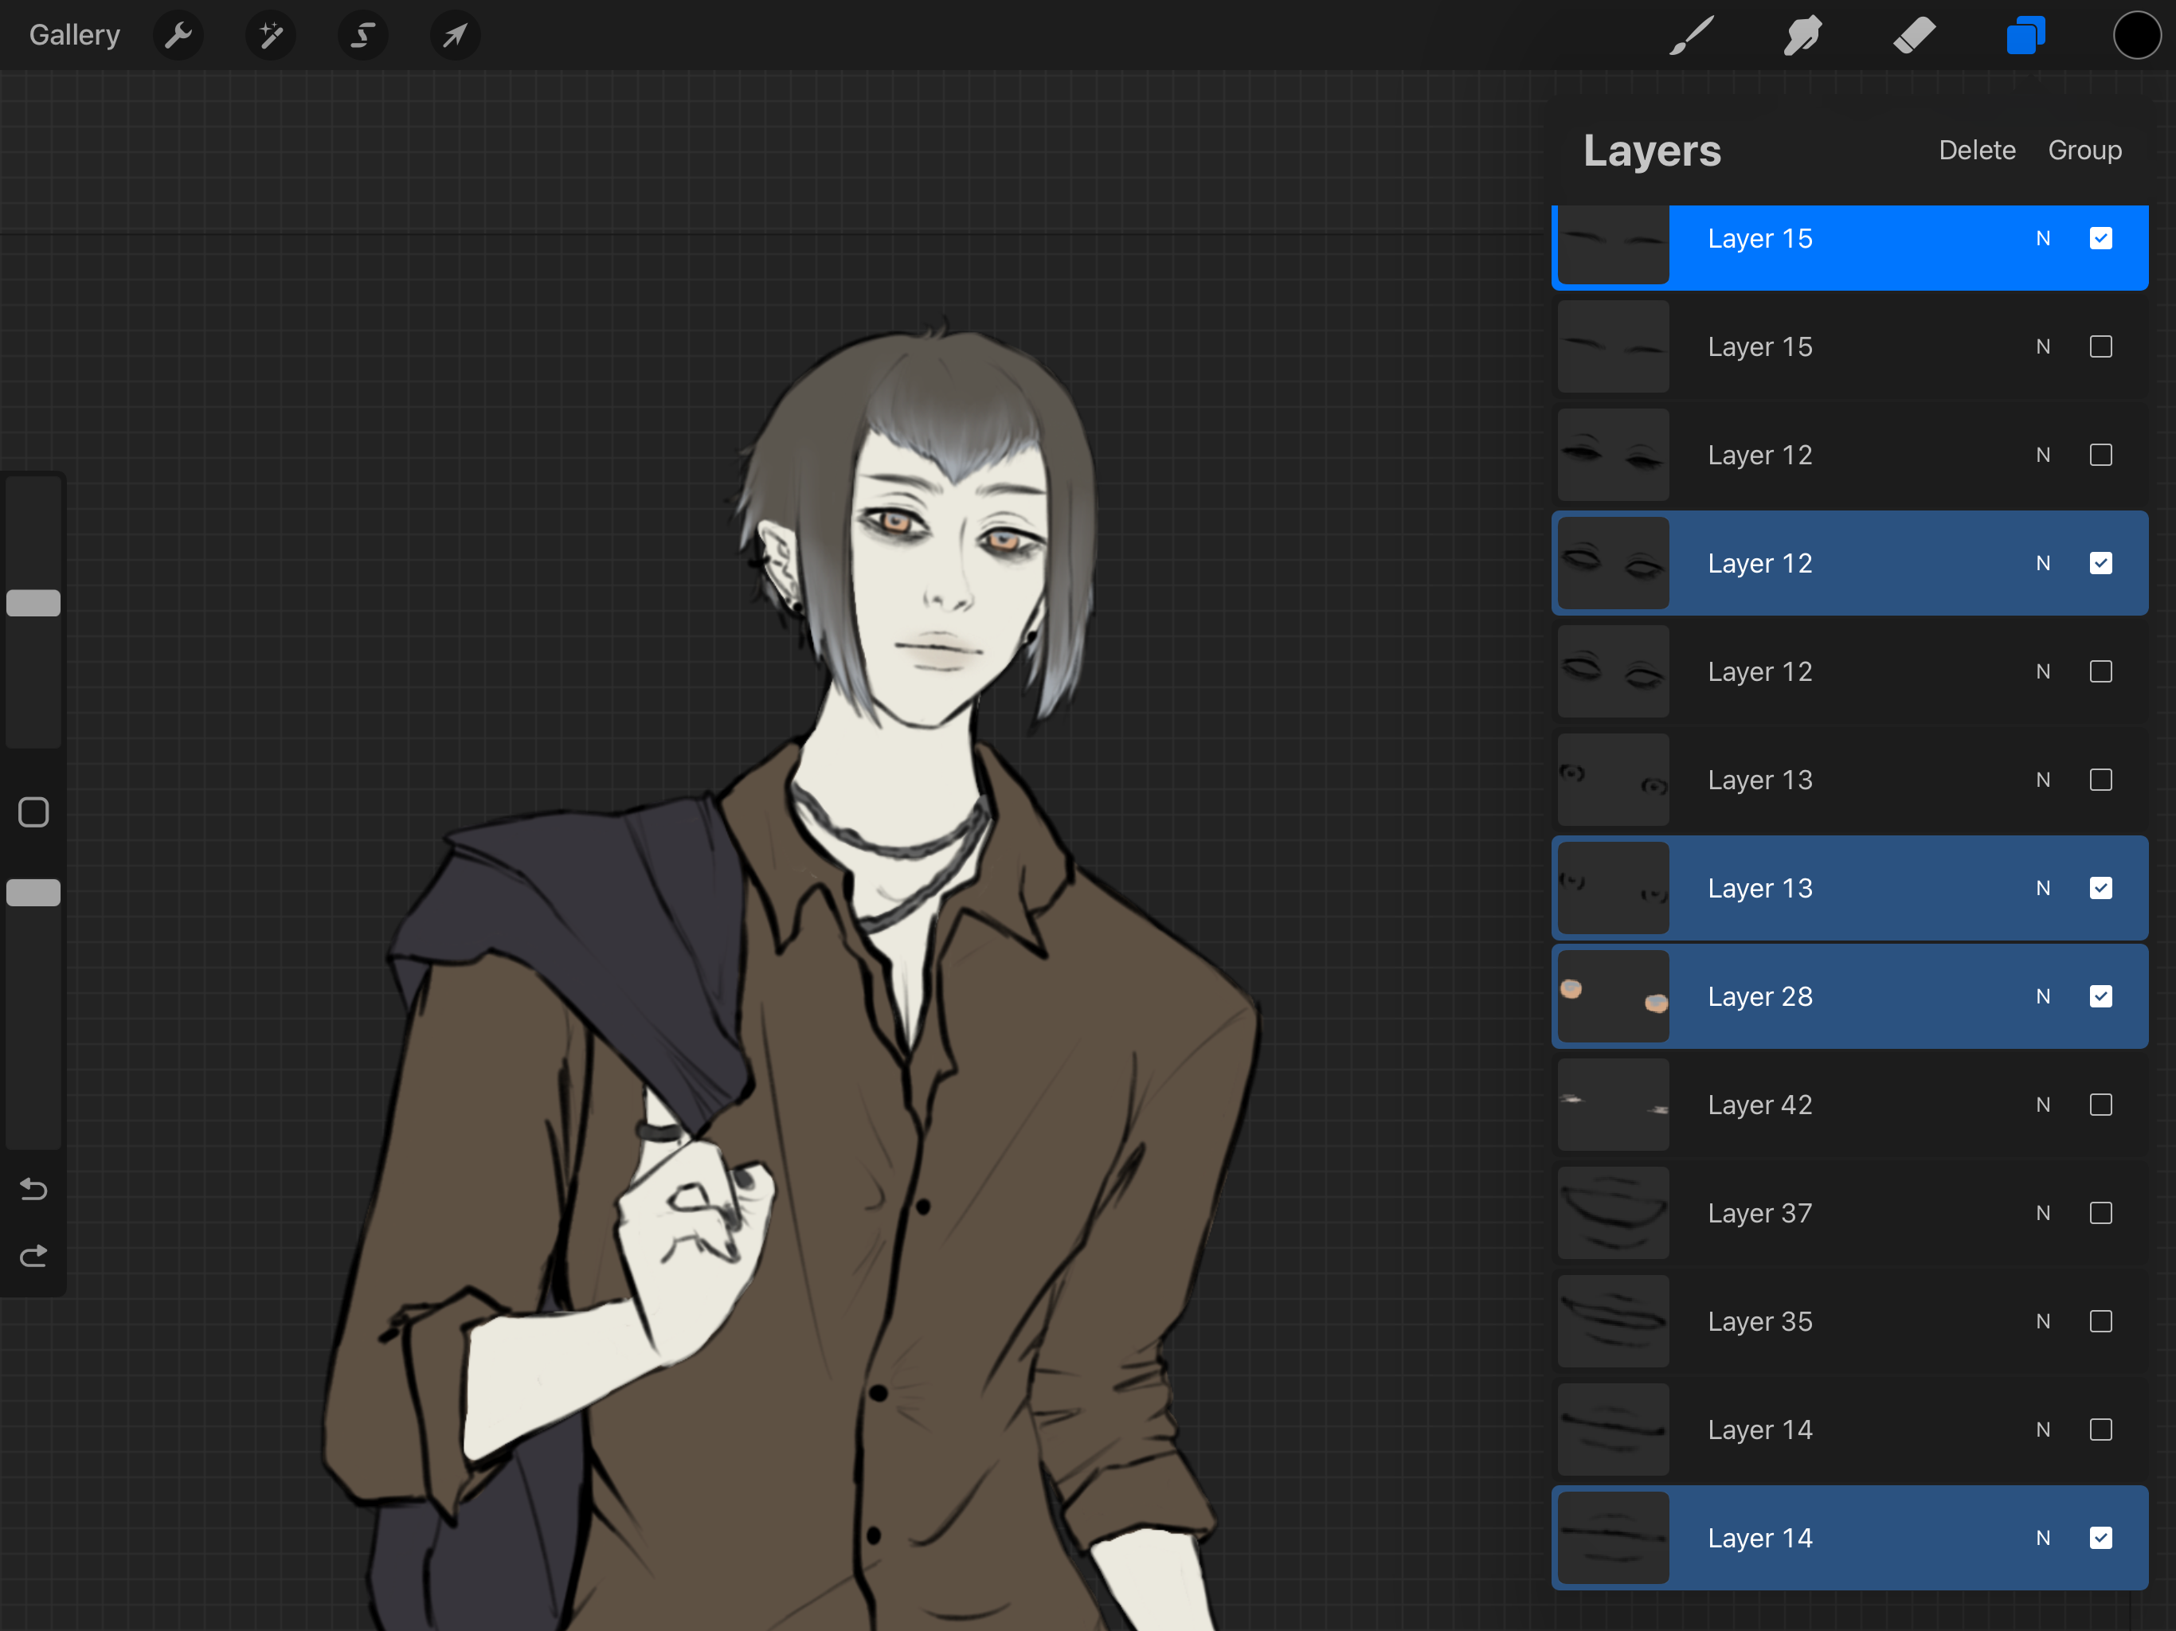

Slide 13
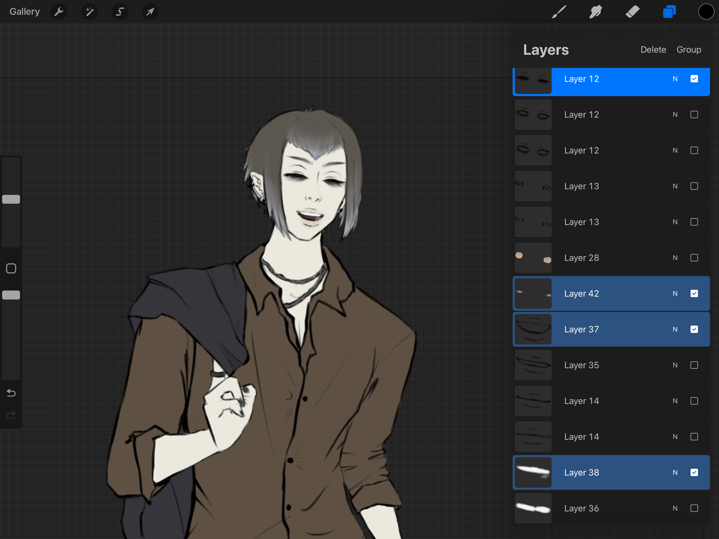

Slide 14
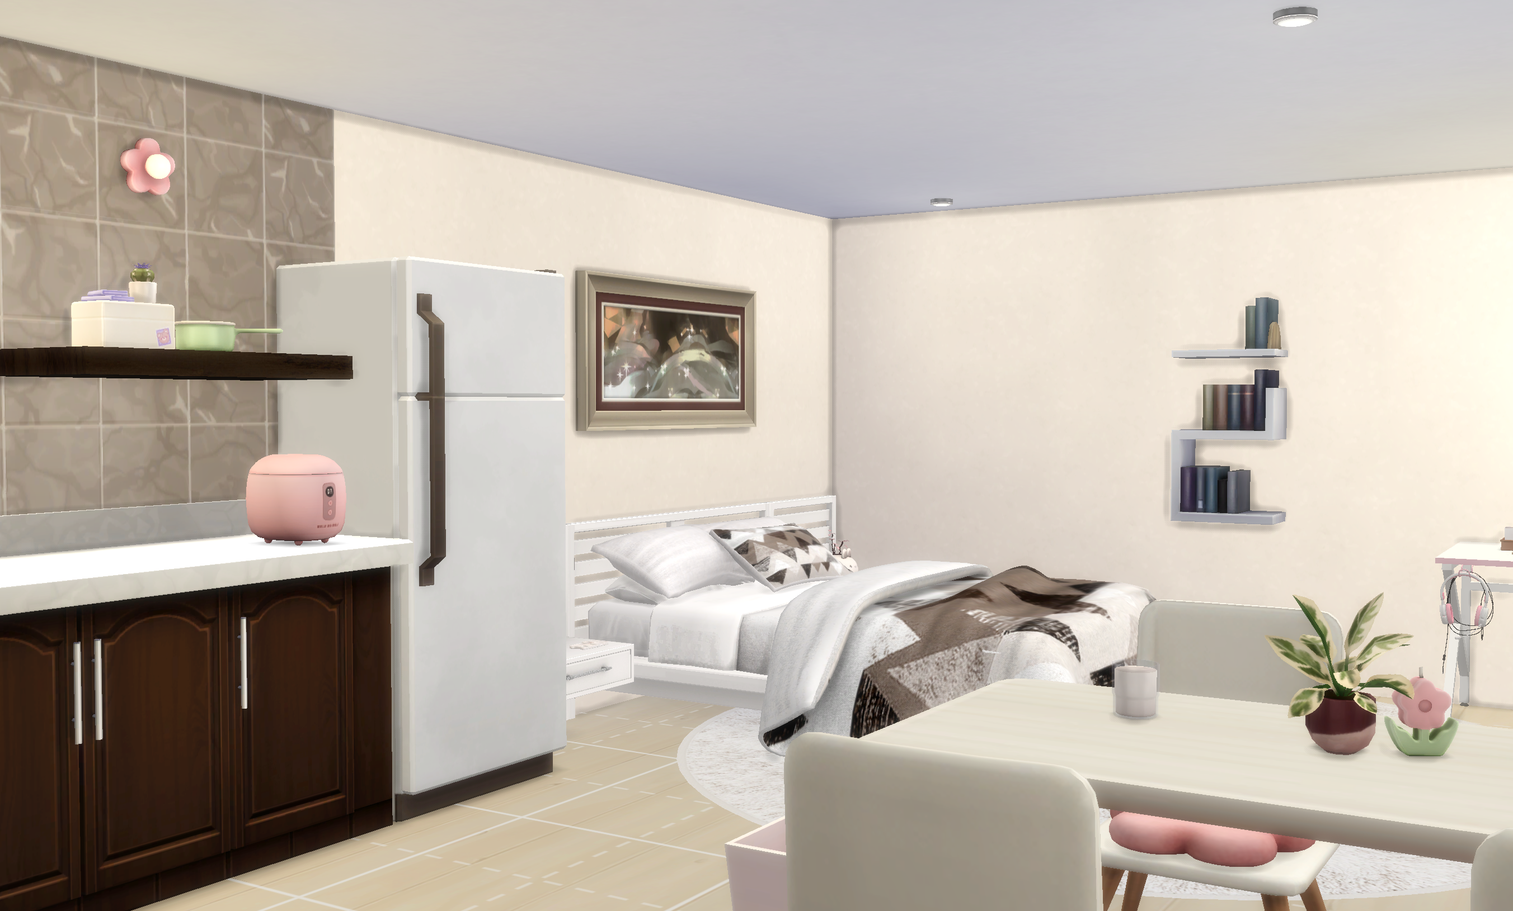

Slide 15







#1B1008
#734555
#E1A6B6
#66514F
#E6E09A
#EB616F
#E95487
#E16DA0
#6f4895
#632f7b
Frank Ruhl Libre

Slide 16
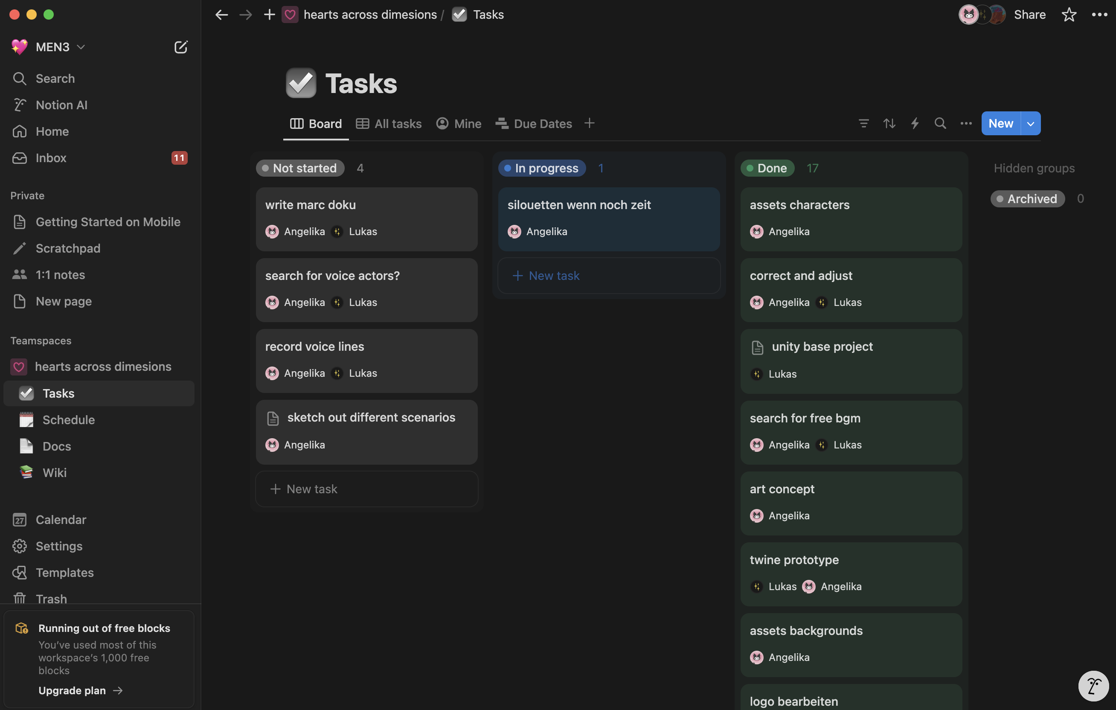

Slide 17
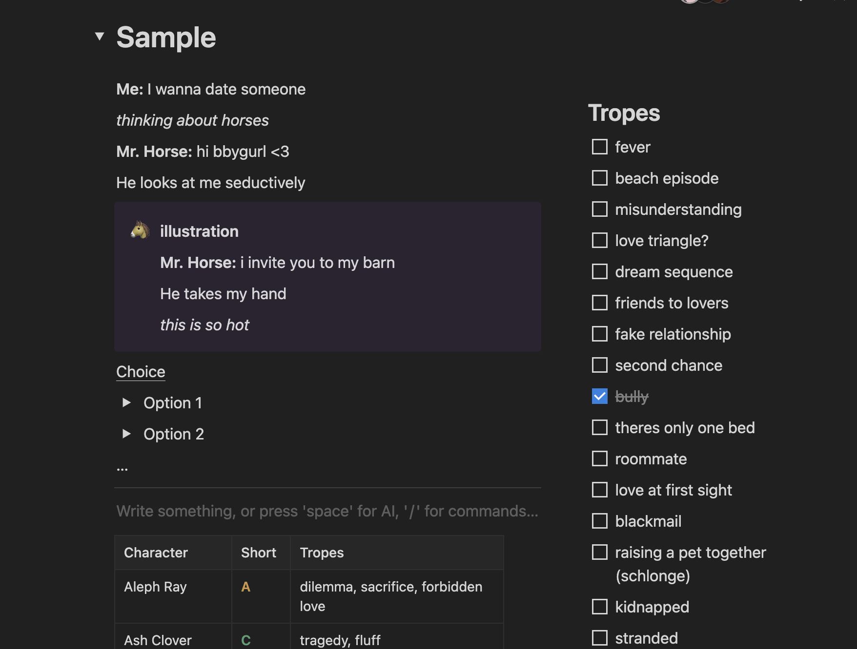

Slide 18
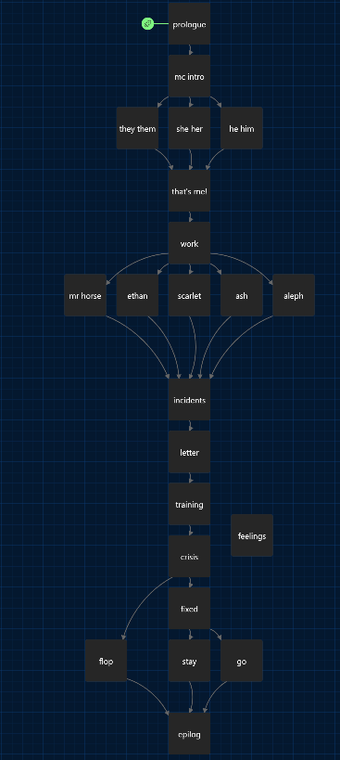
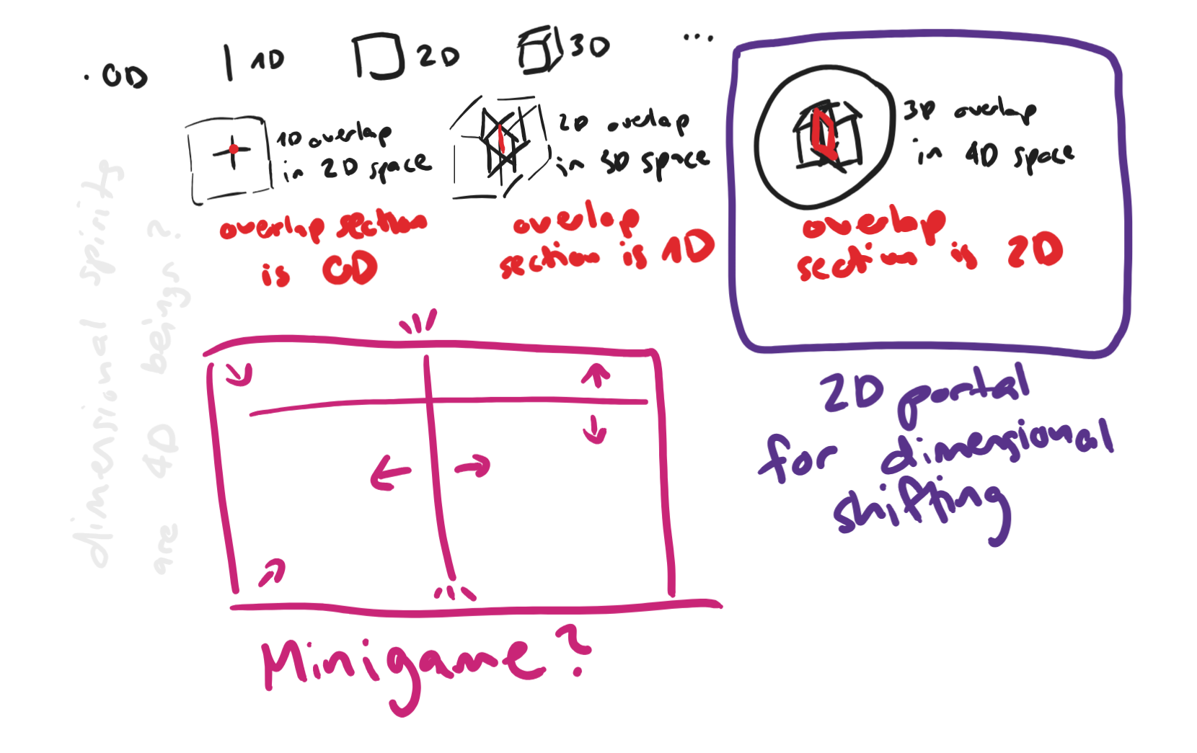

Slide 19
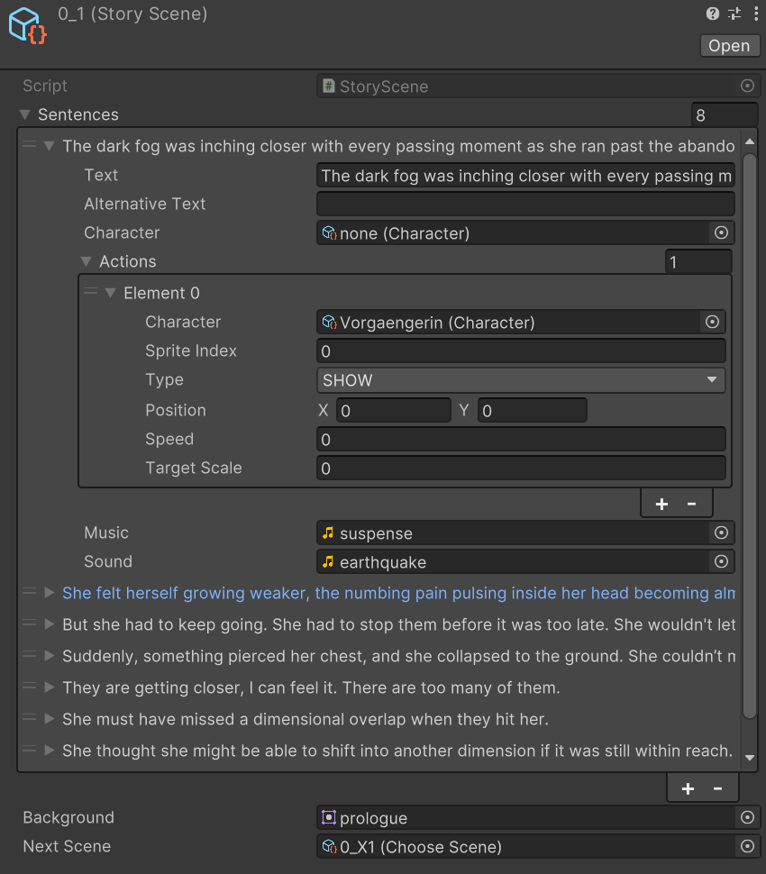
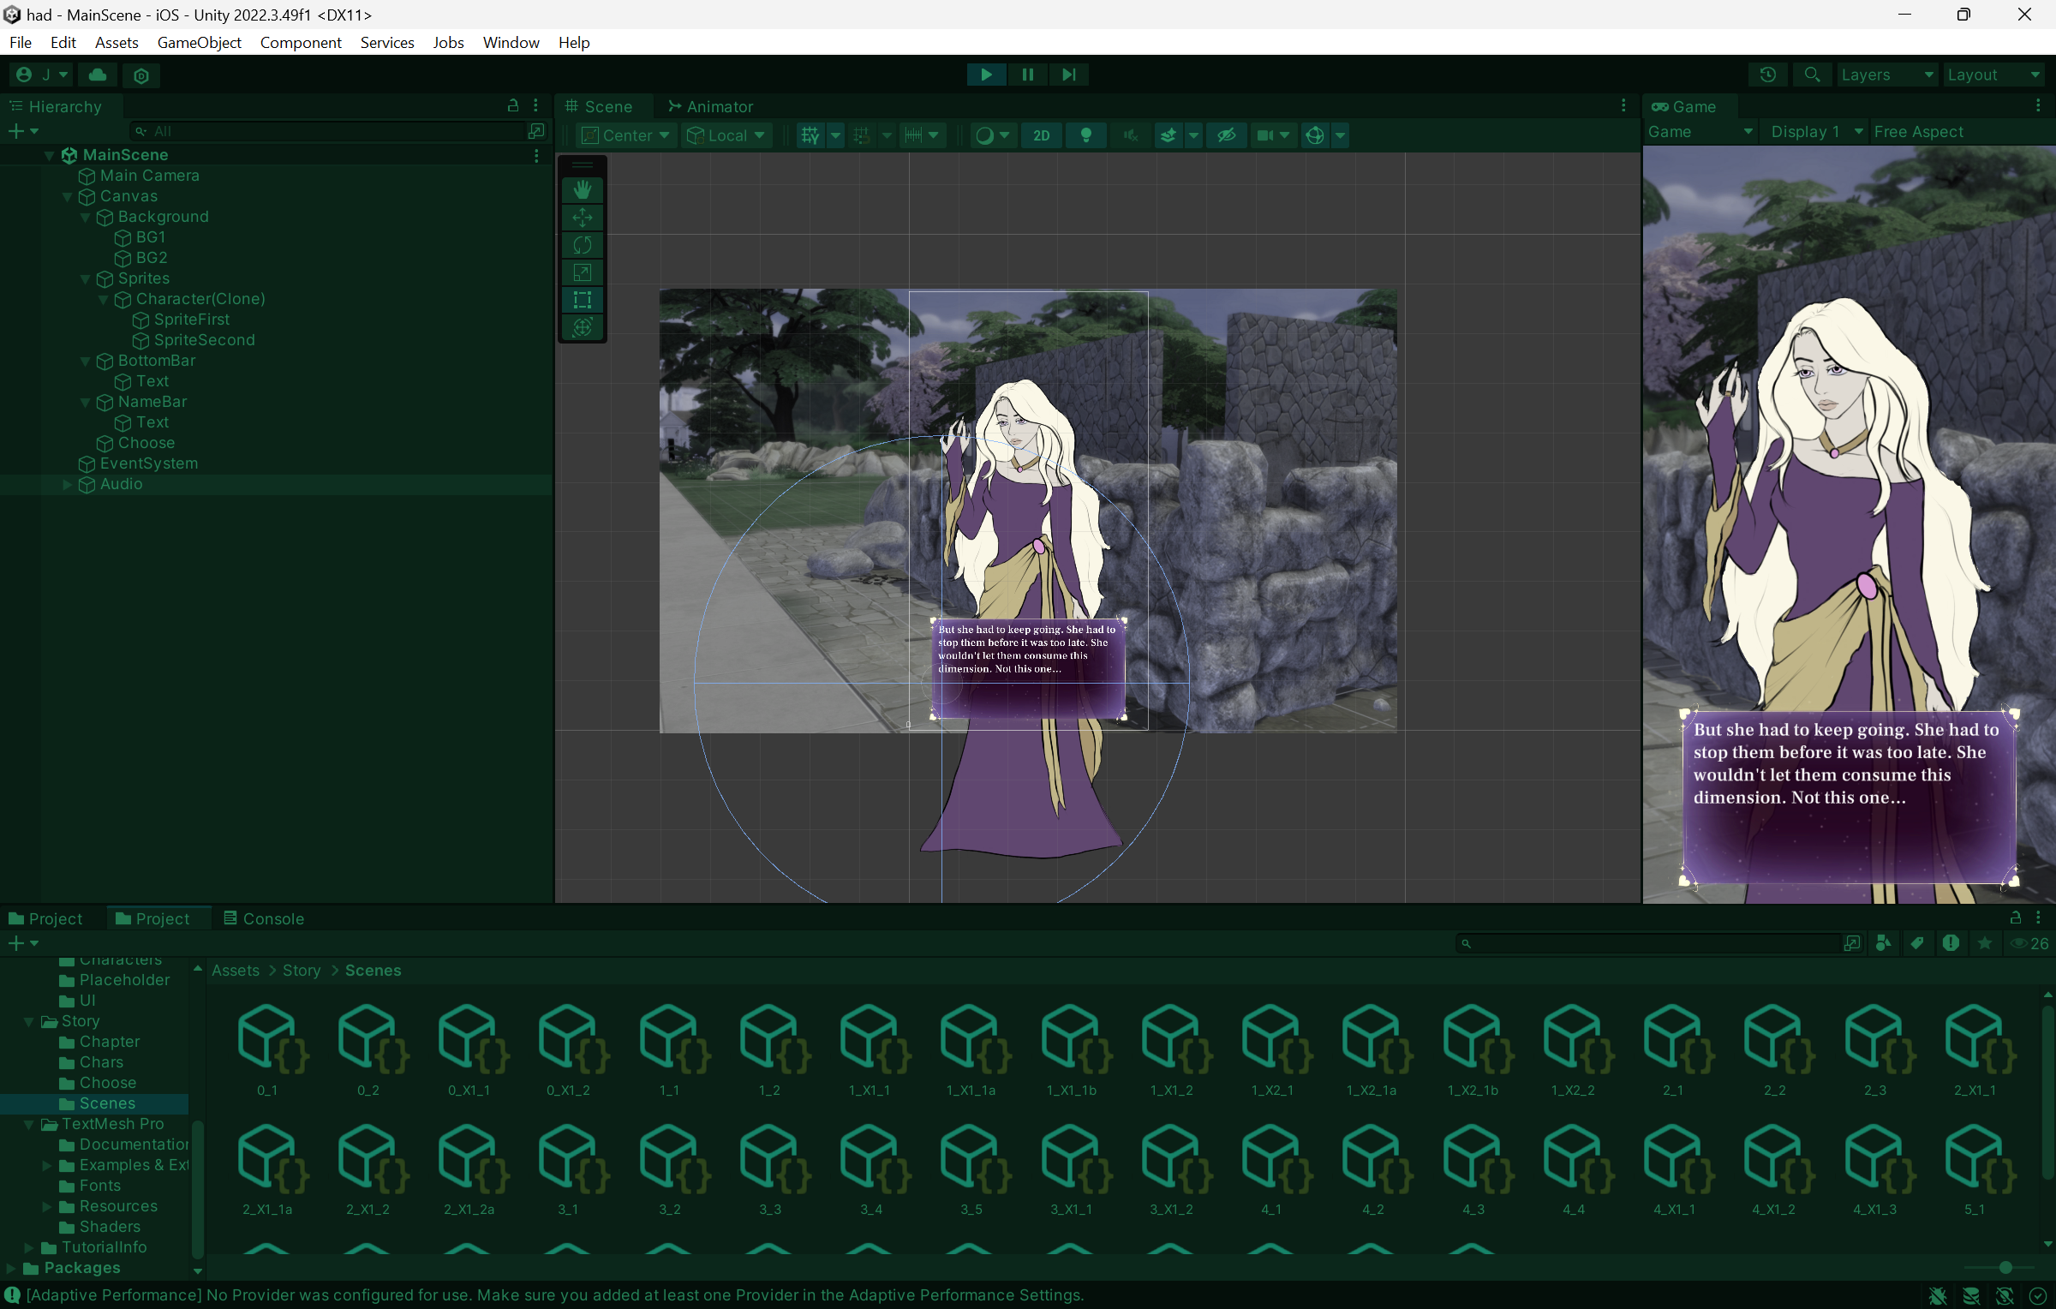

Slide 20
✦
Demo

Slide 21
Reflexion
✦ Motivation & fun
✦ Biweekly meetings
✦ Not all goals achieved
✦ Finished demo!
✦ Continue working on it

Slide 22
Hearts across Dimensions | DI Mentoring 3. Semester | Angelika Gort & Lukas Bucher | Mentored by Zoe Röllin

Slide 23
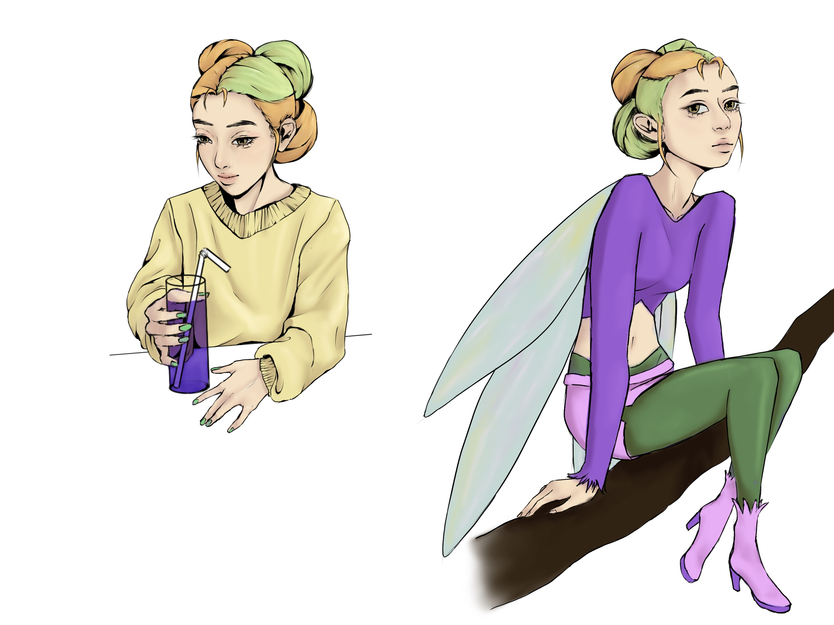
Future

Slide 24
Plans for MEN4
✦ Drawing backgrounds
✦ Characters with shading
✦ Illustrations
✦ Story of at least one character to the end
✦ Minigame
✦ Menu with chapter overview and gallery

Slide 25

Itch.io
Scan me!

Slide 26
Thank you!
see you soon ;)

